Slide 1
EPS Supply / Demand Methodology

Slide 2
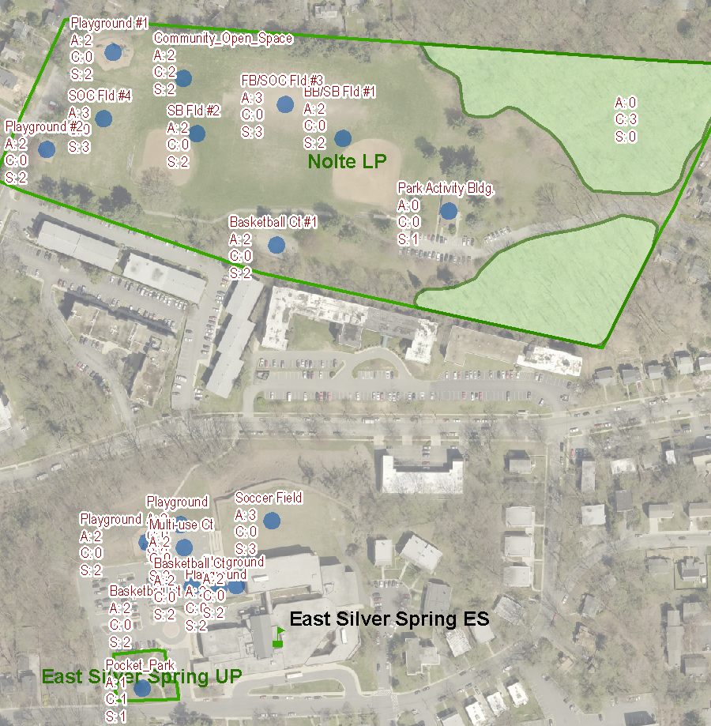
Supply
Supply of the three experiences comes from the inventory of public facilities.
In this area we have facilities from two parks and an elementary school.
Each facility type is given a value in the following three categories:
-Active
-Contemplative
-Social

Slide 3
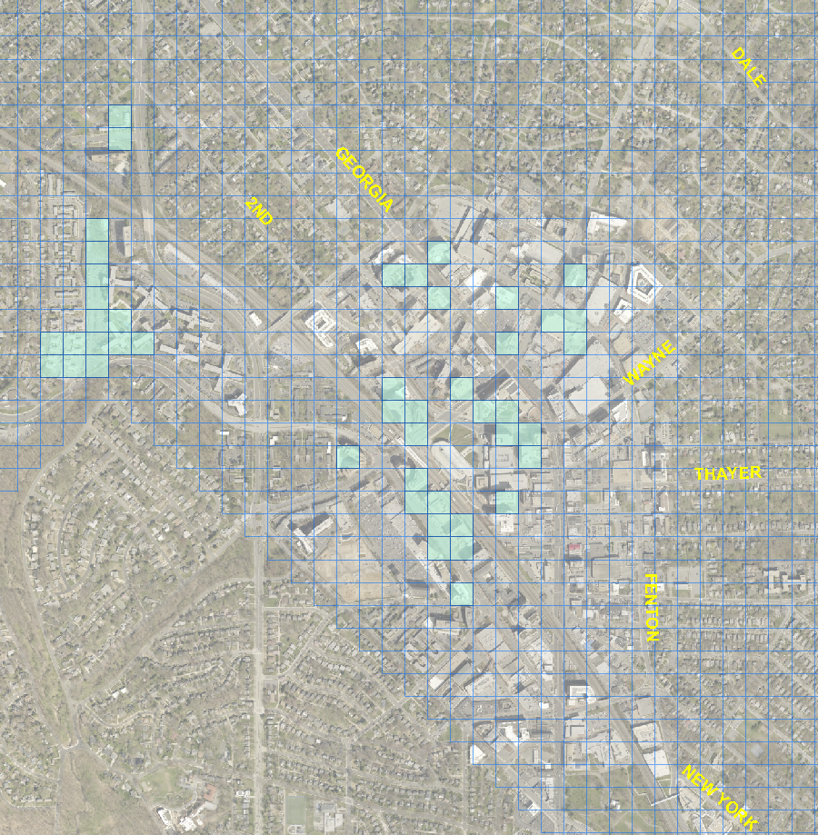
One Acre Grid laid on top of County
Each square gets a total supply score and a total demand.
The supply gap is shown here.
Squares who’s demand outstrips it’s supply are the ones highlighted.

Slide 4
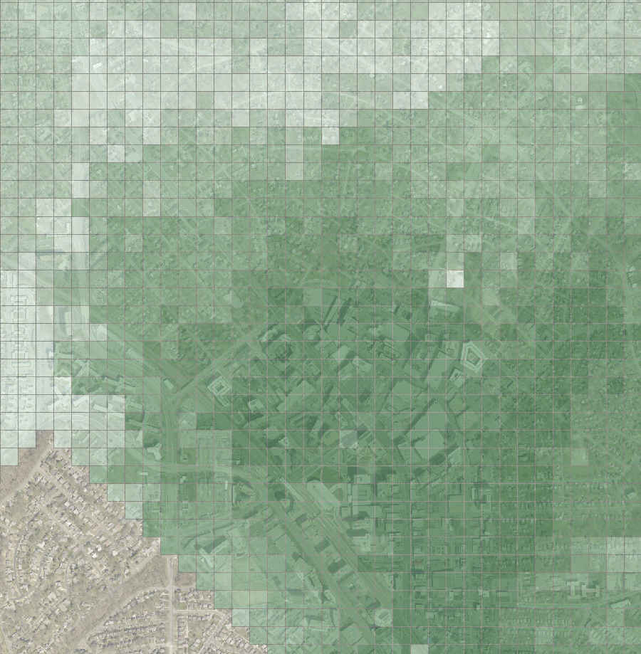
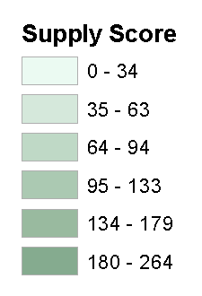
Supply
Total Supply scores per acre square.
Each square has a total score comprised of the total active, total contemplative, and total social score attributed to that square.

Slide 5
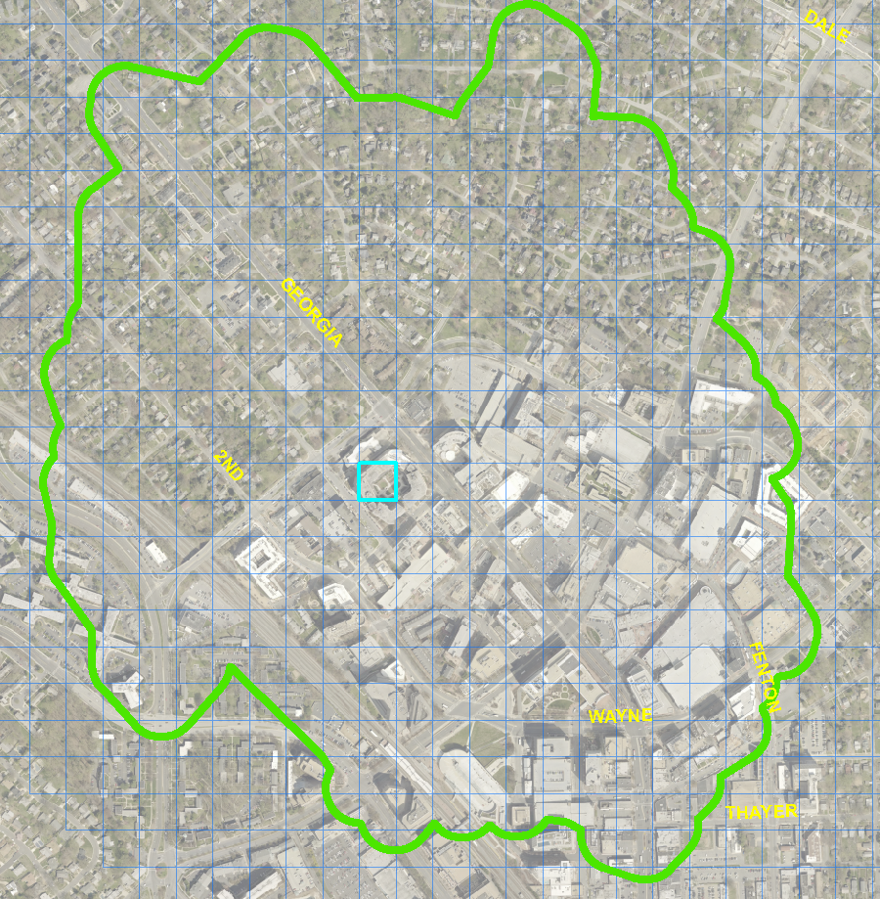
Supply
Each acre square has it’s own walkshed.

Slide 6
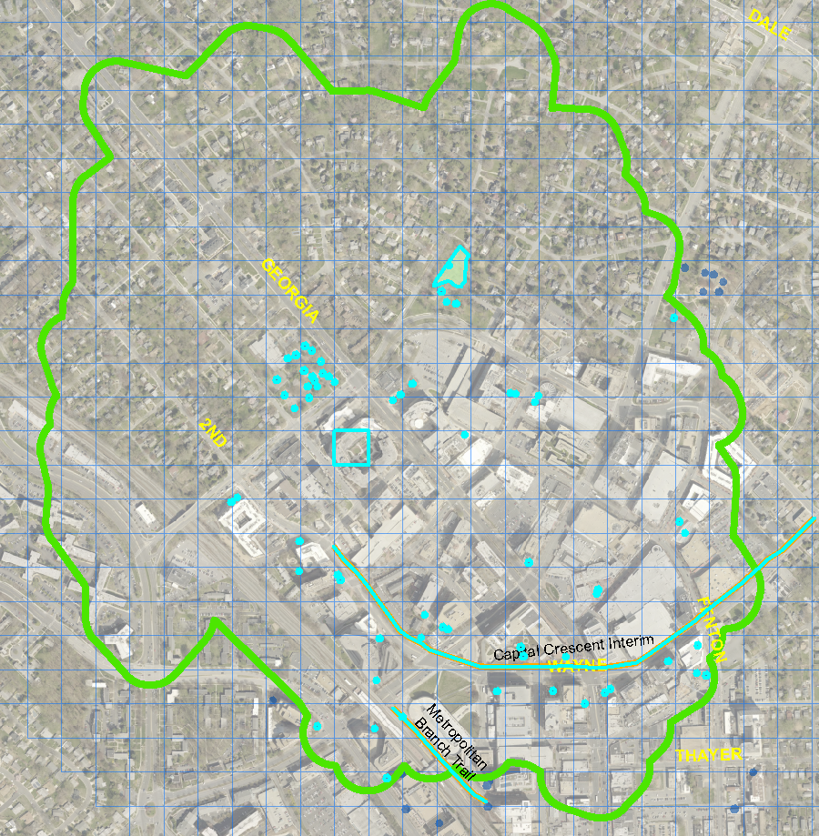
Supply
Trails and facilities within the walkshed for this acre square are highlighted. Each has a value.
The total for this acre square is 188

Slide 7
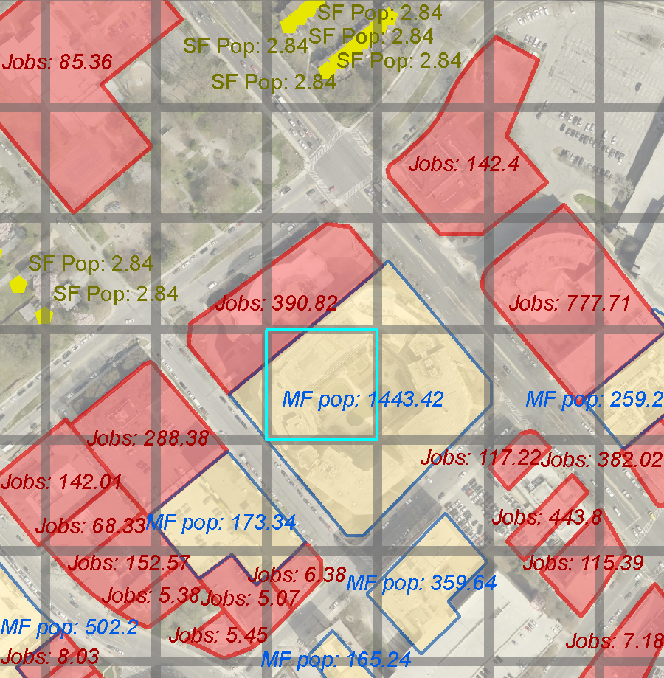
Demand
Demand is the sum of:
Single family population
2.84 people/dwelling unit
Multifamily population
1.62 people/dwelling unit
Office Daytime jobs
250 sf/job
Retail Daytime jobs
400 sf/job
Industrial Daytime jobs
450 sf/job
Other Daytime jobs
500 sf/job
Each acre square apportions jobs, SF and MF population based on the percentage of overlap from that parcel and the acre square itself.
Demand this square:
SUM_POP_JOBS 18.60
SUM_POP_MF 435.90
Total 454.60
(a) Census ACS 5-yr estimate
Aggregate of Silver Spring CBD Block Groups
(b) Aggregate of Jobs
including office,
retail, industrial, other for Silver Spring CBD Block Groups

Slide 8
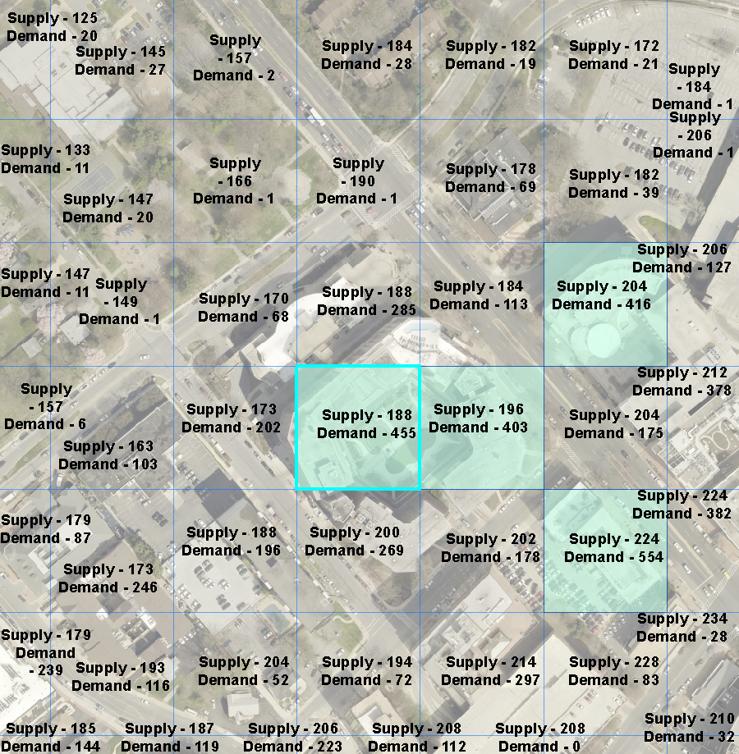
Supply < Demand * 0.5
The supply for this acre square is 188 and the demand is 454.6 so it is highlighted as a service gap.
The following variables are at play:
Facility scoring
Population per SF/MF unit
ORIO sqft to job conversion factors
Supply vs Demand comparison factor (currently at 0.5)

