Slide 1
Original located at
T:\Projects\Park and Trail Planning\@T-TEMPLATE.FILES\ppsd PPT templates\2018-PPT.template-wide.layout.potx
Photo: Klyde Warren Park, Dallas Art District. Source: Pinterest.com
Notes:
Welcome everybody!

Slide 2
How are we addressing health?
Notes:
Thank you for joining us on this Sunday morning to learn about how Montgomery Parks and Park Rx Program are addressing health within Montgomery County!

Slide 3
PEOPLE
(CONSUMER)
PARKS/PUBLIC SPACES
(PROVIDER)
HEALTH
PARK RX
PROGRAM
(PROMOTER)
ENERGIZED
PUBLIC SPACES PLAN
(DATA-DRIVEN TOOL)
Notes:
Park Rx Program uses the credibility of a doctor’s office to encourage patients to get outdoors – it promotes parks and open spaces’ health benefits. Montgomery Parks provides a balance of recreational parks and conservation parks, not only bringing benefits to people’s physical, mental and social health, but also the environment’s health. If you live or work in Montgomery County, the Energized Public Spaces Plan data-driven tool will guide you on where to go and what to do once you there, but most importantly, it will map areas where we have accessibility shortages. Today’s session will address this symbiotic relationship of bringing people to nature and outdoors to enjoy the health benefits of these spaces, and the ability to map where in the county we lack a supply of parks and public spaces to serve the demand of people within a 10-min walking distance. The Energized Public Spaces Plan focused on a user-friendly approach to address accessibility shortages.

Slide 4
what will you learn?
How Park Rx America promotes the Health Benefits of Parks and Public Spaces
How the EPS Plan evaluates access to public spaces
Prioritize where a Park system should allocate its limited resources
Notes:
By the end of this session you will have learned How Park Rx America promotes the Health Benefits of Parks and Public Spaces; How the EPS Plan evaluates access to public spaces; and prioritizes where a Park system should allocate its limited resources

Slide 5
Outline
Health Overview
Park Rx Program
Montgomery Parks’ Energized Public Spaces (EPS) Plan Outcomes
EPS Plan: How we did it?
Debate/Q&A
Notes:
This is also the outline of today’s session. We asked people to hold questions until the end of the presentation. We are planning for 15-20 min Q/A discussion and we brought extra slides to share for that time.

Slide 6
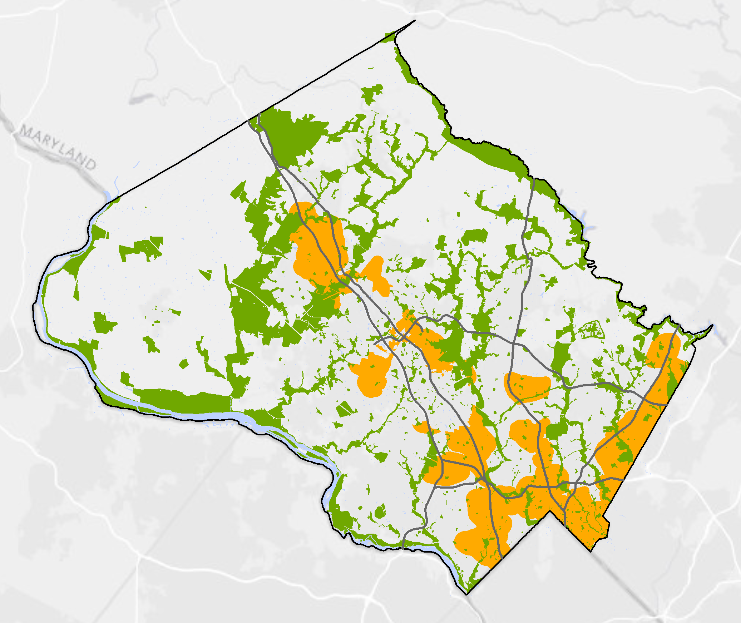
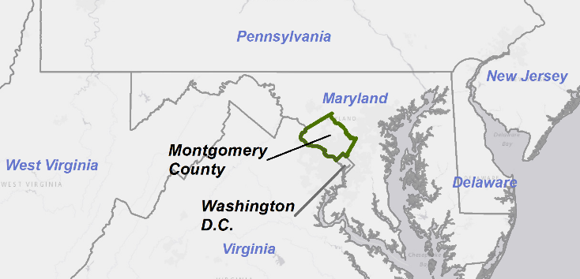
Montgomery county
Frederick
County
Howard
County
Most populous county in MD
Loundon
County
2017: 1,058,800
Prince
George
County
38%
Parks & Open Space
EPS Study Area
Fairfax
County
D.C.
1990: 765,500
+293,300
Notes:
Where is Montgomery County?
Montgomery County is the most populous county in the state of MD, and we are still growing and becoming more diverse with people of color comprising more than 56% of the total population in 2016. International migration has been a significant driver behind the growing diversity in the County, with 1/3 of the population being foreign-born.
Our Study Area highlighted in orange in the map focus on the areas with more people and jobs, and where we are growing. The EPS Study Area represents around 40% of the population within 17% of the county’s land. This area has the highest concentration of people with lower income, public transit’s users and multi-family residents.

Slide 7
Montgomery county health overview
Notes:
How is the health of people in the County? And how important is the connection to nature to our Health.
John Henderson will be answering these questions next.

Slide 8
Overview: Montgomery health
Montgomery County | Top US Performers | MONTGOMERY COUNTY, MD (2018)
21 % | 26% | Adult Obesity | BMI ≥ 30
16 % | 20% | Physical Inactivity | Age ≥ 20 reporting no leisure-time physical activity
100 % | 91% | Access to Exercise Opportunity | % of pop. with access to physical activity locations
9 % | 12% | Children in Poverty | Age ≤ 18
Notes:
On every key metric – Montgomery County excels – beating top US performers.

Slide 9
Overview: Montgomery health
LATINO HEALTH
Source: Blueprint for Latino Health in Montgomery County, MD 2017-2016
Notes:
Although the overall picture shows excellent health metrics – a closer examination reveals significant disparities by race and ethnicity.

Slide 10
EPIDEMIC LEVELS OF CHRONIC DISEASE
133 million Americans currently live with chronic disease
78 million adults and12 million children are obese.
70 million American adults have high blood pressure.
29 million Americans live with diabetes.
10 million adults suffer from serious mental illness.
For every dollar spent on healthcare in the U.S., $0.86 is spent on patients with chronic disease.
Notes:
Another reason for concern is the epidemic of chronic disease.
The cost of chronic disease is staggering. In the United States almost 90% of every healthcare dollar is spent on patients with chronic disease.
What are chronic diseases? Chronic diseases are slow killers – they originate from the collective damage we do to our bodies as we age. This is a normal process. By the time a doctor is able to diagnose a chronic disease, however, much damage has already occurred.
Therefore, we are living longer but not healthier.

Slide 11
Humans living in landscapes that lack trees or other natural features undergo patterns of social, psychological and physical breakdown …
Professor Frances (Ming) Kuo
University of Illinois at Urbana-Champaign
Notes:
Dr. Francis Kuo, is a professor at the University of Illinois in the US. She did a study of public housing in Chicago to determine level of trust among residents – what is often referred to “social capital.” Did the residents know each other and did they trust each other? If there was an emergency would they help their neighbors? Would they expect their neighbors to help them?
To Dr. Kuo’s surprise – among all the variables she tested – it was the presence of greenspace that made the most significant difference. Persons living in units with access to greenspace had developed greater levels of trust with their neighbors. This was a revelation. Over many years – since that study – Dr. Kuo as performed many studies that confirm the powers of greenspace -- to reduce the impacts of chronic disease, to clean the air, to stimulate physical activity, and to increase social capital.

Slide 12
Humans have an innate biological connection to nature.
When that connecting is broken, we are more vulnerable to health risks.
Notes:
Professor E.O. Wilson believes we are collectively making ourselves sicker because of our lack of exposure to “nature”– both plant and animal. His Biophilia Hypothesis says that we have an innate biological attraction to nature and that when we sever that connection – by not spending time outdoors in green settings – we deprive ourselves of an element that is essential for a healthy life. This deprivation is resulting in serious consequences for human society.

Slide 13
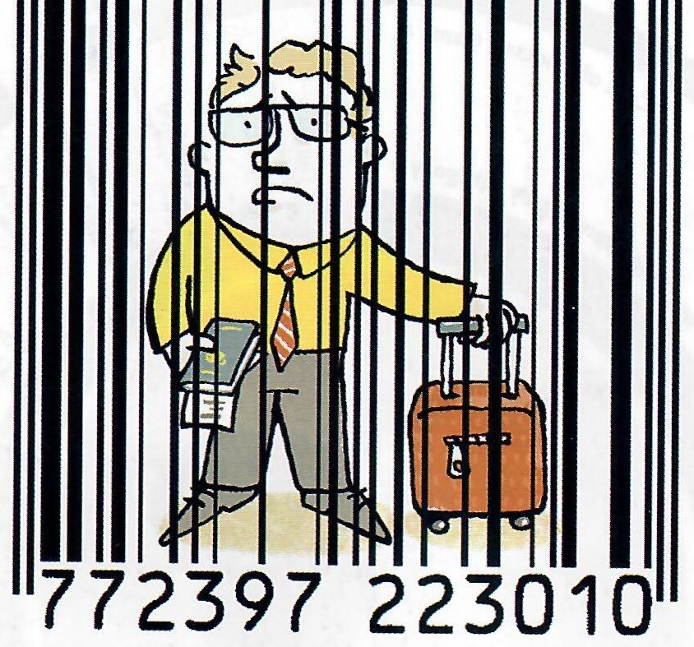
BURNOUT
Caused by chronic stress
Symptoms include:
Emotional Exhaustion
Cynicism
Feeling Ineffective
Among young people 26 and younger rates of depression, psychological distress, and suicidal thoughts are increasing.
Image Source: the Economist
Notes:
Stress is the neurological and physiological response of your body to stressors.
Psychologist Cheryl Zeigler calls “Burnout” Chronic Stress Gone Awry”
95% of human Resource leaders say burnout is sabotaging workplace retention
Over 50% of doctors say they are experiencing the symptoms of burnout.
Young people seem to be especially vulnerable to stressors.

Slide 14
PHYSICAL INACTIVITY
4 leading risk factor for global mortality
The average American spends 90% of their day indoors and 10 or more hours viewing screens
Notes:
The WHO says that “physical inactivity” is the 4th leading risk factor for global mortality
It is widely believed that the leading cause of inactivity is the lure of technology – our obsessive and addictive use of our TVs, computers, cell phones and tablets. Today, the average American spends 90% of their day indoors and devotes 10 or more hours of their day to screen time.
Kids learn by watching their parents. 40% of adults report NO leisure physical activity¹

Slide 15
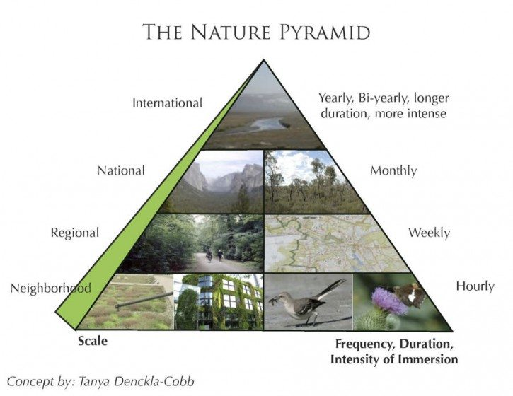
Notes:
Professor Tim Beatley at the University of Virginia created this “Nature Pyramid” The concept it simple – everyday experiences are likely to happen more frequently and closer to home – those more frequent experiences form the base of our personal experience pyramid. At the top of the pyramid are peak experiences, perhaps to exotic locales. These are often once-in-a-lifetime events.
Over a lifetime, we get over 90% of our outdoor experiences close to home. The challenge is to make the everyday experience as meaningful as possible.

Slide 16
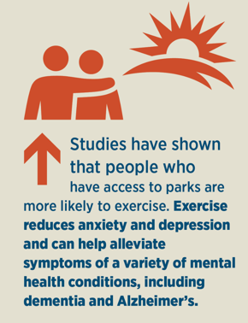
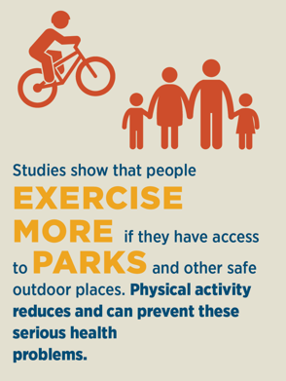
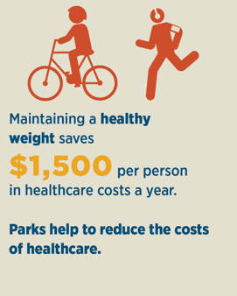
HEALTH AND ACCESS TO PARKS
Source: Blueprint for Latino Health in Montgomery County, MD 2017-2016
Notes:
Public health officials, physicians, nurse practitioners, and other health professionals should advise patients and the public at large about the benefits of green exercise… and nature-based play and recreation.
Form alliances with parks departments, departments of planning and design, … to increase access to green spaces where people live, work, and play and to raise awareness about their value.

Slide 17
Park rx program

Slide 18
PEOPLE
(CONSUMER)
PARKS/PUBLIC SPACES
(PROVIDER)
HEALTH
PARK RX
PROGRAM
(PROMOTER)
ENERGIZED
PUBLIC SPACES PLAN
(DATA-DRIVEN TOOL)

Slide 19
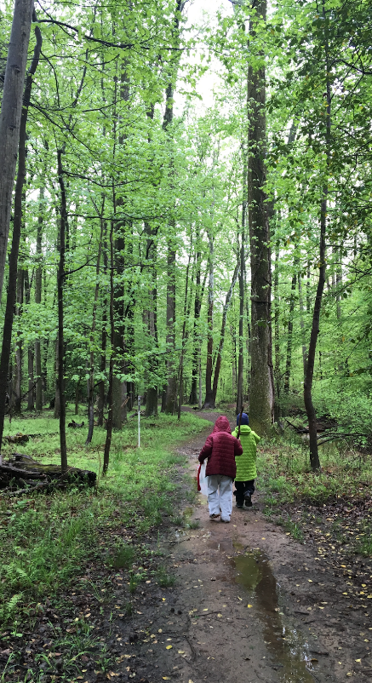
A Scalable Park Prescription Model
Our MISSION is to ease the burden of chronic disease, increase health and happiness, and foster environmental stewardship by encouraging doctors to routinely prescribe time in nature to patients.

Slide 20
Park and Leisure Agencies
Health Providers
Community Outreach

Slide 21
HEALTH BENEFITS
OPPORTUNITY
EXPERIENCE
OUTREACH / INCENTIVES

Slide 22
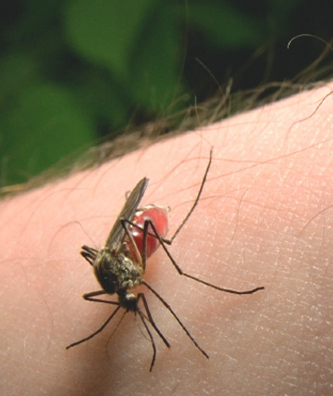
OUTDOOR DANGERS
Sun Exposure
Insect borne diseases
Contaminated soils
Predators
Notes:
Patients often perceive being outdoors as risky because of dangers posed by:
Sun Exposure
Insect borne diseases
Contaminated soils
Predators

Slide 23
WHAT IS PARKRX?
An initiative involving a health or social service provider who encourages clients or patients to spend time in nature to improve health and well-being.
ParkRx Program Census 2018
Institute at the Golden Gate
www.ParkRx.org
Notes:
ParkRx is a simple concept. There are 2 elements –A medical professional + recommendation to spend time in nature
Park Rx leverages the Trust Relationship Between the Doctor and Patient to Get the Patient Outdoors in a Green Setting.

Slide 24
Physical Activity
Being in Nature
Notes:
From a public health context point-of-view, the ParkRx concept promotes not one but two public health messages that are traditionally promoted separately -- the benefits of physical activity and the benefits of being in nature.
It promotes favorable outcomes in both healthcare and public health contexts simultaneously. The distinction being that healthcare tends to focus on treatment of individuals and curing illness, while public health tends to focus on populations and disease prevention.

Slide 25
What is a Park Prescription?
PRESCRIPTION CONTENT:
Visit Location
Time of Visit
Visit Frequency
Visit Duration
On-Site Activity

Slide 26
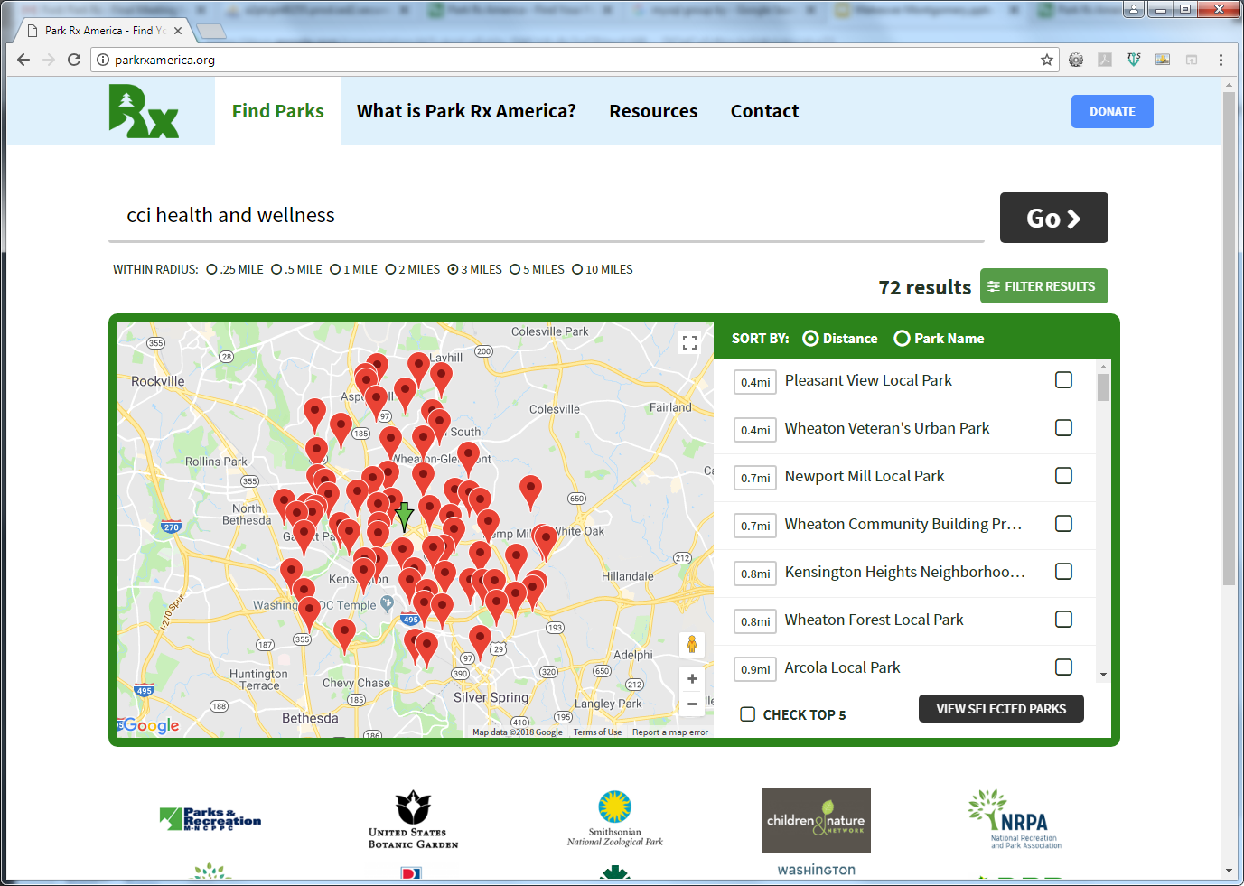
Find parks

Slide 27
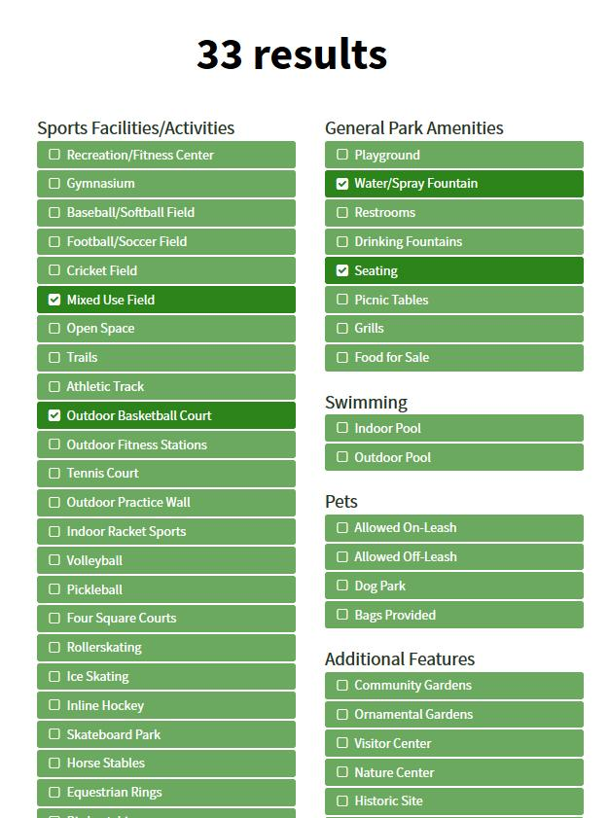
Park filters
Narrow down results by choosing activities, amenities, and other park services that interest your patient.

Slide 28
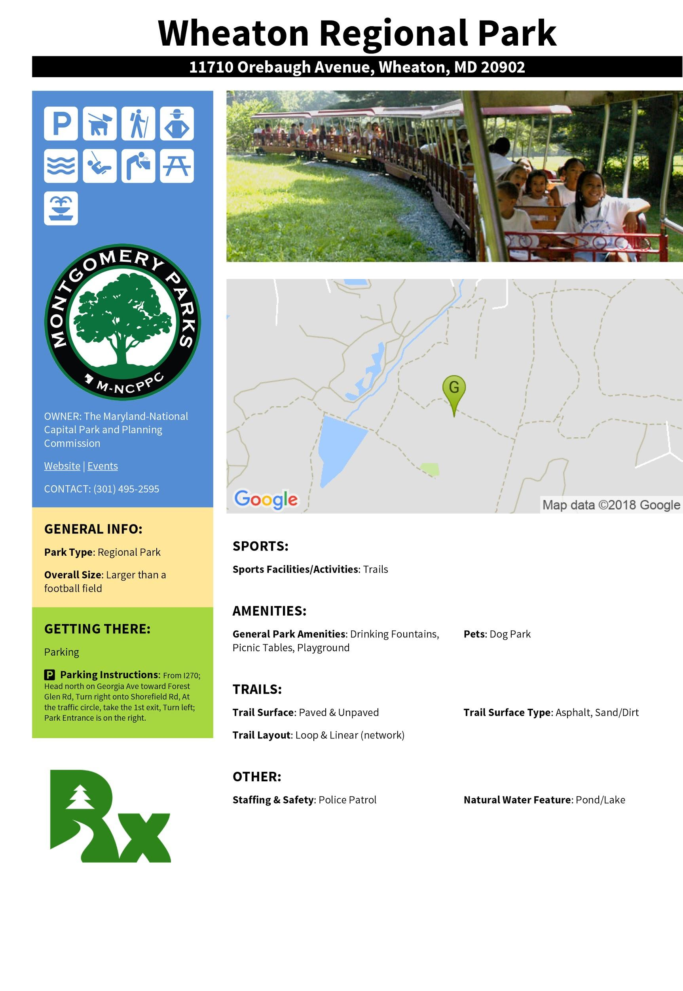
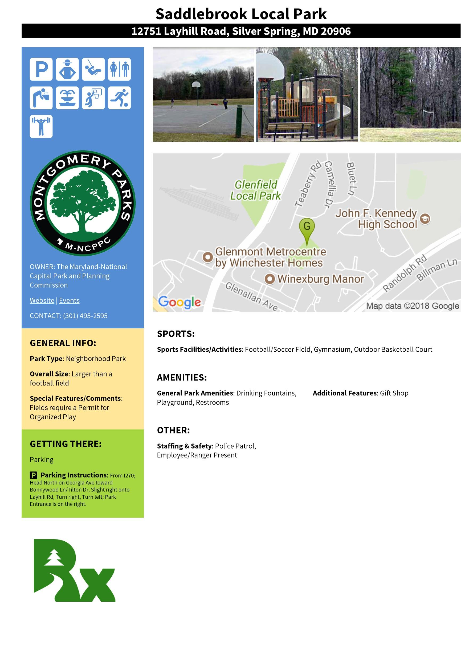
One-page park summaries

Slide 29
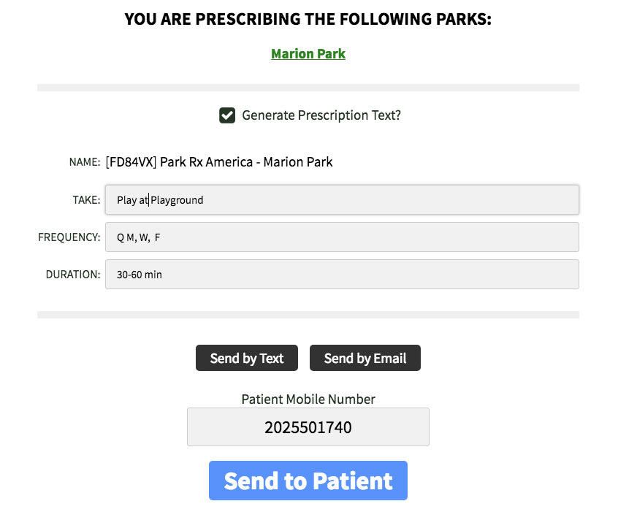

Slide 30
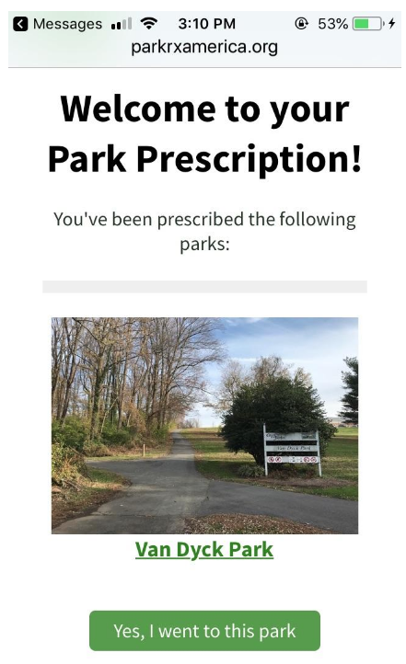

Slide 31
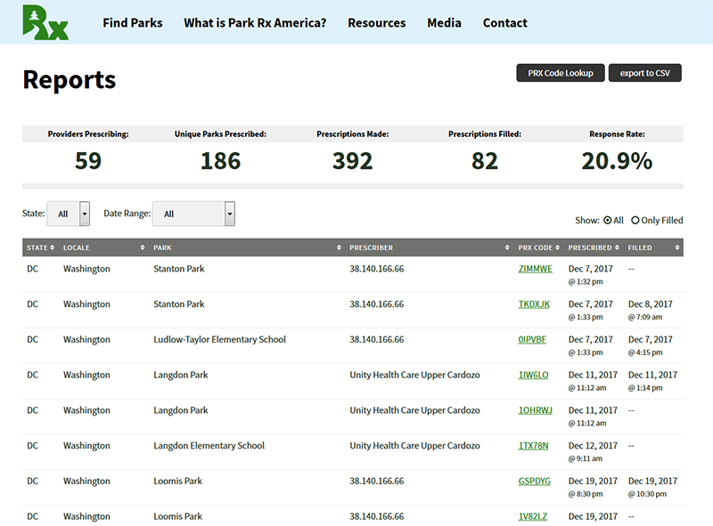

Slide 32
ikigai
reason d’etre
life satisfaction
cambios profundos en tu vida
Notes:
Experiences that provide a deeper connection to nature are the most important. The Japanese use the term ikigai – to distinguish between those aspects of leisure that have strong impacts on our sense of wellbeing and that affect our satisfaction with life, in contrast to those that are just pleasant or pleasurable. Research in the fields of ecotherapy and biophilia indicate that our experience with nature can deliver ikigai – an experience that is life changing.

Slide 33
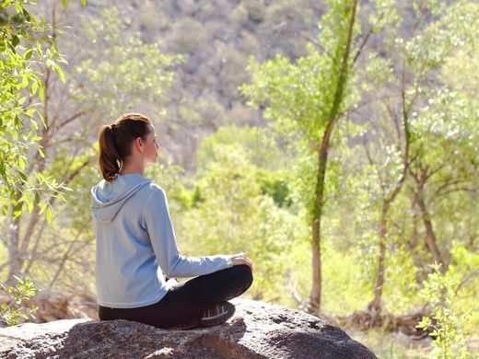
Notes:
Often the most effective way to get a meaningful dose of nature it to quietly immerse yourself in a natural setting.

Slide 34
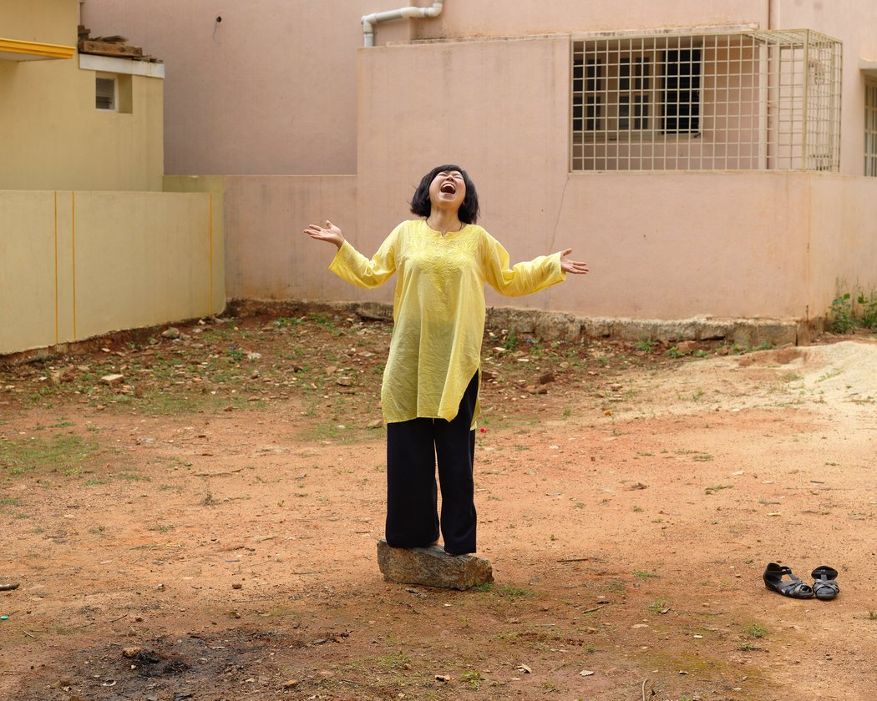
Notes:
Whatever your activity – whether alone or with others -- doing it outdoors will likely provide greater health benefit.

Slide 35
Energized public spaces functional master plan (eps plan)
Notes:
Thank you John for covering the health benefits associated to being outdoors and how the Park Rx Program is trying to encourage people to fight physical inactivity.
Let’s learn how Montgomery Parks is joining efforts with Park Rx Program in the fight against chronic diseases by mapping the areas where we have the highest concentration of people but lack of accessibility to a supply of outdoor/nature experiences.

Slide 36
PEOPLE
(CONSUMER)
PARKS/PUBLIC SPACES
(PROVIDER)
HEALTH
PARK RX
PROGRAM
(PROMOTER)
ENERGIZED
PUBLIC SPACES PLAN
(DATA-DRIVEN TOOL)
Notes:
Montgomery Parks’ role as a parks agency is critical in the fight against physical inactivity and lack of outdoors experiences. As John mentioned before in his biophilia slide, exposure to nature is an essential component for a healthy life. Our agency mission considers a balance between recreation and conservation to allow people and nature (plant and animal) to have a symbiotic healthy and sustainable relationship.

Slide 37
Montgomery county
Frederick
County
Howard
County
Most populous county in MD
Loundon
County
2017: 1,058,800
Prince
George
County
38%
Parks & Open Space
EPS Study Area
Fairfax
County
D.C.
1990: 765,500
+293,300
Notes:
A reminder that we are focusing our efforts where we have more people, where we are growing and where we have the least amount of parkland or public spaces per population.

Slide 38
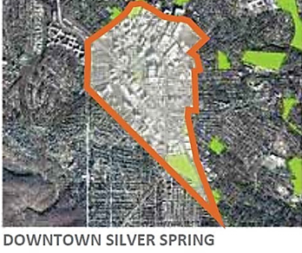
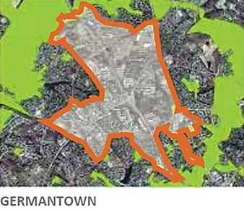
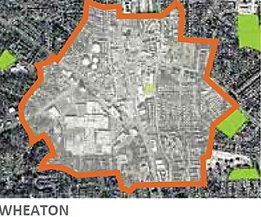
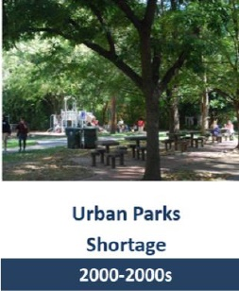
from suburban to urban
Growing Suburban
Growing Urban
Notes:
Like many other jurisdictions, Montgomery County has a shortage of parks in its urbanizing areas - no central park for us here. How did we get here?
Our agency Maryland National Capital Park and Planning Commission was founded in 1927 to provide long range planning and park acquisition and development. Montgomery Parks started with our stream valley parks to control the water quality within the dc region. After that, regional parks and athletic fields, neighborhoods parks, they all responded to the suburban life style where we drove everywhere.
In the late 60’s and 70’s, environmental policy started taking shape and we started to have a better understanding of the impact of suburban sprawl. Growth management policies started emerging. The introduction of the Agriculture Reserve preserved our farmland, and really encouraged the shift in the direction of growing smarter, and preserving our natural resources, especially access to farmland and open spaces. Initially, parks were created as buffer between suburban residential and urban commercial areas. Now, people are living in these urban centers that lack central parks. What brings us to the Energized Public Spaces Functional Master Plan. We will be setting a framework to locate the right types of parks in the right places.

Slide 39
Vision: Energized public spaces
In the EPS Study Area, everyone can walk to a public space.
Photo: Klyde Warren Park, Dallas Art District. Source: Pinterest.com
Notes:
This image illustrates a vision of what we want: a variety of experiences for all people, all incomes and all abilities.
As John mentioned in the pyramid concept slide, 90% of outdoor experiences happened close to home – that makes walking access to parks a critical and necessary element to promote community health. The Energized Public Space Functional Master Plan will be an implementation guide to meeting this challenge.
Urban Parks became a platform for a diversity of community experiences –mixed-use spaces with many direct and indirect benefits to our lifestyle and health.
“Functional Master Plan: A master plan addressing either a system, such as circulation or green infrastructure, or a policy, such as agricultural preservation or housing. A functional master plan amends the General Plan but does not make land use or zoning recommendations.” from Planning Dept. Glossary.

Slide 40
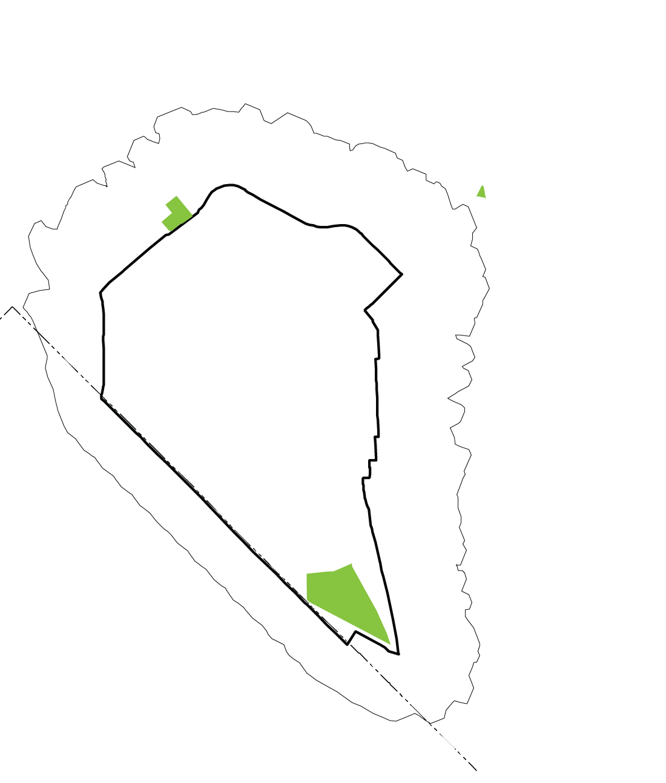
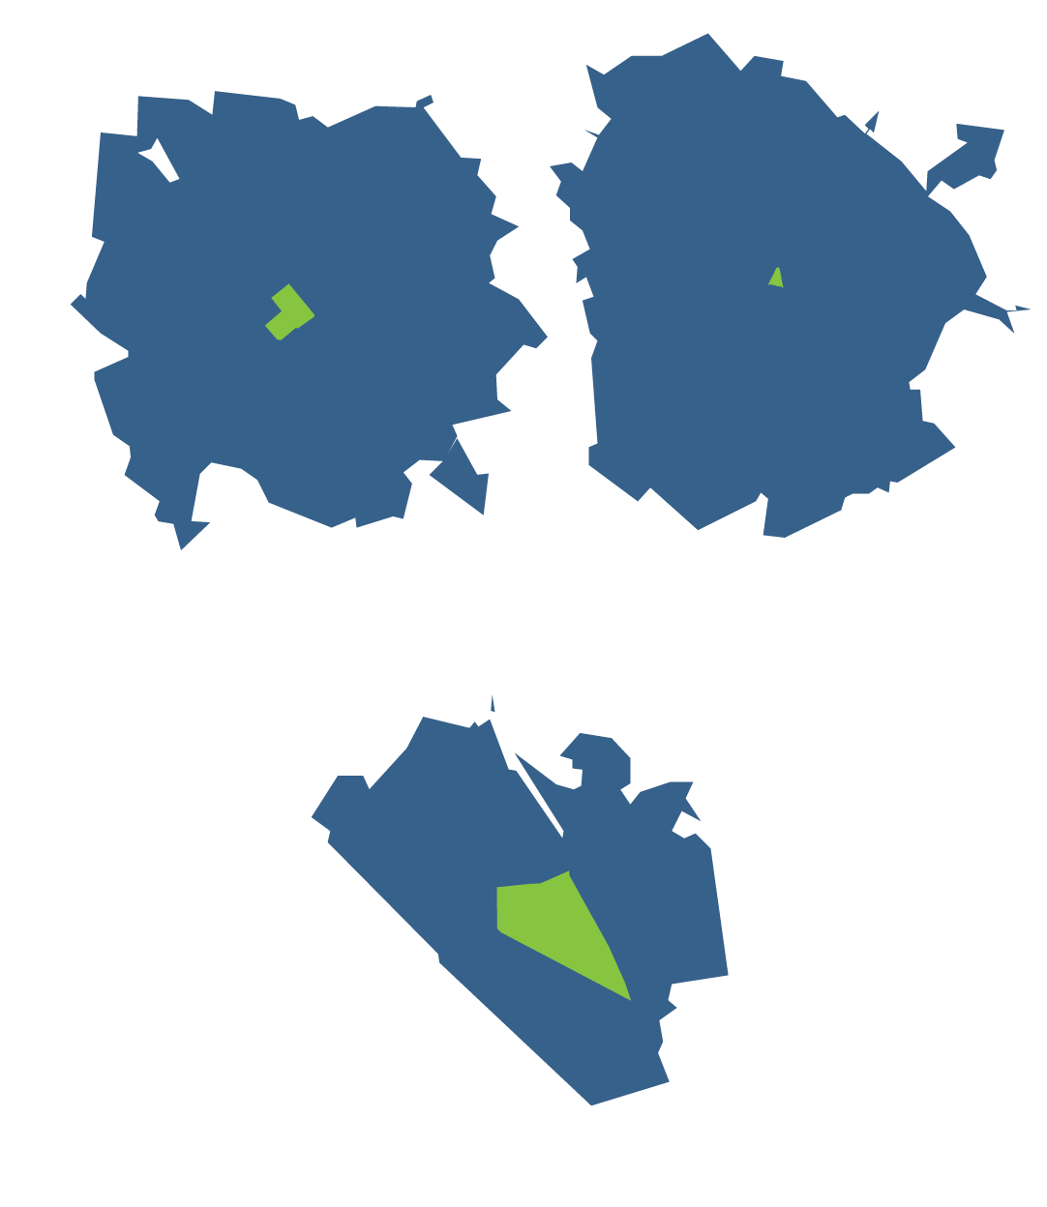
WALK TO PARKLAND
Q: How do we measure access to parks and public spaces?
People covered by walkshed = served
ACCESSIBLE
AREAS
10-min
walkshed
10-min
walkshed
ACCESSIBLE
AREAS
ACCESSIBLE
AREAS
Notes:
When we started the plan we looked into the existing metric to measure accessibility to parks. Usually the tools uses a 10-min walkshed from the center of the park. All residents within that walkshed are considered covered.

Slide 41
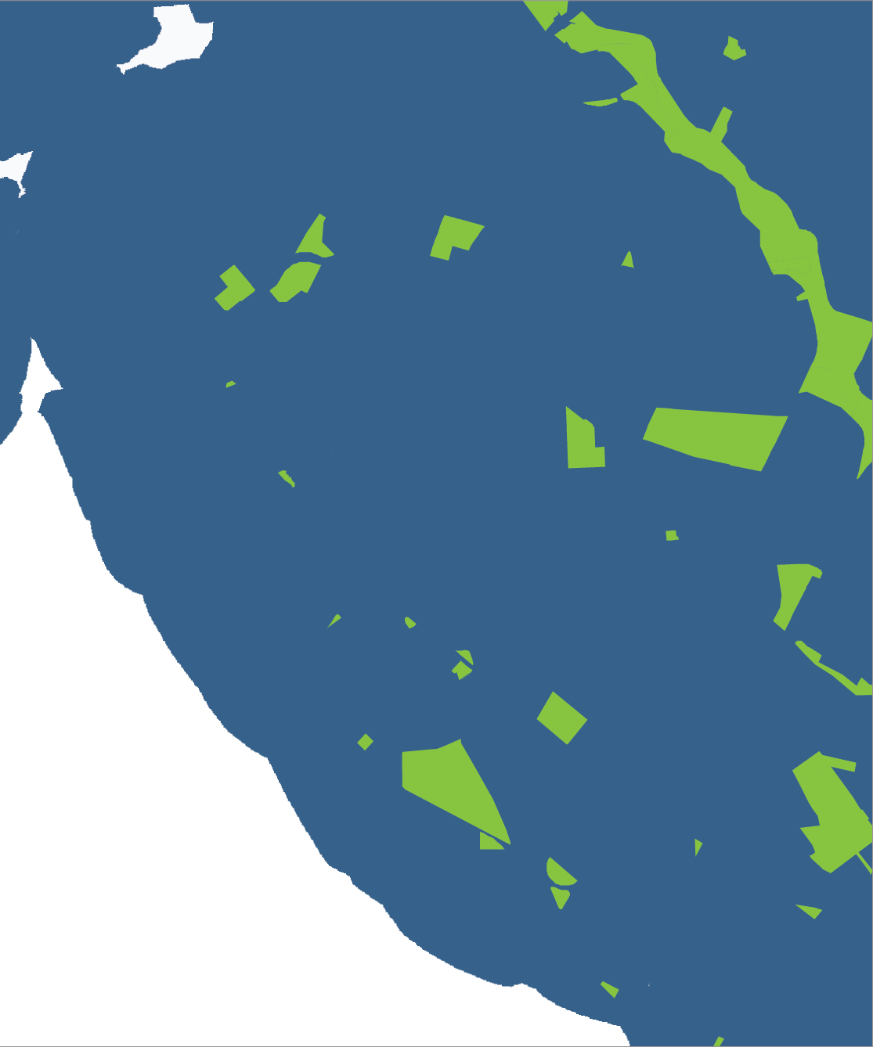
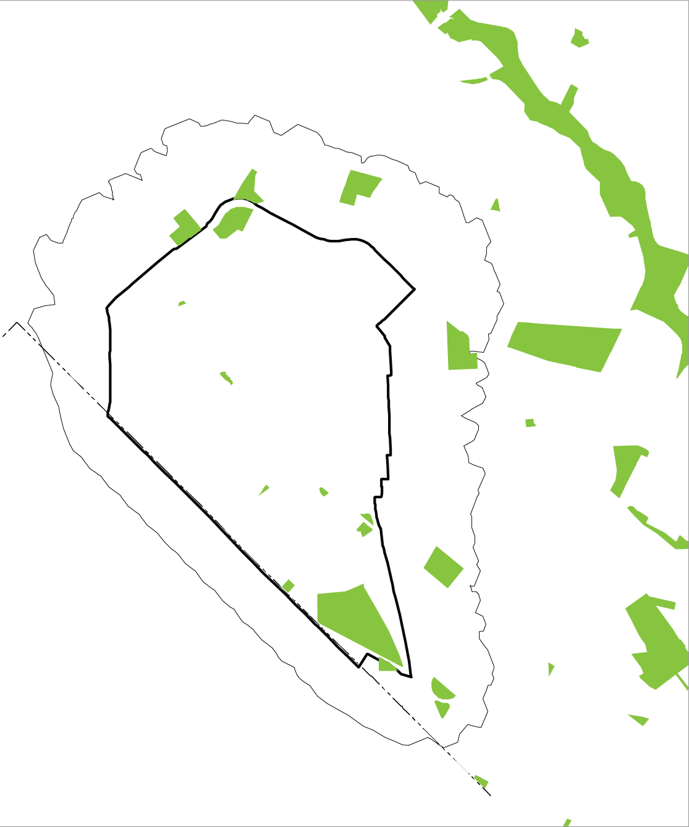
CURRENT THINKING
Q: How do we measure access to parks and public spaces?
Pilot Area = no gaps…
Notes:
Then we decided to apply these tool in all Montgomery Parks surrounding the pilot area of Silver Spring. By this metric, this area is served with no gaps. But notice that not all parks have the same size. The traditional metric parkland per thousand people can help understand this discrepancy. But we are still not talking about things to do here.

Slide 42
All parks/public spaces are not equal.
All park experiences (supply) are not created equal for everyone (demand).
Notes:
All parks and public spaces are not equal. And we have a growing and diverse population to serve.

Slide 43
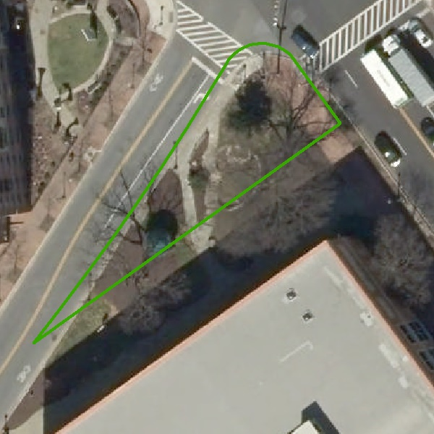
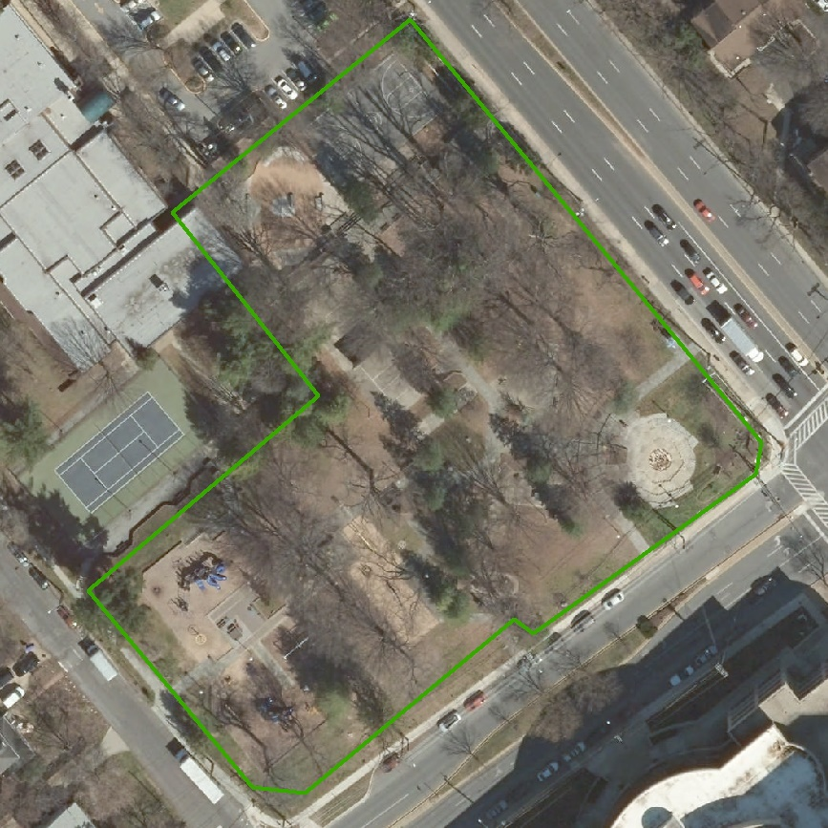
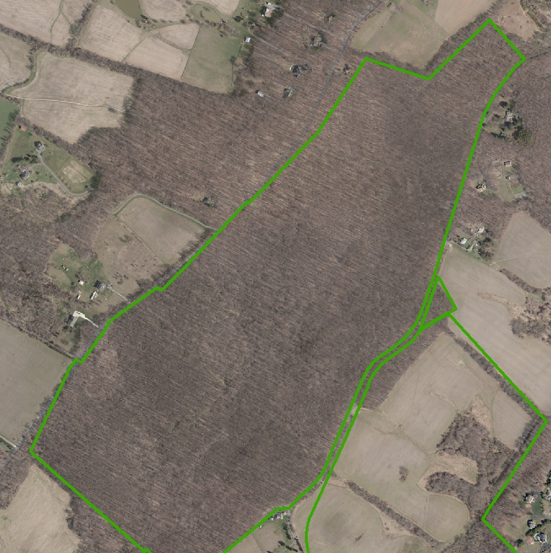
Access to land vs. amenities
Acorn Urban Park
Woodside Urban Park
Conservation Park
Size: 0.15 acres
Amenities: 13
Size: 2.45 acres
Amenities: 50
Size: 214 acres
Amenities: 1
Notes:
Let’s look at these 3 examples. On one end a small historic urban park and in the opposite side a conservation park. Even though I can live nearby the larger conservation park and be considered well-served since the parkland per population in this region will be considerable, I don’t get many options for things to do here. We wanted to have a value system that would consider the things to do there to encourage people to come and visit us, and access to parkland was not enough to respond to this inquire.
The EPS Plan applies a 3-value system focused on accessibility to outdoor experiences that benefit our overall health. What value each amenity brings to people? We wanted to add an experience value to all amenities based on 3 major categories of recreation:

Slide 44
Contemplative Recreation – Mental Health
What to do - Experiences:
Enjoy Nature
Relax, Meditate, Reflect
Escape Chaos
Where - Facilities:
Natural Areas
Historic Sites
Benches
Trees for Shade
Community Open Space
Gardens
Small Green Spaces
Trails
Notes:
First –THE Contemplative Recreation EXPERIENCE. CONTEMPLATIVE VALUE IS WHAT WE ARE ASSOCIATING WITH THE LARGE FOREST FROM THE PREVIOUS SLIDE.
CONTEMPLATIVE RECREATION WILL allow people to reconnect with nature and get the health benefits associated to this experience. to fight chronic disease, burnt out feeling, escape chaos and depression

Slide 45
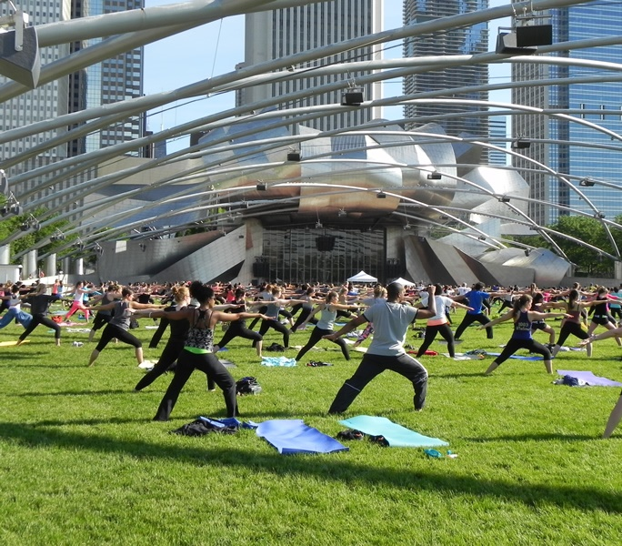
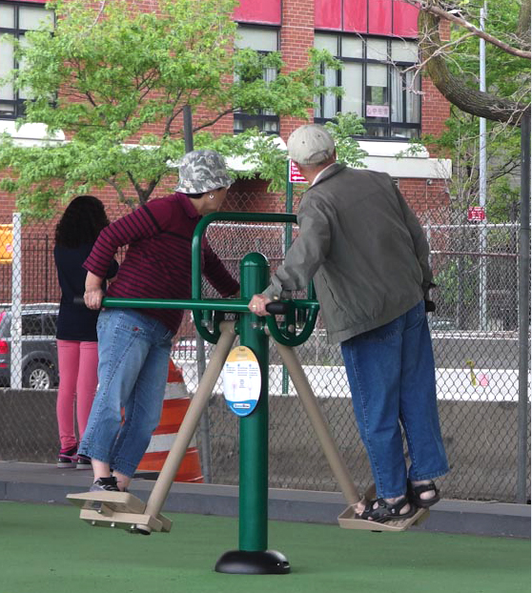
Active Recreation - Physical Health
What to do - Experiences:
Kick a Ball
Run/Walk
Play Games
Exercise
Where - Facilities:
Field: Open space/Grass
Trails
Hard Courts & Surfaces
Nature-inspired Interactive Elements (climbing)
Playgrounds
Notes:
Second, Active recreation to encourage people to exercise outdoors and live longer and healthier lives, and fight physical inactivity.

Slide 46
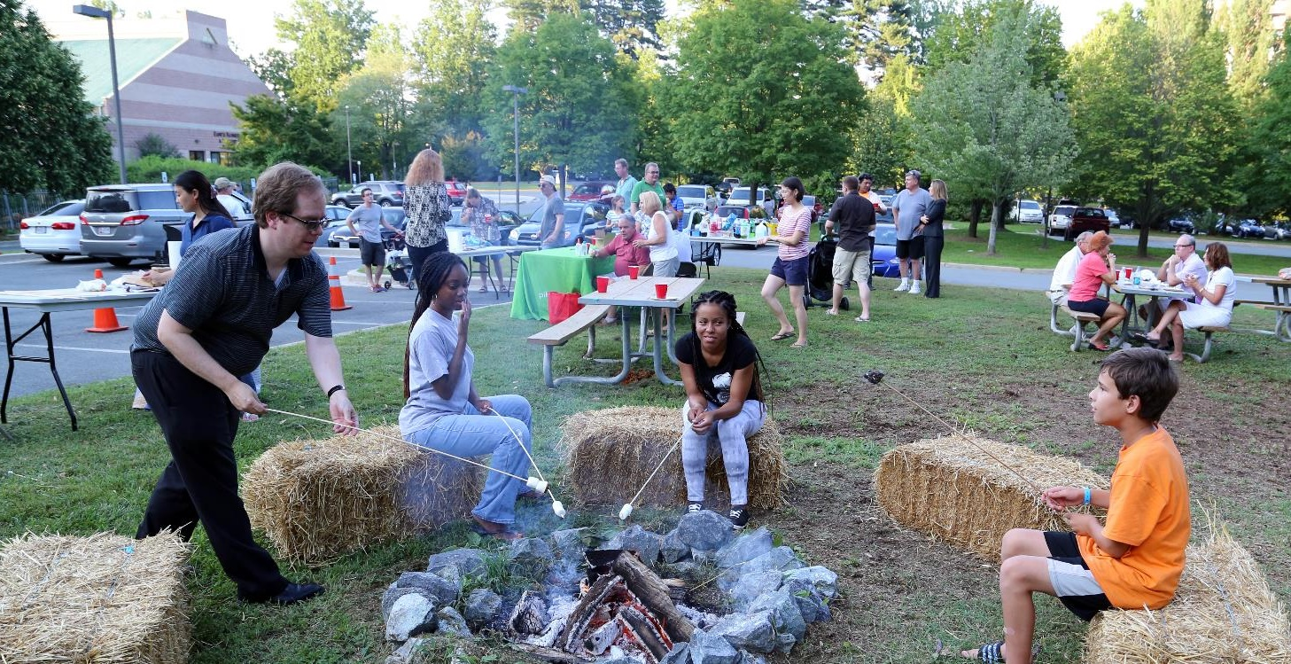
Social Gathering –Social Health
What to Do - Experiences:
Community Festivals
Farmer’s Market
Lunch Places
Concert, Parades
Outdoor Movies
Historic Sites
Where - Facilities:
Plazas with Seating
Stages/Amphitheaters
Cluster of Picnic Tables
Community Open Spaces
Dog Parks
Notes:
Third, social gathering - offer places where people can come together as a community, and fight depression and loneliness. This slide illustrates an outdoor event “cookout” in Wall Park – great activation opportunity to come together as a community.

Slide 47
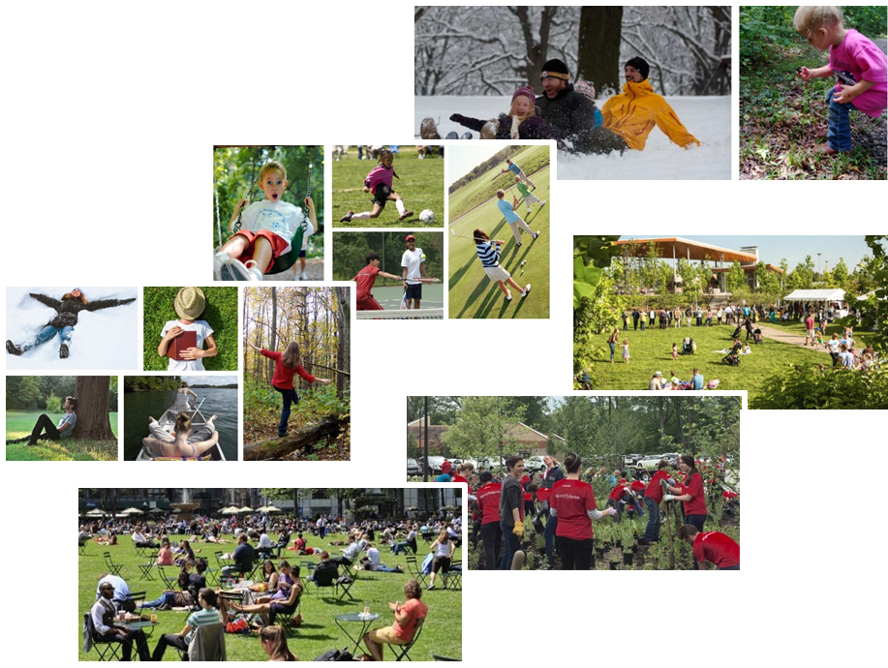
EPS PLAN
We measure access to experiences,
not acres.
Notes:
In summary, one of the main outcomes of this plan is a methodology to identify our service gaps/shortages/deficits (words we are using today interchangeably), to assist park planning for these areas. Where don’t we have enough supply of amenities for the amount of people?

Slide 48
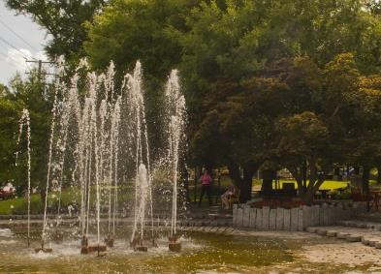
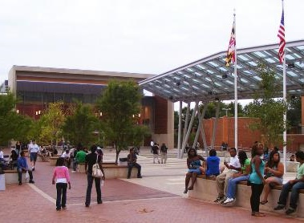
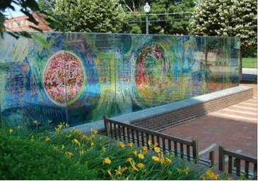
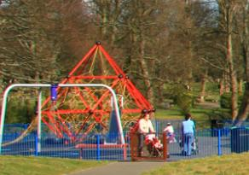
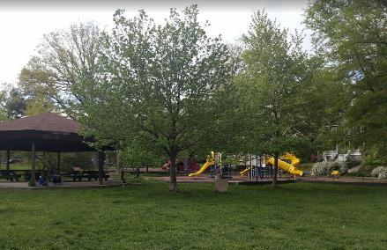
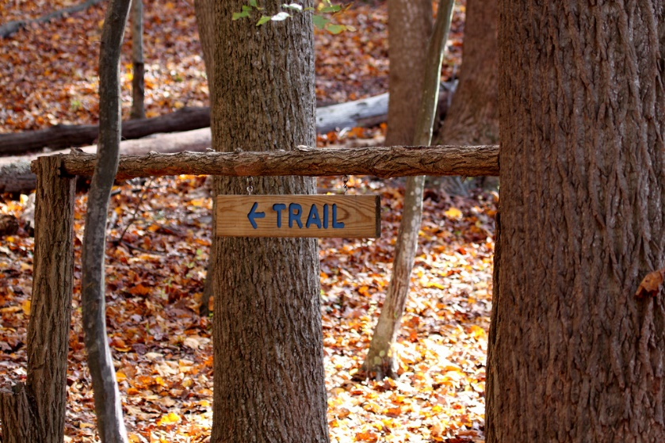
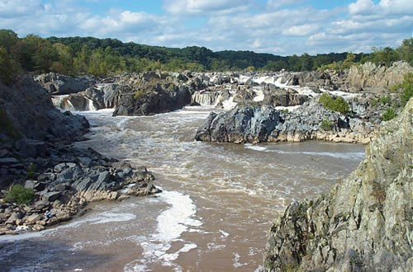
Integrated public spaces system
independent of ownership
ENERGIZED PUBLIC SPACES NETWORK
MONTGOMERY PARKS
MONTGOMERY COUNTY
PRIVATELY-OWNED PUBLIC SPACES (POPS)
SCHOOLS
NEIGHBORING COUNTY/ MUNICIPAL PARKS
STATE PARKS
NATIONAL PARKS
Notes:
Montgomery Parks is one of the providers of parks and public spaces. In order to look into the supply of places to go and things to do, we have to consider all the providers of public spaces and parks. We understand that in areas of higher concentration of people, where land is scarce, people rely on an integrated network that includes both publicly-owned and privately owned public spaces.
The EPS Plan provides an analysis based on the user’s perspective.

Slide 49
Eps study area Preliminary results
Notes:
Let’s look at the mapping of our preliminary results.
This methodology developed a data-driven tool for evaluating park needs that can be employed systematically to prioritize and distribute parks and open spaces across the higher population and mixed use areas of the County.

Slide 50
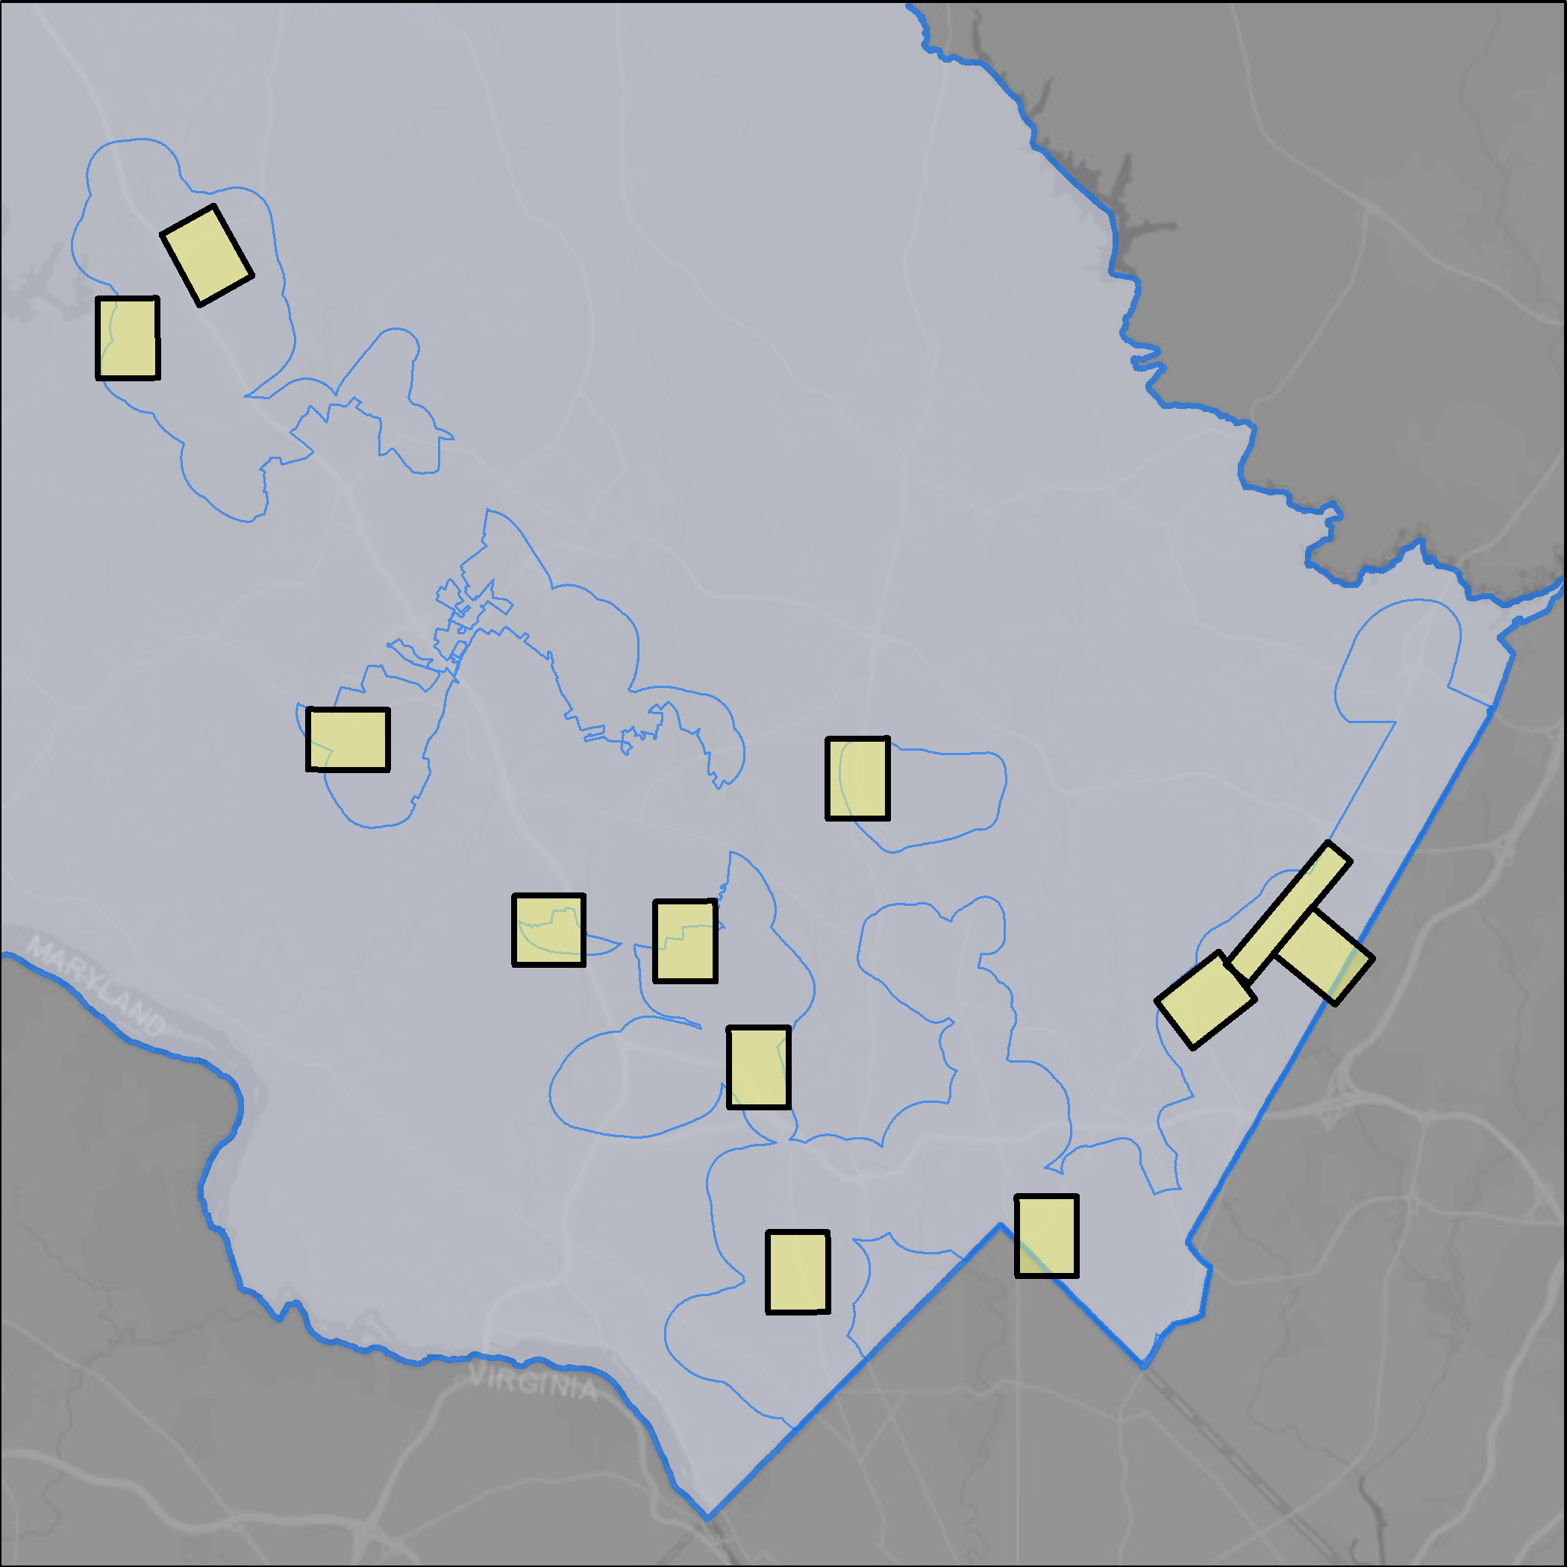
Eps plan top 12 deficit clusters
Germantown
North
Potomac
Aspen Hill
White Flint
Rolling
Acres
Montgomery Square/Potomac
White Oak
Grosvenor
Top 12 Deficit Clusters
EPS Study Area
Montgomery County
Silver Spring
Bethesda
* Graphics represent preliminary results
Notes:
These are the top 12 deficit clusters that were prioritized numerically based on total deficit score and order of magnitude of those. The location of these clusters is in alignment with the locations where we have more people

Slide 51
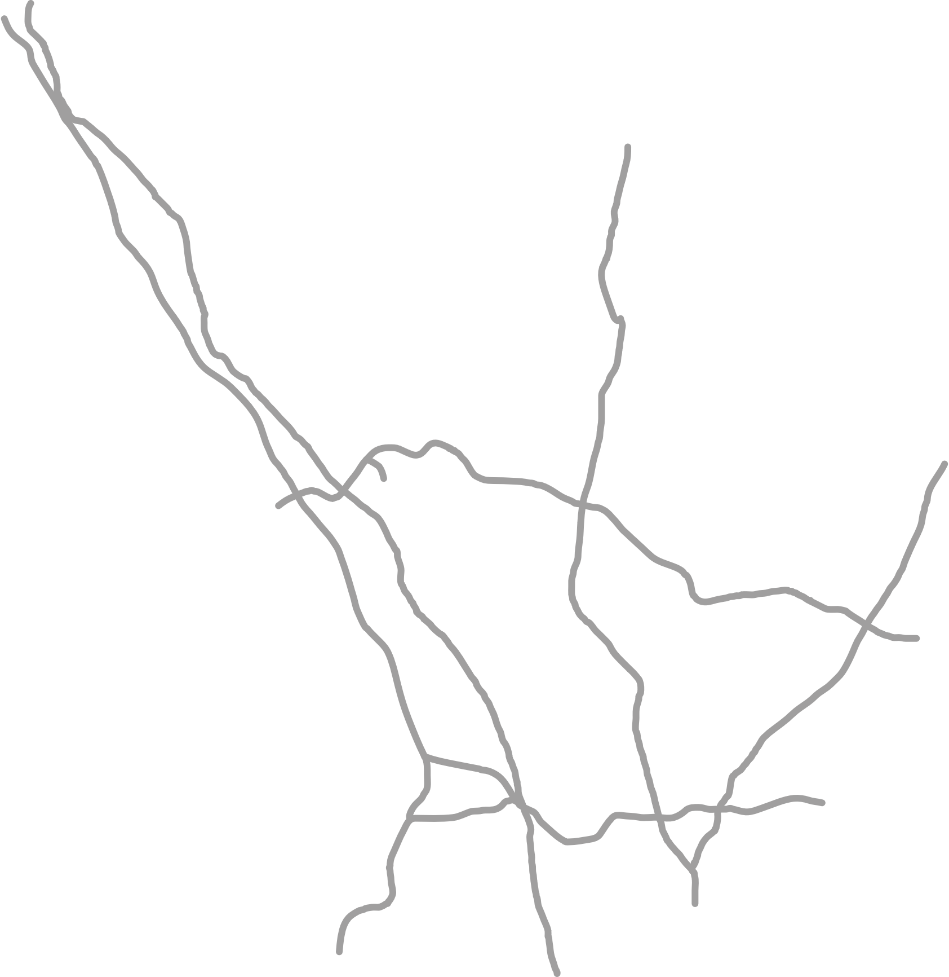
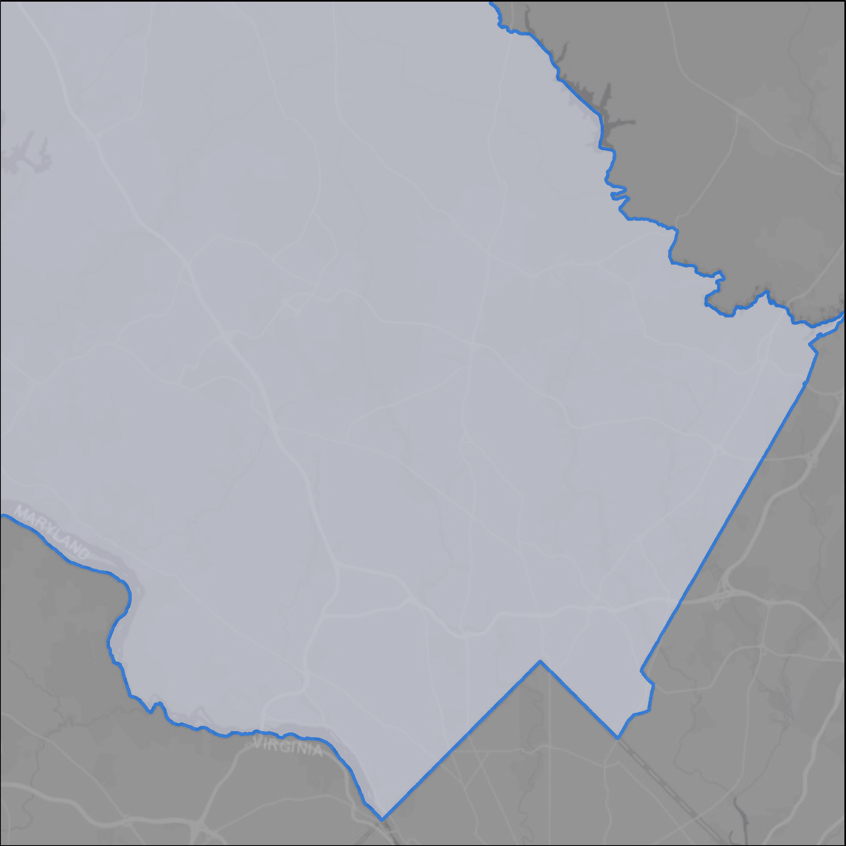
Eps plan County
Montgomery County
Notes:
Let’s look into how we get here.

Slide 52
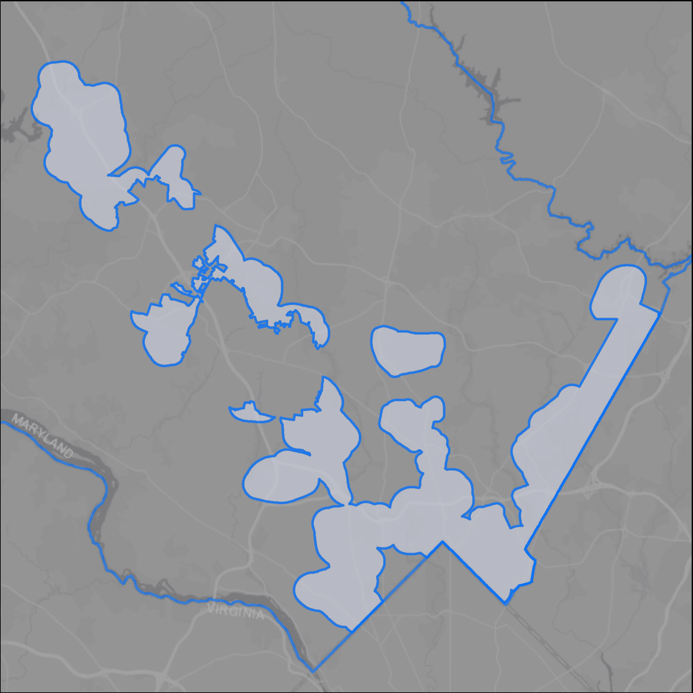
Eps plan study area
EPS Study Area
Montgomery County

Slide 53
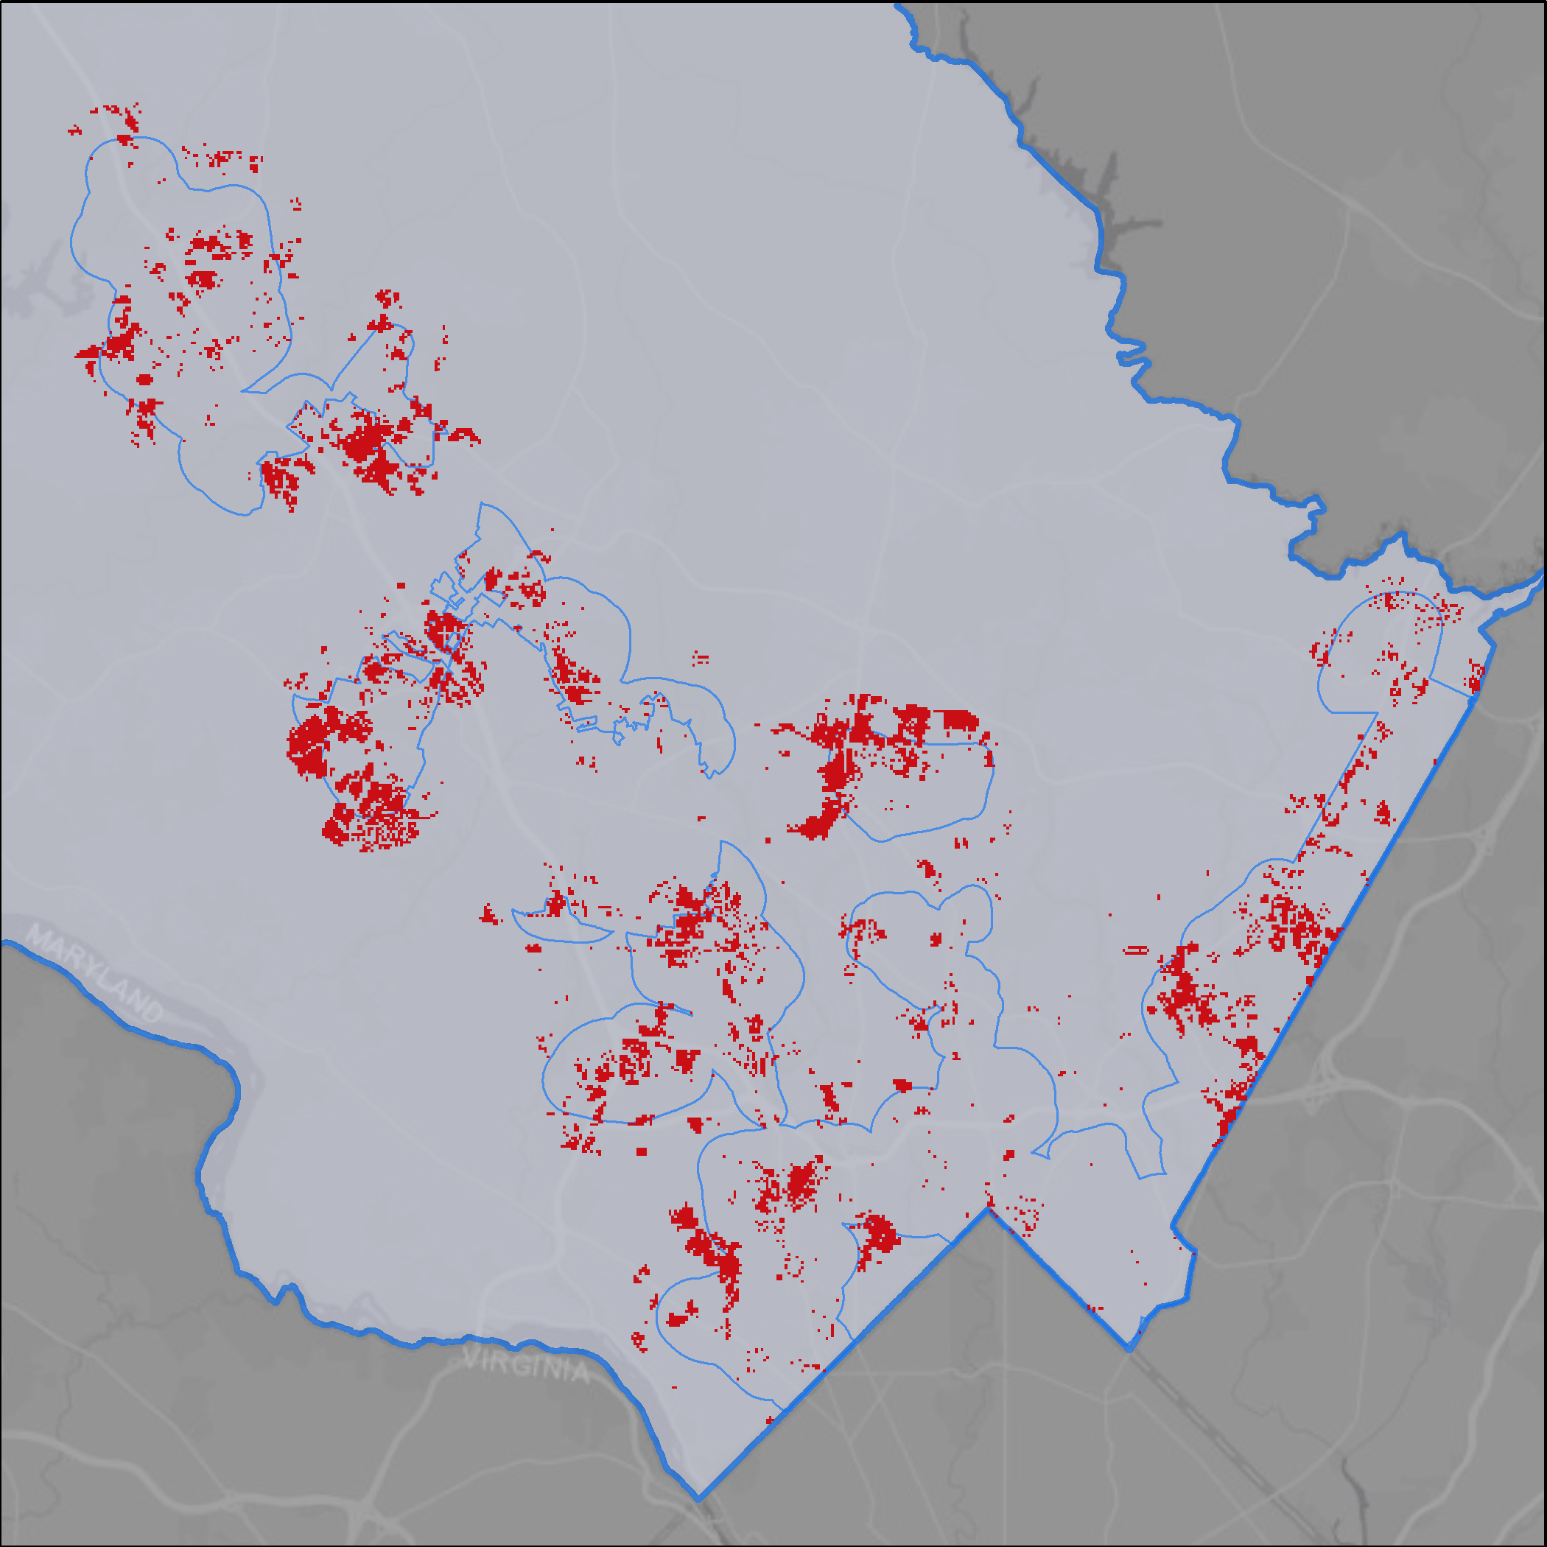
Eps plan deficits
Deficits/Shortage of Accessible Experiences
EPS Study Area
Montgomery County
* Graphics represent preliminary results
Notes:
Deficits/shortages concentration are located along major corridors NE and SW coinciding with where we have the highest concentration of people. The results shown here account for all 3 experiences shortages combined.

Slide 54
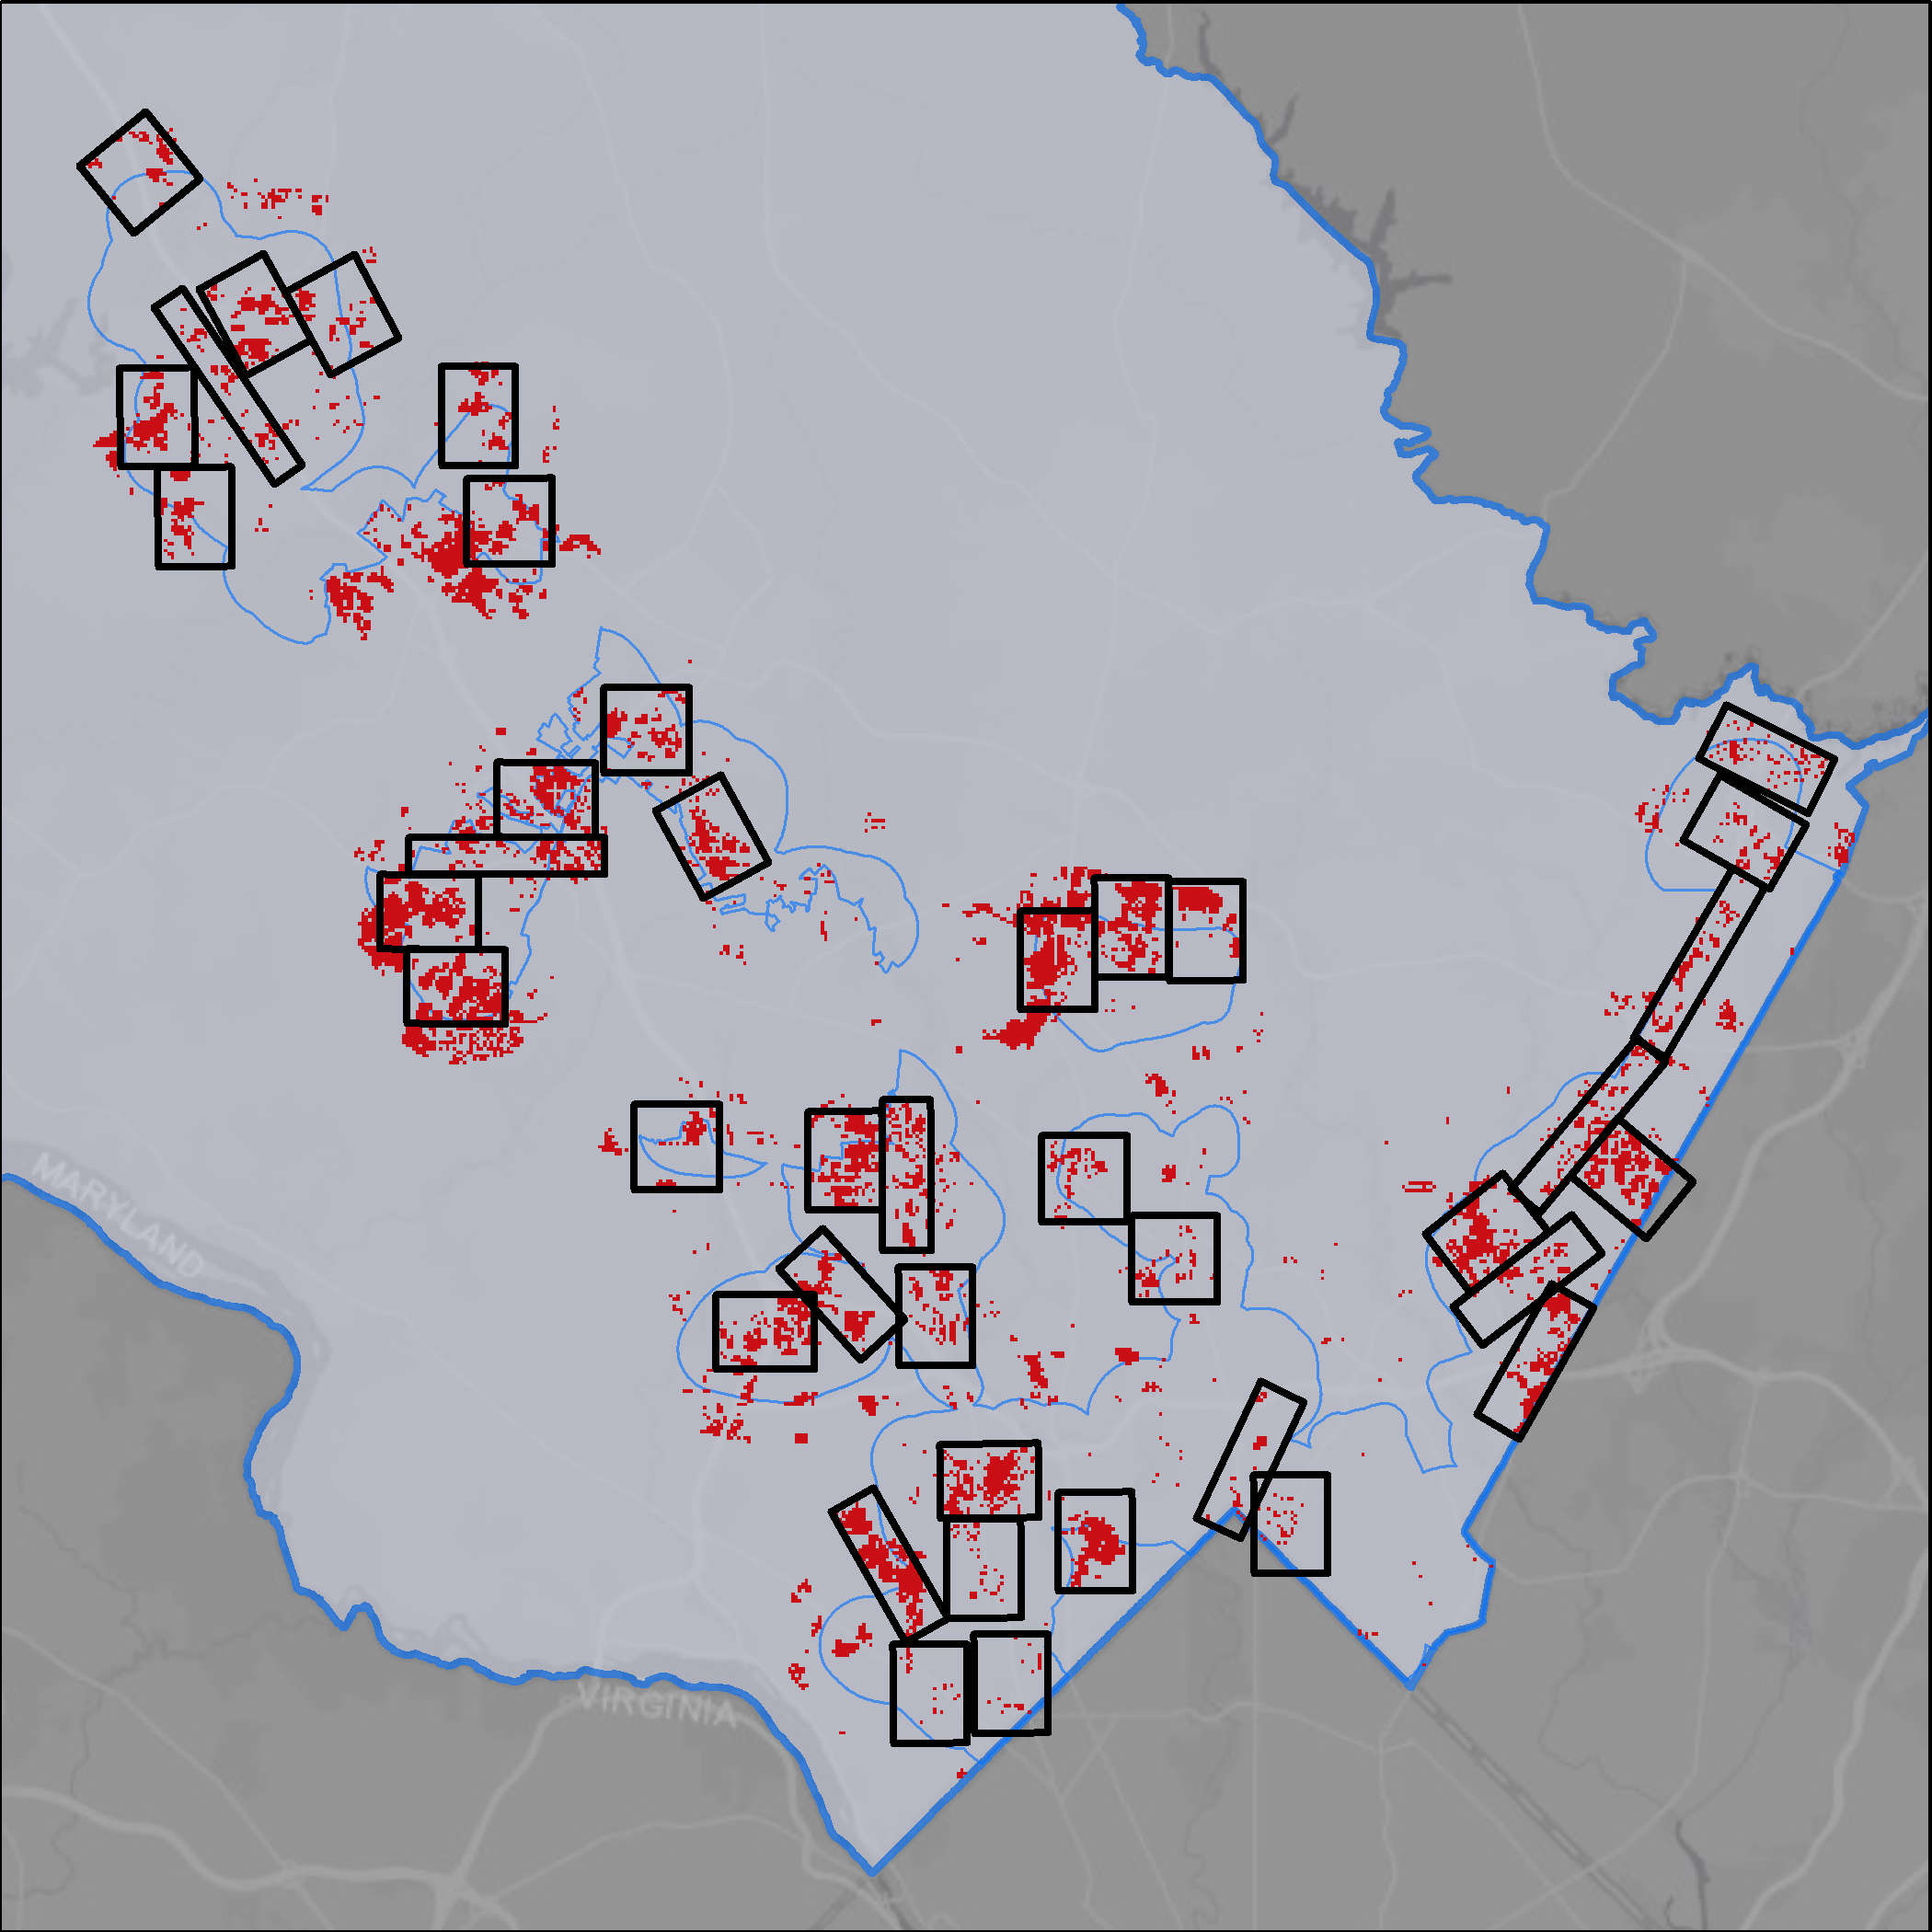
Eps plan 40 clusters
Pppt layer that showcase the top 12
Development Clusters (1 square-mile)
Deficits/Shortage of Accessible Experiences
EPS Study Area
Montgomery County
* Graphics represent preliminary results
Notes:
We combined the shortages into clusters of 1-square-mile to compare the total deficits.
WITH THE 40 DEFICIT CLUSTERS IDENTIFIED AND NUMERICALLY RANKED, WE WILL ADVANCE THE TOP 12 SUCH CLUSTERS AS OUR PRIORITY.

Slide 55
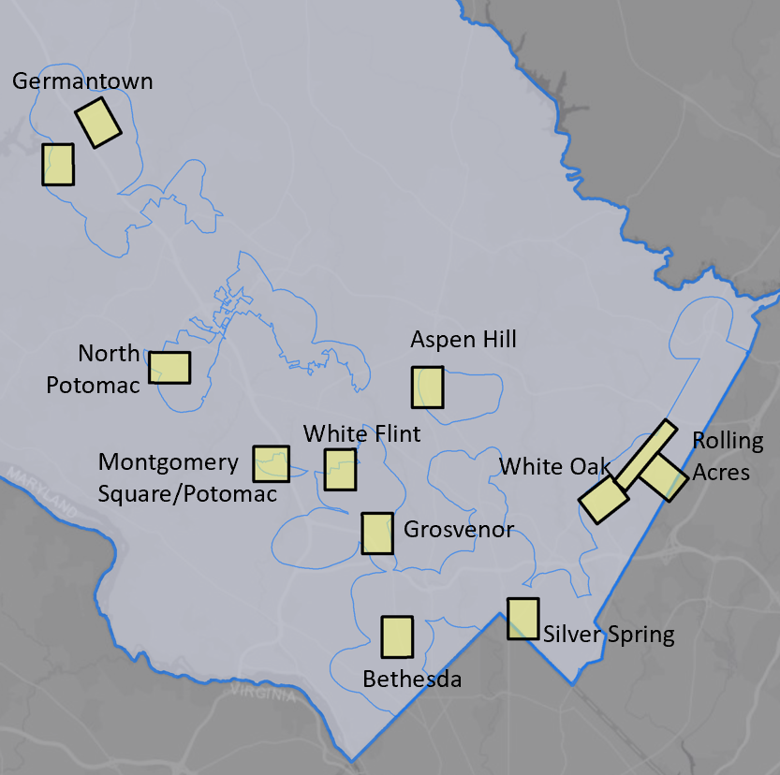
Eps plan top 12 clusters
North
Potomac
Aspen Hill
Deficit Clusters
White Flint
Rolling
Acres
Montgomery Square/Potomac
White Oak
Grosvenor/
Stratmore
* Graphics represent preliminary results
3D Focused Area
Silver Spring
Bethesda
Notes:
This is the ranking of the top 12 clusters (out of 40).
One note: the population demand of our methodology consists of residents and workers, to select the top 12 clusters, we focused on those that presented a minimum of 25% of its population as residents. We are focusing on areas of mixed-use and higher residential density, so we remove the office campus and large federal facilities campuses from this comparison.

Slide 56
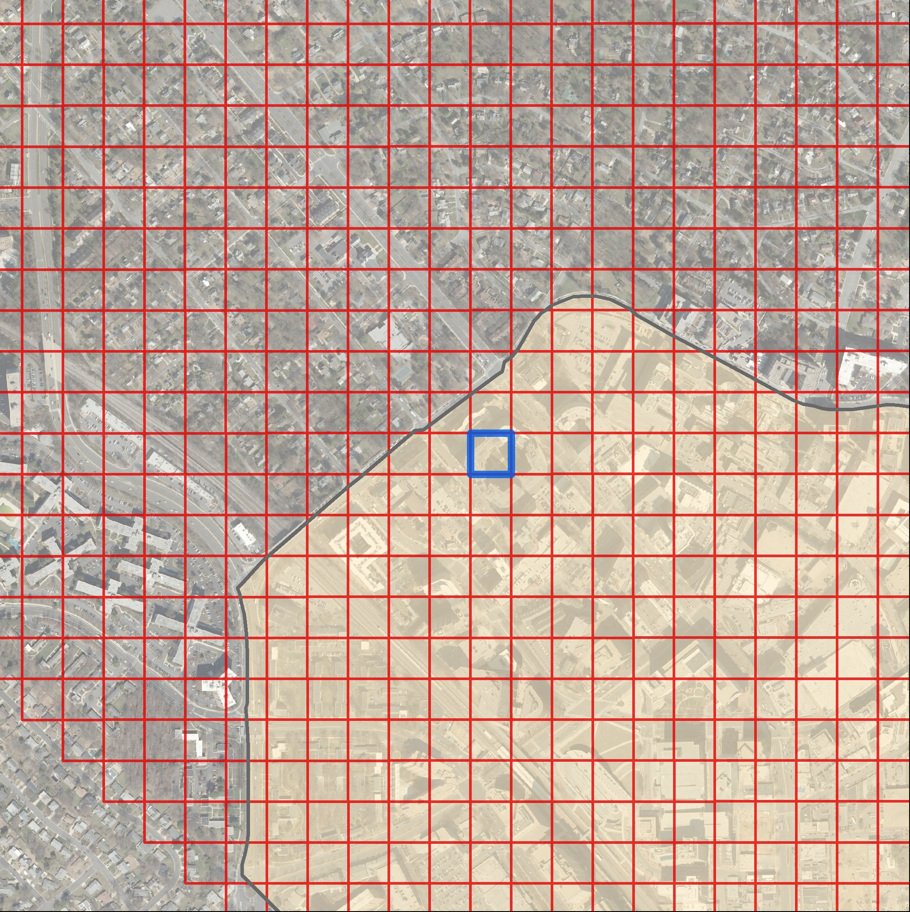
The Grid
Regular grid system
Each grid has a supply and demand associated to it
Grids with these attributes can be viewed and analyzed in many ways
Notes:
One important aspect of our tool is that instead of relying on census block boundaries, we create a regular grid system to allow an equal comparison of supply and demand relationship for the many different areas of the County. Each grid square has a supply and demand value associated to it. Chris will go into more details in the second part of our presentation. All red squares you saw in the previous deficit maps were representing these square grids where the demand surpassed the supply.

Slide 57
Eps plan top 12 deficit clusters
Germantown
North
Potomac
Aspen Hill
White Flint
Rolling
Acres
Montgomery Square/Potomac
White Oak
Grosvenor
Top 12 Deficit Clusters
EPS Study Area
Montgomery County
3D Focused Area
Silver Spring
Bethesda
* Graphics represent preliminary results
Notes:
Let’s look into another way of visualizing the same data
We are measuring deficits as by-products of a supply and demand relationship based on accessibility to the 3 major experiences that will benefit overall health. To better visualize the components that led us to these top 12 clusters we will be using a 3D rendering version and focus on a specific area.

Slide 58
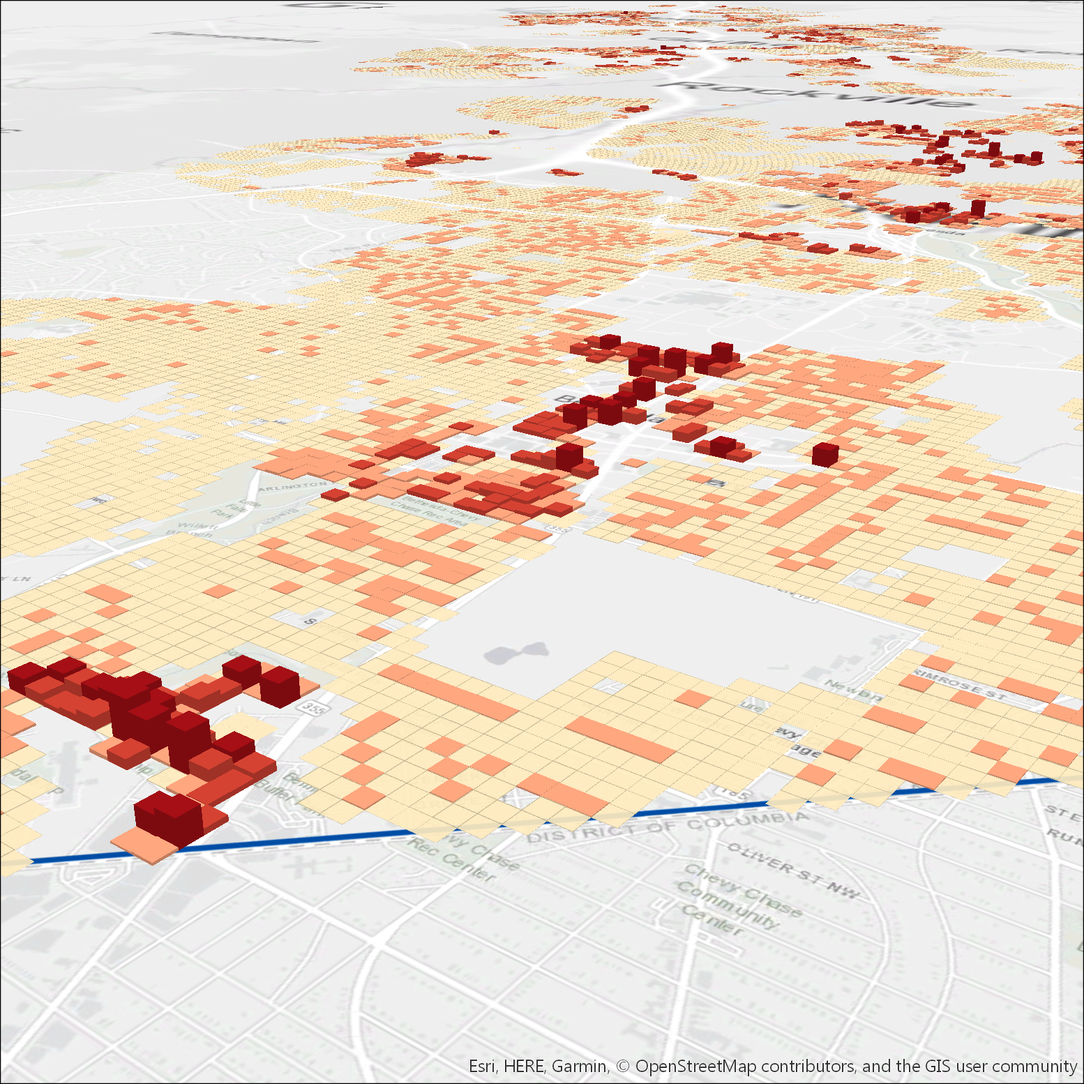
Demand residential
< 12 (Single-Family)
< 50 (Single-Family Attached)
< 200 (Garden)
< 1,384 (High Rise)
Development Cluster (1 square-mile)
Montgomery County
* Graphics represent preliminary results
Notes:
We looked into the residential demand.
Single-family and townhomes are surrounding the mixed-use centers of Bethesda. With the highest demand of residents concentrated into multi-family buildings at the core of the CBD.

Slide 59
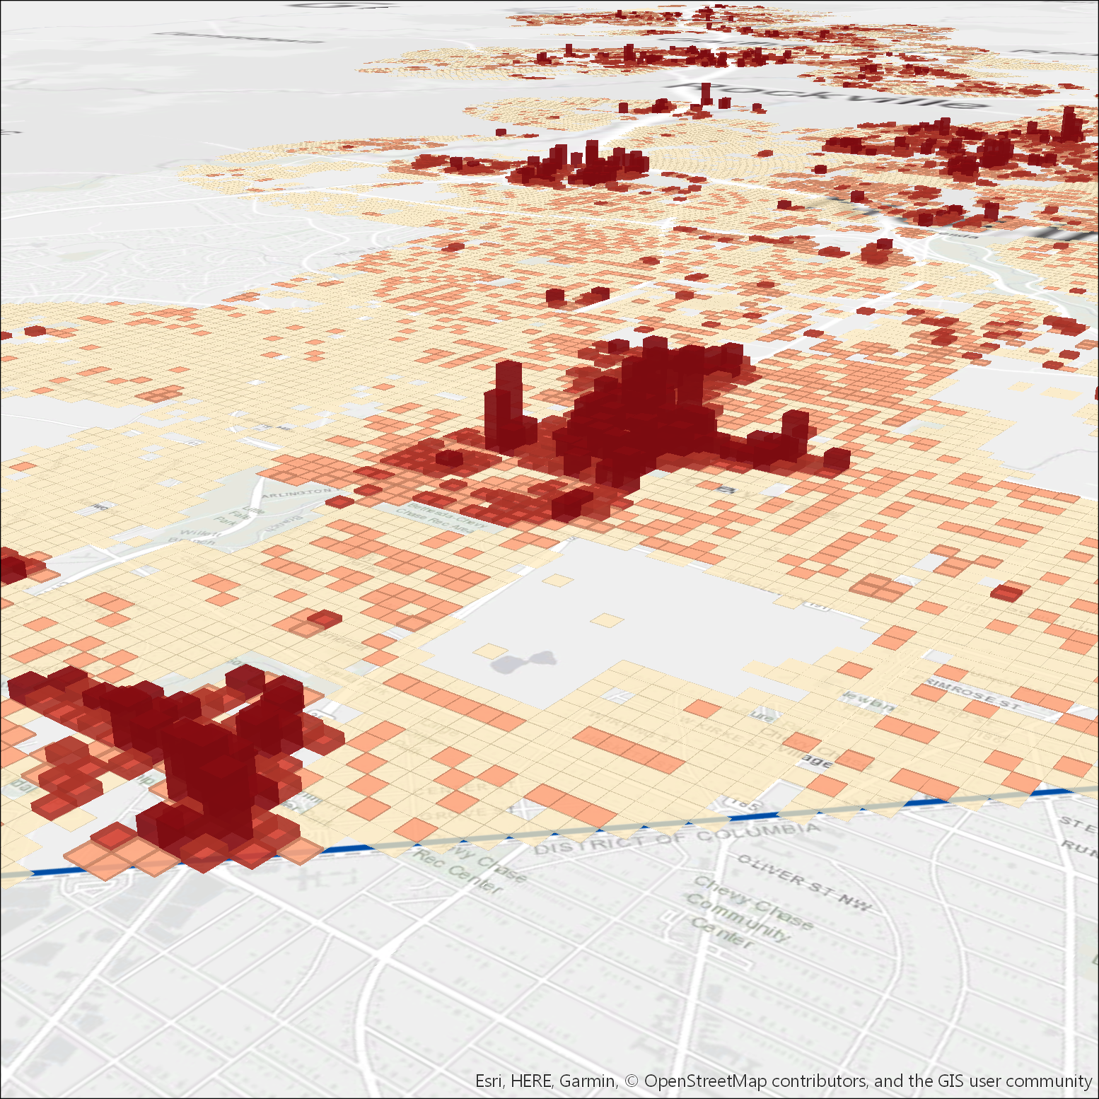
Demand resid.+ comm.
Less People
More People
Development Cluster (1 square-mile)
Montgomery County
* Graphics represent preliminary results
Notes:
Then we added the commercial demand. Notice the peaking of the demand at the core of the CBD and the maintenance of low demand where SF is located.

Slide 60
Supply active
Less Supply
More Supply
Development Cluster (1 square-mile)
Montgomery County
* Graphics represent preliminary results
Notes:
Moving to Supply. We looked at 3 supply values based on the 3 recreational experiences.
Notice that the supply of active recreation is low in active recreation with the 3D rendering showing flat areas - need of central spaces to promote exercise and physical health – especially in CBDs areas where not only residents can benefit of these spaces but also workers can take a break at lunch time.

Slide 61
Supply contemplative
Less Supply
More Supply
Development Cluster (1 square-mile)
Montgomery County
* Graphics represent preliminary results
Notes:
Similar to the active recreation results, contemplative recreation supply is low.

Slide 62
social gathering
Supply
Less Supply
More Supply
Development Cluster (1 square-mile)
Montgomery County
* Graphics represent preliminary results
Notes:
Social Gathering increases in the core of the CBD due to the concentration of smaller pocket parks associated to new high-rise development and the open space requirement associated to this type of development.

Slide 63
Supply total
Less Supply
More Supply
Development Cluster (1 square-mile)
Montgomery County
* Graphics represent preliminary results
Notes:
And here is the combined supply of all 3 experiences. This wrap up the visualization of our supply.

Slide 64
Overlay supply + demand
Development Cluster (1 square-mile)
Montgomery County
* Graphics represent preliminary results
Notes:
Here is where the magic happens.
We combined supply and demand points, where the demand exceeds the supply it will show through the supply model (stick out). The higher the peak the higher the deficit magnitude for each grid square.

Slide 65
Deficits/
< level of service
Deficits
Development Cluster (1 square-mile)
* Graphics represent preliminary results
Notes:
Here we isolated the deficits for better visualization of the peaks where demand exceeds the supply. These deficits established here were the red areas shown in the countywide maps in previous slides.

Slide 66
deficits
40 deficit squares
* Graphics represent preliminary results
Deficits (1 square-acre) Development Cluster (1 square-mile)
Notes:
Let’s take a closer look at this cluster.

Slide 67
152
deficit squares
40
deficit squares
GERMANTOWN
BETHESDA
* Graphics represent preliminary results
Deficits (1 square-acre) Development Cluster (1 square-mile)
Notes:
We selected a suburban location to compare with the deficits of the Bethesda CBD. The first has a larger amount of grid deficits than the second.

Slide 68
deficits have different weight
GERMANTOWN
152
deficit squares
< demand
< supply
connection
BETHESDA
40
deficit squares
> demand
< supply
connection
DEFICIT = 5,732
DEFICIT = 7,203
Lesser Deficit Medium Deficit Greater Deficit
Notes:
However, not all deficits squares have the same weight, or magnitude of deficit. As you can see in this comparison the suburban location has a large amount of lesser deficit squares compared to the fewer greater deficit squares in the CBD area.

Slide 69
Not all deficits will be treated the same
The EPS Plan establishes five major strategies to improve the mapped deficits.
Notes:
As not all deficits are the same, we established 5 different strategies to improve the identified deficit areas.

Slide 70
EPS strategies
ACTIVATE
CONNECT
REPURPOSE/REDEVELOP
DEVELOP
CREATE
Notes:
From the cheapest to the most expensive, here are the 5 EPS Plan strategies
Activate existing/Approved parks and/or temporary areas
Connect: improve connections by working with other public agencies and partners
Repurpose/Redevelop underutilized public and/or private public space land
Develop on existing land that still has space or was recently purchased
Create new parks by acquiring land and/or partnering with other providers

Slide 71
CREATE & DEVELOP – PARKS DEPT.
New Park
Source: PACP, M-NCPPC
Notes:
Create is expensive

Slide 72
CREATE WITH PARTNERS
New Park
Building Roof
POPS
(privately-owned public spaces)
Parking Garage Roof
Source: PACP, M-NCPPC

Slide 73
REPURPOSE
BEFORE: Underutilized courtyard
AFTER: Popular dog park
Source: PACP, M-NCPPC

Slide 74
CONNECT
Improvements to cross busy avenue & connect to larger park
Public Open Space
Public/Private Open Space
Proposed Pedestrian Node
Existing Crosswalk
Proposed Crosswalk/Pedestrian Improvement
Proposed Park Pedestrian Connection
Source: PACP, M-NCPPC

Slide 75
ACTIVATE
White Flint Placemaking Festival
Source: PACP, M-NCPPC

Slide 76
ACTIVATION
Montgomery Pop-Up
Source: PACP, M-NCPPC
Source: PACP, M-NCPPC

Slide 77
ACTIVATION
Yappy Hour
https://www.montgomeryparks.org/
events/yappy-hour-pop-dog-park/
Source: PACP, M-NCPPC

Slide 78
ACTIVATION
Climbing
Source: PACP, M-NCPPC

Slide 79
Methodology: how we did it
Thank YOU
Notes:
Before Chris starts talking about the EPS Plan Methodology in details, I want the audience to take a 15s pause and enjoy this image.

Slide 80
Methodology: how we did it

Slide 81
The Grid
Divide area into 1-acre grid
300k+ acre grids
Regular grid – getting supply and demand in each grid
Compare equally
More precise than census tract
2
3
1
Notes:
Relate every place to supply/demand – grid of 1-acre square – attribute to each cell: supply/demand

Slide 82
demand
Demand:
Population of Residents + Workers
Sample demand for one square
18
439
Less People
More People
Grid
Residential
Commercial
Notes:
Accurate property GIS layer
SF of commercial uses converted to population

Slide 83
Demand: CONSOLIDATE LARGE SITES
1
2
1
6
3
4
5
6 PARCELS
Only 1 parcel contains total info
1 PARCEL
Consolidation of parcels
DEMAND BY GRID
Distribution of demand on buildings only

Slide 84
Supply - grid
1-acre focus area
supply of Amenities within the walkshed
woods
10-min walkshed
barrier
Substitute for new image with amenities in blue
Notes:
How do we get the supply in each grid?

Slide 85
Collecting and scoring
Frederick
County
Howard
County
Amenity
Montgomery
County
Active
Contemplative
Social Gathering
Prince
George
County
Loundon
County
Fairfax
County
D.C.
90+
categories
500+
locations
14k+
amenities
Notes:
Supply:
Menu of Amenities
90+ categories

Slide 86
trails scoring
 | ACTIVE | CONTEMPLATIVE | SOCIAL
TRAIL | 6/10/14 | 6/10/14 | 2/2.5/3
Less Access to Trails
More Access to Trails
Trails
Notes:
Each facility is assigned a value for active, contemplative and social gathering experiences
And here is the result of the supply calculation for the same walkshed area: These outcome maps show the areas where residents and workers have more or less access to the facilities – darker colors mean more access.
In this example, a resident of the highlighted square has a relatively less access to places for active recreation but a higher level of access to places to gather socially and relax or read a book.

Slide 87
woods scoring
Scoring Points
Size (amount of woods)
Less Access to Woods
More Access to Woods
Woods
Notes:
Each facility is assigned a value for active, contemplative and social gathering experiences
And here is the result of the supply calculation for the same walkshed area: These outcome maps show the areas where residents and workers have more or less access to the facilities – darker colors mean more access.
In this example, a resident of the highlighted square has a relatively less access to places for active recreation but a higher level of access to places to gather socially and relax or read a book.

Slide 88
Walkable network
Create Walk Links:
Neighborhood roads
Trail systems
Park, school, and private retail walkways
Any road with a sidewalk
Walkshed
Walkable Network
Non-Walkable Network
Notes:
Walk link to power walkshed
Findings: categorize roads: walkable or not
Add little pathways in addition to the regular data

Slide 89
Walkable network
Montgomery Park-owned pathway/trail
Private-owned public pathway/trail
Pathways
Notes:
Pathways –
Looping hard surface trails, public and private owned.

Slide 90
thank YOU

Slide 91
recap
How Park Rx America promotes the Health Benefits of Parks and Public Spaces
How the EPS Plan evaluates access to public spaces
Prioritize where a Park system should allocate its limited resources
Source: Carl Morgan, M-NCPPC

Slide 92
Questions?
www.montgomeryparks.org
Cristina.Sassaki@montgomeryparks.org
Christopher.McGovern@montgomeryplanning.org
https://parkrxamerica.org/
John@parkrxamerica.org
Source: ForsythWoman.com

