Slide 1
SMART TOOLS FOR
RECREATION PLANNING
www.mcatlas.org/recreation
2019 APA National Capital Area Chapter Conference
Silver Spring Civic Center
Veterans Plaza, Silver Spring, MD
September 13, 2019
Maryland National Capital Park and Planning Commission
Montgomery County Planning Department
Mary Beth O’Quinn, Project Coordinator
Christopher McGovern, ITI-GIS Supervisor

Slide 2
What are Recreational Guidelines?
Regulatory guidelines for housing development to assure recreation opportunities for future residents
Required by Zoning Ordinance
Established by the Montgomery Planning Board in 1992 to supplement public sector recreation facilities
Provide predictable requirements to ensure safe, adequate and efficient recreational facilities for private residential development
Applied to regulatory review of subdivision and site plans

Slide 3
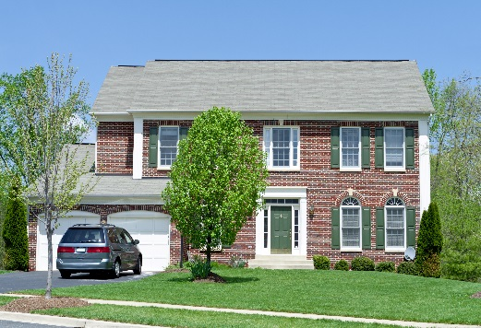
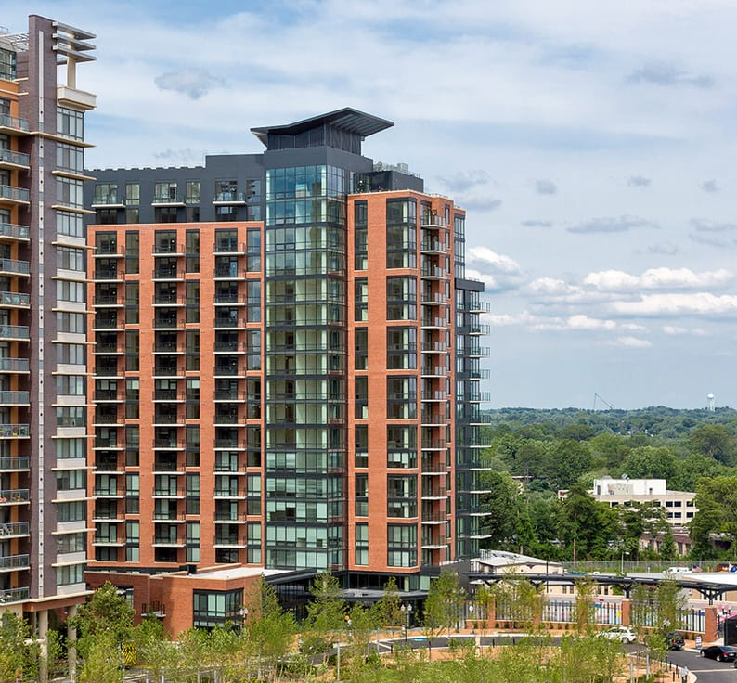
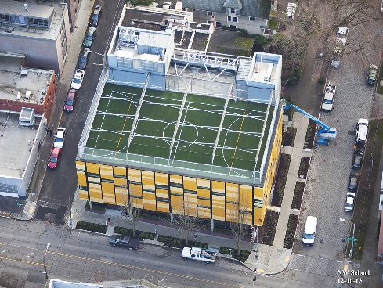
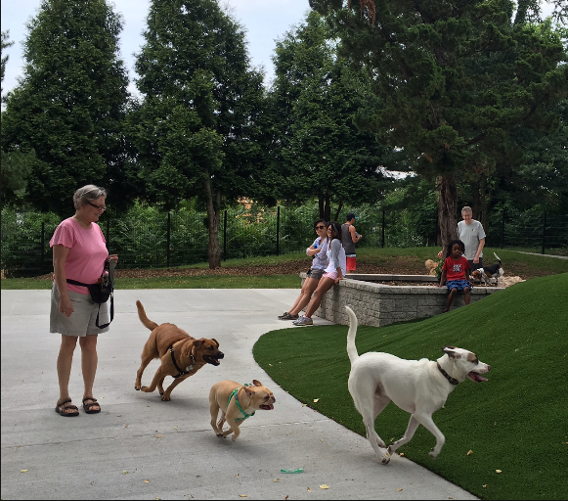
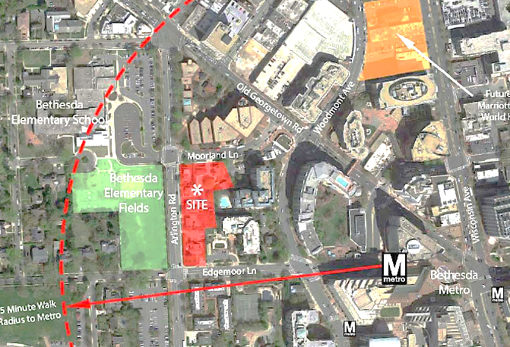
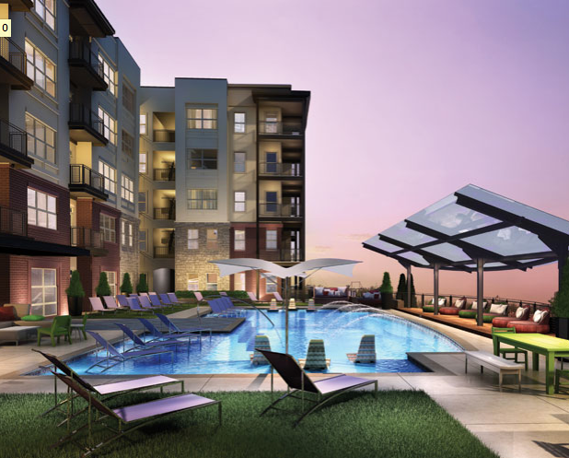
Why Update Recreational Guidelines?
Development Type Change
Urban Infill
Multi-family Housing
Schools, Amenities

Slide 4
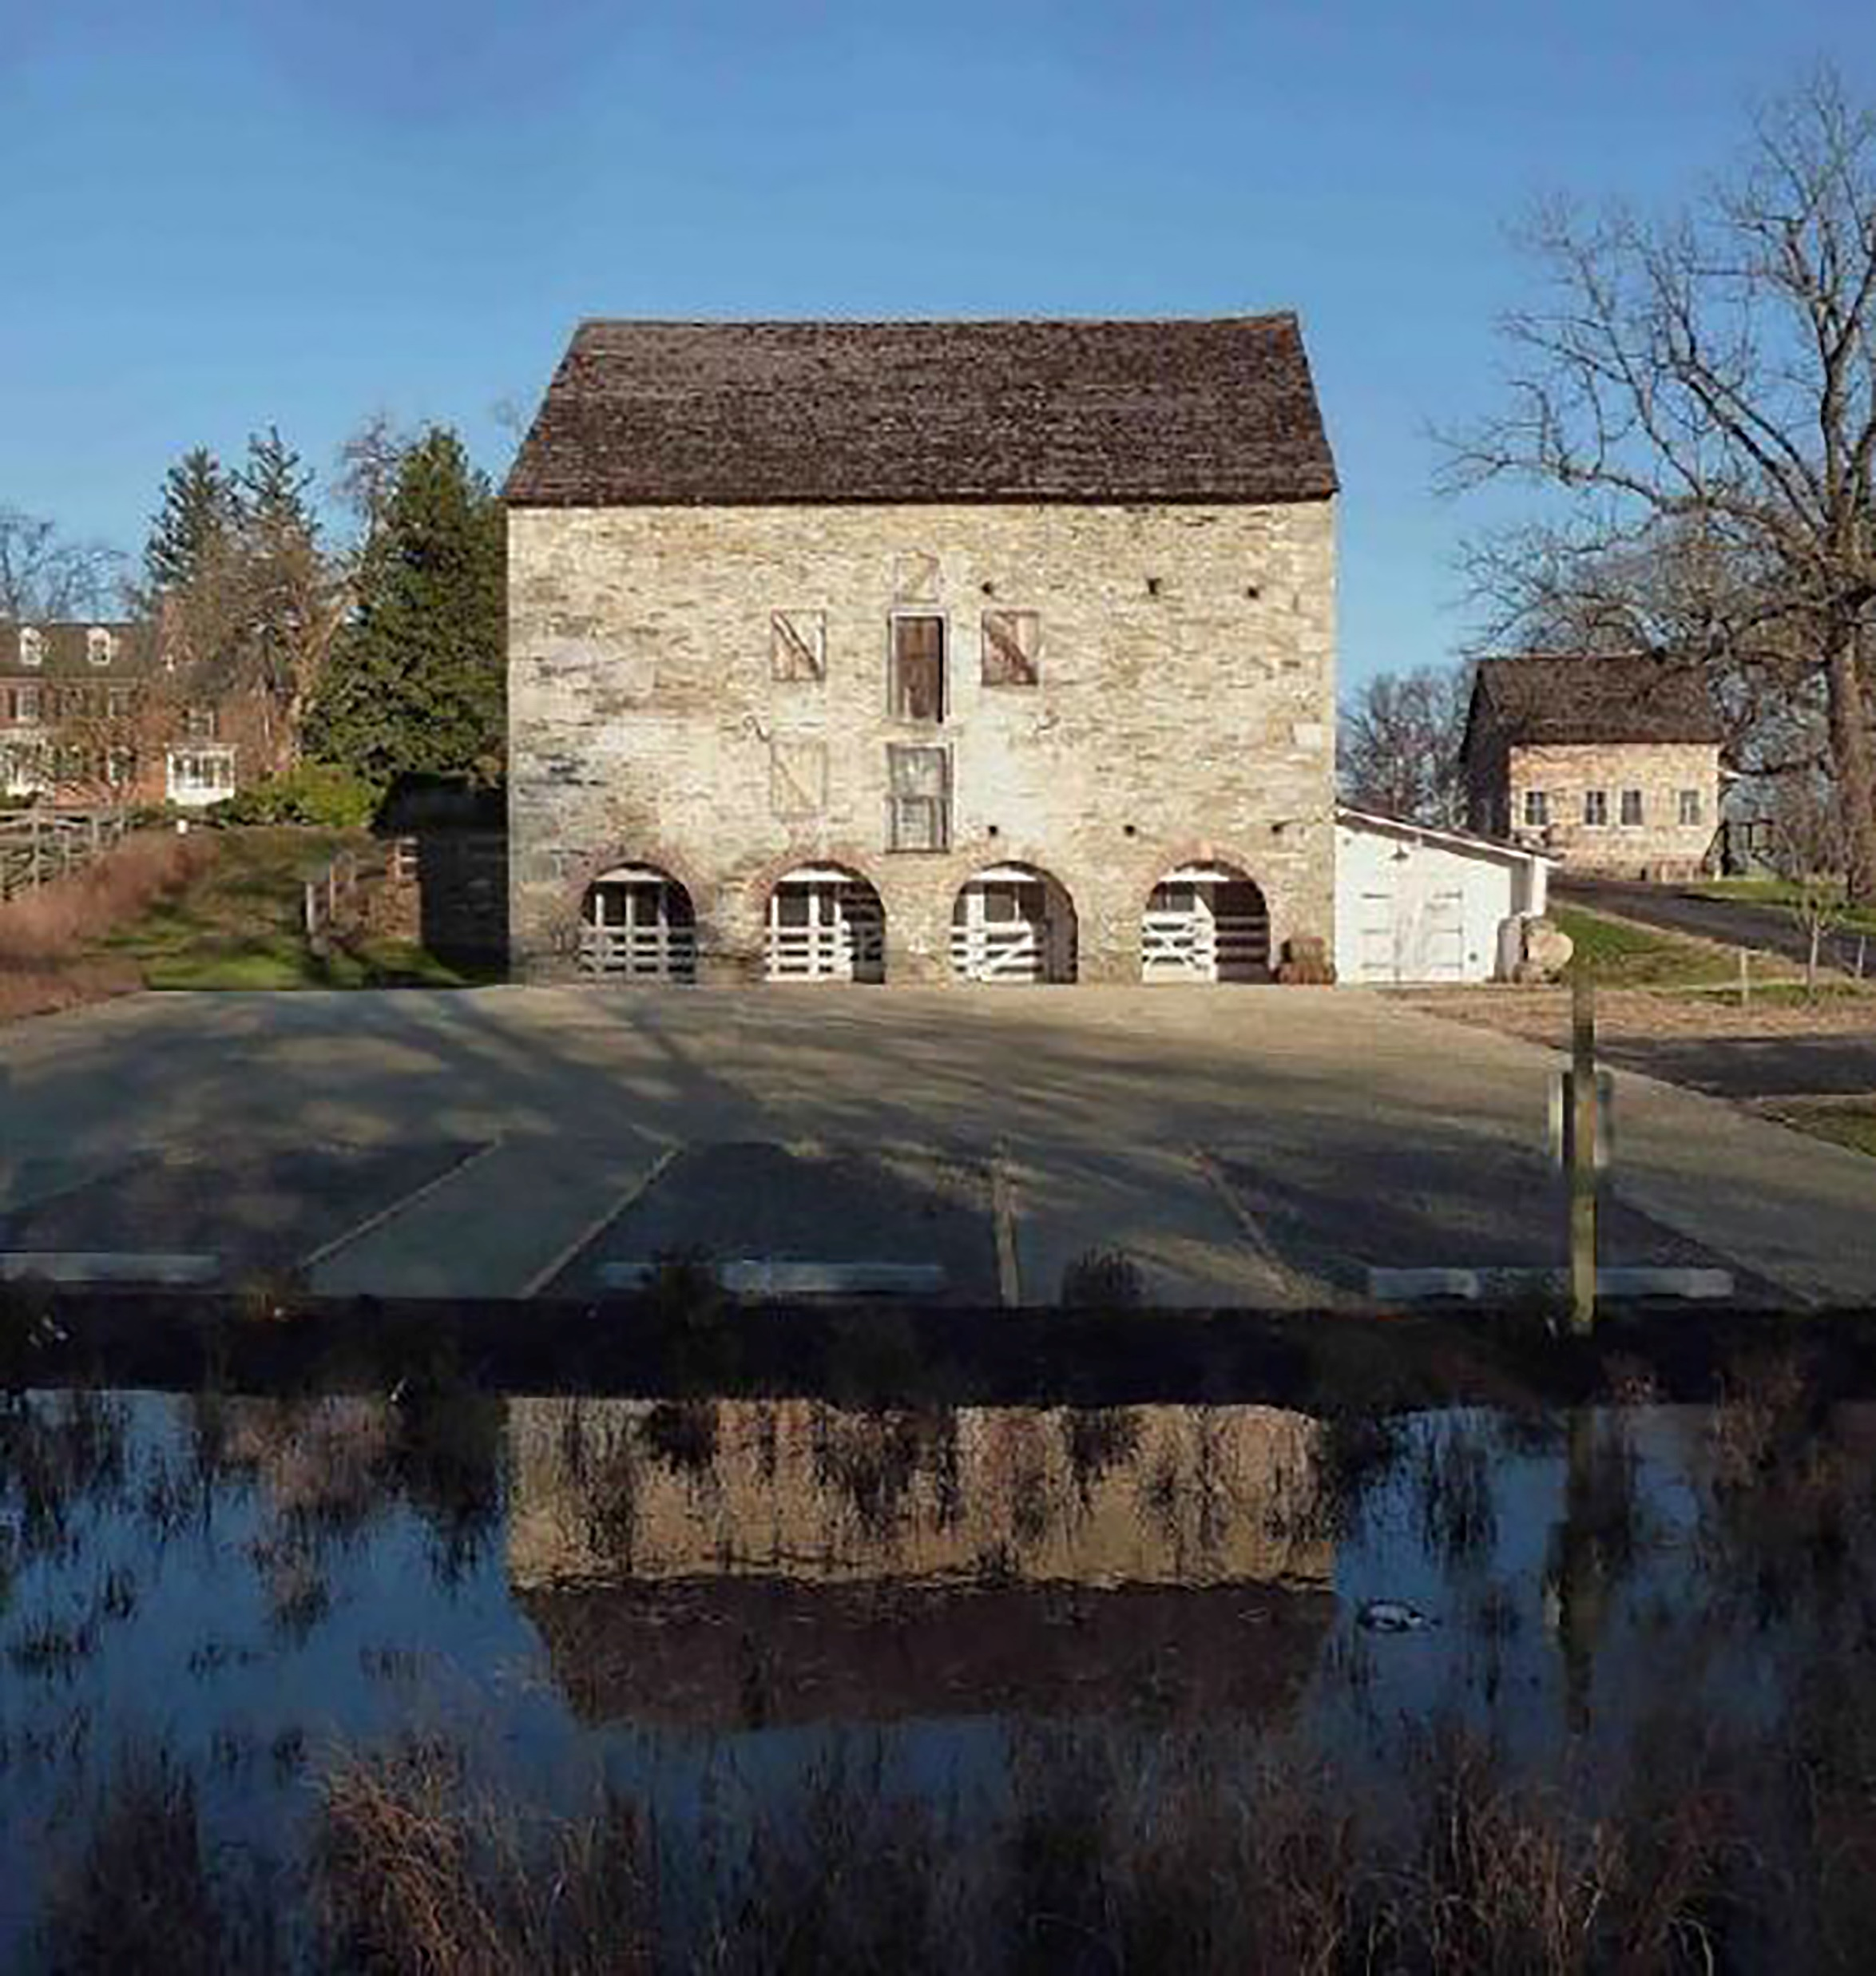
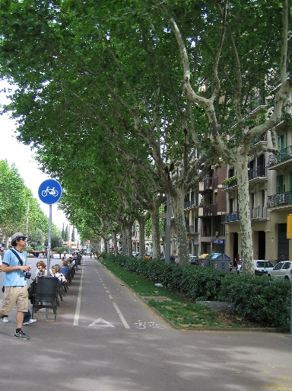
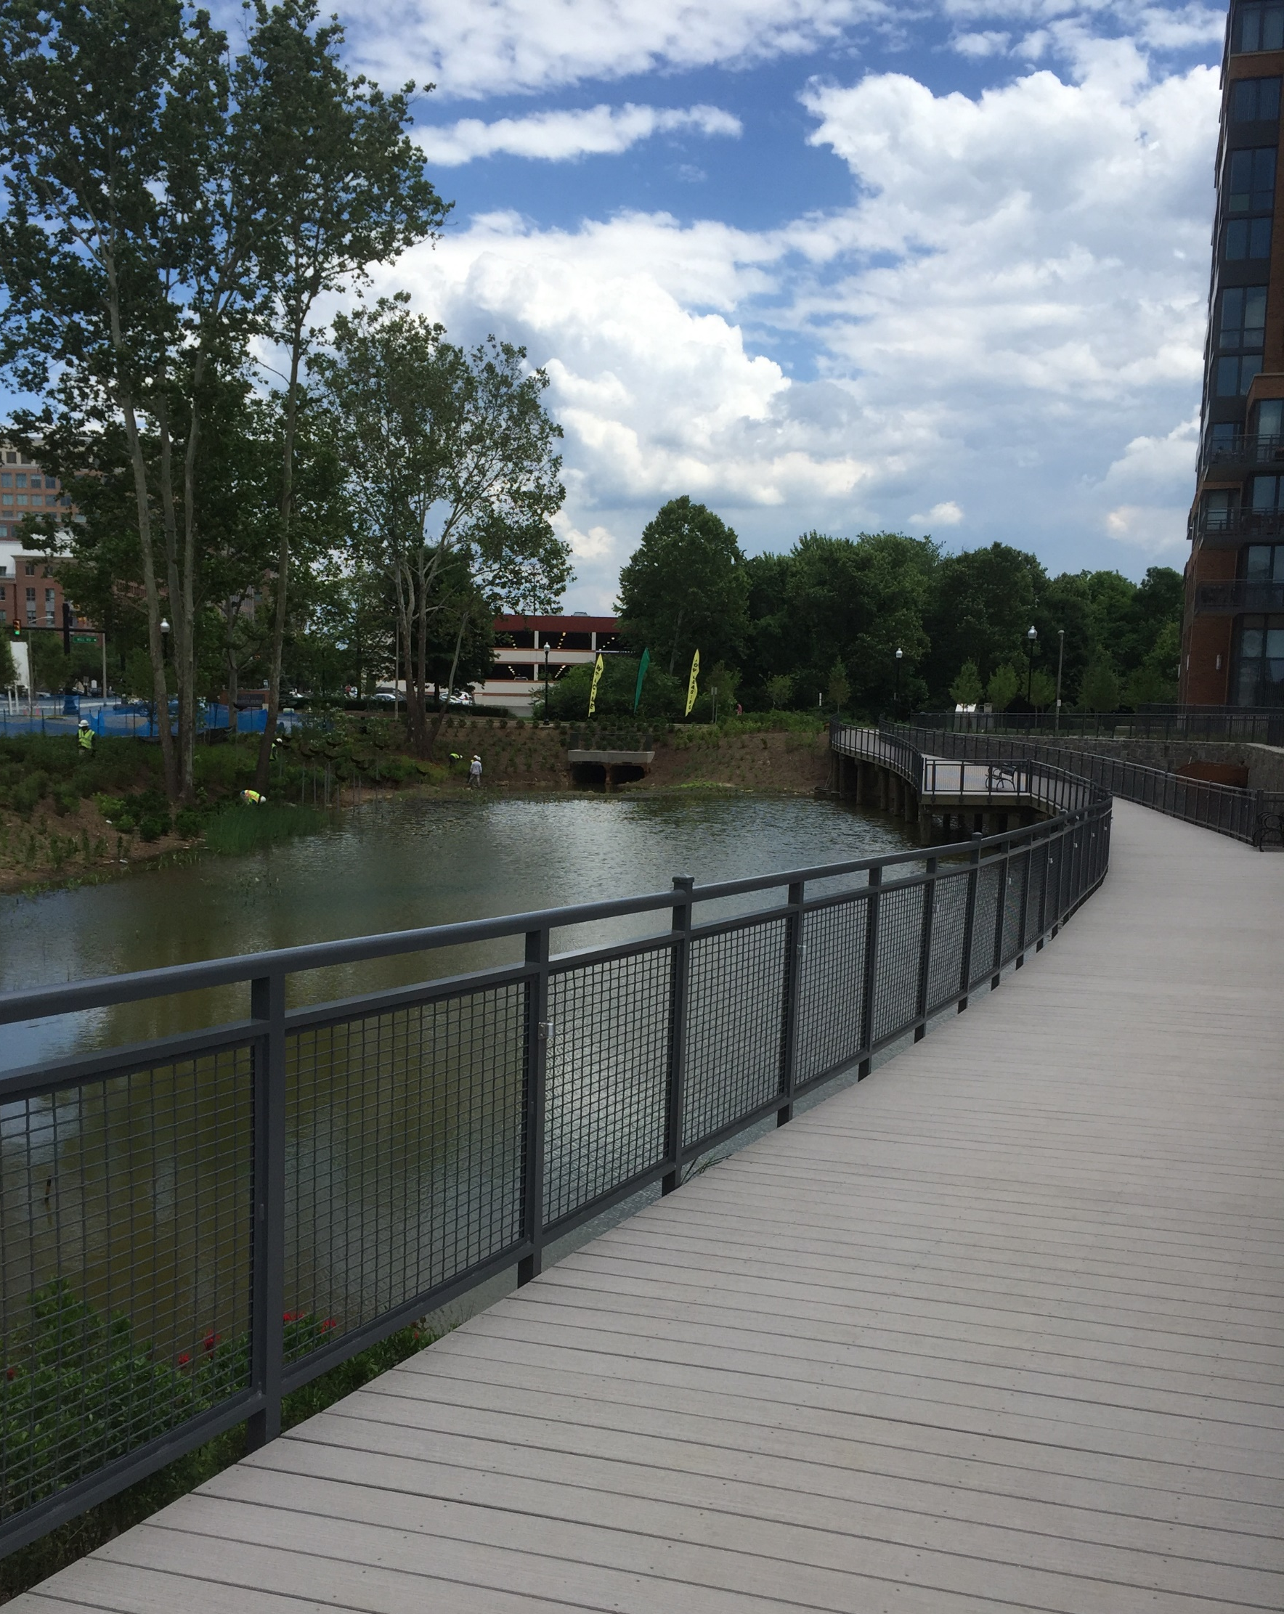
Why Update Recreational Guidelines?
Development Considerations
Infrastructure
Storm Water
Transportation
Environmental
Historic Preservation
Pedestrian Safety

Slide 5
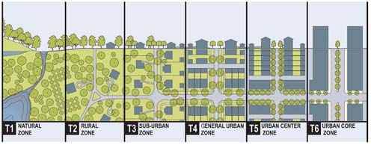
New Features of the Guidelines: Recreation Demand
Current Demographics-Based Recreation Demand
Montgomery County Demographics
from 2015 American Community Survey
Six Age Group Categories
Full Building Cycle:
Recently Built Housing (2009-2015)
Age Group Representation:
Four Housing Types in the County

Slide 6
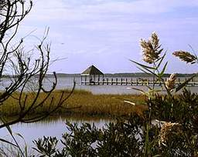
New Features of the Guidelines: Recreation Supply
Existing public facilities data:
Public Parks and Schools
Community Centers & Recreation Centers
Privately-Owned Public Spaces
Bikeways and Trails
Creation of the 10-minute walkshed
Shows distance to all accessible public
recreation facilities within ½ mile
Expanded Recreation Facility Menu
53 New Recreation Facility Types (80 Total)
Custom Rec Facility Option

Slide 7
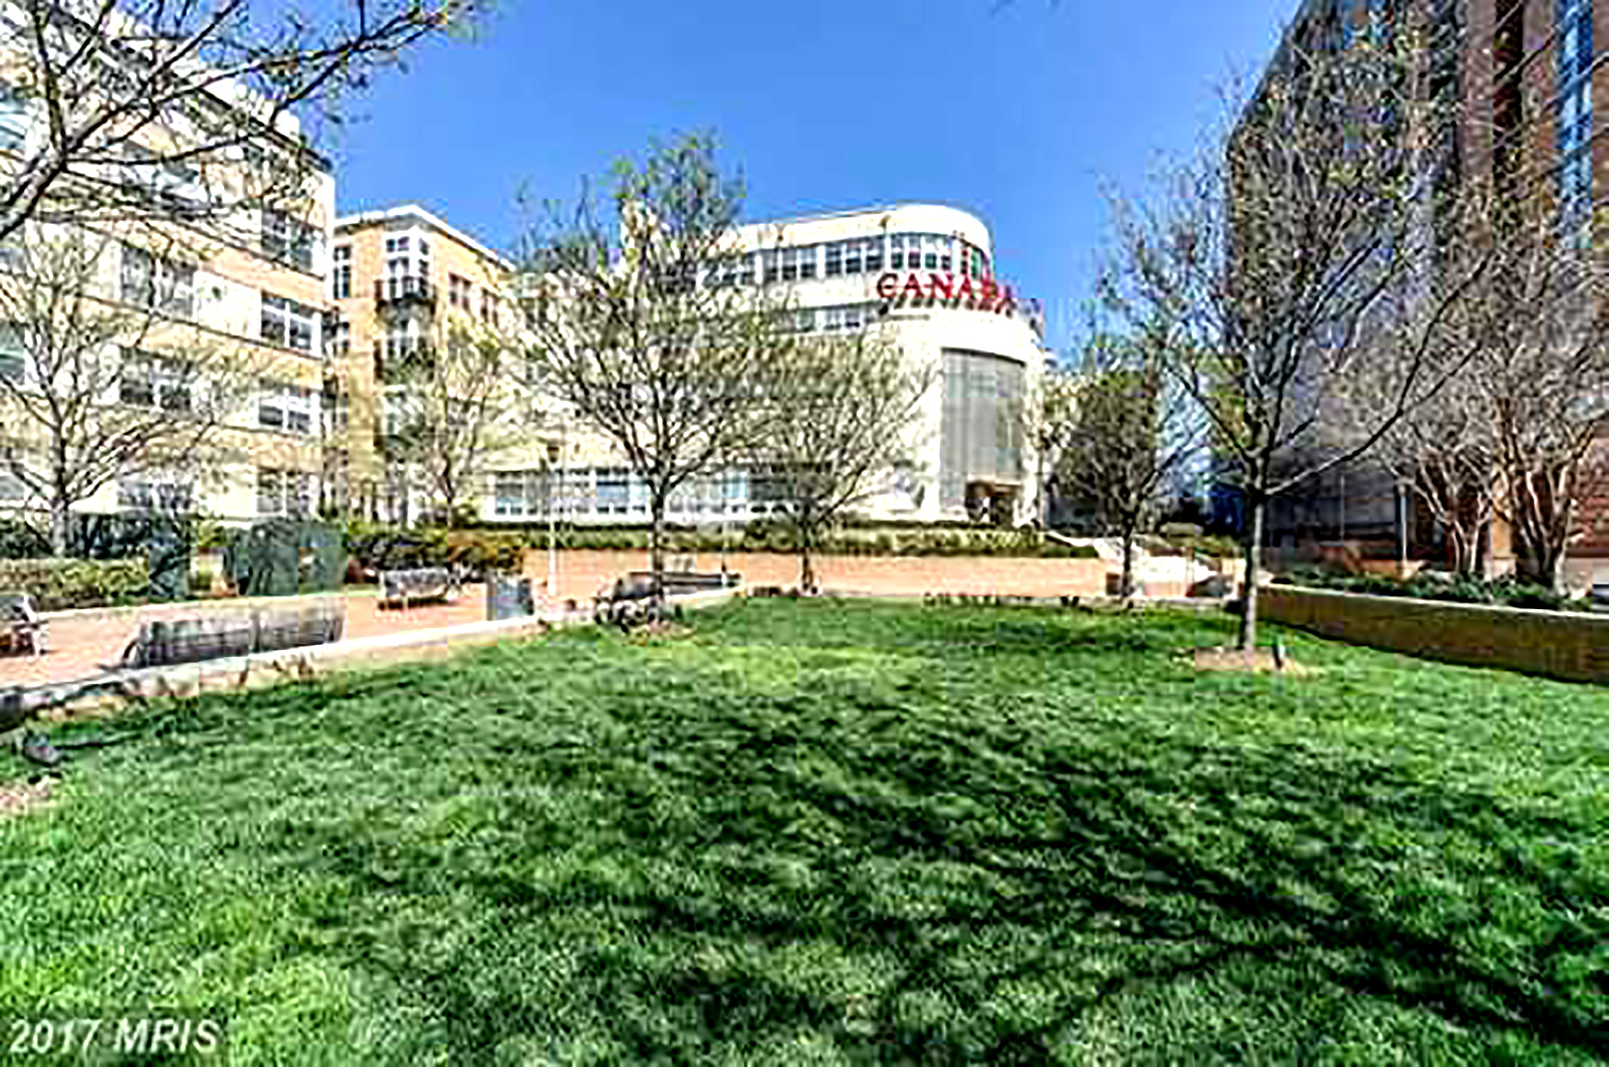
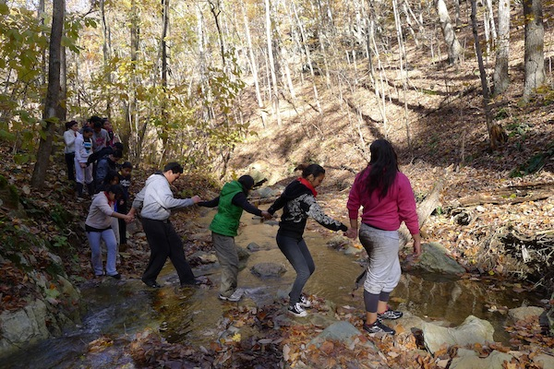
Bonus Incentives
Recommendations of the Master Plan, Sector Plan
or PROS Plan (Parks, Recreation and Open Space).
Bonus supply credit for providing master plan, sector plan or PROS plan recommendations for public open space or recreation facilities.
Co-location of Stormwater Management facilities and recreation amenities.

Slide 8
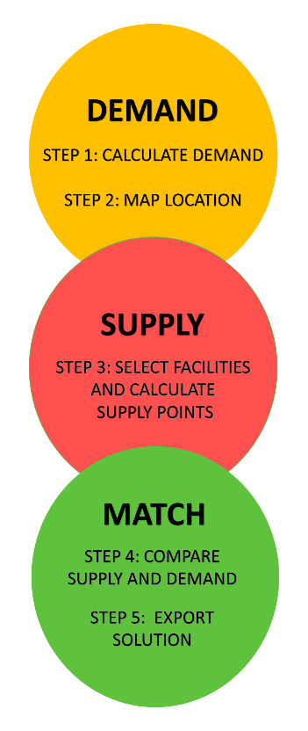
www.mcatlas.org/recreation
The Web Tool: A Point-Based System
1st Regulatory System Tool in Use!
We wanted a web tool to make this easier
Informs all supply and demand parameters
Allows for easy alternative scenario testing
Regulatory reviewers can rely on the results
Transparent process
Existing Public Amenities included for Developers
Predictable, consistent accounting
Scenario comparisons – facility choices
Geo-spatial data – location based
Master & Sector Plans: Public Recreation Open Space Plan
Notes:
Getting across the desire to streamline our regulatory process

Slide 9
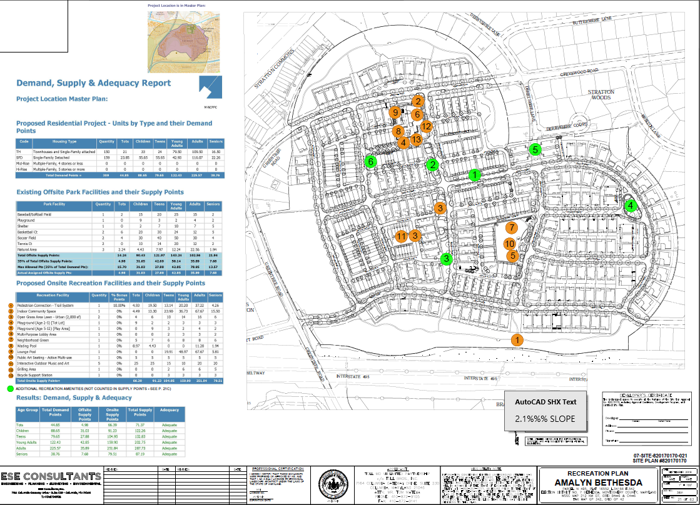
How It Works
https://mcatlas.org/recreation/Default.aspx?ScenarioId=8091
WMAL
Site Plan

Slide 10
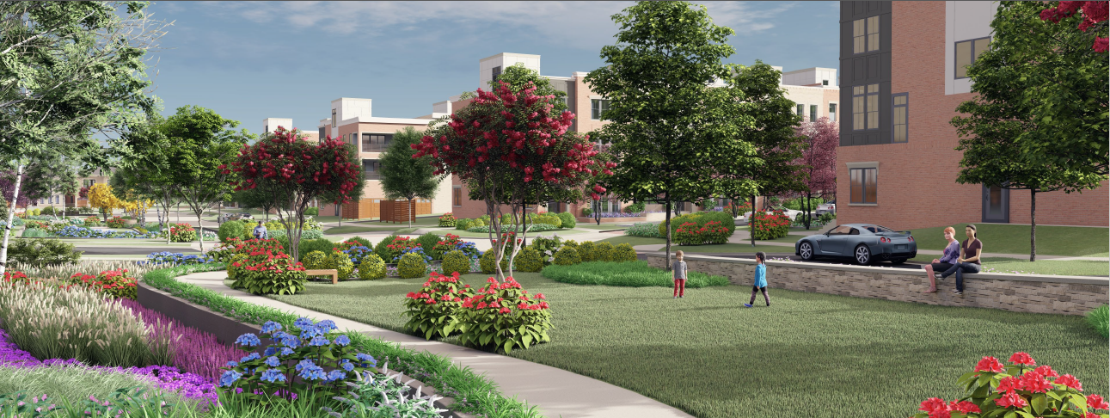
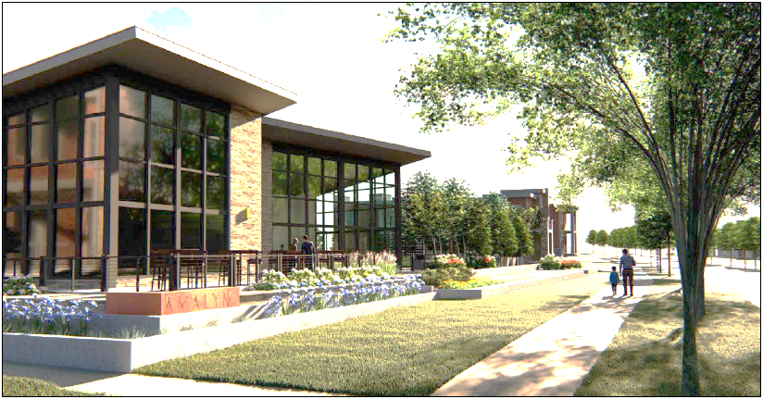
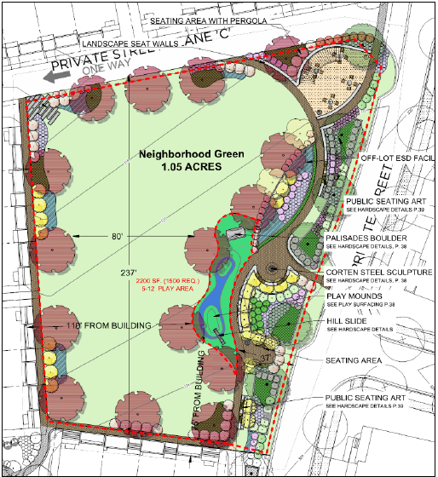
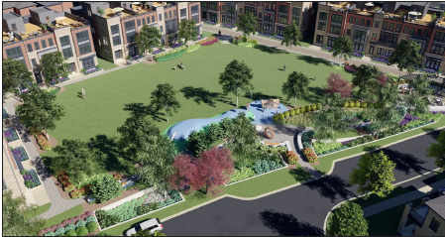
How It Works
https://mcatlas.org/recreation
WMAL Site Plan
https://mcatlas.org/recreation/Default.aspx?ScenarioId=8091

Slide 11
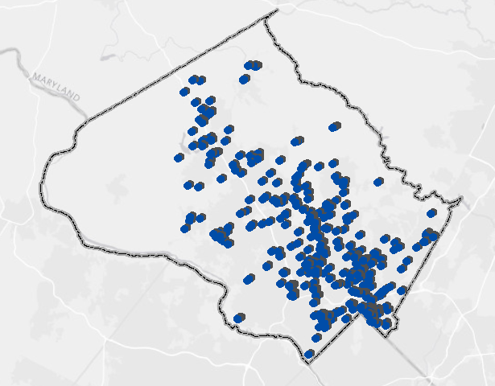
728 Web Scenarios since 2017
Recreation Plans Submitted
61 Site Plans
78 Subdivision Plans
AGRICULTURAL & RURAL OPEN SPACE | 4 |  | KENSINGTON SECTOR PLAN 2010 | 6
ASPEN HILL | 26 |  | LONG BRANCH SECTOR PLAN | 2
BETHESDA CBD MASTER PLAN | 4 |  | MASTER PLAN FOR KENSINGTON WHEATON | 28
BETHESDA CHEVY CHASE | 15 |  | MONTGOMERY VILLAGE MASTER PLAN | 13
BETHESDA DOWNTOWN PLAN | 60 |  | NORTH AND WEST SILVER SPRING(2000) | 19
BETHESDA PURPLE LINE STATION MINOR MP AMENDMENT | 4 |  | NORTH BETHESDA GARRETT PARK MASTER PLAN | 43
BOYDS MASTER PLAN | 1 |  | OLNEY MASTER PLAN | 16
BURTONSVILLE CROSSROADS NEIGHBORHOOD PLAN | 1 |  | POTOMAC SUBREGION 2002 | 65
CAPITOL VIEW & VICINITY | 2 |  | ROCK SPRING SECTOR PLAN | 18
CHEVY CHASE LAKE MASTER PLAN | 9 |  | ROCKVILLE | 13
CLARKSBURG MASTER PLAN | 19 |  | SANDY SPRING ASHTON | 2
CLARKSBURG TEN MILE CREEK LIMITED AMENDMENT | 2 |  | SHADY GROVE SECTOR PLAN | 10
DAMASCUS MASTER PLAN | 11 |  | SILVER SPRING CBD | 113
FAIRLAND MASTER PLAN | 21 |  | SILVER SPRING EAST | 10
FOREST GLEN SECTOR PLAN 1996 | 12 |  | TAKOMA PARK | 6
FOUR CORNERS | 10 |  | UPPER ROCK CREEK | 21
GAITHERSBURG | 5 |  | VEIRS MILL CORRIDOR MASTER PLAN | 1
GAITHERSBURG VICINITY | 6 |  | WESTBARD SECTOR PLAN 2016 | 5
GERMANTOWN MASTER PLAN | 6 |  | WHEATON SECTOR PLAN 2010 | 20
GERMANTOWN SECTOR PLAN | 23 |  | WHITE FLINT SECTOR PLAN | 15
GLENMONT SECTOR PLAN 2012 | 14 |  | WHITE FLINT SECTOR PLAN PHASE 2 | 14
GREAT SENECA SCIENCE CORRIDOR MASTER PLAN | 6 |  | WHITE OAK MASTER PLAN | 8
GREATER LYTTONSVILLE SECTOR PLAN | 4 |  | WHITE OAK SCIENCE GATEWAY | 4
KEMP MILL MASTER PLAN | 10 |  | WOODMONT TRIANGLE AMENDMENT | 1

Slide 12
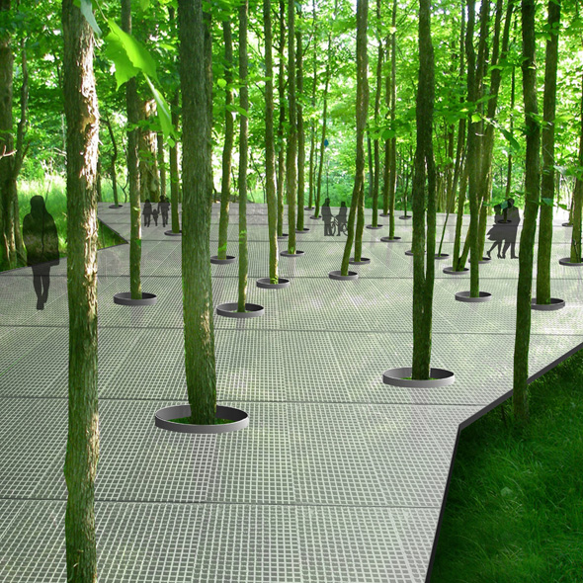
Future Enhancements
Amendments to Guidelines
New Recreation Facility Types: Urban Woodland, Recreation Pond, Fishing Pier, Pickleball Courts, etc.
Adjustment +/-of particular supply values to reflect neighborhood recreation needs.
Updating of ACS demographics.
Re-evaluation and enhancement of Public Use supply bonuses to implement Master Plan policy.
Coordination with M-NCPPC Parks Public system: Energizing Public Space.

Slide 13
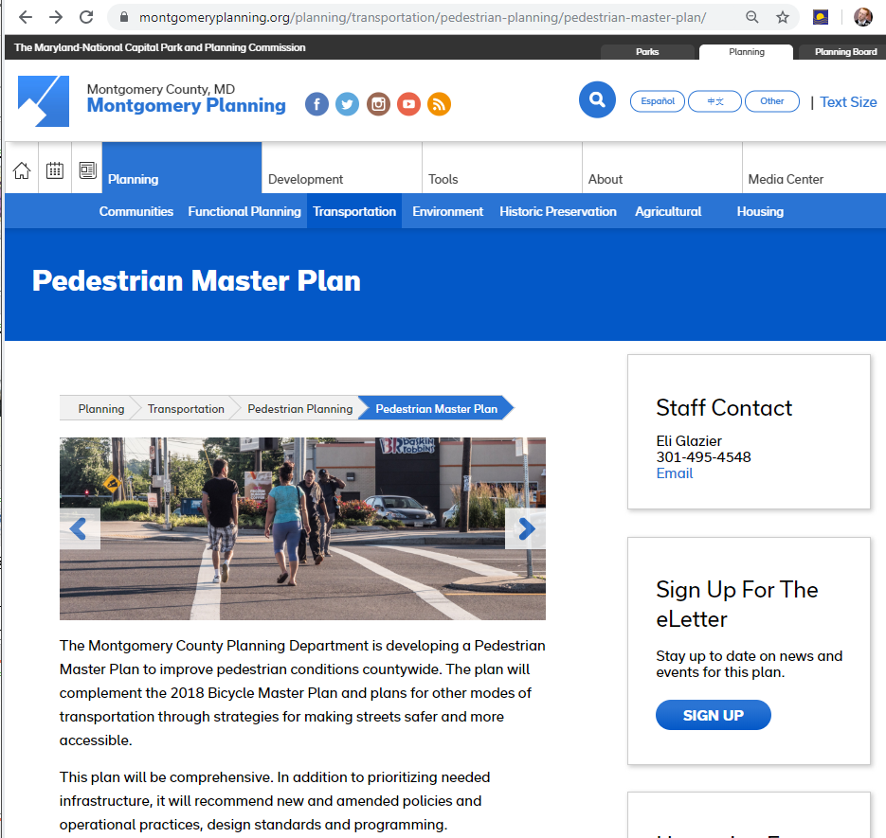
Future Enhancements
Walkshed Integration
with Pedestrian Plan
Currently usable walking network is distance based: a ½-mile walkshed is assumed to represent a 10-min walkshed.
The new walking network integrated with the Pedestrian Master Plan will enable time-based walksheds to reflect actual pedestrian walk time.
Mapping every crosswalk, path or sidewalk.
Setting time sinks where appropriate for intersection walk signals, etc.

Slide 14
END

Slide 15
What are Rec guidelines
Update – history and why
##Updated and New stuff
Custom Facility tool vs Amenity list
Public Use bonus
Stormwater co-location
MP bonus capability
Demo
How has it gone so far
Stats
Narrative
Future
##Changes public use bonus, additional facilities, tweak supply value on benches
Walkshed improvements via current Planning Pedestrian Plan

Slide 16
Demonstration – How it works
Link: https://mcatlas.org/recreation
4 steps –
establish project demand
Establish Site and existing public amenities
Select additions from facility menu
Facility List and Custom Facility
Scenario ID, Bookmarks, Cloning scenarios
Bookmark scenario: https://mcatlas.org/recreation/Default.aspx?ScenarioId=10487
Report

Slide 17
www.mcatlas.org/recreation
Web Tool Design: Step 1
Demand: # Dwelling Units, Housing Types, Age Groups

Slide 18
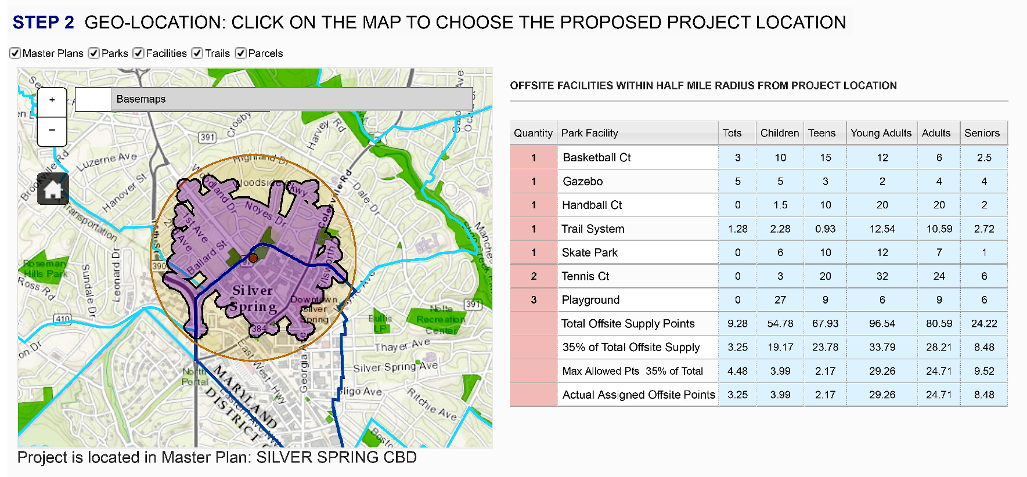
www.mcatlas.org/recreation
Web Tool Design: Step 2
Geolocation
Existing Public Facilities: Parks, Recreation

Slide 19
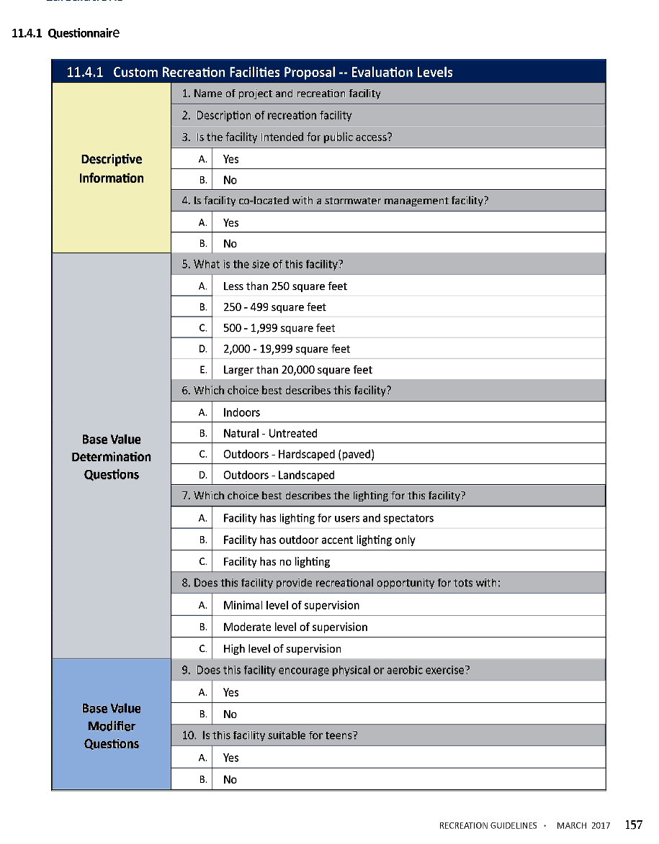
Deriving Recreation Demand Points
Incentives for Providing Public Facilities
Custom Facilities
Allows developers or owners to propose new facilities types

Slide 20
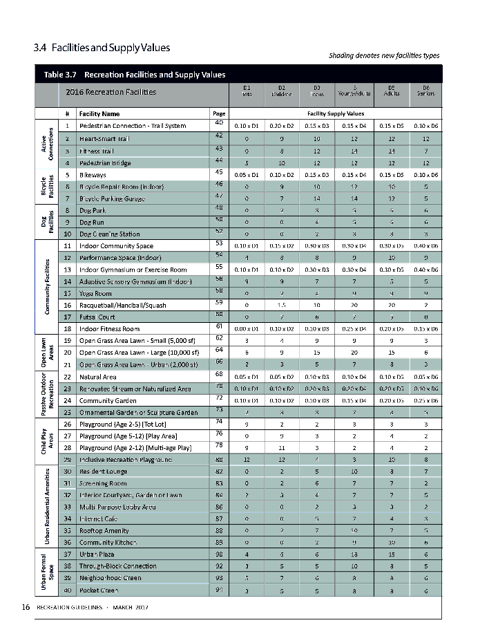
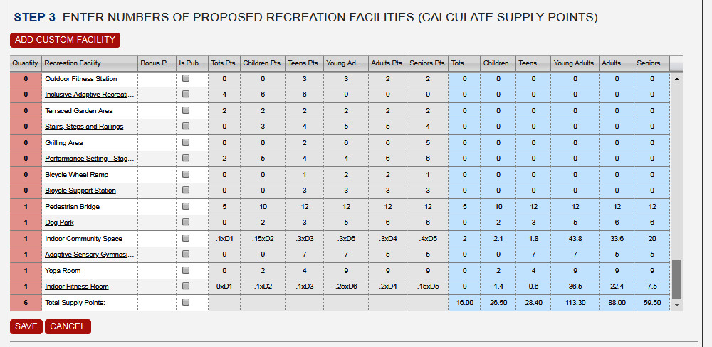
www.mcatlas.org/recreation
Web Tool Design: Step 3
Recreation Facilities Proposed

Slide 21
www.mcatlas.org/recreation
Web Tool Design: Step 4
Export Results to Report

