Slide 1
AR Solar availability Soils Discussion
July 15, 2020

Slide 2
USDA Soil survey – Prime Farmland
https://www.nrcs.usda.gov/Internet/FSE_DOCUMENTS/nrcseprd1338623.html
For each County, the USDA soil survey categorizes each soil type in that county as:
Prime Farmland
Farmland of Statewide importance
Not prime farmland
Each soil is also designated with a production category 1,2,3,4 +
All Prime Farmlands are in category 1-3
Not all category 1-3 soils are prime farmland.

Slide 3
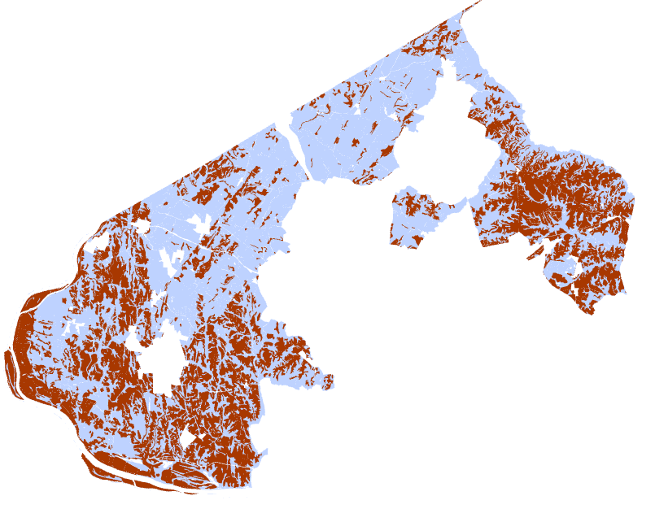
Version1 - Prime Farmland in AR
AR lands (blue) = 102k ac.
USDA Prime Farmland in AR (red) = 38,739 ac.
Removes 38% of AR land
470 parcels remain with at least 15 ac.

Slide 4
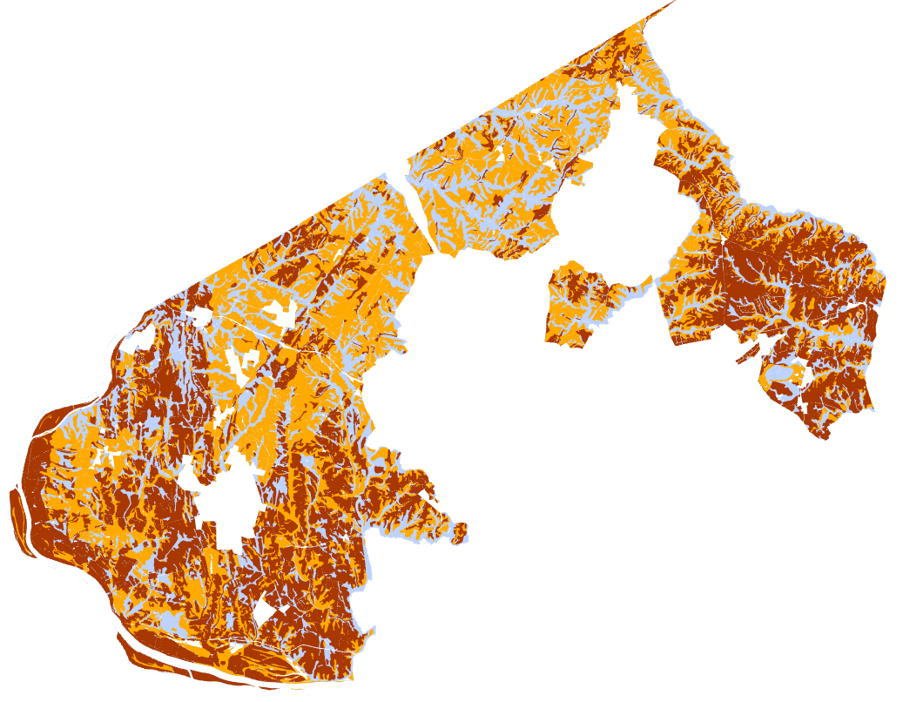
Version2 - Prime Farmland and Farmland of Statewide Importance in AR
AR lands (blue) = 102k acres
USDA Prime Farmland in AR (red) = 38,739 ac.
USDA Farmland St Importance (orange) = 38,390 ac.
Removes 75.6% of AR land
427 parcels remain with at least 15 ac.
299 privately owned parcels remain with 15+

Slide 5
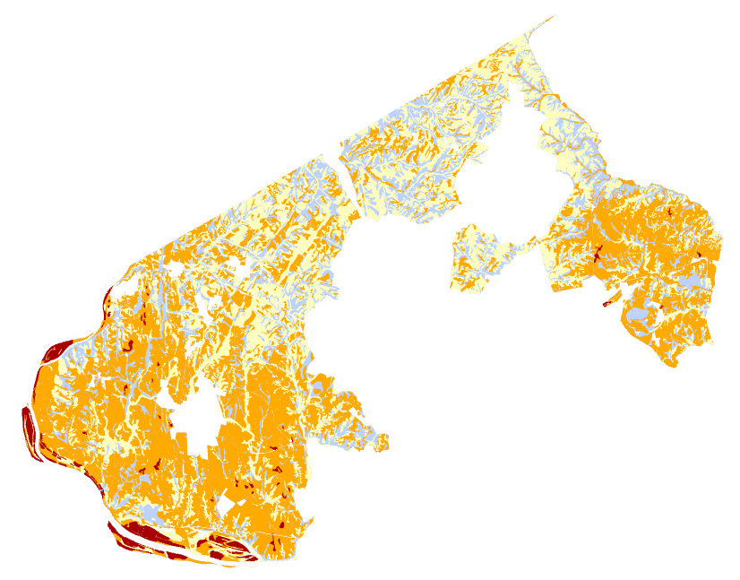
Version3 – All soils with production category 1,2,3
AR lands (blue) = 102k ac.
Cat1(red) 2,371ac.
Cat2 (orange) 47,607ac.
Cat3 (yellow) 32,468ac.
Removes 80.3% of AR land
321 parcels remain with at least 15 ac.
227 privately owned parcels remain with 15+

Slide 6
https://montgomeryplans.org/portal/apps/webappviewer/index.html?id=aebeb7bae0ac4f97b95c909156f47138
Map Viewer link – contains three versions of soils, power company service areas, and other restricting boundaries.

