Slide 1
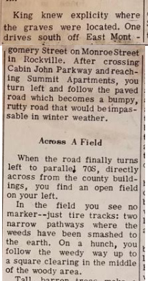
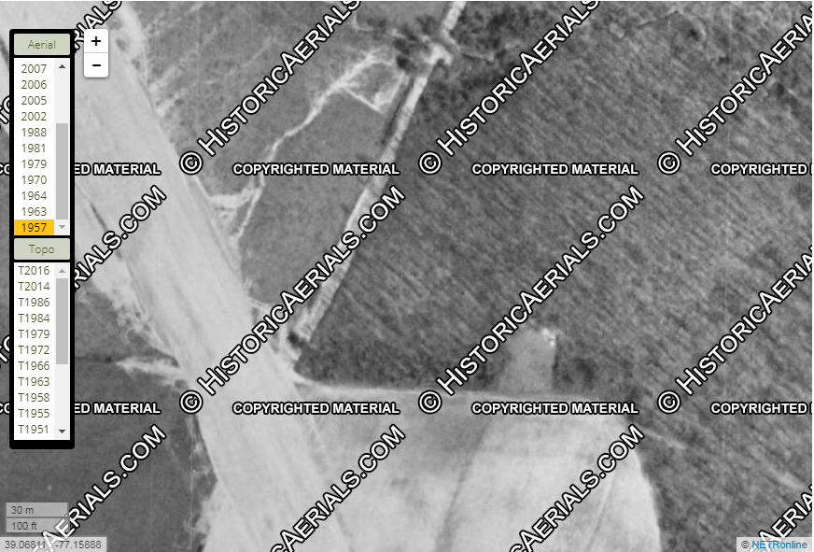
Monroe Street
Square clearing
In the middle of the woody area.
County
buildings/ jail
70S/I-270
Open field

Slide 2
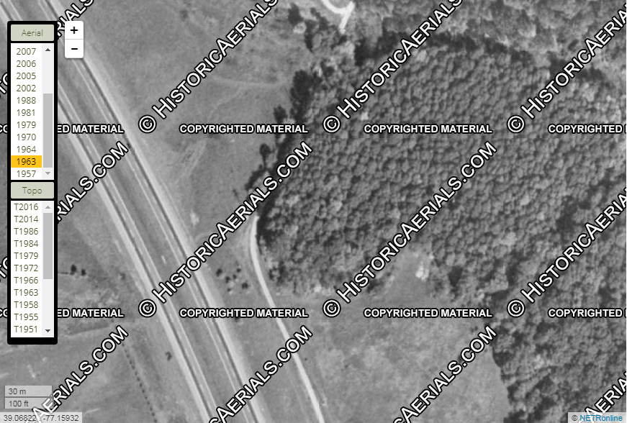

Slide 3
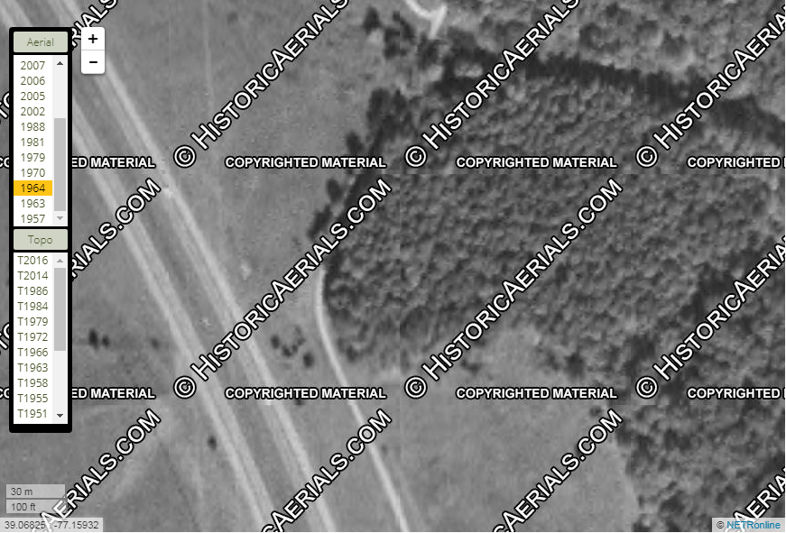

Slide 4
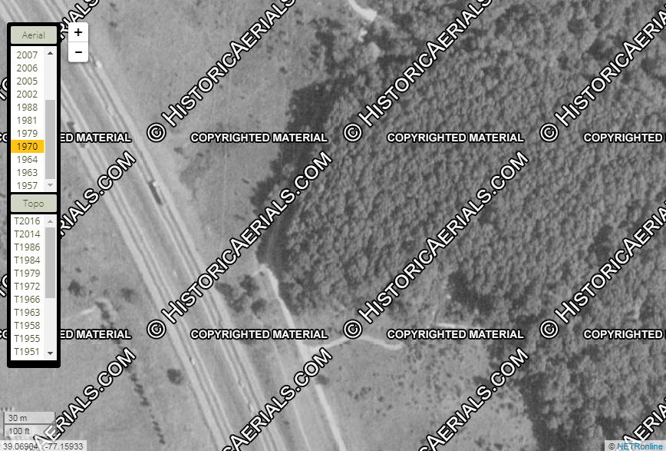

Slide 5
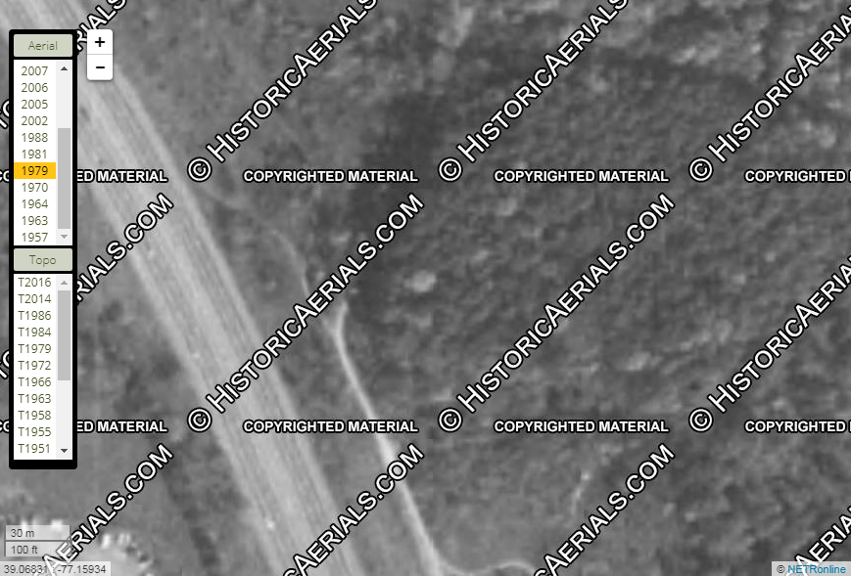

Slide 6
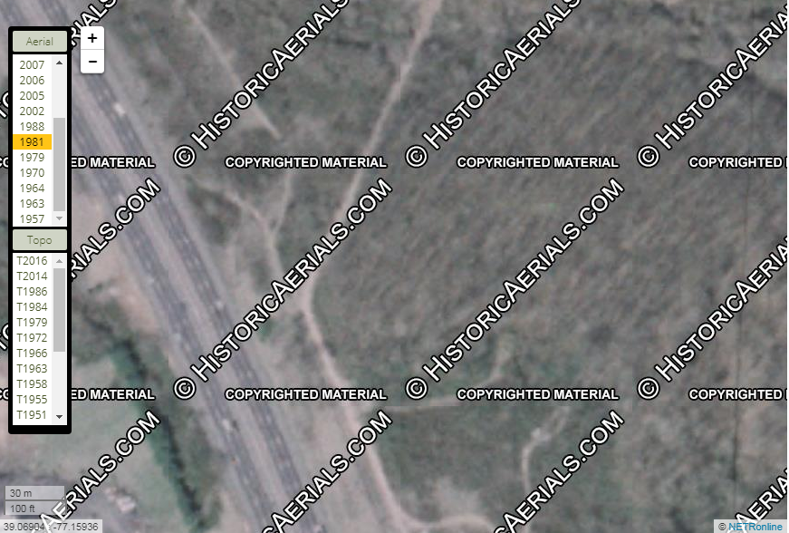

Slide 7
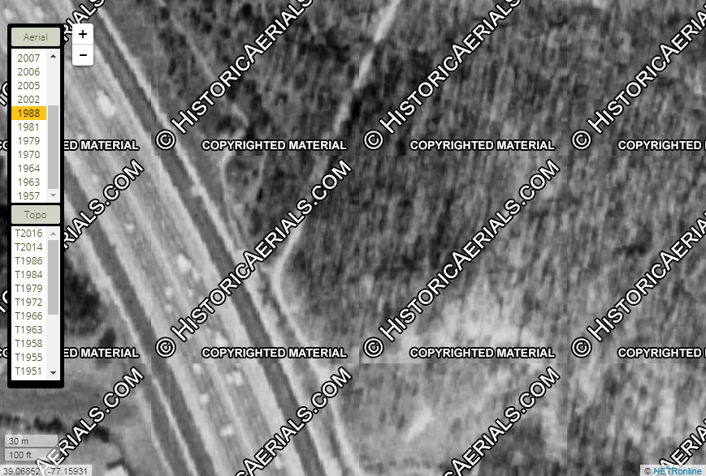

Slide 8
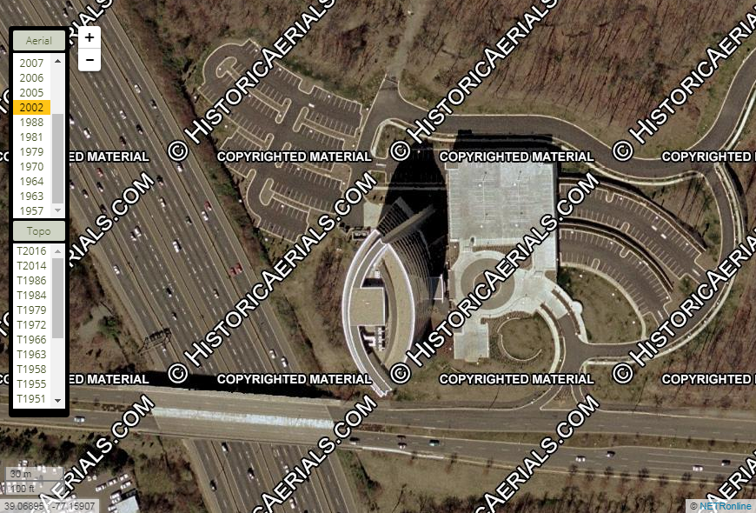
Monroe Street

Slide 9
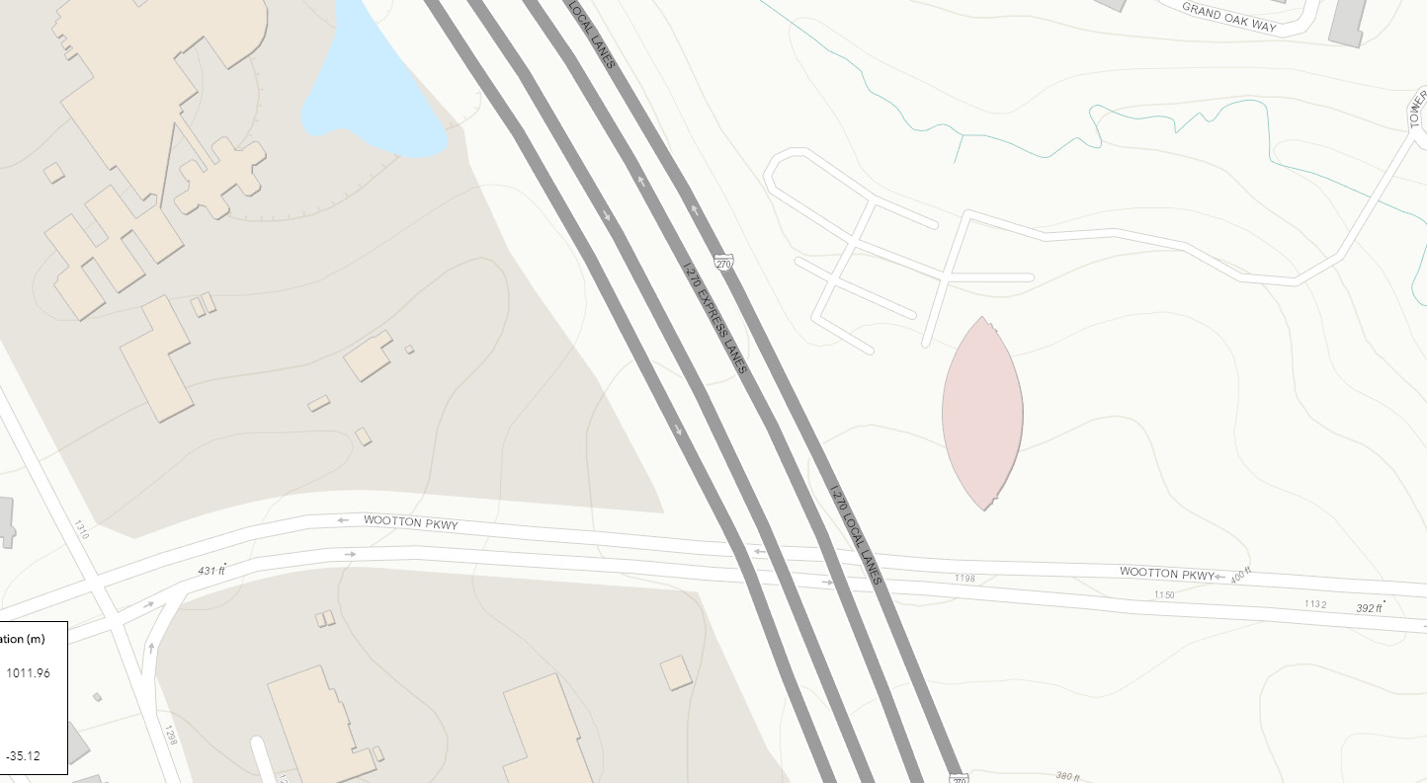
360’
370’
380’
390’
400’
430’
420’
410’
400’
390’
https://geodata.md.gov/topoviewer/

