Slide 1
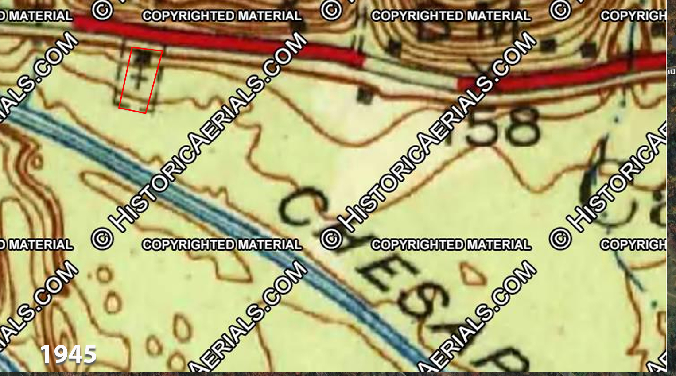
Mt. Glory Baptist Church, Cabin John, MD (# 226)
Mt. Glory Bapt. Church

Slide 2
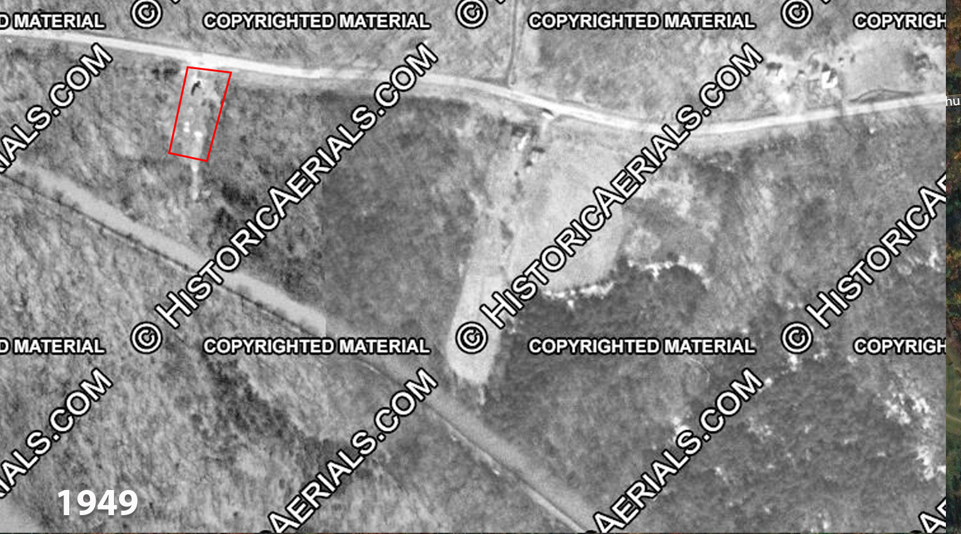
Mt. Glory Baptist Church, Cabin John, MD (# 226)
Mt. Glory Bapt. Church

Slide 3
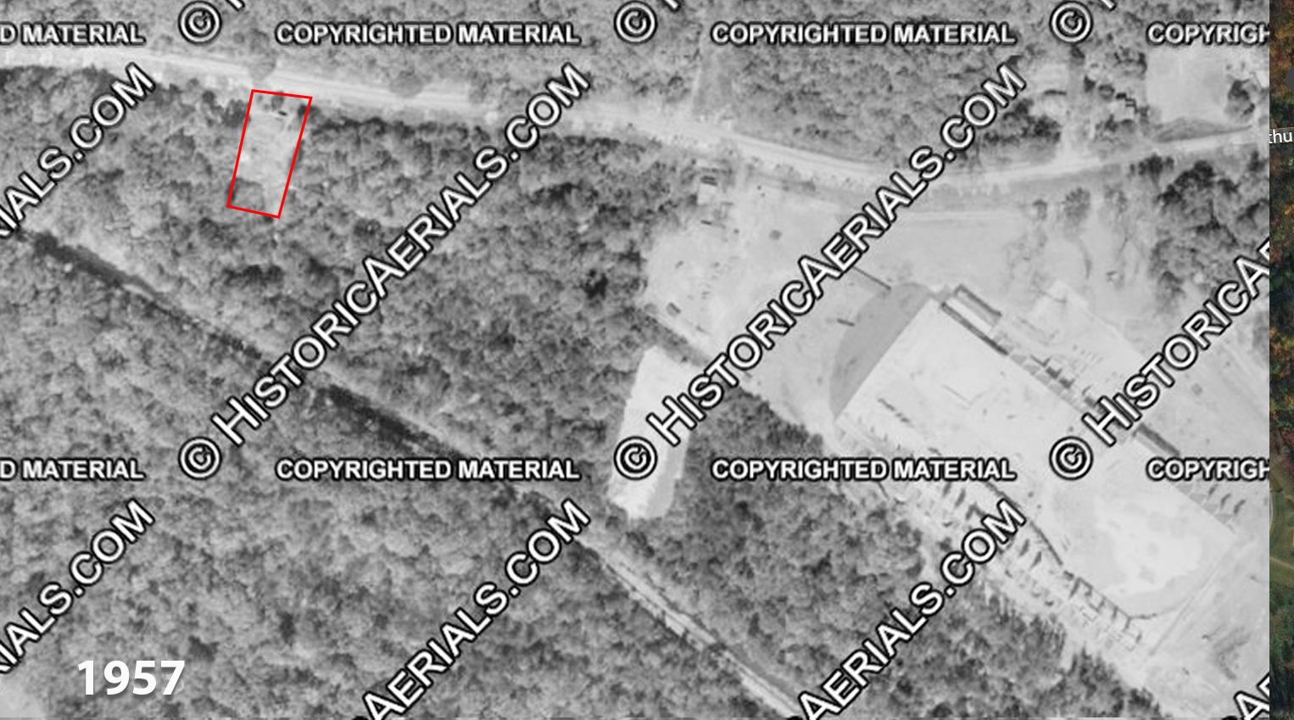
Mt. Glory Baptist Church, Cabin John, MD (# 226)
Church is gone

Slide 4
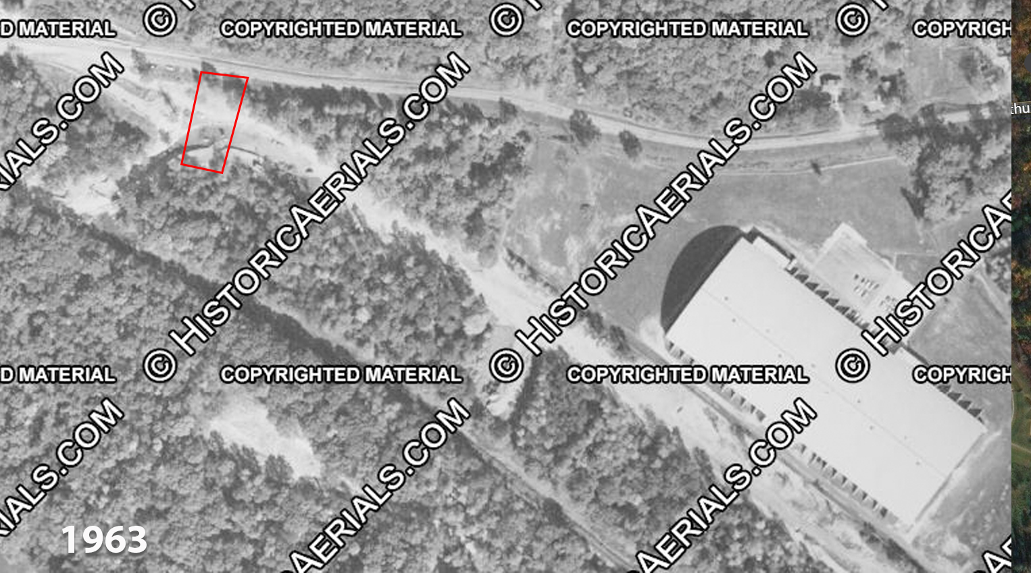
Mt. Glory Baptist Church, Cabin John, MD (# 226)

Slide 5
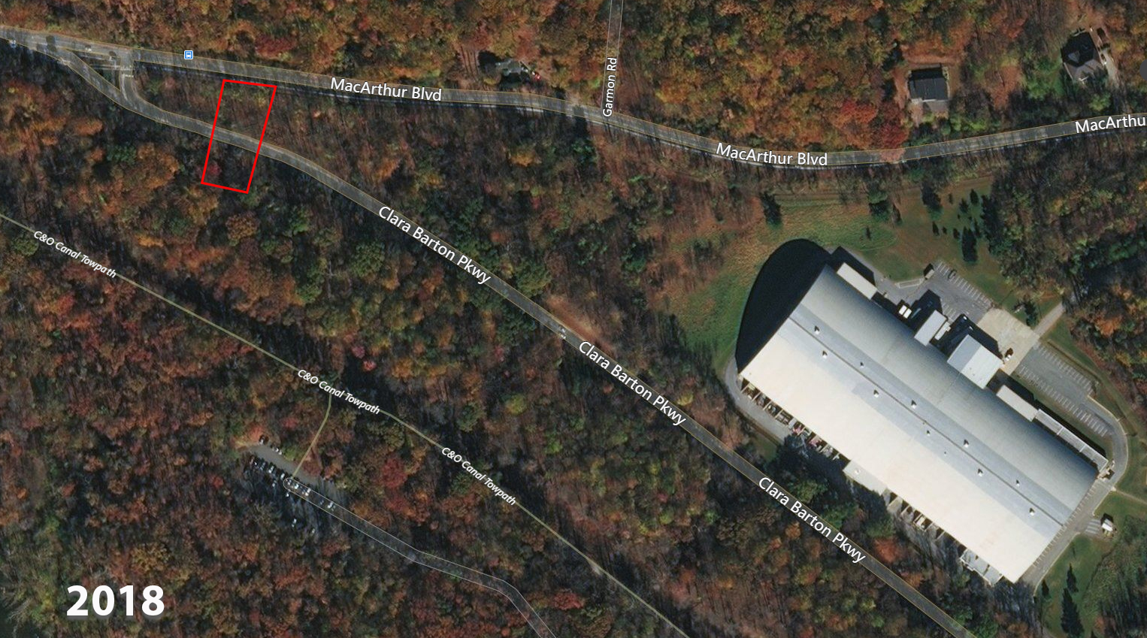
Mt. Glory Baptist Church, Cabin John, MD (# 226)
Residence

Slide 6
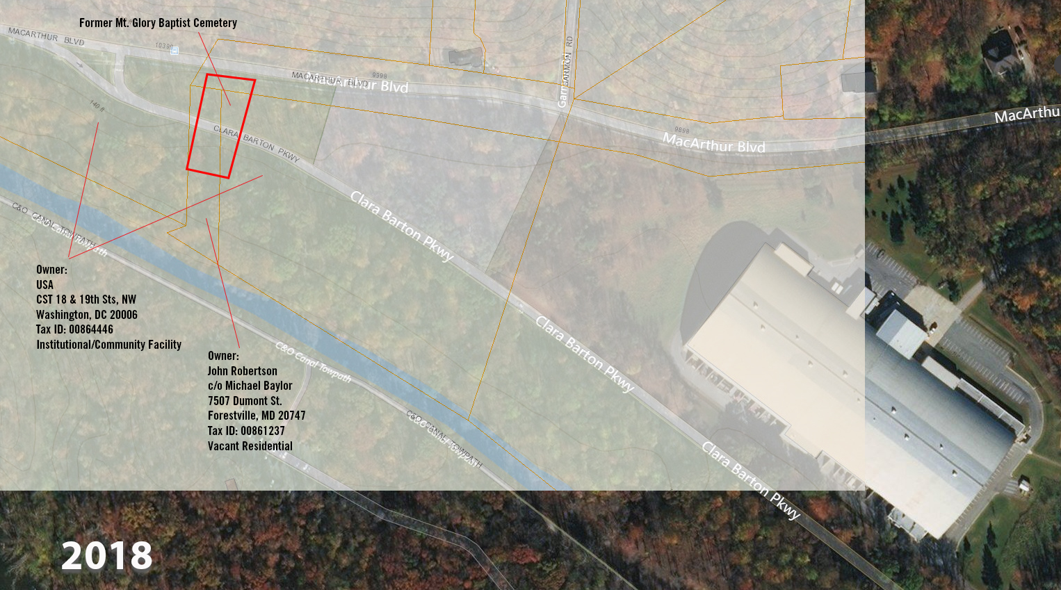

Slide 7
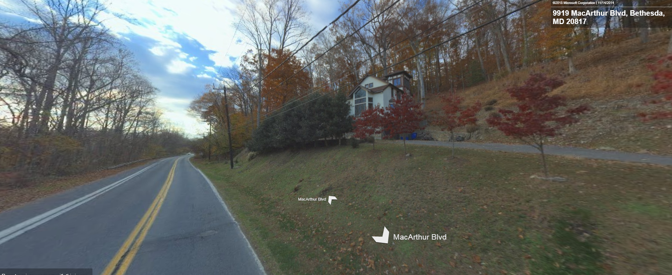
Former location of
Mt. Glory Baptist Church
Cemetery
Former location of
Mt. Glory Baptist Church

Slide 8
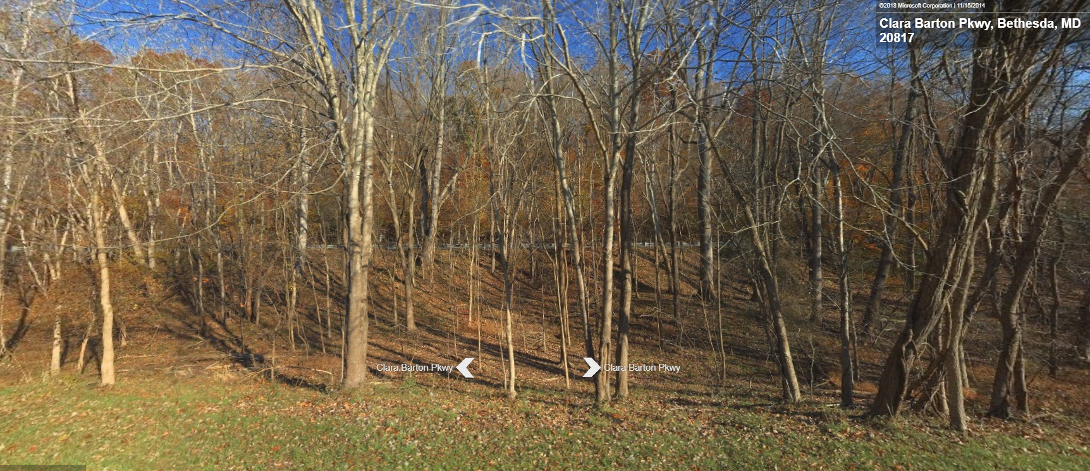
Former location of
Mt. Glory Baptist Church
Cemetery

