Slide 1
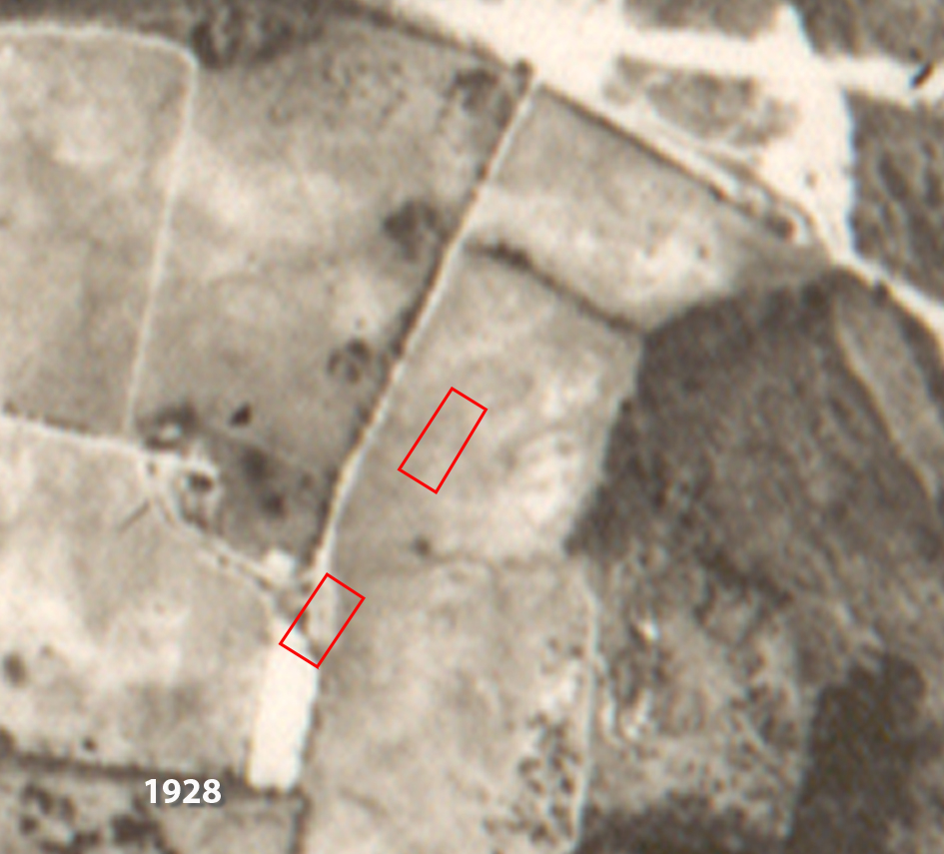
Posey-Busey Family Cemetery
Bethesda, MD
(#282)

Slide 2
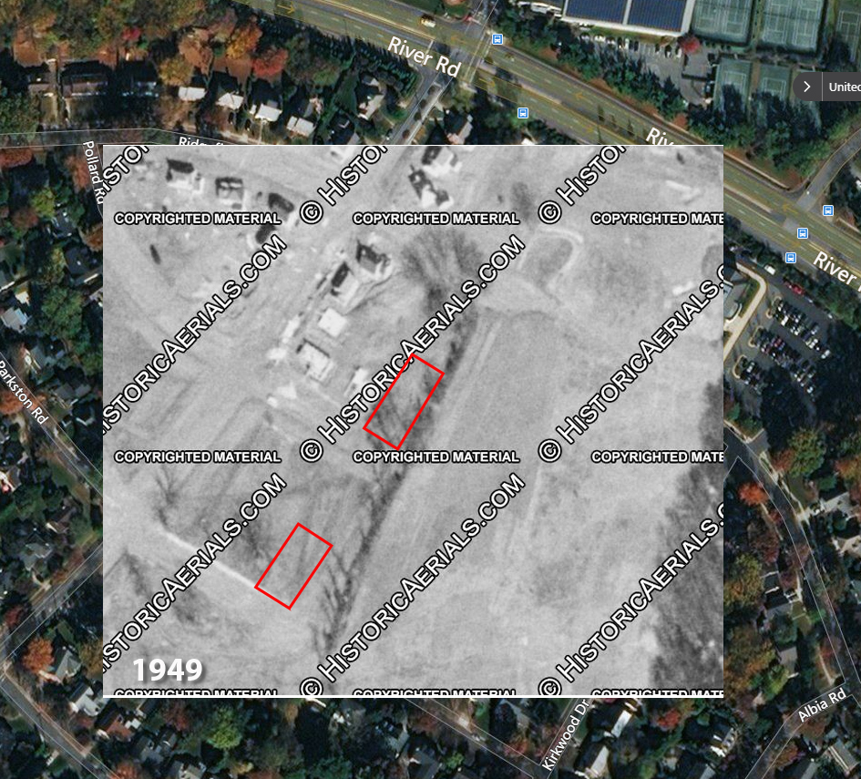
Posey-Busey Family Cemetery
Bethesda, MD
(#282)

Slide 3
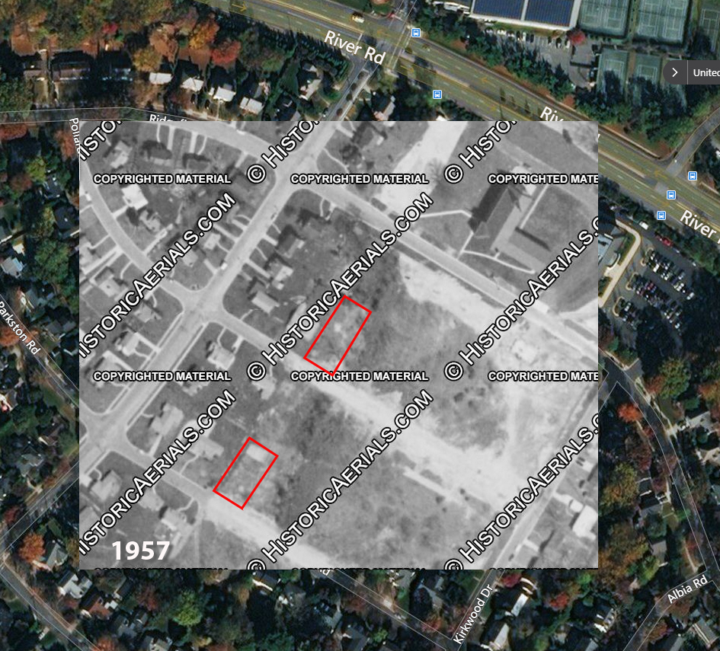
Posey-Busey Family Cemetery
Bethesda, MD
(#282)

Slide 4
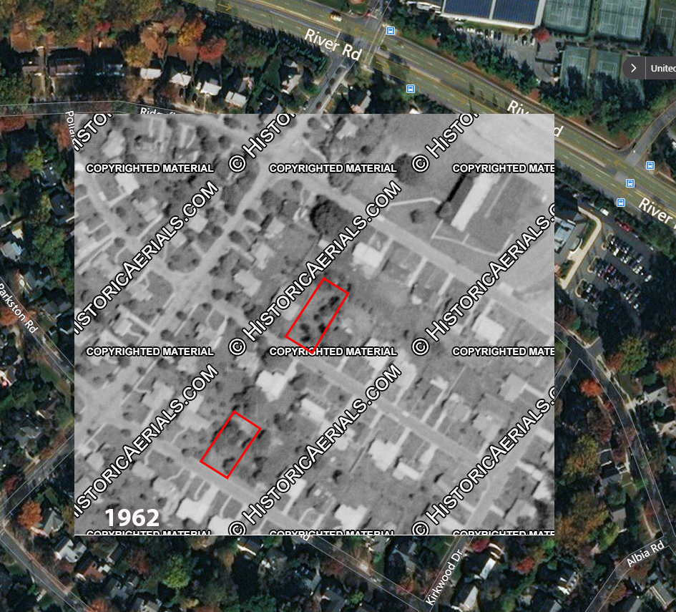
Posey-Busey Family Cemetery
Bethesda, MD
(#282)

Slide 5
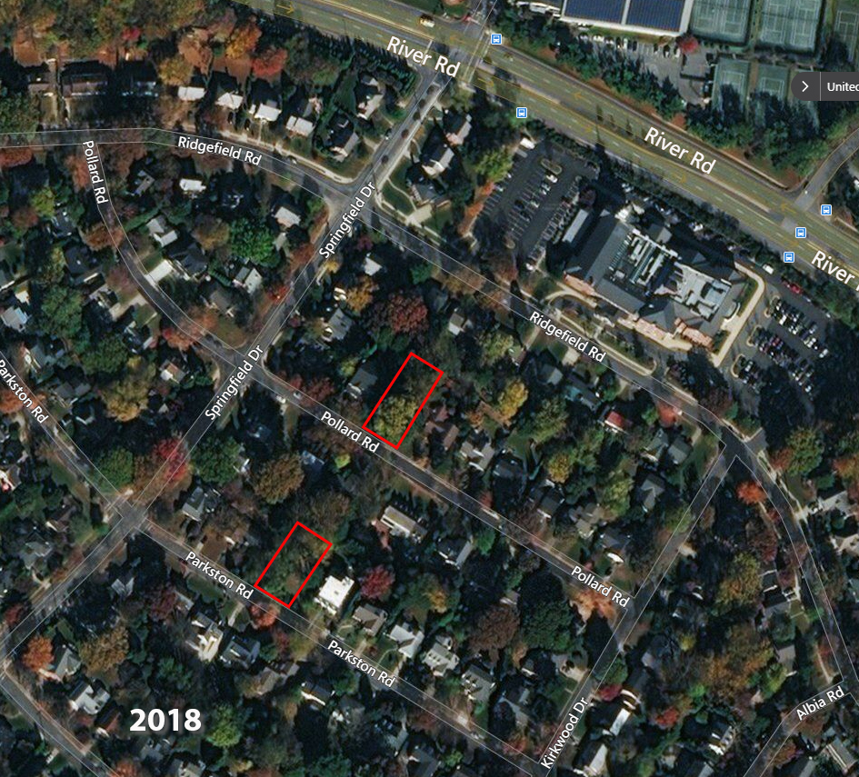
Posey-Busey Family Cemetery
Bethesda, MD
(#282)

