Slide 1
MNCPPC Tree Canopy Dataset Summary
November 22, 2021

Slide 2
Workflow

Slide 3
Tree Canopy Assessment Workflow
Not part of the current project scope
Resource Management
Data Preparation
Mapping
Analysis
Reporting
Decision Support
Prepare the data for mapping and analysis.
Map tree canopy change.
Compute the tree canopy change at various units of analysis.
Summarize the findings.
Aid decision-makers in interpreting the data.

Slide 4
Data Preparation

Slide 5
LiDAR point clouds are processed to generate surface models

Slide 6
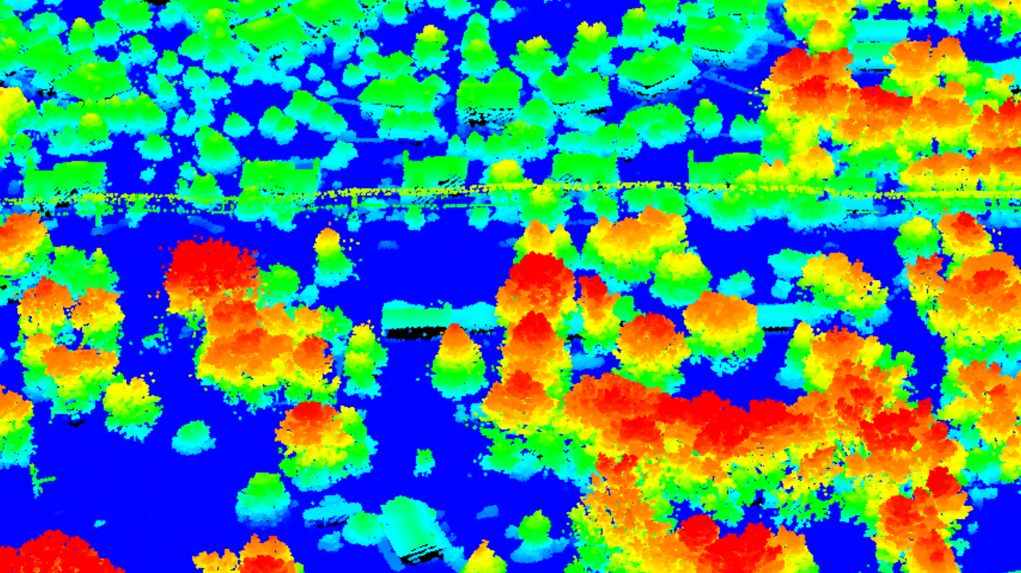
LiDAR Point Cloud

Slide 7
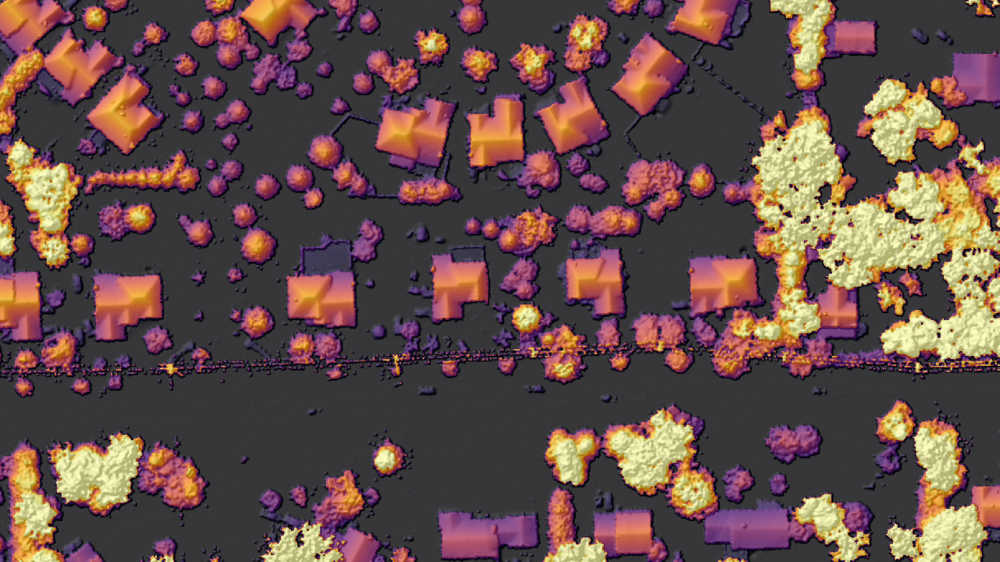
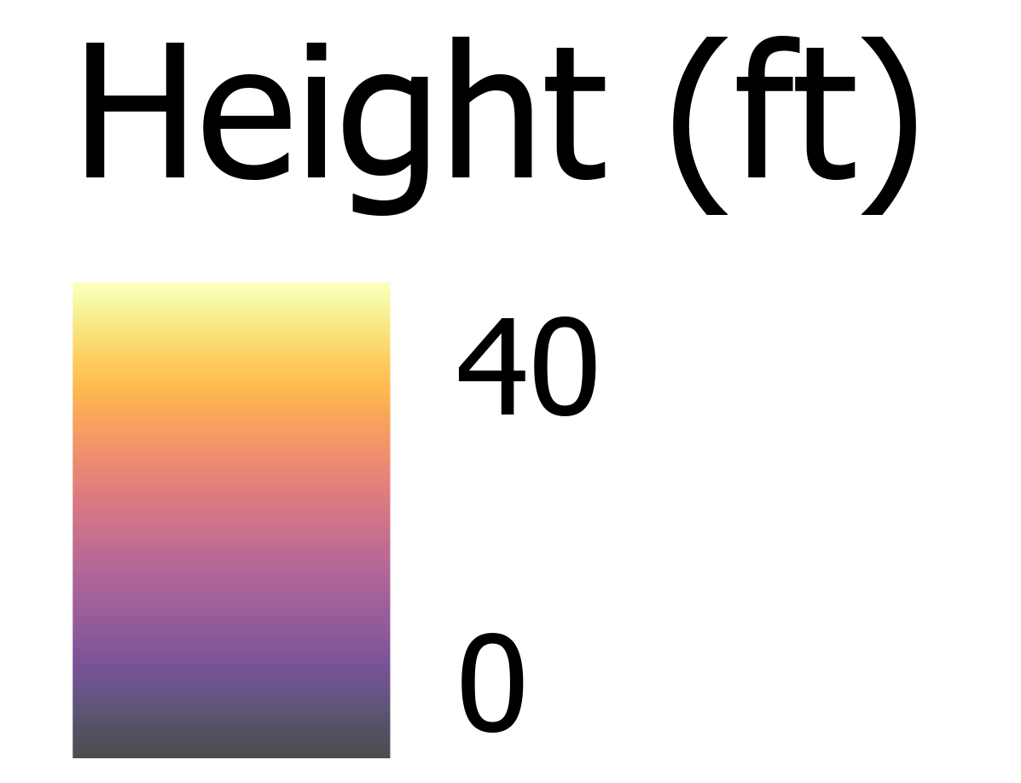
LiDAR nDSM (normalized digital surface model)

Slide 8
Mapping

Slide 9
Tree Canopy Change Mapping
No Change
Gain
Loss
New canopy was added from 2018-2020
Canopy was lost from 2018-2020
Canopy has not changed from 2018-2020
Tree canopy is defined as vegetation 8 feet or taller

Slide 10
Mapping Challenges
Two LiDAR datasets are never directly comparable due to acquisition, sensor, and processing differences.
The 2020 LiDAR proved superior for detection small trees and gaps in forested canopy.

Slide 11
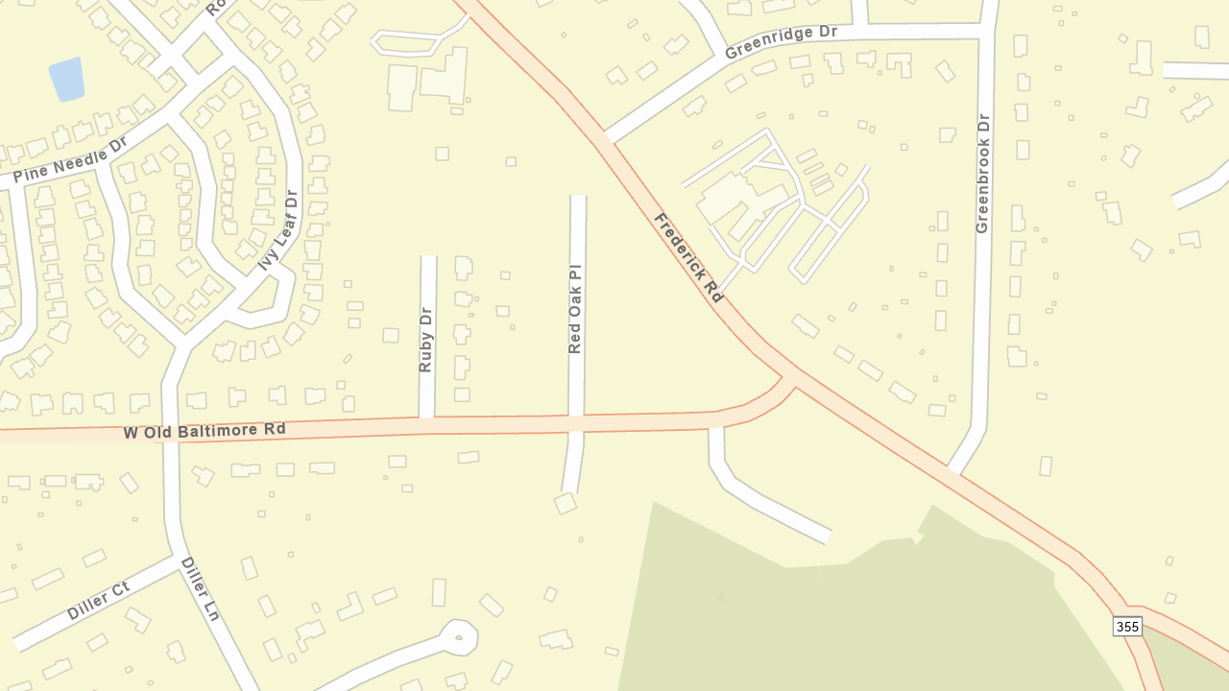
Montgomery County

Slide 12
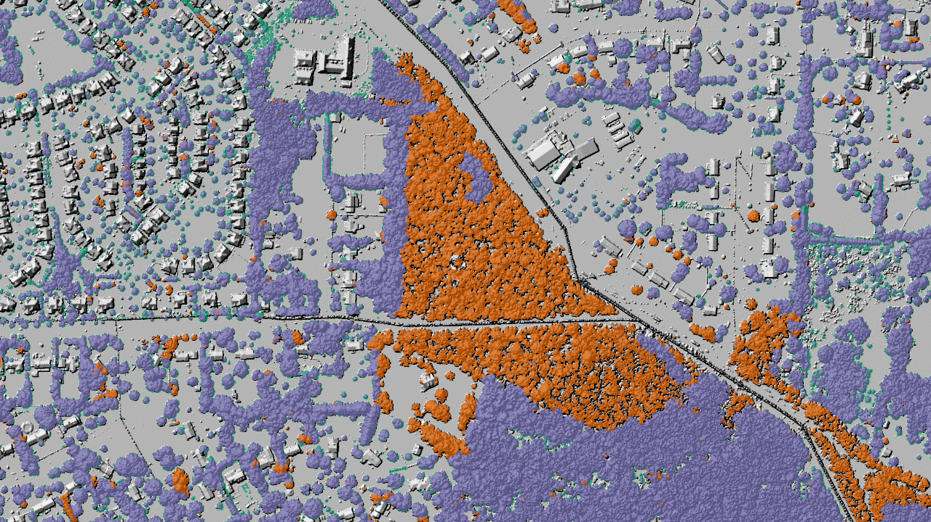
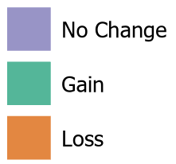
Tree Canopy Change: 2018 LiDAR
Areas of gain appear smooth in the 2018 LiDAR as no tree canopy exists currently.
Areas of loss appear smooth in the 2020 LiDAR as the tree canopy has been removed.
Areas of no change appear rough in the 2018 LiDAR as there is tree canopy present.

Slide 13
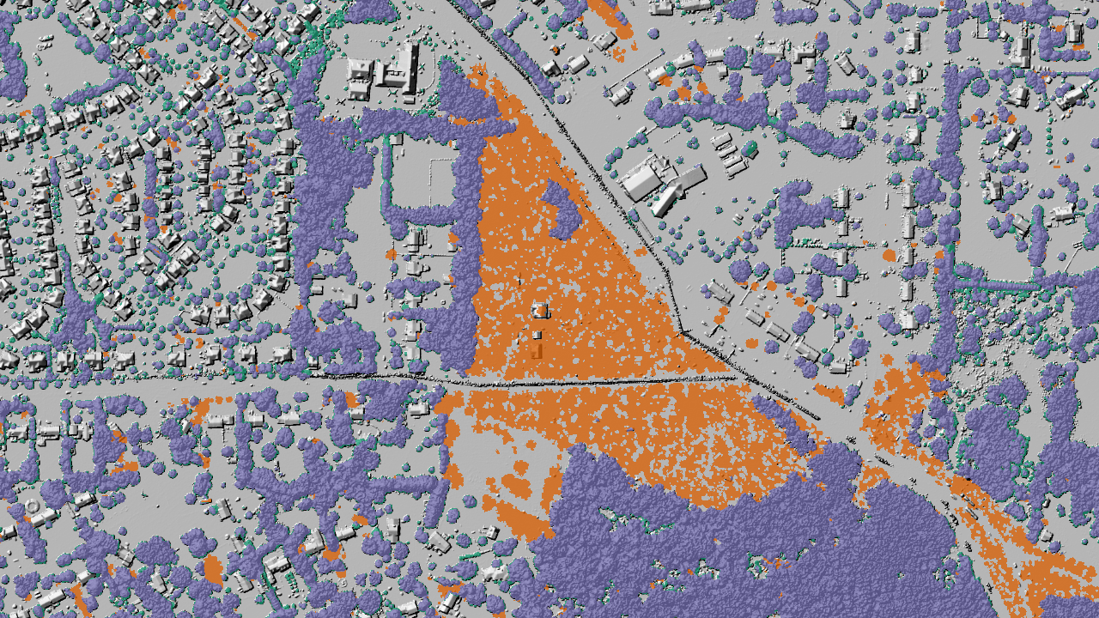
Tree Canopy Change: 2020 LiDAR
Areas of gain appear rough in the 2018 LiDAR there is now tree canopy present.
Areas of loss appear smooth in the 2020 LiDAR as the tree canopy has been removed.
Areas of no change appear rough in the 2020 LiDAR as there is tree canopy present.

Slide 14
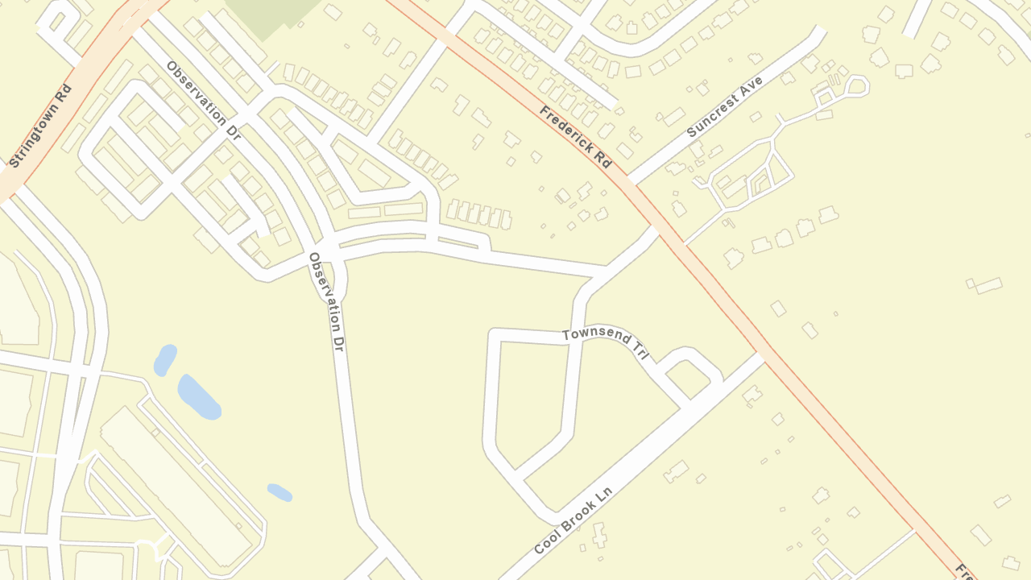
Montgomery County

Slide 15
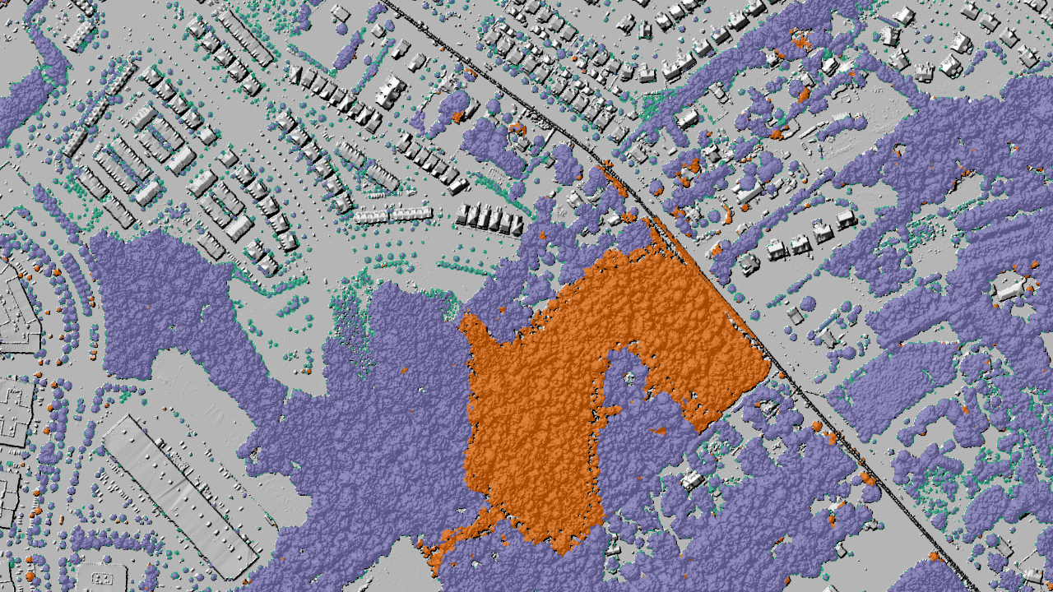
Tree Canopy Change: 2018 LiDAR

Slide 16
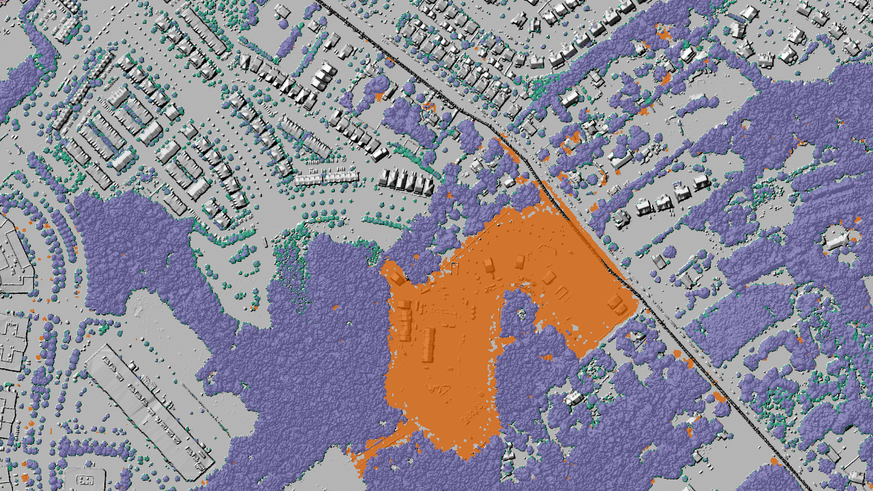
Tree Canopy Change: 2020 LiDAR

Slide 17
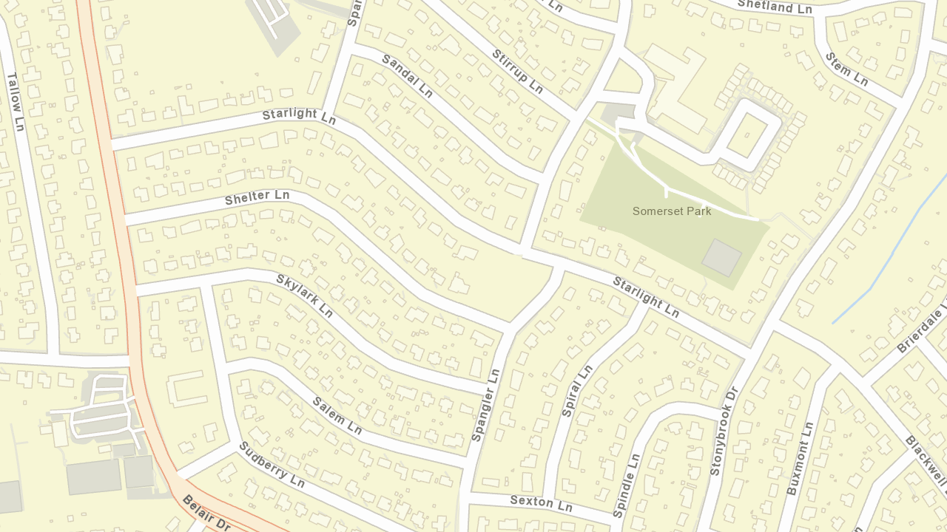
Prince George’s County

Slide 18
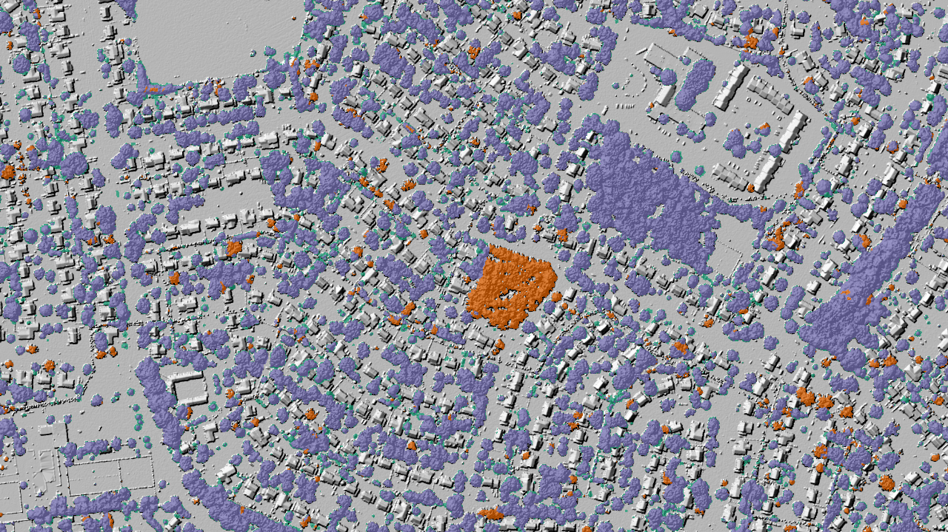
Tree Canopy Change: 2018 LiDAR

Slide 19
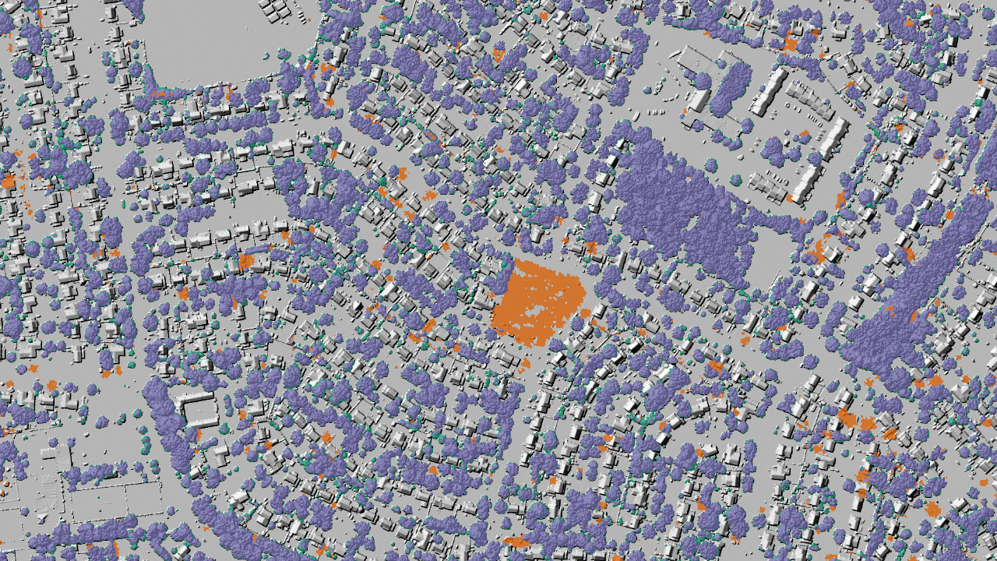
Tree Canopy Change: 2020 LiDAR

Slide 20
Results

Slide 21
Caveats
Tree canopy metrics, including area, percent coverage, and change are only valid if the US Forest Service’s Tree Canopy Assessment Protocols are applied. This project created data, but the application of the Tree Canopy Assessment Protocols was not part of the scope.
Percent changes are based on county area, including water. The US Forest Service’s Tree Canopy Assessment Protocols specify that change be reported as a percent of land area. Full land cover mapping is part of a Tree Canopy Assessment.
The county boundaries provided for the 2014-2018 and 2018-2020 projects differed slightly and thus the amount of county land is not consistent between the two analyses.
The results should be considered preliminary due to the caveats listed below. It is not recommended that they not be used for decision-making.

Slide 22
Tree Canopy Coverage for 2020
46.7%
151481.5 acres
Montgomery County
51.2%
163583.1 acres
Prince George’s County
*Percent coverage is based on county area, including water. The US Forest Service’s Tree Canopy Assessment Protocols specify that change be reported as a percent of land area. Full land cover mapping is part of a Tree Canopy Assessment.
*The county boundaries provided for the 2014-2018 and 2018-2020 projects differed slightly and thus the amount of county land is not consistent between the two analyses.

Slide 23
Tree Canopy Change Area
*Area in acres. The county boundaries provided for the 2014-2018 and 2018-2020 projects differed slightly and thus the amount of county land is not consistent between the two analyses.

Slide 24
Tree Canopy Change Percent
County Area
Tree Canopy Area
+1.8%
+4.1%
Montgomery County
Montgomery County
+1.5%
+3.1%
Prince George’s County
Prince George’s County
*The US Forest Service’s Tree Canopy Assessment Protocols specify that change be reported as a percent of land area. Full land cover mapping is part of a Tree Canopy Assessment and was not done for this mapping phase.

Slide 25
Next Steps

Slide 26
Conclusions & Recommendations
The 2014-2018 & 2018-2020 datasets are not directly comparable
A full tree canopy assessment would bring these datasets into alignment
A tree canopy assessment would also help uncover the drivers of change
Both counties gained tree canopy from 2018-2020. Montgomery Gain = 1.8%. Prince George’s Gain = 1.5%.

