Slide 1
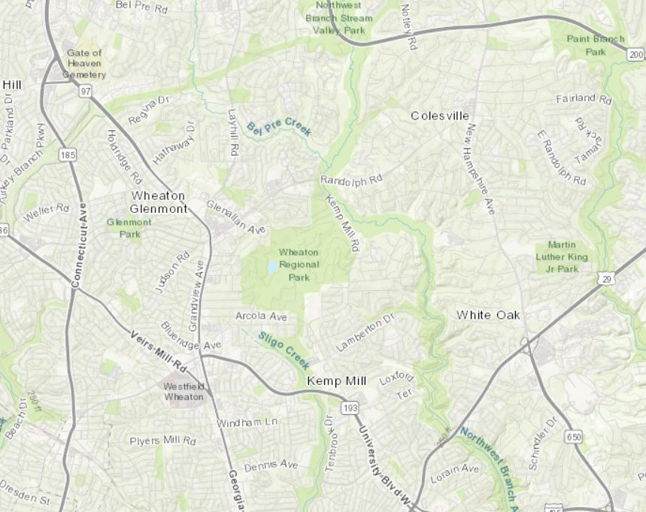
ACCESS TO EXPERIENCES, NOT ACRES #4
Cristina Sassaki, Planner Coordinator Chris McGovern, IT Systems Manager
Notes:
Thank you, Chris and Carter. Hello everybody, I am Cristina Sassaki, Park planner and urban designer within the Park Planning and Stewardship Division. My work focus on planning the needs and locations for parks and public spaces within master/sector plans, functional plans and park studies. Chris, can you introduce yourself?

Slide 2
CHALLENGE: MORE PEOPLE, MORE PARKS How to prioritize where and what to add for people to enjoy the outdoors?
?
Notes:
A functional plan focus on a system, in this case a system of parks and open spaces. Today we will be focusing on one aspect of the Energized Public Spaces Functional master plan: its quantitative analysis. To respond to the challenge of providing more parks where we have more people, we created a GIS tool to help us prioritize and analyze where and what type of experiences we can add to our system for people to enjoy the outdoors.

Slide 3
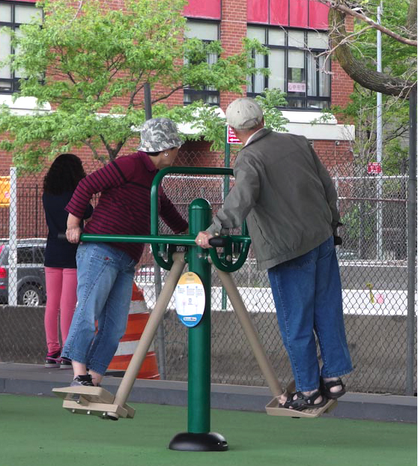
EPS PLAN: ACCESS TO EXPERIENCES
ACTIVE
CONTEMPLATIVE
SOCIAL GATHERING
Eps METRIC:
WALKING ACCESS TO AMENITIES/EXPERIENCES
+
AMENITY’S
COMMUNITY BENEFIT
=
Experience points/person
ALL PARKS ARE NOT CREATED EQUAL
Notes:
The key and innovative idea here is the understanding that all parks are not created equal. We need to ensure that we have a well distributed geographic park system, and distributed experiences (things to do) among them. Only then will we truly be serving all of our residents.
We use experience points per person as our metric and we will learn more about it in the upcoming slides.
Active recreation to encourage people to exercise outdoors and fight physical inactivity.
CONTEMPLATIVE RECREATION to allow people to reconnect with nature, fight chronic disease, burnt out feeling, escape chaos and depression
Third, social gathering - offer places where people can come together as a community, and fight depression and loneliness. Especially in urbanizing areas, where we have the highest concentration of multi-family buildings with no backyards and outdoor spaces where people can meet and get together as a community.

Slide 4
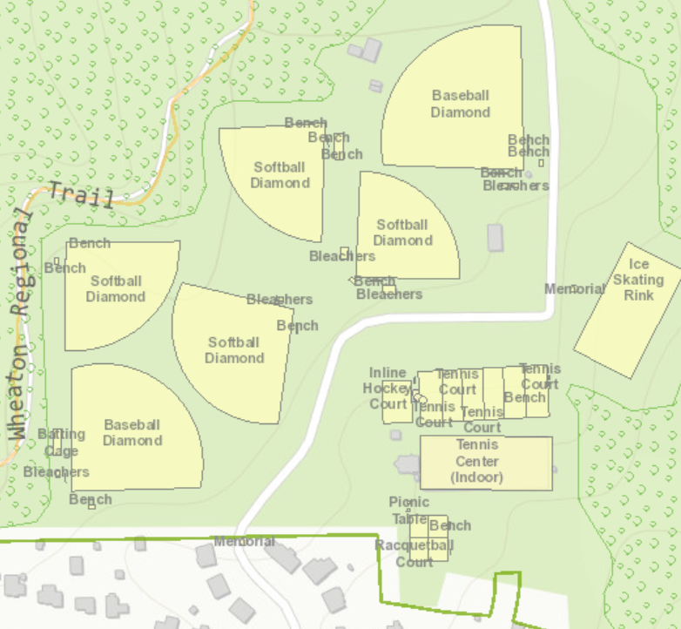
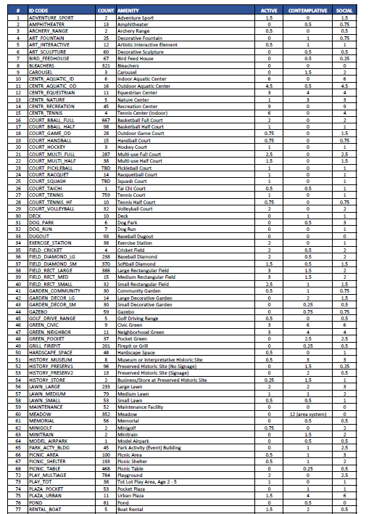
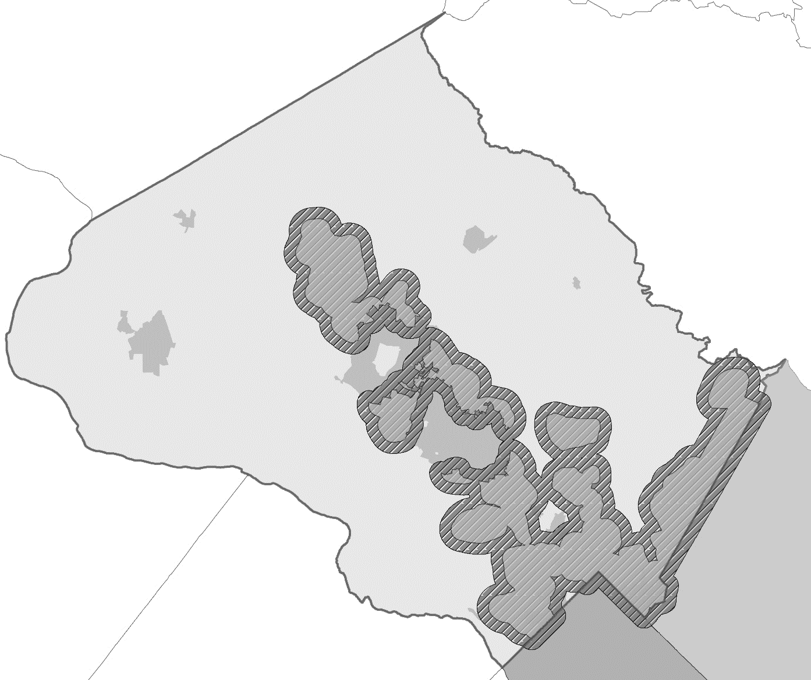
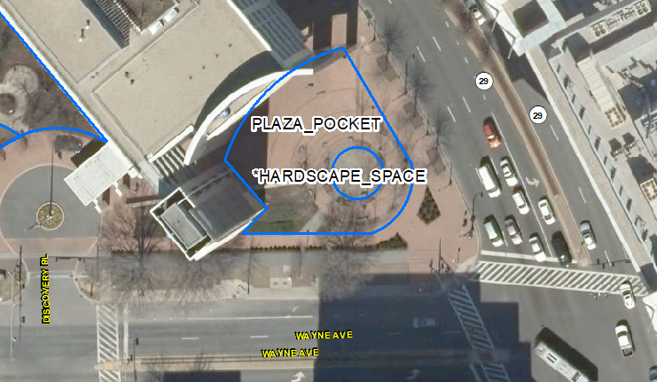
COLLECTING AND SCORING
Frederick
County
Howard
County
Amenity
Montgomery
County
Active
Contemplative
Social Gathering
Prince
George
County
Loundon
County
Fairfax
County
D.C.
90+
categories
500+
locations
15k+
Amenities
39% MNCPPC
Notes:
In order to provide results based on these experiences we had to collect data on all the amenities/facilities that were accessible within a walking distance. This Plan identifies all things people can do for all public spaces, independent of ownership: M-NCPPC-own parks, state, federal, municipal, schools and privately-owned public spaces. We ended up collecting beyond the study area to be able to do the analysis in areas of equity that were outside the urbanizing areas. As you can see, M-NCPPC facilities correspond to around 40% of the total supply we analyzed.

Slide 5
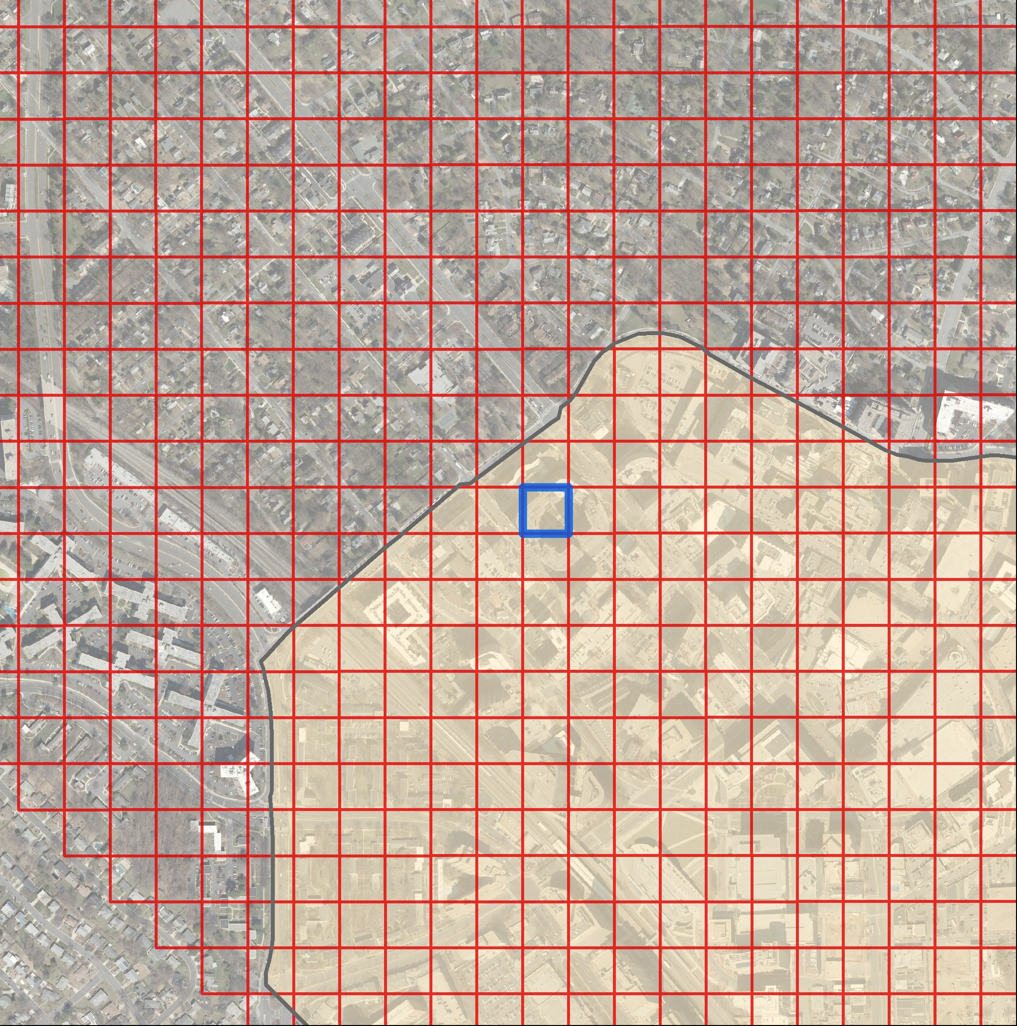
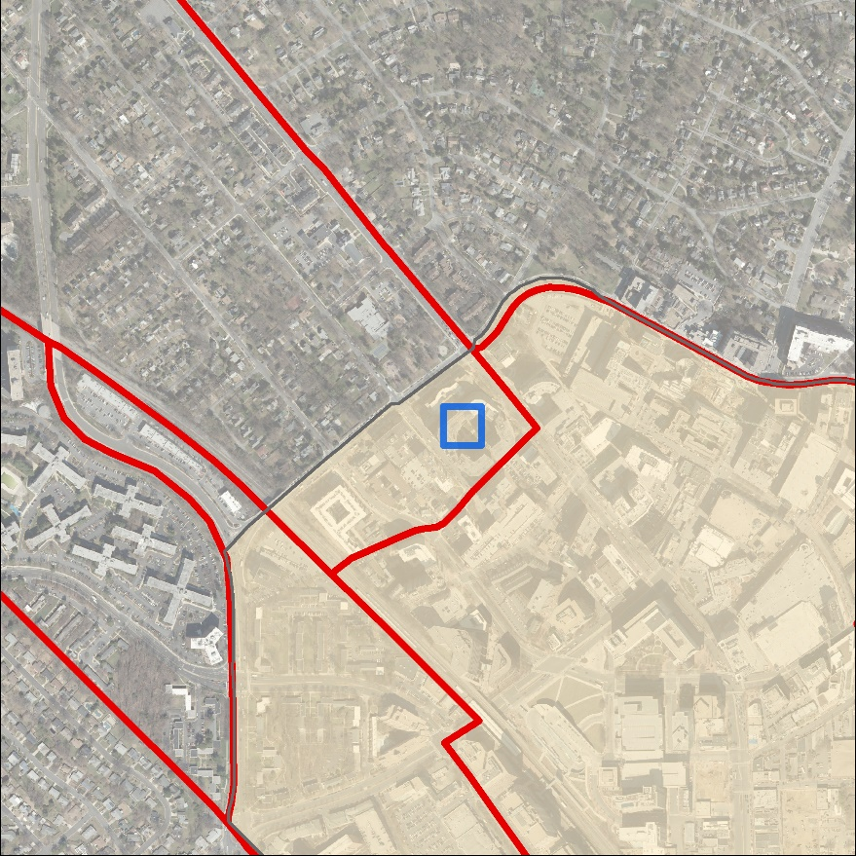
THE GRID
Divide area into 1-acre grid
90k+ acre grids
Regular grid – getting supply and demand in each grid
Compare equally
More precise than census tract
2
3
1
Notes:
One of the most important things we did from the beginning in GIS was to break up the county into a regular grid of 1-acre square. Each acre-square of the grid will have a supply and demand number associated to it and allows the equal comparison among the cells. As a contrast, if we were using census tracts instead the information would be dissolved into fewer areas – in the picture in the screen 3 census tracts vs. 186 cells in the grid. This approach also deviates from the traditional GIS analysis that measures walkability from park entrances and trailheads since it allows to measure walking distance from where you are within the grid. Without GIS it will be impossible to generate the more than 90k walksheds we have in the study area.

Slide 6
HOW WE DID: METHODOLOGY
ENERGIZED PUBLIC SPACES NETWORK
WORKERS
RESIDENTS
WALK
NETWORK
SUPPLY
DEMAND
EXPERIENCES/PERSON
Notes:
How we did it:
In summary, we map a walking network and generated 100 of thousands of walksheds from each cell in the grid. Once we mapped all the “things to do” within the 3 experiences, we look at the demand of people, including workers and residents who will be potentially benefiting from those amenities. The outcome will be a map showing the amount of experiences points per person for each location.
A REMINDER: we are not measuring capacity and/or conditions at this version of the tool. The focus is on accessibility and community benefit reflected on amount of experience and diversity of people who can use that facility.

Slide 7
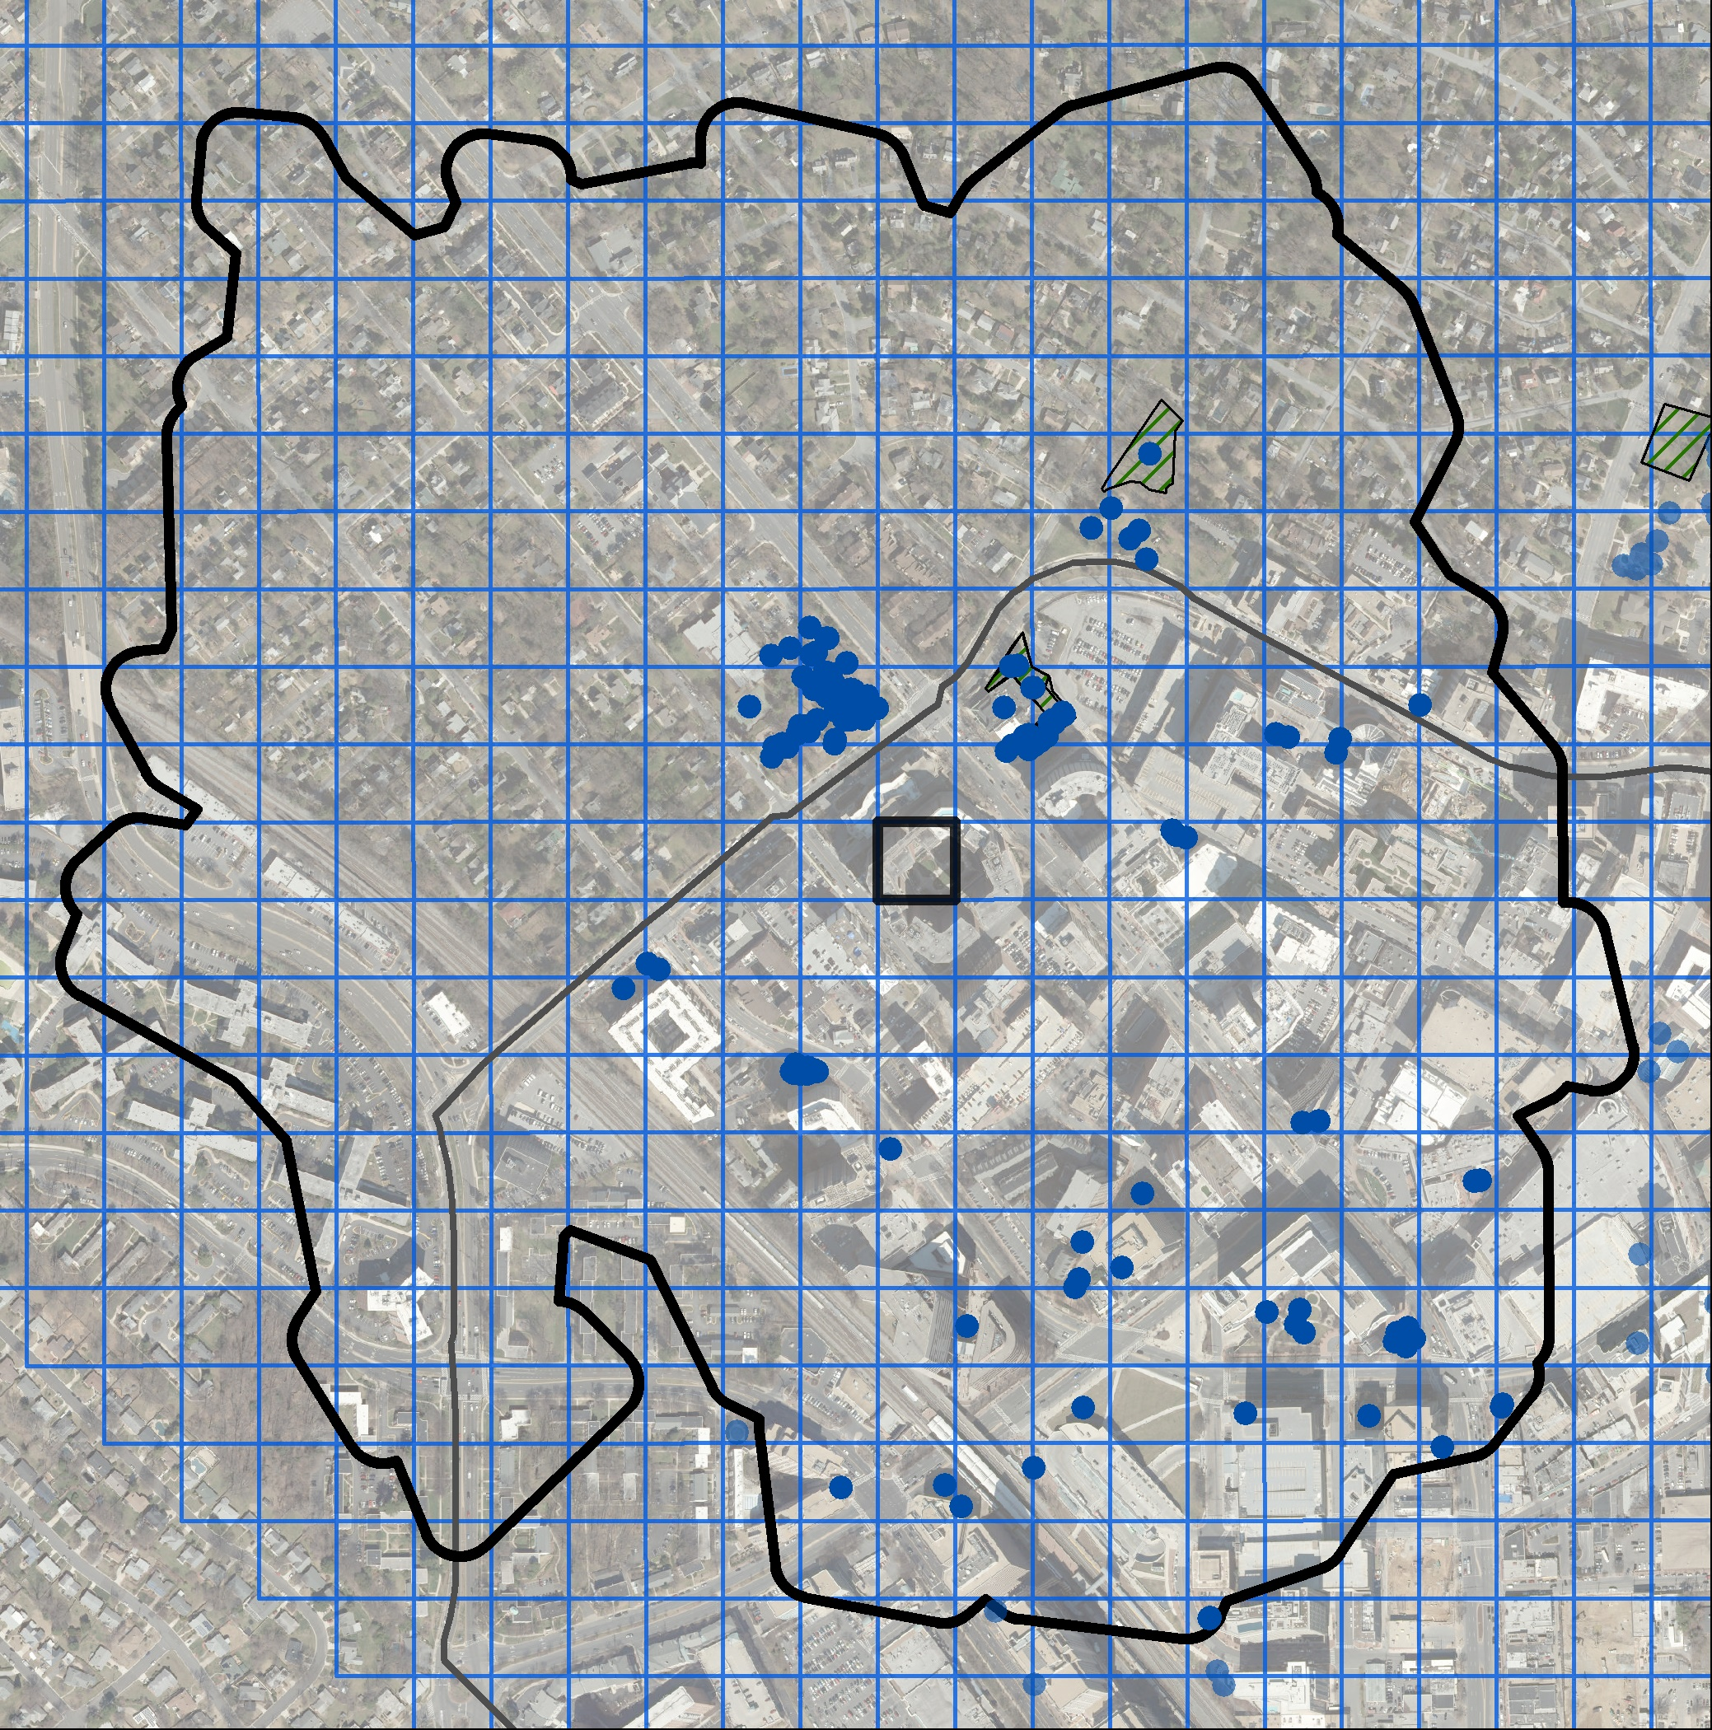
WALK & SUPPLY MAP
Your Walkshed
Walkability to Experiences/Scoring
Type of experience provided
Active, Contemplative, Social Gathering
Community Benefit provided
Amenities
Amount of experience/
diversity of people served
Woodside Urban Park
low
high
You
1-acre focus area
supply of Amenities within the walkshed
woods
10-min walkshed
barrier
Notes:
Let’s take a closer look on how we worked with supply.
From each acre square we produce a walkshed based on half-mile distance or average 10-min walk. ESRI has a tool to generate these walksheds and we use our customized pedestrian network for the county. And one at the time we cross-referenced the amenities: these blue dots you are seeing in the map. For each amenity such as dog parks, fields, courts, playgrounds, trails, we provide a score in each of the three types of recreational experiences: active, contemplative and social gathering. Chris wrote a python script to help in calculating for each of these acre-square the total score for each experience within each walkshed. It will be almost impossible task to do it without GIS, considering 90+k of walksheds we have in the study area.
Important: we are MEASURING facilities FROM WHERE YOU ARE. Let’s take a look at Woodside Urban Park to see what amenities we found there.

Slide 8
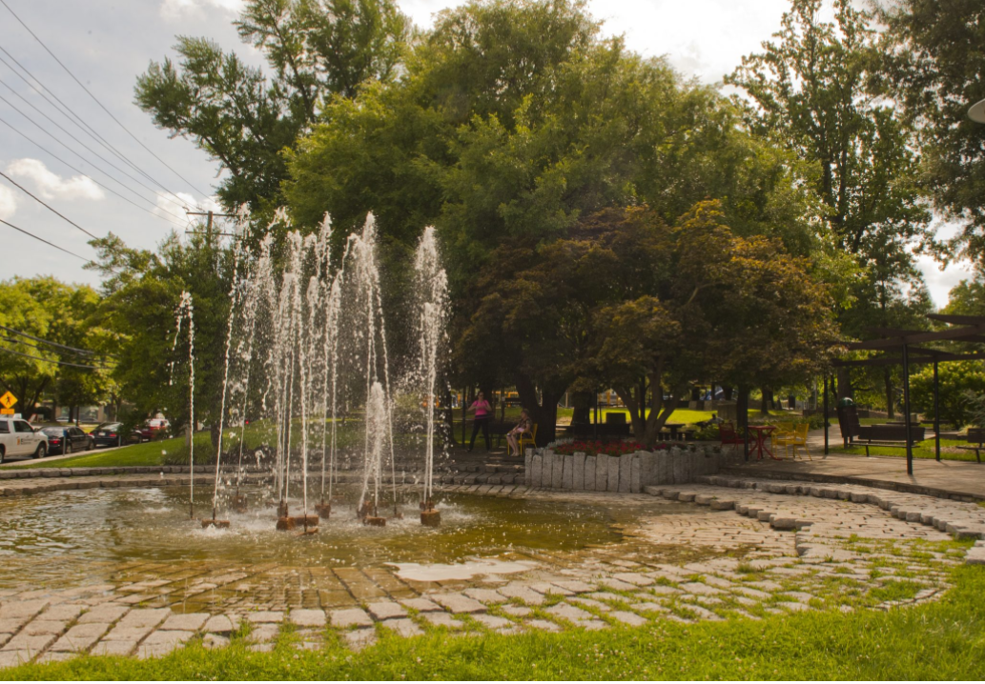
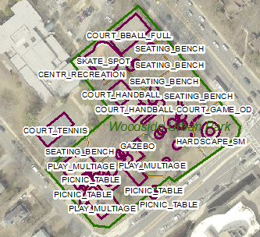
WOODSIDE URBAN PARK:EXPERIENCE POINTS
AMENITIES | ACTIVE | CONTEMPLATIVE | SOCIAL | TOTAL
Basketball Full Court | 2 | 0 | 2 | 4
Decorative Fountain | 0 | 1 | 1 | 2
Game Table | 0 | 0 | 2 | 2
Gazebo | 0 | 1 | 1 | 2
Handball Court x2 | 1 | 0 | 1 | 4
Hardscape | 1 | 0 | 1 | 2
Memorial | 0 | 1 | 1 | 2
Picnic Table x7 | 0 | 0 | 1 | 7
Playground | 2 | 0 | 2 | 4
Shuffleboard Court x2 | 2 | 0 | 2 | 8
Skate Spot | 2 | 0 | 1 | 3
Gymnasium / Court | 6 | 0 | 6 | 12
Paths (.25 miles) | 8 | 4 | 3 | 15
Tree Canopy | 0 | 3 | 1 | 4
TOTAL | 27 | 10 | 34 | 71
Link to inventory and scoring
Notes:
In the chart you see the list of facilities and the score each facility received on the three experiences. In the map on the bottom right you can see the GIS database with polygons identifying each facility. For courts, fields and the most common facilities we used existing data from EAM, but since we collected data from other providers as well, we created a separate GIS layer for the EPS amenities analyzed.

Slide 9
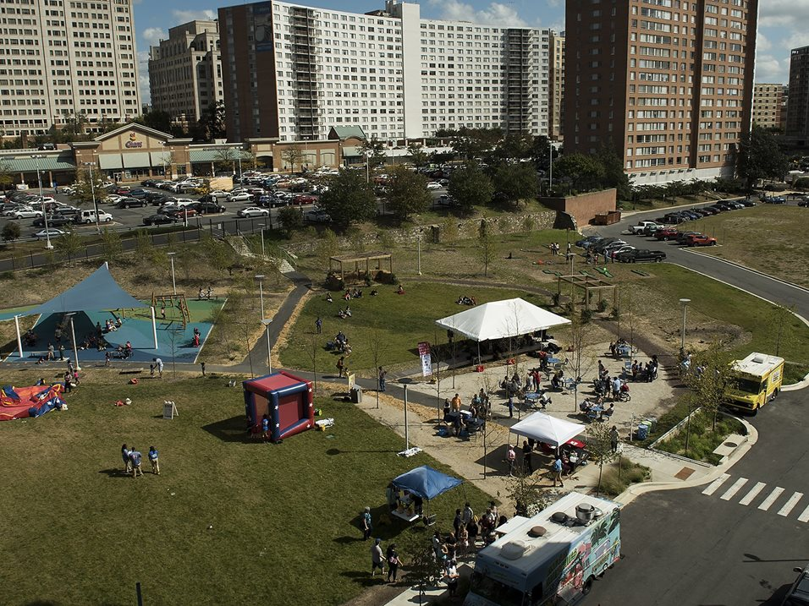
EXAMPLES OF PARKS OVERALL SUPPLY POINTS
Woodside Urban Park
71 points
Veteran’s Plaza
36 points
The Blairs (POPS)
56 points
Notes:
Just a quick look in other locations when compared to Woodside Urban Park.

Slide 10
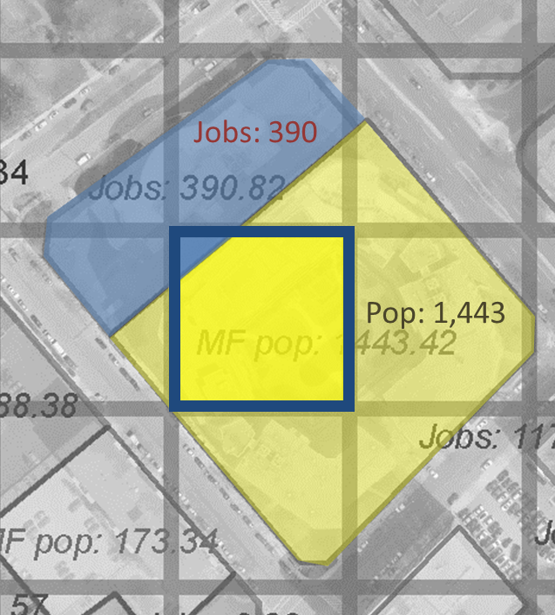
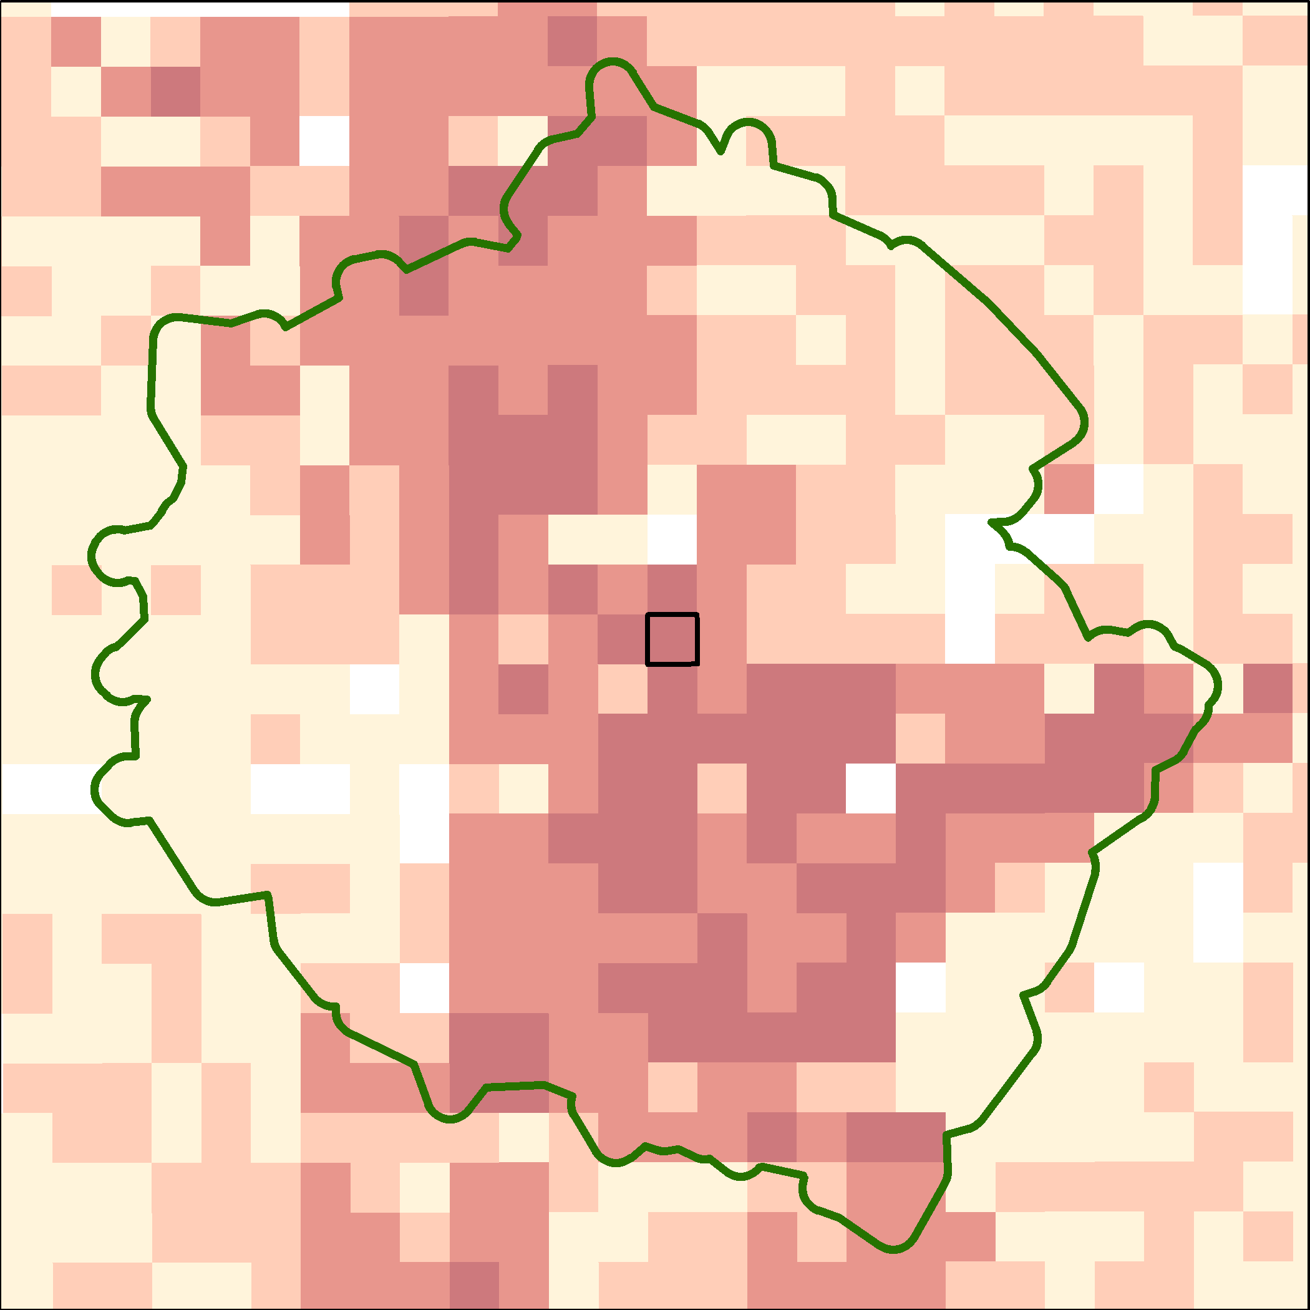
DEMAND MAP
Dividing Supply by Demand
Population of Residents + Workers
Sample demand for one square
18
439
Less People
More People
Grid
Residential
Commercial
Notes:
Let’s move on to demand.
We are calculating our demand based on our GIS property layer.
Here you see that we are trying to calculate the demand of one-acre square that is overlaying two parcels showing different land uses: yellow for residential and blue for commercial/office. We are apportioning the area within the acre-square in comparison to the overall parcel. In this case, our acre-square has 439 out of the 1,443 residents in that parcel and 18 out of 390 jobs.
The small map shows the results of the demand results for each square-acre, the darker red showing more people

Slide 11
HOW WE DID: METHODOLOGY
RESULTS
ENERGIZED PUBLIC SPACES NETWORK
WORKERS
RESIDENTS
WALK
NETWORK
SUPPLY
DEMAND
EXPERIENCES/PERSON
Notes:
So far we covered the walk network, the supply and demand. Now let’s focus on the results and the tool metric of experiences points per person. Chris will be showing you the tool in a live demo.

Slide 12
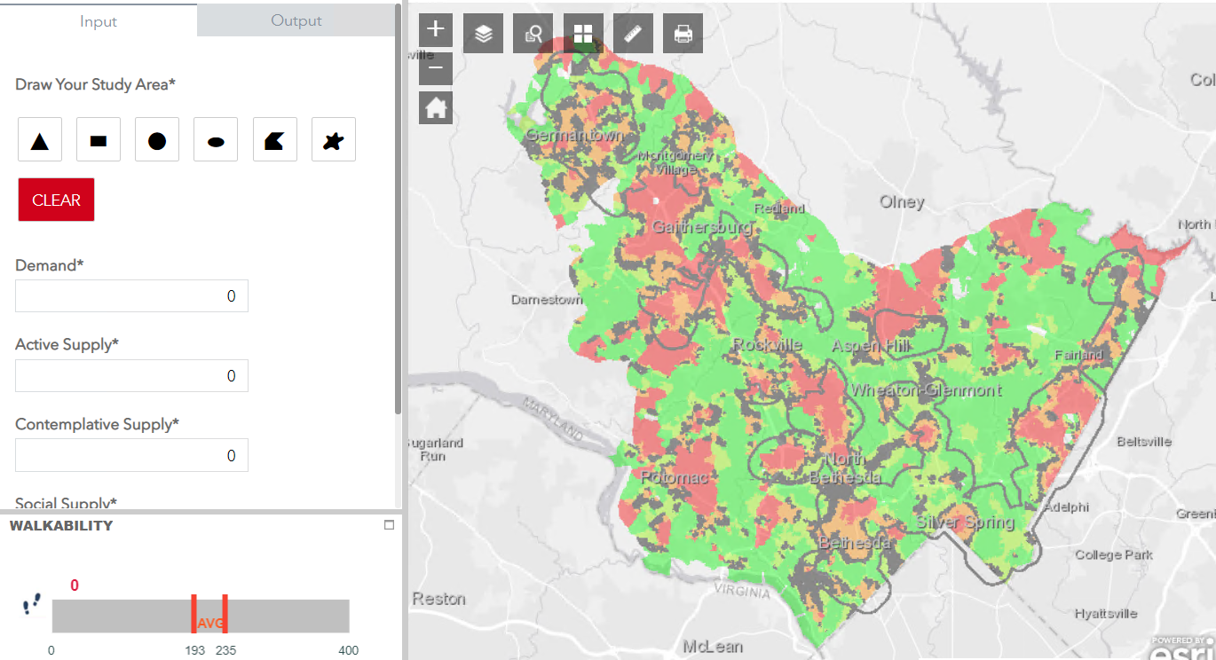
TOOL: WHAT YOU HAVE @ WHERE YOU ARE
ACTIVE
EXPERIENCES/PERSON
EPS EXPERIENCE INDEX EVALUATION
AMENITIES LIST
below average
at average
above
average
SCENARIO TOOL
above average
at average
XX IDENTIFY ACTIVE POINTS NEEDED TO BE AT AVERAGE
below average
CONTEMPLATIVE
EXPERIENCES/PERSON
below average
at average
above
average
XX IDENTIFY CONTEMPLATIVE POINTS NEEDED TO BE AT AVERAGE
SOCIAL GATHERING
EXPERIENCES/PERSON
WALKABILITY TOOL
below average
at average
above
average
XX IDENTIFY SOCIAL POINTS NEEDED TO BE AT AVERAGE
Notes:
Chris text here…
With supply and demand captured on all the grids in the county, we use another python script to create the affected points per person for all of the County you see here on the map.
With the county measured, we put the results into a statistical distribution curve where we identified the amount of points per person that represents the 50th percentile. From there we color coded the grids that are below average red/orange, and the grids that are above average are colored green.
One of the main ideas behind this tool, help staff be able to ‘fix’ the below average red areas.
We want to highlight the areas that are below average and determine how many and what types of amenities are needed to fix a problem area.
Go into tool- show below average areas
Tool, staffer wants to put a park in a red area, finds out how much is needed
What if it was a development review? Add people determine more points.
Mention that the tool uses a geoprocessing model created initially in ArcMap model builder.
The website is a customized esri dashboard app that is able to submit jobs and display the results from that published geoprocessing model.
In addition to the applications I just shared with you, there are other uses for the tool. Cristina will be covering the other uses. Back to our PPT slides.

Slide 13
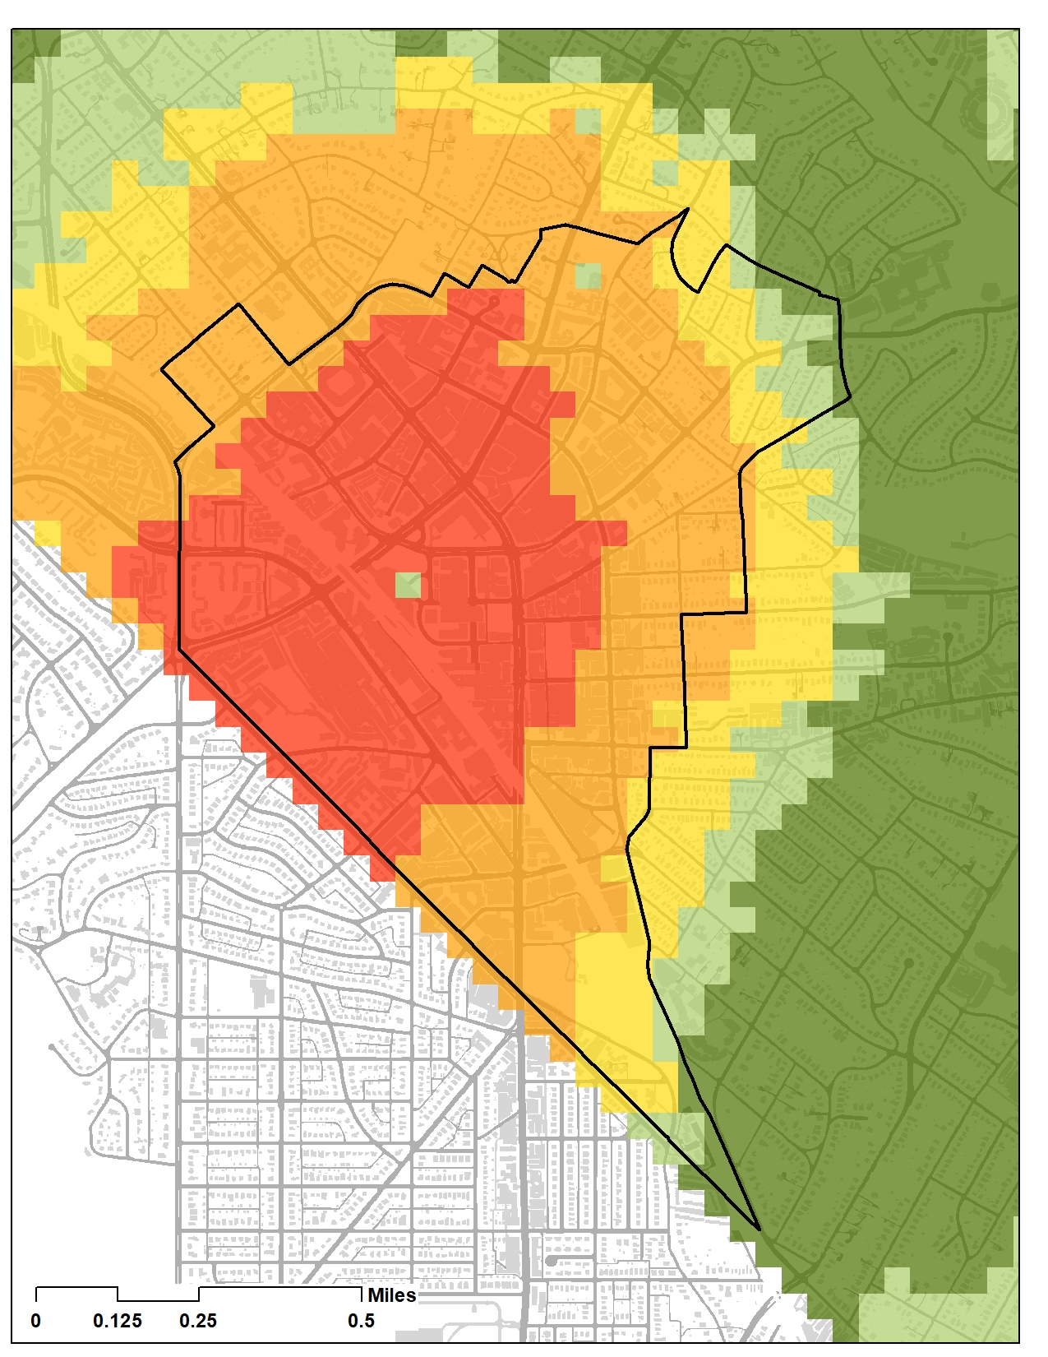
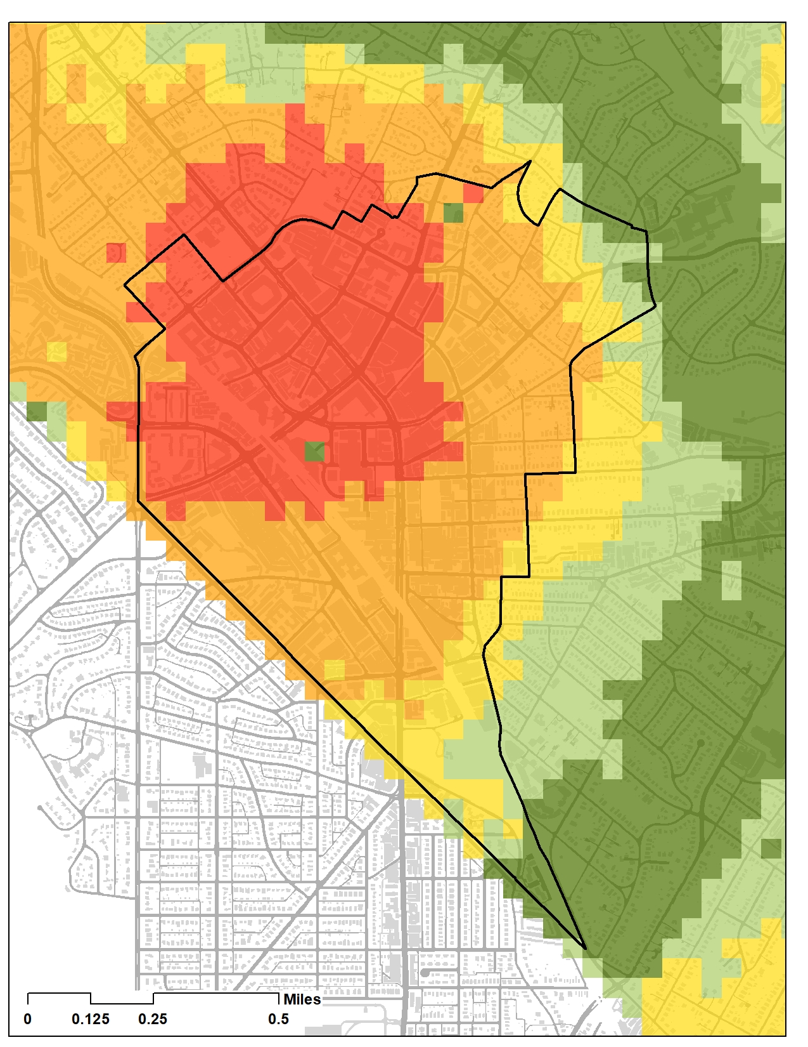
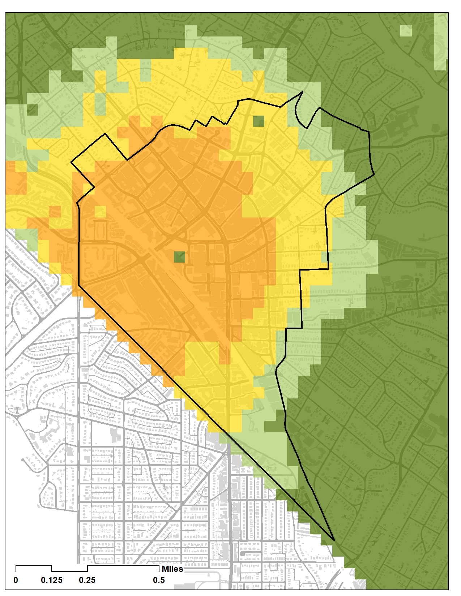
APPLICATION: MASTER/SECTOR PLAN
ACTIVE
EXPERIENCES/PERSON
CONTEMPLATIVE
EXPERIENCES/PERSON
SOCIAL
EXPERIENCES/PERSON
below average
at average
above
average
below average
at average
above
average
below average
at average
above
average
86.4% of pop. is below average
inside the Silver Spring Boundary
96.3% of pop. is below average
inside the Silver Spring Boundary
81% of pop. is below average
inside the Silver Spring Boundary
Above Average (> 80th)
Above Average (60th -80th)
At Average (40th-60th)
Below Average (20th -40th)
Below Average (<20th)
Above Average (> 80th)
Above Average (60th -80th)
At Average (40th-60th)
Below Average (20th -40th)
Below Average (<20th)
Above Average (> 80th)
Above Average (60th -80th)
At Average (40th-60th)
Below Average (20th -40th)
Below Average (<20th)
Notes:
Thanks Chris. Another use of the tool is on sector/master plans. In this example, we have the new SS Downtown and Adjacent Communities boundary. We can see that within the boundary we are below average in all the experiences. But particularly short in active experiences where 86.4% of the people are way below the active experience points per person on the slider. The goal of the analysis here is to make sure our programmatic recommendations during the plan process allow opportunities to reduce the gaps of park experiences where they are needed the most. Since we have a scenario tool, we can predict the impact of our recommendations.

Slide 14
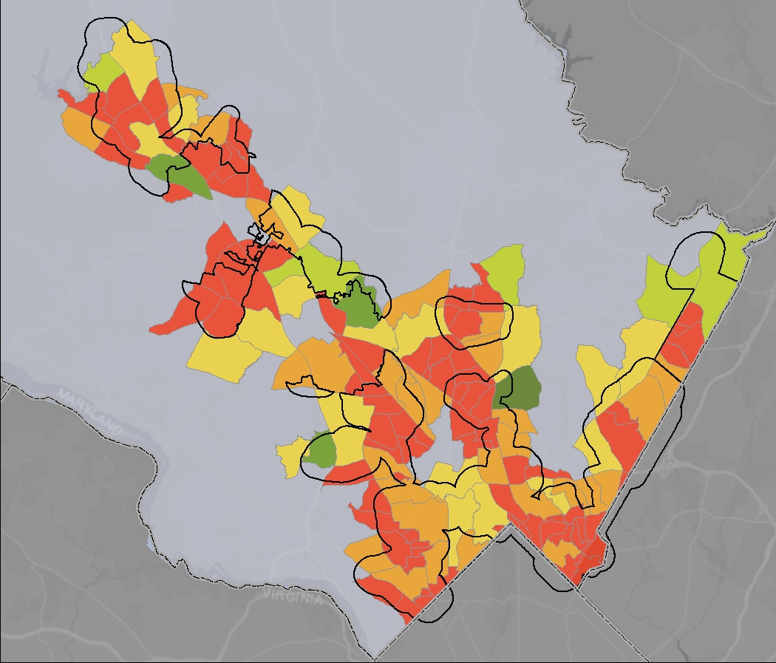
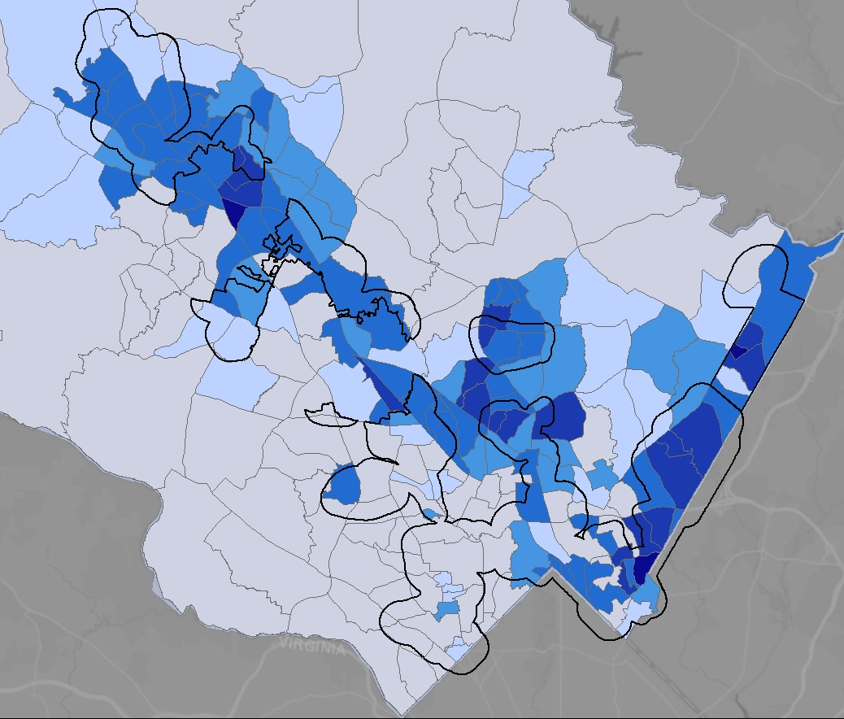
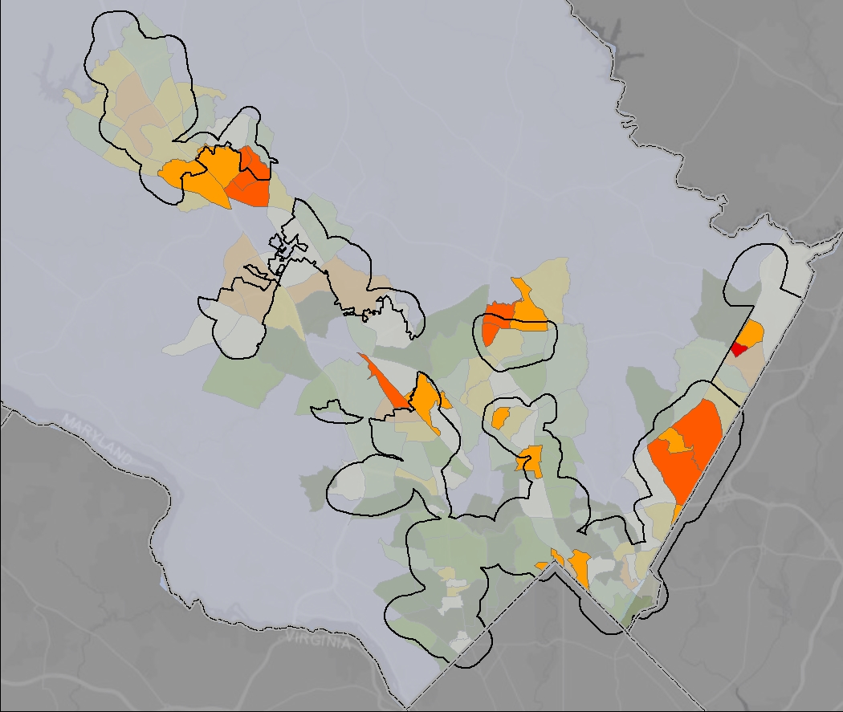
APPLICATION: PRIORITIZE $
TOP LOW experience level + RACE/INCOME AREAS
EXPERIENCE INDEX EXPERIENCES POINTS PER PERSON
RACE/INCOME
Silver Spring
Highest Level of Experience per Person
Lowest Level of Experience per Person
Low Experience Level + Mostly Non-White Lower Income Residents
Lower Experience Level + Mostly Non-White Lower Income Residents
Lowest Experience Level + Mostly Non-White Lower Income Residents
Fewest Non-White Lower Income Residents
Mostly Non-White Lower Income Residents
Notes:
The last application I would like to cover in this presentation is how we started to consider equity in this analysis.
First, we converted the square acre results into census tracts to make the visualization of the level of service comparable to demographic census tract data available. Here you can see how the deficits concentrated down county and along major corridors. Read= more areas below average
We then add the two layers we used in our CIP process this year to address equity: Race and Income. The darker the blue, the more vulnerable the area is.
Last map shows a combination of underserved areas in terms of experiences and race/income. A new equity map is being finalized by the General Plan team, once we get that, we will substitute our race/income placeholder map, and rerun the results. The beauty of our grid GIS data is that because it is so precise it can adapt the next scale of info to be comparable to other set of analysis. We can always do the opposite process and convert the census tract into square acre data in GIS if we want more precise geolocated results.
We will be working with the land acquisition team soon to map the best locations that fulfill equity and other issues.

Slide 15
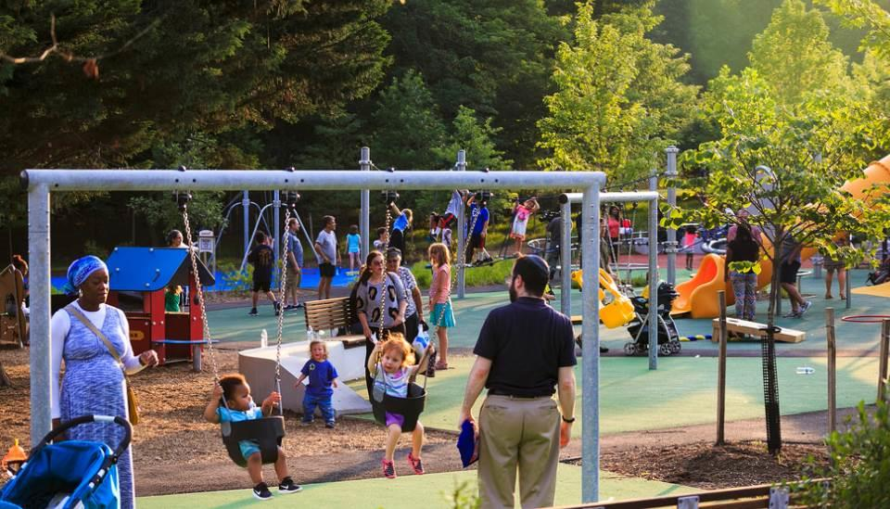
RECAP OF PLAN BENEFITS
MEASURE & MAP ACCESS TO PARK EXPERIENCES
PRIORITIZE WHERE TO SPEND LIMITED FUNDS
CREATE AN INTEGRATED NETWORK OF ENERGIZED PUBLIC SPACES
Notes:
To wrap up, this slide shows a recap of the Plan’s major benefits. By using our new methodology to analyze access to parks and open spaces, we can prioritize where we spend limited public funds and create a network of publicly- and privately-owned energized spaces to serve the public.

Slide 16
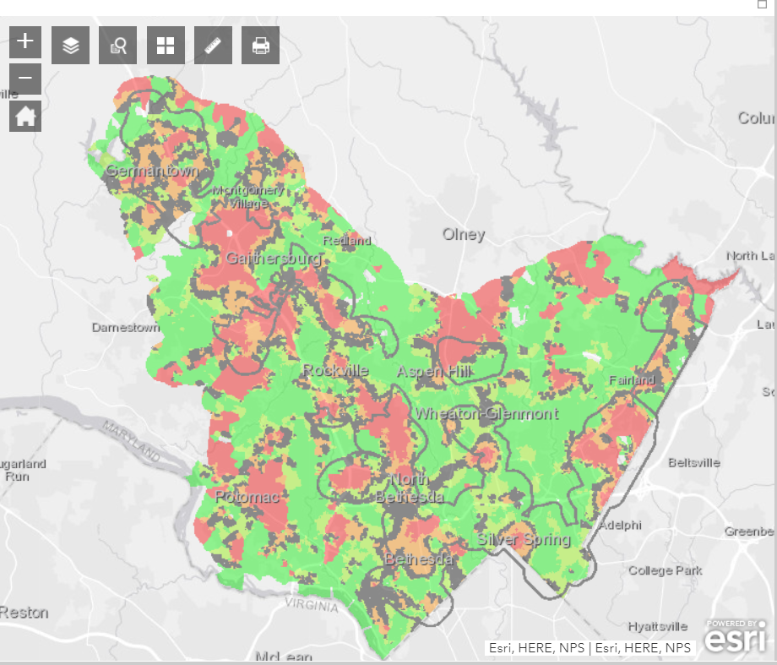
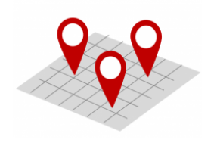
RESOURCES
EPS ANALYSIS TOOL
INTERACTIVE EPS
STORYMAP
https://mcatlas.org/epstool/
https://bit.ly/32yvR1T
DESIGN GUIDELINES
MASTER PLAN
Thank you!
shorturl.at/bvzTY
shorturl.at/JU237
Notes:
Thank you for your time, here are the links to some of the online resources and tools you can learn more about this GIS tool and methodology and about the project.

