Slide 1
Elton Farm Road, a rustic road recommended as exceptional rustic

Slide 2
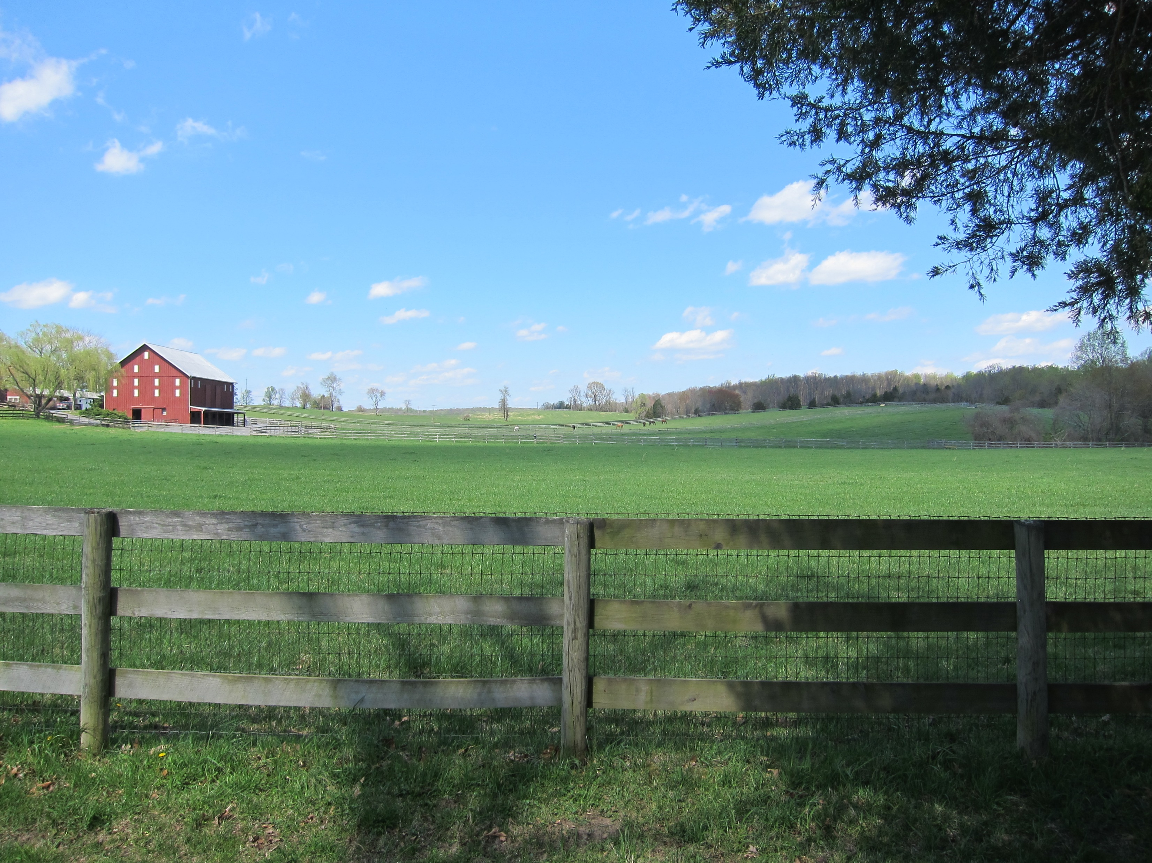
Background
There are many roads throughout Montgomery County which reflect the agricultural origins of the County, provide glimpses of its history, and afford views of scenic beauty and unusual roadside character. Many of these roads will be altered by the continued development of the County and its accompanying roadway construction and improvements unless protective measures are adopted.
Executive Summary
Proposal for a Rural/Rustic Roads Program
March 1990
Old Bucklodge Lane, a proposed exceptional rustic road
Notes:
The Agricultural Reserve was created in 1980 when the County Council approved and adopted the Functional Master Plan for the Preservation of Agriculture and Rural Open Space in Montgomery County. That Plan established land conservation policies to protect farmland and agriculture areas encompassing 93,000 acres along the County’s northern, western, and eastern borders. However, the Plan did not provide protections for the historic, rural roads within the Agricultural Reserve and adjacent rural areas.
There was a great concern in the late 1980’s and early 1990s that many of the historic roads in the county were disappearing as suburban road standards were being applied to them as were being maintained.
So there was a study done and out of this came the rustic roads program.

Slide 3
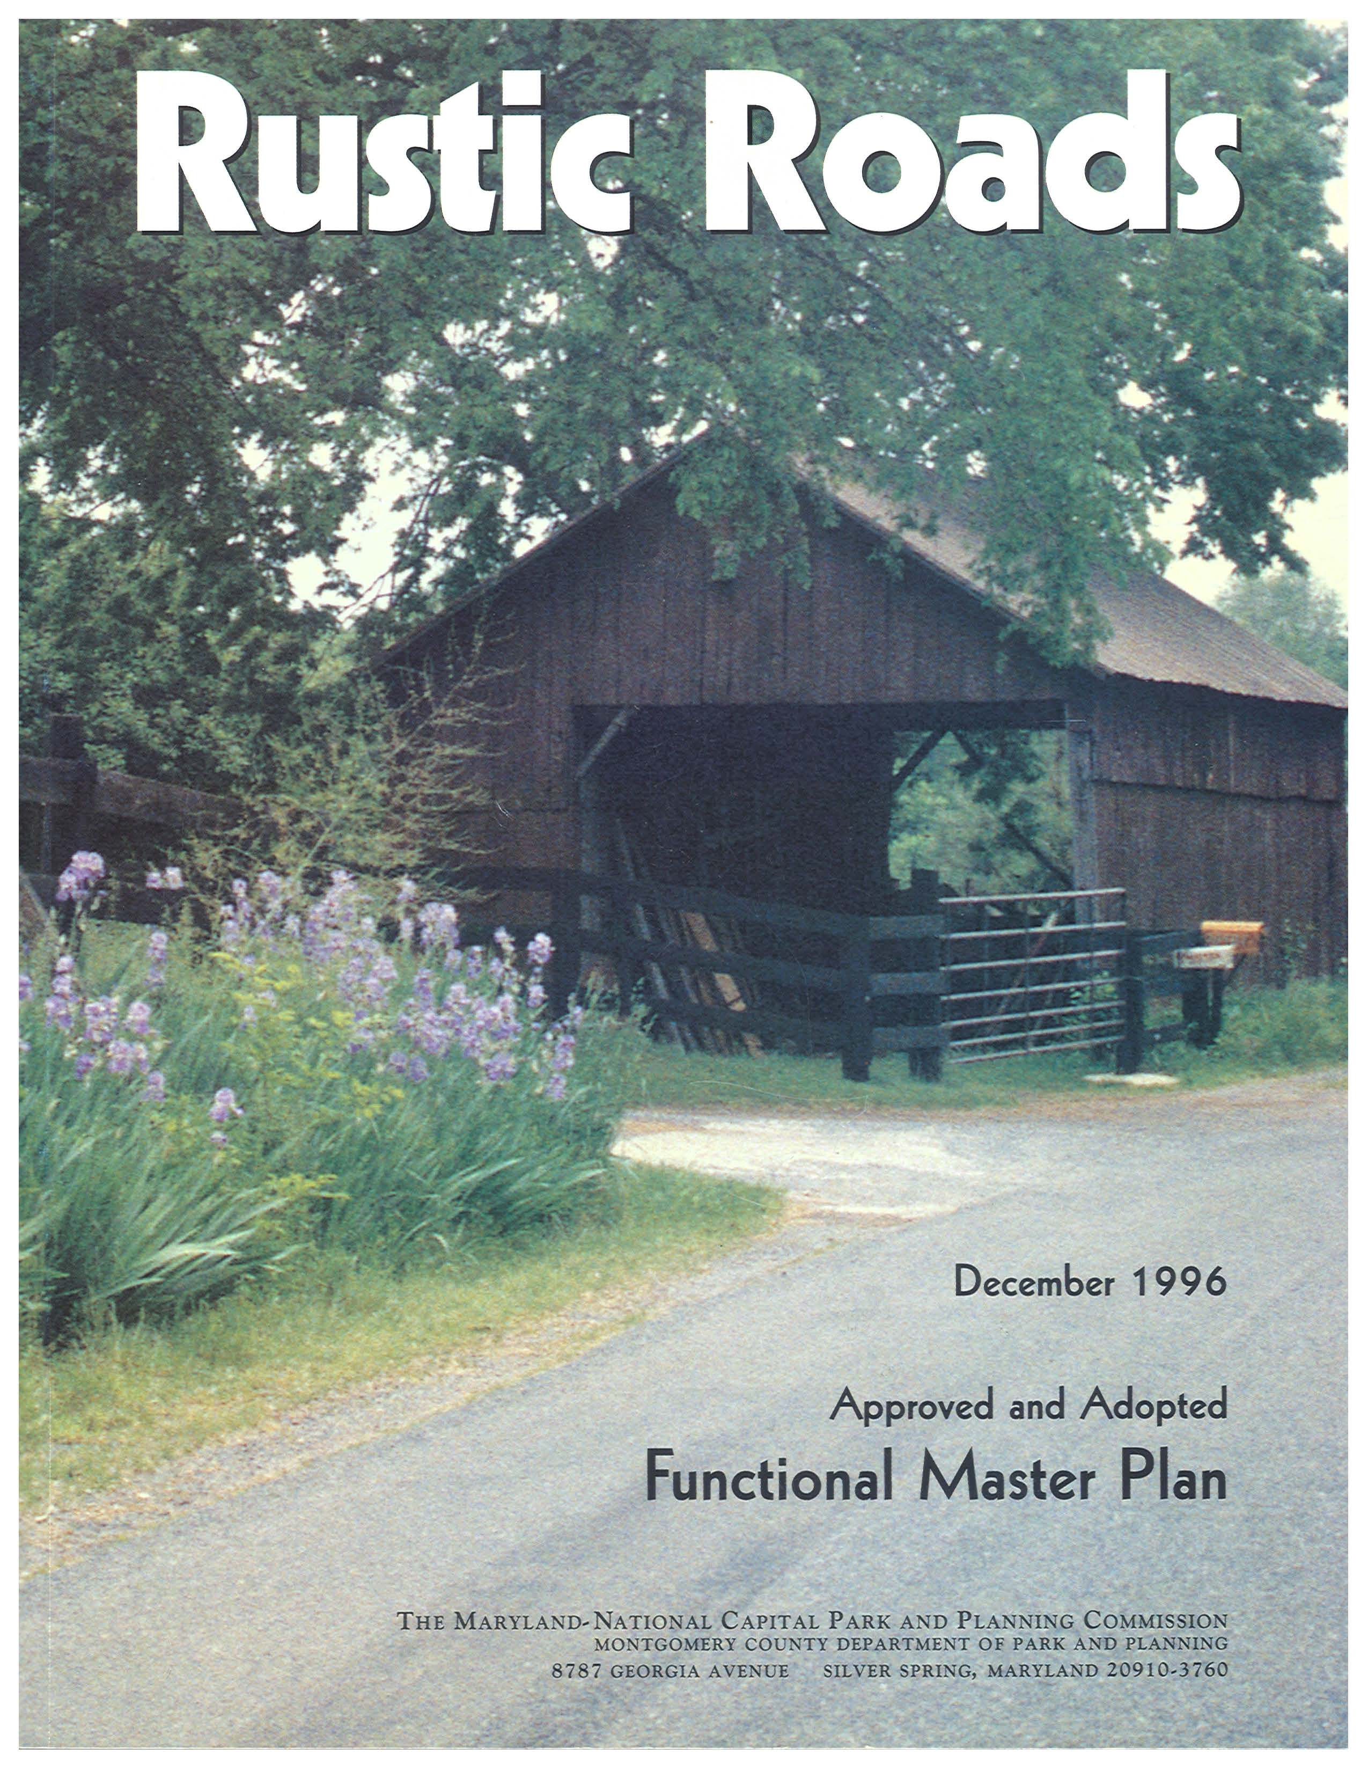
Rustic Road Functional Master Plan Update
Assesses roads which have been nominated to the program
Completes the incomplete descriptions of roads already in the program
Considers reclassifications of some existing rustic roads
Changes extents of some rustic roads
Updates existing road descriptions and recommends changes to their significant features
Notes:
The 1996 Rustic Roads designated 66 roads as either rustic or exceptional rustic. All of the roads in the initial 1996 Plan are located in the agricultural reserve area. I will get into the differences between the road types in the next few slides, but I just wanted to talk briefly about the rustic roads plan update.
The scope of work for the rustic roads plan update was approved by the planning board in February 2020. Then the pandemic hit and later the manager for the project retired and Jamey Pratt and I inherited the project about one year ago.
We provided the Planning Board with an update on the status of the plan in April. We wanted to give them an opportunity to see the types of recommendations we will be making for the proposed working draft that we are hoping to present to them late next month.
The rustic roads program is a living document, so roads can be nominated to the program through a master plan, by a community member, by the Rustic Roads Advisory Committee.

Slide 4
A Rustic Road:
Montgomery County Code, Chapter 49. Streets and Roads.
Article 8. Rustic Roads Program
Sec. 49-78. Rustic road classification and reclassification.
is located in an area where natural, agricultural, or historic features are predominant
is narrow and intended predominately for local use
is a low volume road
has one of the following characteristics:
has outstanding natural features along its borders
provides outstanding vistas of farm fields and rural landscapes or buildings
provides access to historic resources, follows historic alignments, or highlights historic landscapes
In addition, the history of vehicle and pedestrian accidents on the road in its current configuration does not suggest unsafe conditions.
The Council must not classify a road as rustic if that classification will significantly impair the function or safety of the road network.
Notes:
Rustic Roads Program was established in Chapter 49, Streets and Roads, of the County Code.
Rustic road are narrow, low volume roads where natural, agricultural, and/or historic features are prominent. These roads have outstanding natural features along their edges, have vistas to farm fields, rural landscapes or buildings and/or provide access to historic resources and landscapes.
Rustic roads must be safe for vehicles and pedestrians. A road may not be classified as rustic if function or safety is significantly impaired.

Slide 5
An Exceptional Rustic Road:
is a rustic road
contributes significantly to the natural, agricultural, or historic characteristics of the County
has unusual features found on few other roads in the County
would be more negatively affected by improvements or modifications to the road than would most other roads in the rustic roads program
Berryville Road, an Exceptional Rustic Road
Notes:
An exceptional rustic road is a rustic road, contributes significantly to the character of the county, has unusual features and would be more negatively affected by improvements.
Berryville Road is winding road with a on lane bridge.

Slide 6
Significant Features
The significant features are those elements that need to be preserved when the roads are maintained and improved, or when a public utility completes work on or near the roads.
Each rustic road and exceptional rustic road must be maintained and improved in a manner that preserves the road's significant features, but this requirement does not preclude improvements to promote safety or movement of farm equipment.
Belle Cote Drive, an Exceptional Rustic Road
Notes:
The significant features are those elements that give each rustic road its unique character and needs to be preserved even as these roads are being maintained and improved. Please note that improvements do not preclude improvements to promote safety or to move farm equipment.
Narrow road that winds through the landscape.
Gravel surface with an extensive tree canopy and one lane bridge.

Slide 7
99 Roads in Total
80 Roads
13 Roads
6 Roads (both)
Notes:
Since its establishment, the rustic roads program has grown to 99 roads. Most of the new roads in the program are outside of the agricultural reserve.

Slide 8
27 Roads
25 Roads
Notes:
Majority of the roads that need a description are outside of the AG reserve.

Slide 9
Rustic Road Description
1996 Rustic Roads FMP Description
Brief Introduction
Significant Features
History
Driving Experience
Map (with Roadway Characteristics)
Update Description
Brief Introduction
Significant Features
History
Driving Experience
Roadway Characteristics
Environmental
Map

Slide 10
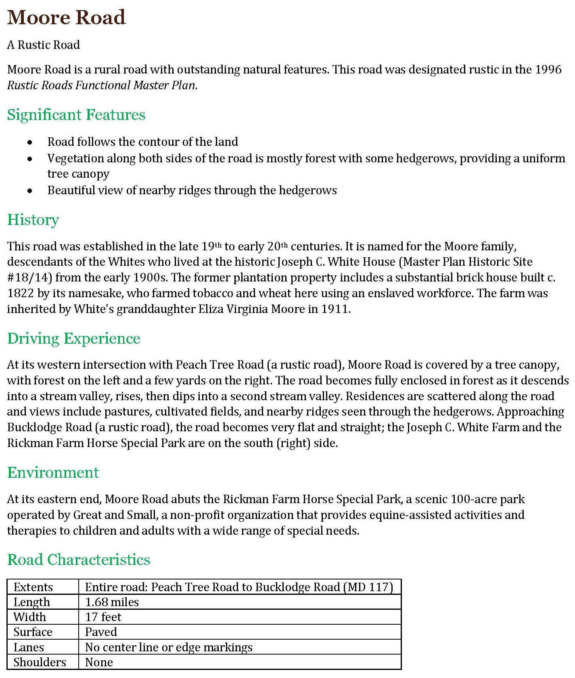
1996 and Updated Rustic Road Description
Notes:
Here is a comparison of the 1996 road profile vs the road profile that will be in the updated plan.

Slide 11
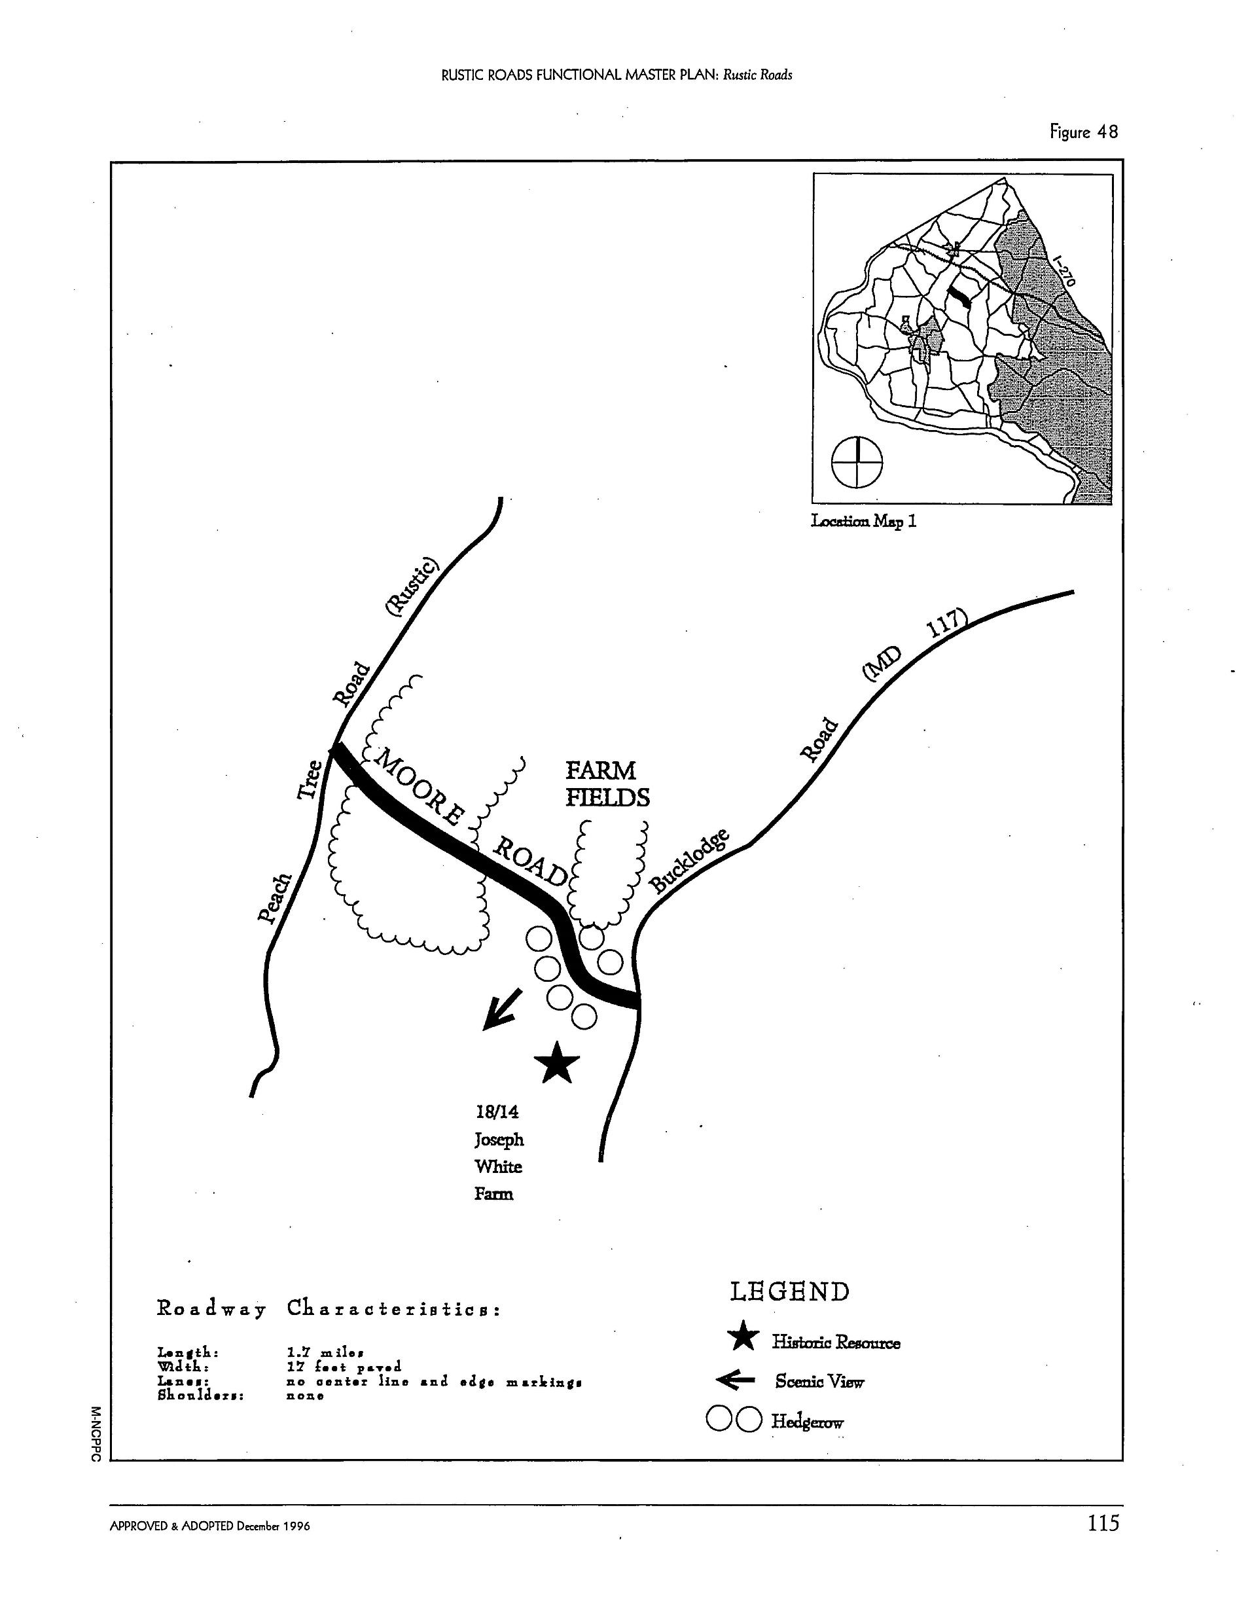
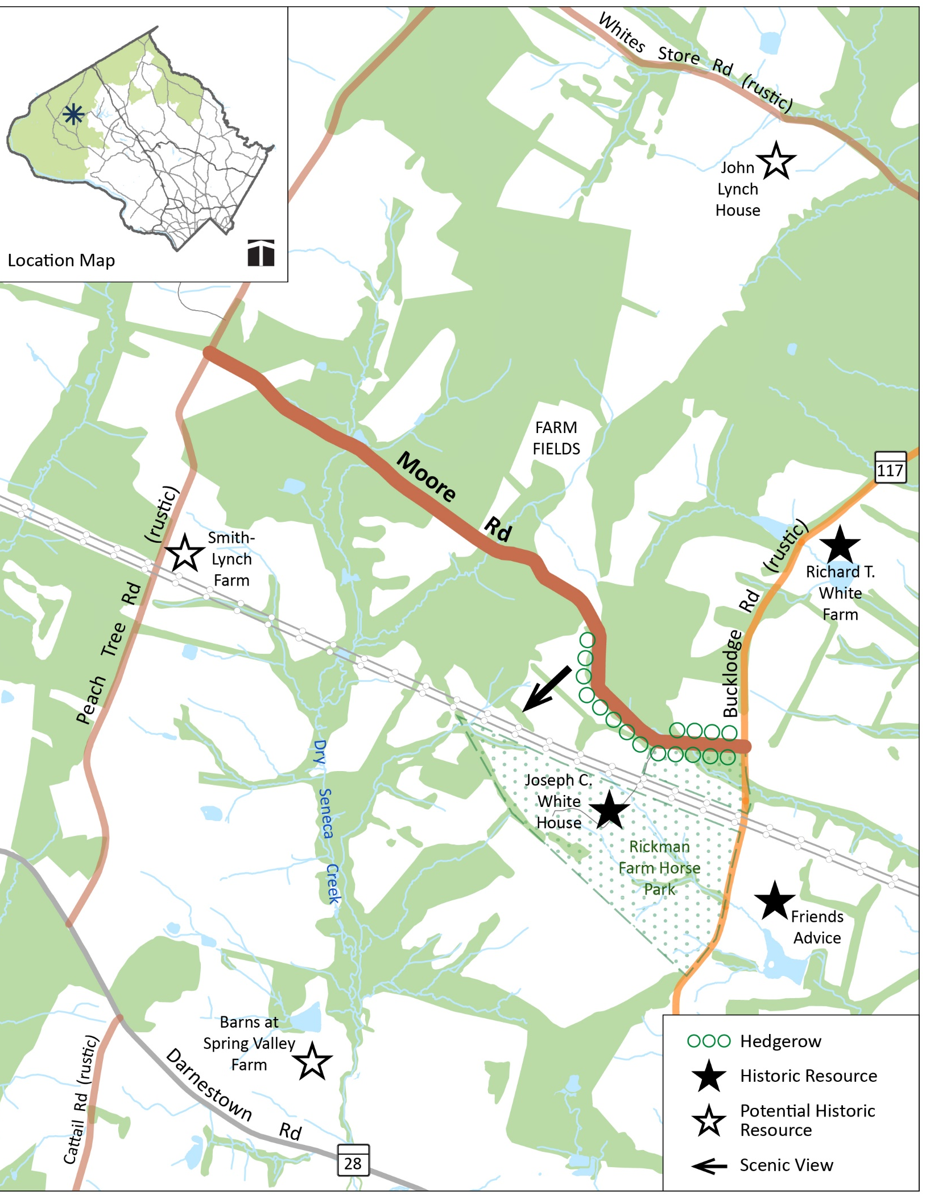
1996 and Updated Rustic Road Map
Notes:
We have added color to the maps to help better disthinguish features. We have also included additional features that help to give reads better bearing of where they are along the road such as streams, more forested areas, power lines.

Slide 12
Planning Board Decisions
Designate nominated road rustic or exceptional rustic
Approve changes to existing road descriptions
Changes to extents
Approve significant features
Change classification from rustic to exceptional rustic
Other text changes
Remove road from program
Notes:
When we bring the Working Draft to you, we will be asking for the following decisions from you:
Designating the nominated roads as rustic or exceptional rustic.
Approving any changes to existing road descriptions, such as the extents of the road, its significant features, a change in classification or other material text changes
Remove roads from the program.
The following slides will show roads that we believe fall in each of these categories.

Slide 13
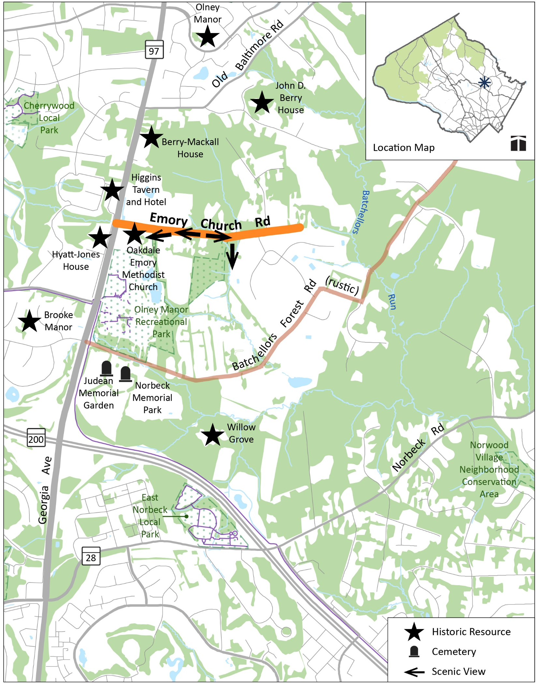
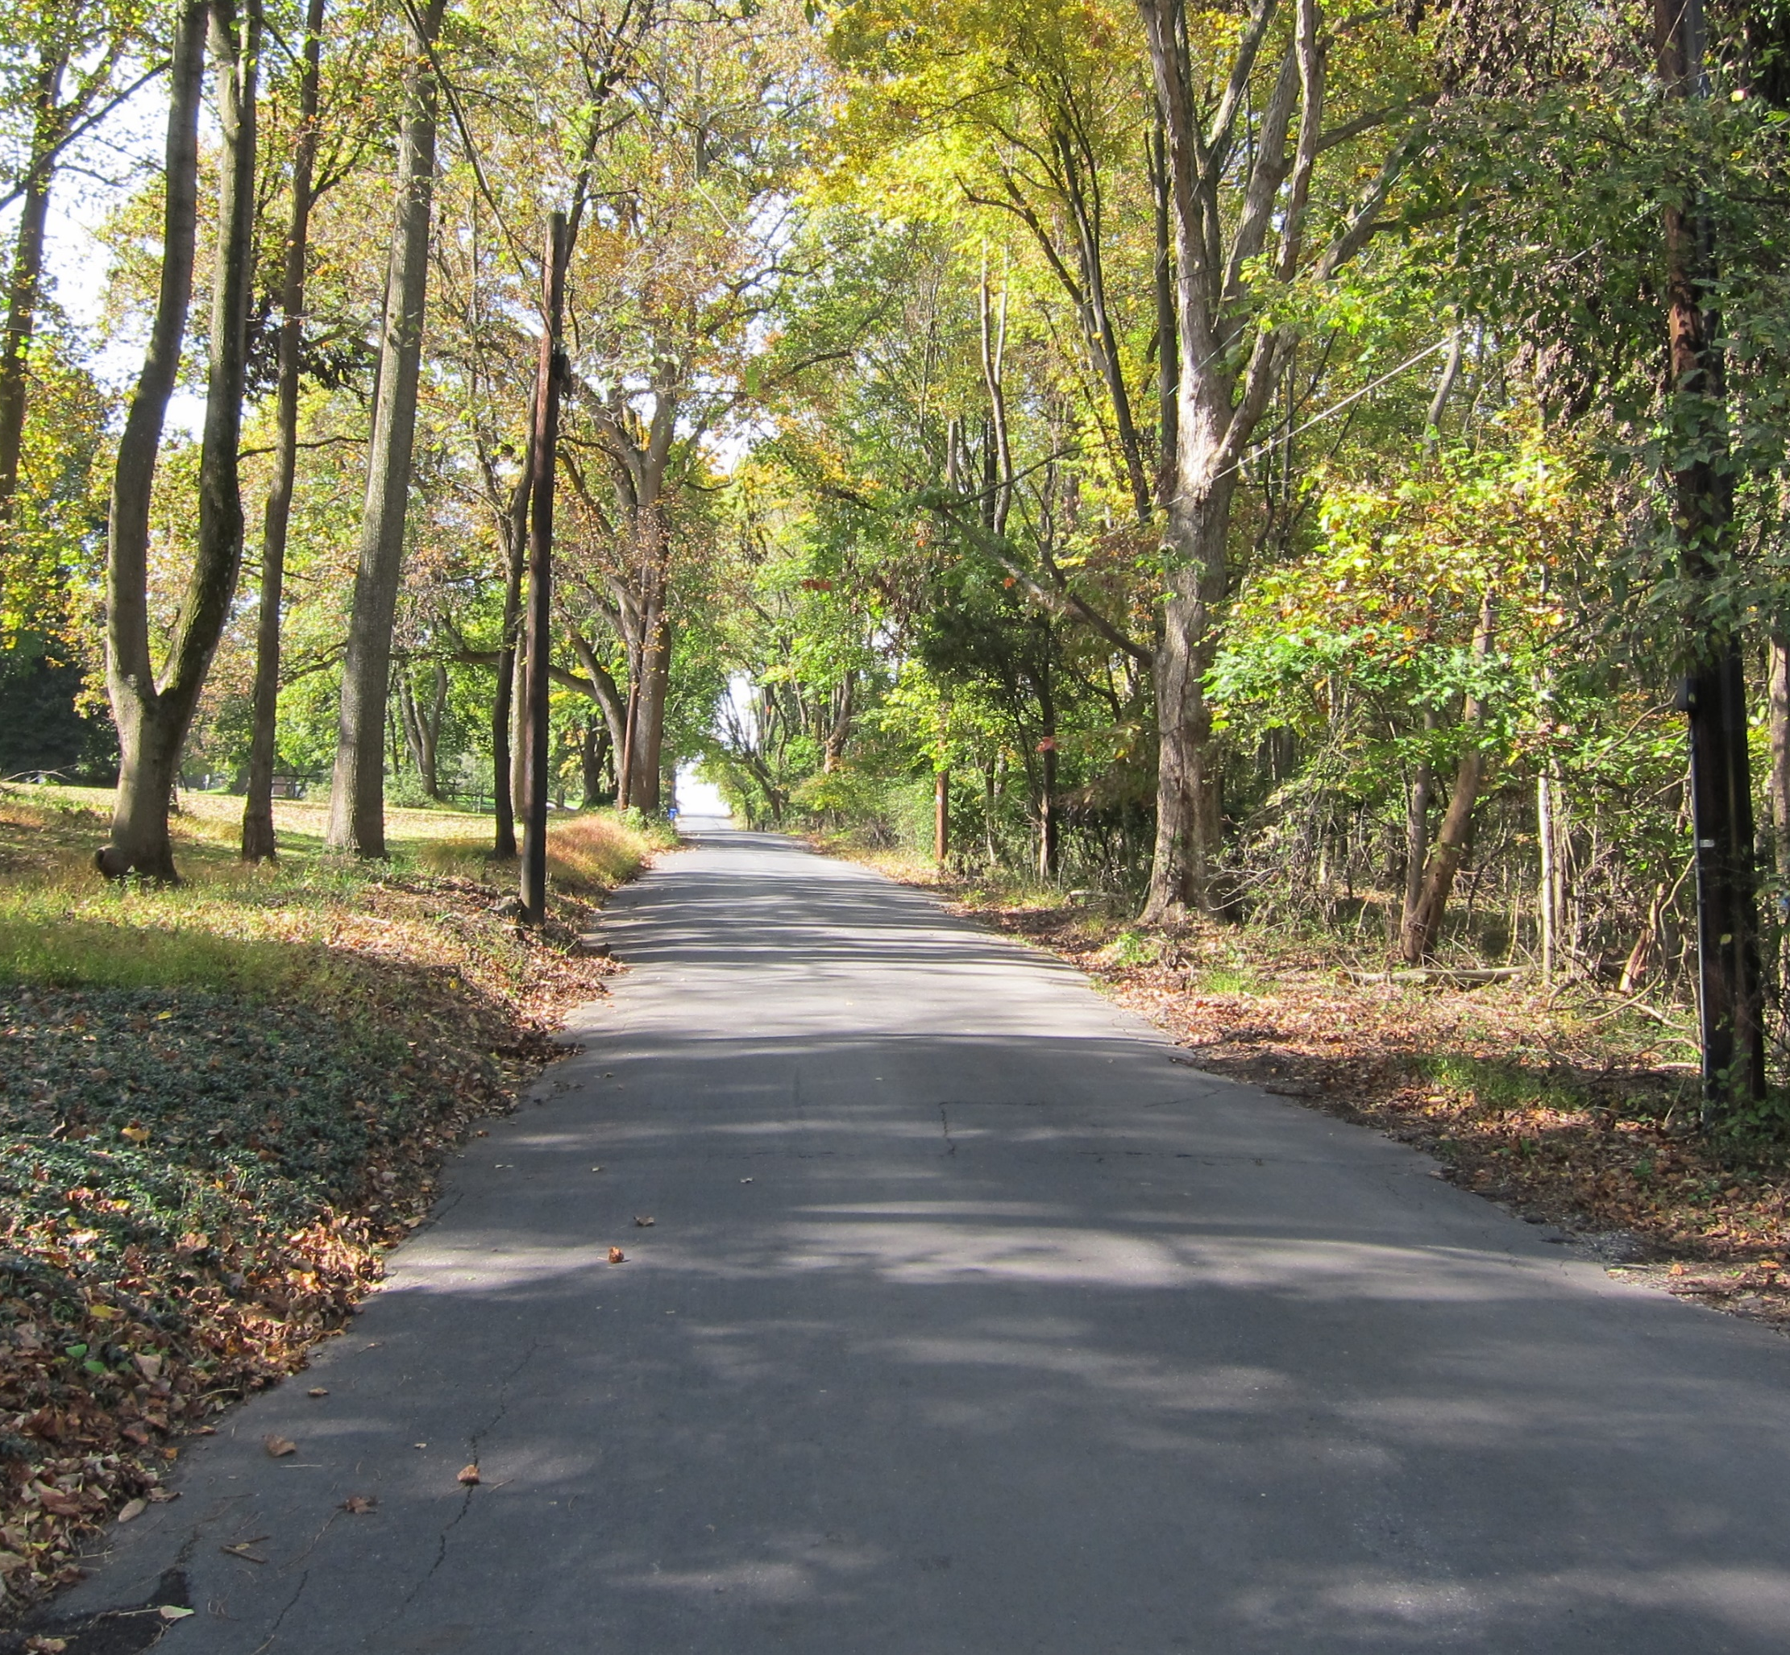
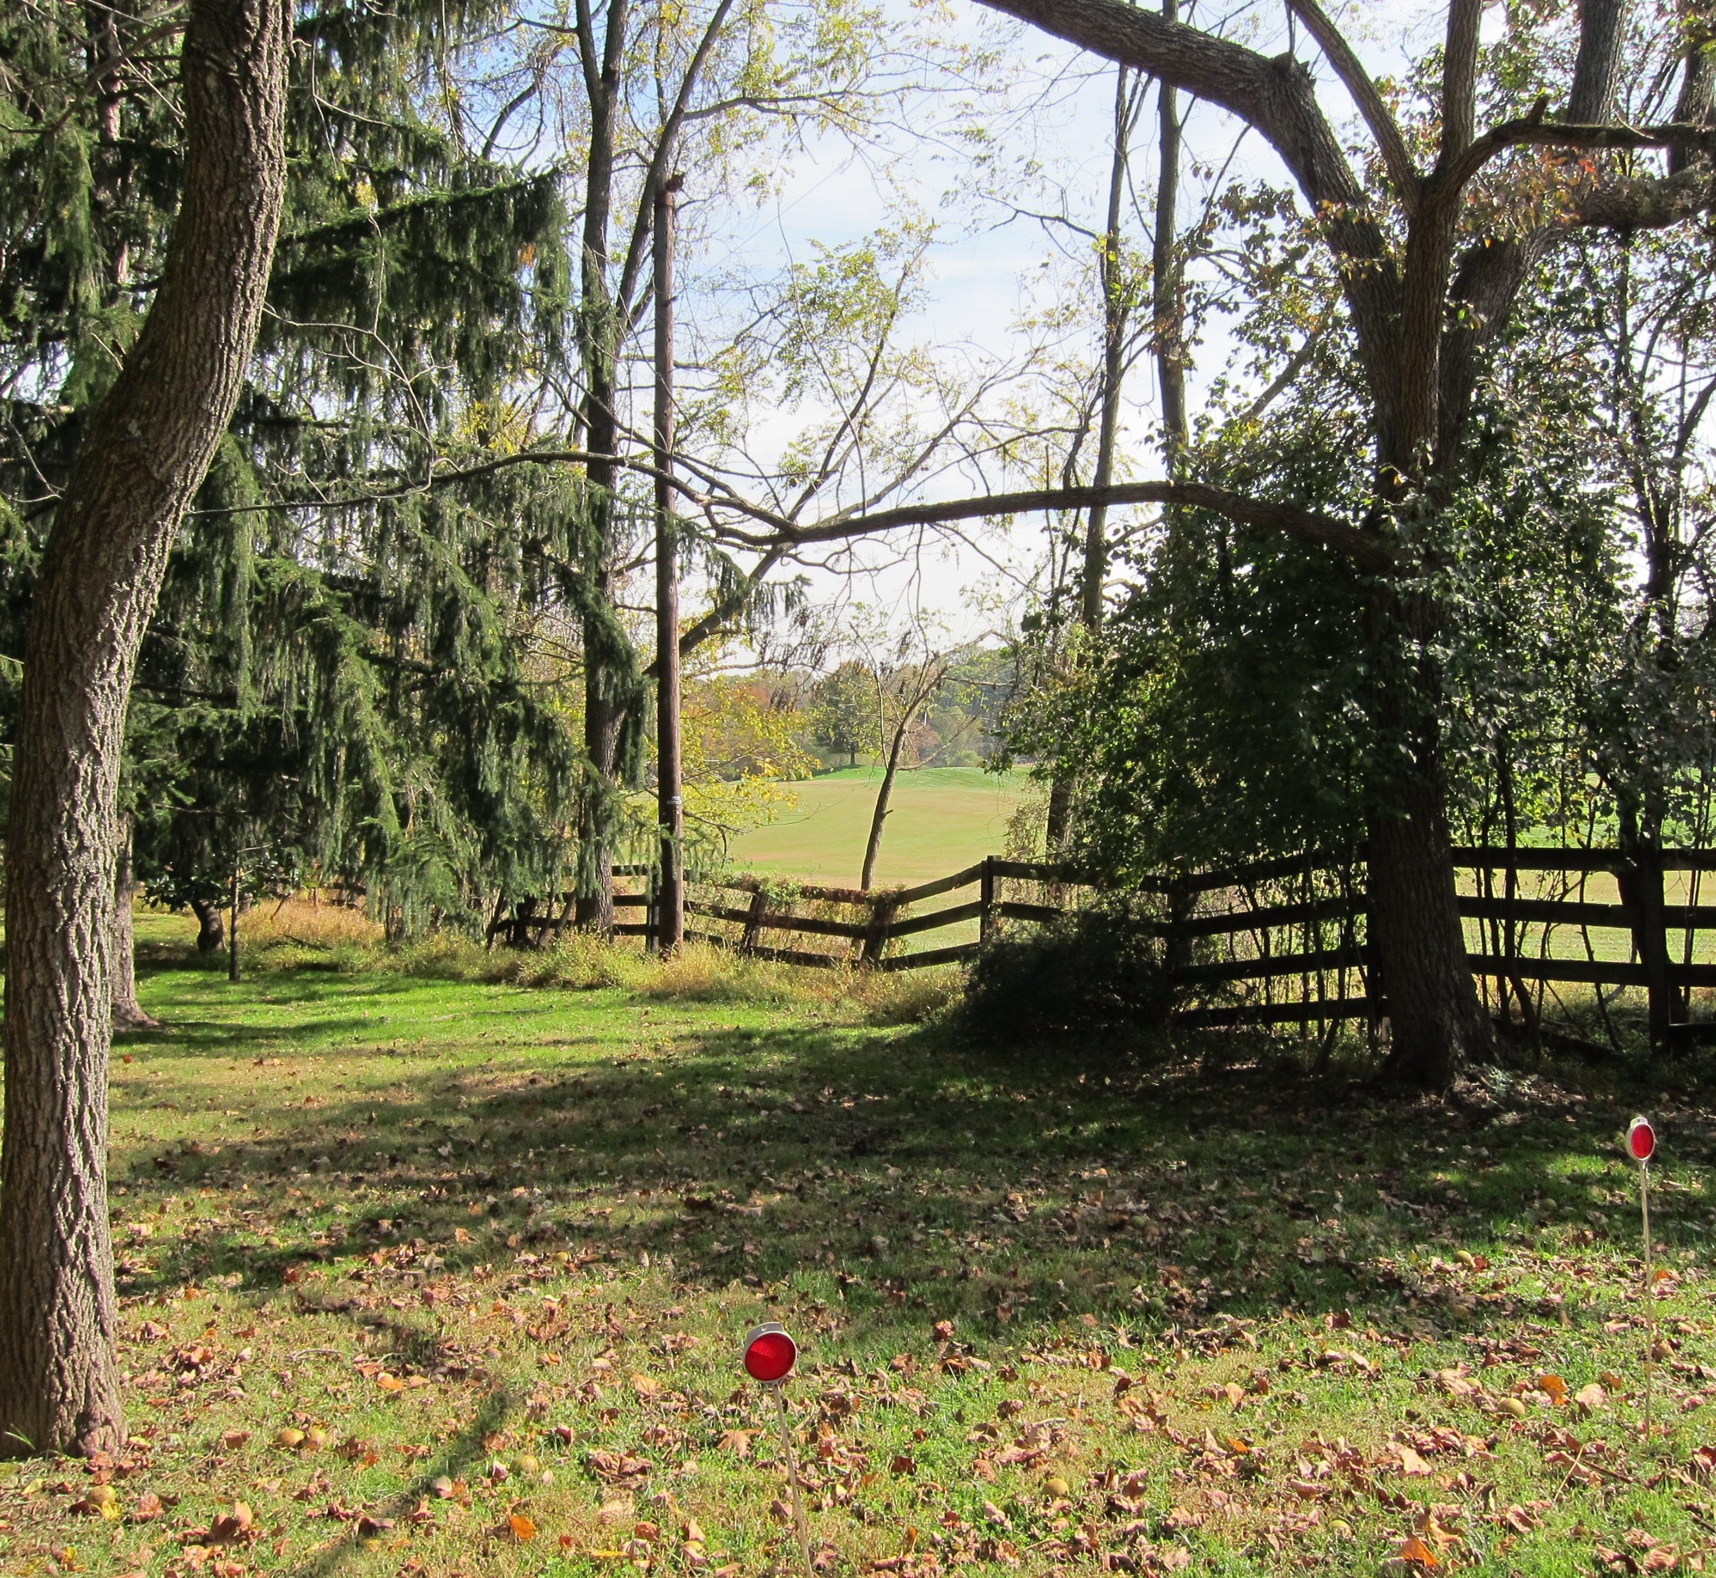
Emory Church Road
We recommend designating the road as a rustic road.
Notes:
First, we have Emory Church Road located east of Georgia Avenue in the Olney area. Emory Church Road is recommended as being designated a rustic road. As you can see, the road is narrow with a high tree canopy and sense of enclosure. Also, there are views to the surrounding fields.

Slide 14
25 Roads
Recommended Rustic
Aitcheson Lane
Brighton Dam Road
Brown Church Road
Bucklodge Road (MD 117)
Dickerson Church Road
Dickerson School Road
Emory Church Road
Halterman Road
Holly Grove Road
Kings Valley Road (part)
Lewisdale Road
Mullinix Mill Road
Nicholson Farm Road
Seneca Road
Sugarloaf Mountain Road
Thurston Road
Recommended Exceptional Rustic
Greenbridge Road
Holsey Road
Kings Valley Road (part)
Mount Carmel Cemetery Road
Not Recommended
Allnutt Road
Awkard Lane
Barnesville Road
Conoy Road
Georgia Avenue
Kings Valley Road (part)
The farm road
Notes:
There are 25 roads that are recommended as rustic, 3 recommended as exceptional rustic, and 1 with segments recommended as both rustic and exceptional rustic in this update. Another 7 seven roads or road segments were considered for designation in the program but are not being considered because they are either private roads or they did not meet the criteria discussed earlier.

Slide 15
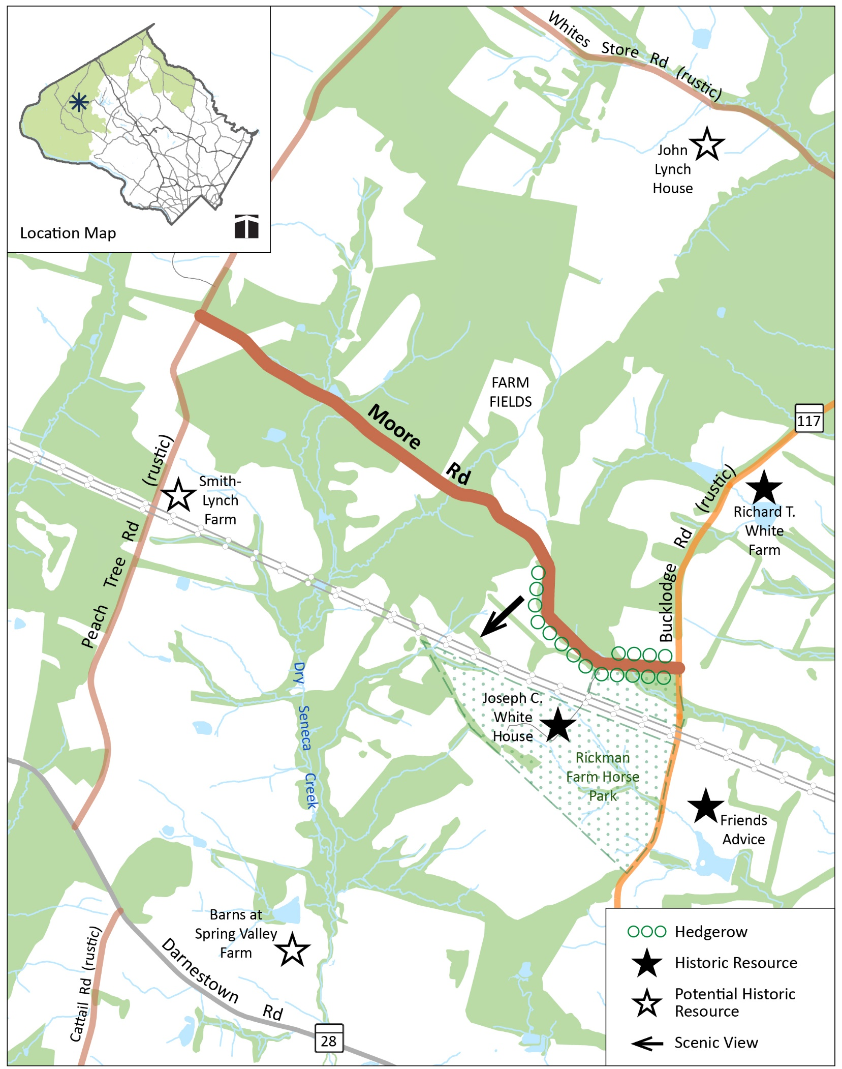
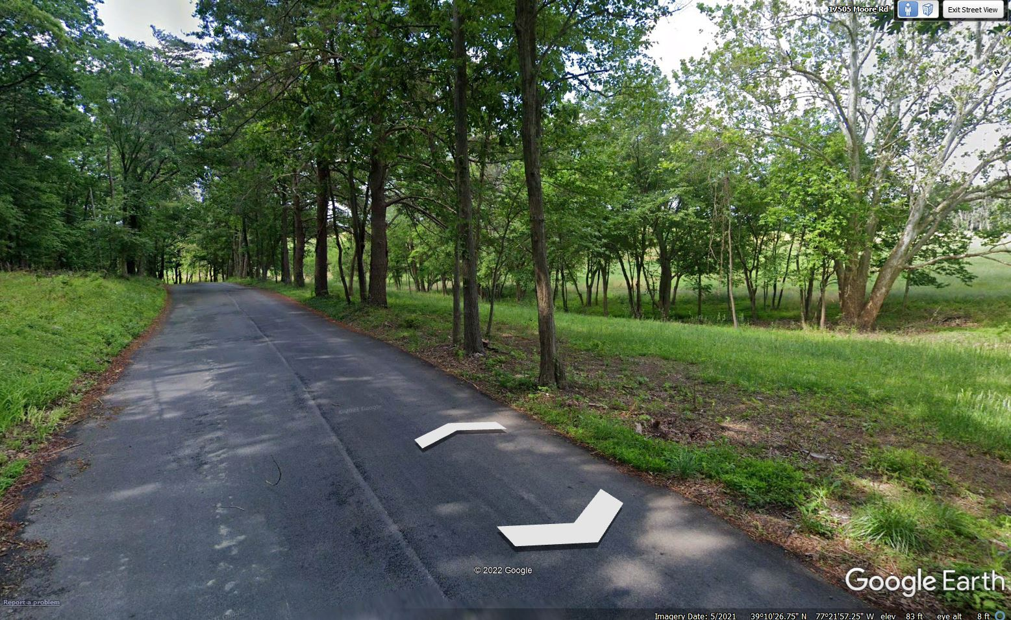
Moore Road
Designated rustic in the 1996 Rustic Roads Functional Master Plan.
No change to designation, significant features, or extents… only minor text updates
Notes:
Moore Road is a road that has been in the rustic roads program since the 1996 Plan. There are no changes to its designation, significant features or extents. There are only minor text updates and the maps are being updated to the new style.

Slide 16
34 Roads
Bentley Road
Big Woods Road
Black Rock Road
Budd Road
Burdette Lane
Cattail Road
Clopper Road
Club Hollow Road
Comus Road
Edwards Ferry Road
Elmer School Road
Haines Road
Hawkes Road
Hipsley Mill Road
Jerusalem Road
Jonesville Road
Kingsley Road
Kingstead Road
Meeting House Road
Montevideo Road
Moore Road
Mount Nebo Road
Mountain View Road
Prices Distillery Road
Purdum Road
Rileys Lock Road
Sugarland Lane
Trundle Road
Violettes Lock Road
West Offutt Road
West Willard Road
Whites Ferry Road
Whites Store Road
Zion Road
Notes:
There are 34 roads that fall within this category. Most of these roads are from the 1996 Plan and can be found in the Ag Reserve.

Slide 17
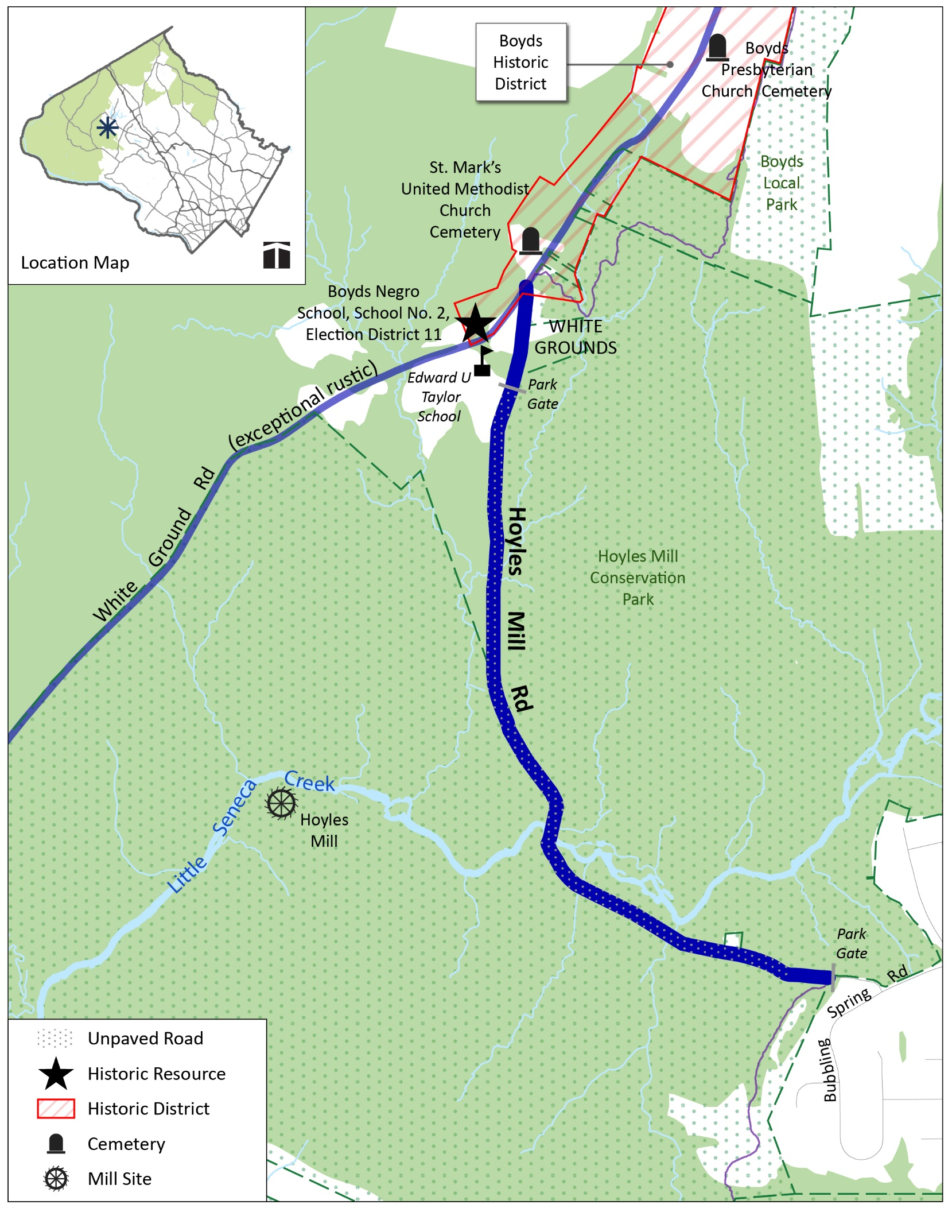
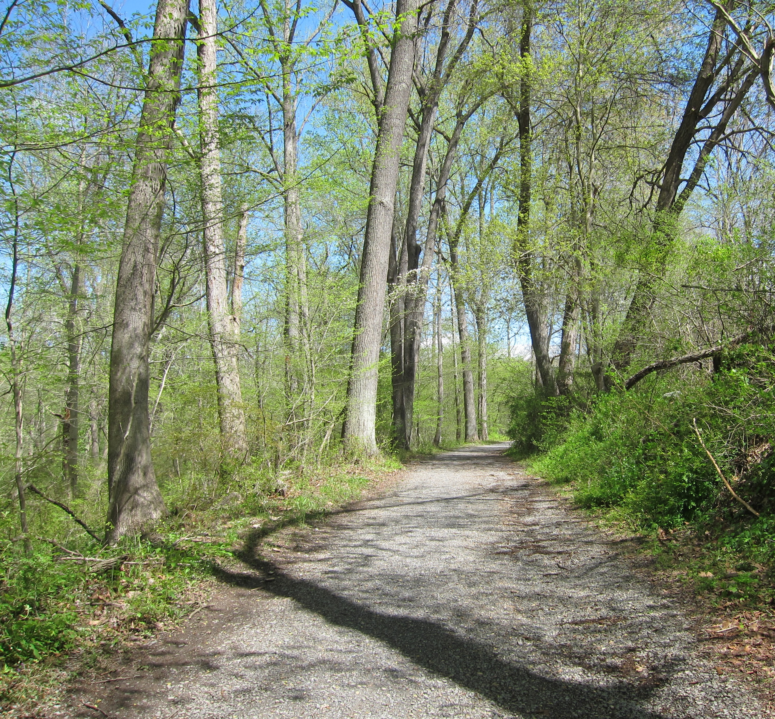
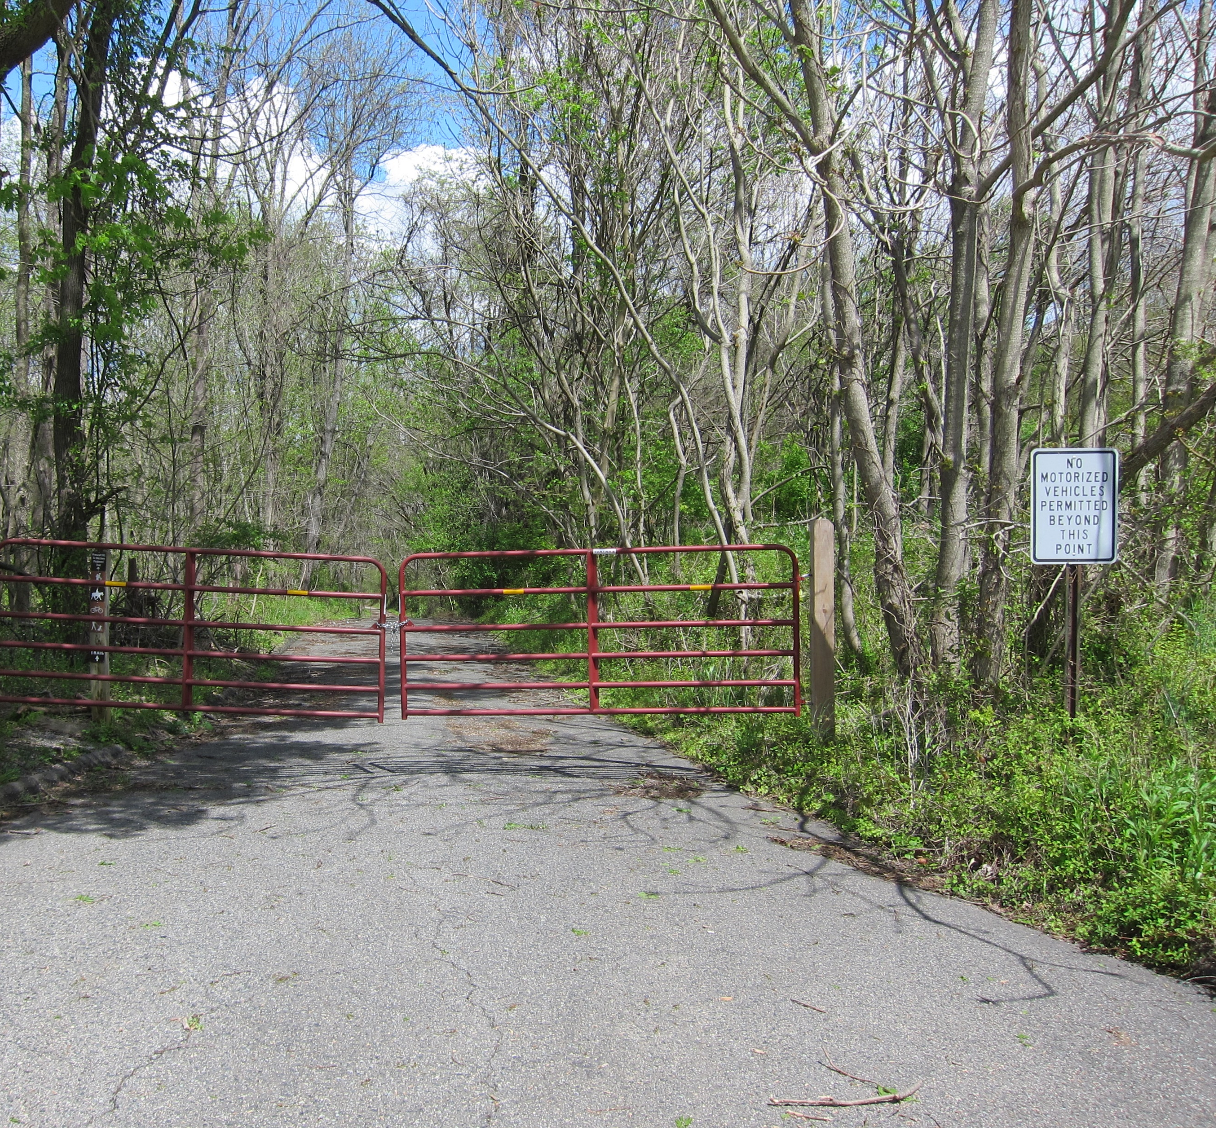
Hoyles Mill Road
Designated exceptional rustic in the 1996 Rustic Roads Functional Master Plan.
Update eastern extent of the road.
Exceptional Rustic Designation Extended
Notes:
Hoyles Mill Road was designated exceptional rustic in the 1996 Plan. This Plan updates the eastern extent of the road to continue to the Park Gate.

Slide 18
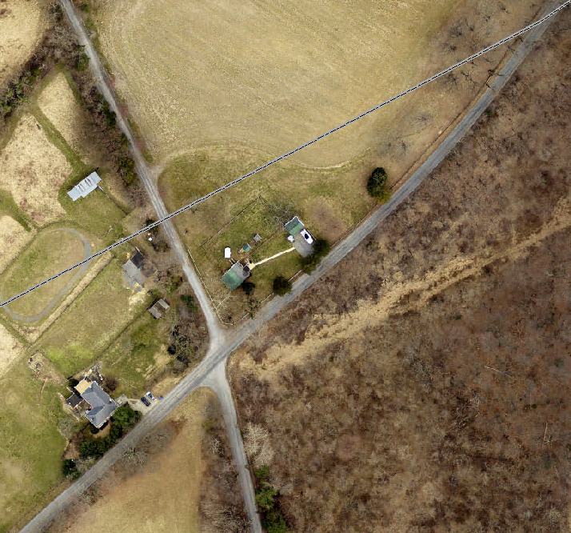
14 Roads
Batchellors Forest Road (shorter)
Brookeville Road (shorter)
Dustin Road (shorter)
Hoyles Mill Road (longer)
Hughes Road (clarification)
Johnson Road (clarification)
Mount Ephraim Road (clarification)
Mouth of Monocacy Road (longer)
Schaeffer Road (shorter)
Slidell Road (shorter)
Stringtown Road (shorter)
Sugarloaf Mountain Road (clarification)
Turkey Foot Road (shorter)
West Harris Road (clarification)
Frederick County Line
Mount Ephraim Road
Sugarloaf Mountain Road
Mount Ephraim Road
West Harris Road
Notes:
There are 14 roads were the extents change by either getting longer, shorter or by being clarified. The photograph is an example of a clarification. The 1996 Plan show West Harris Road extending to the Frederick County Line. In fact, West Harris Road ends at the intersection of Mount Ephraim and Sugarloaf Mountain Roads. Beyond the intersection the road continues as Mount Ephraim Road.

Slide 19
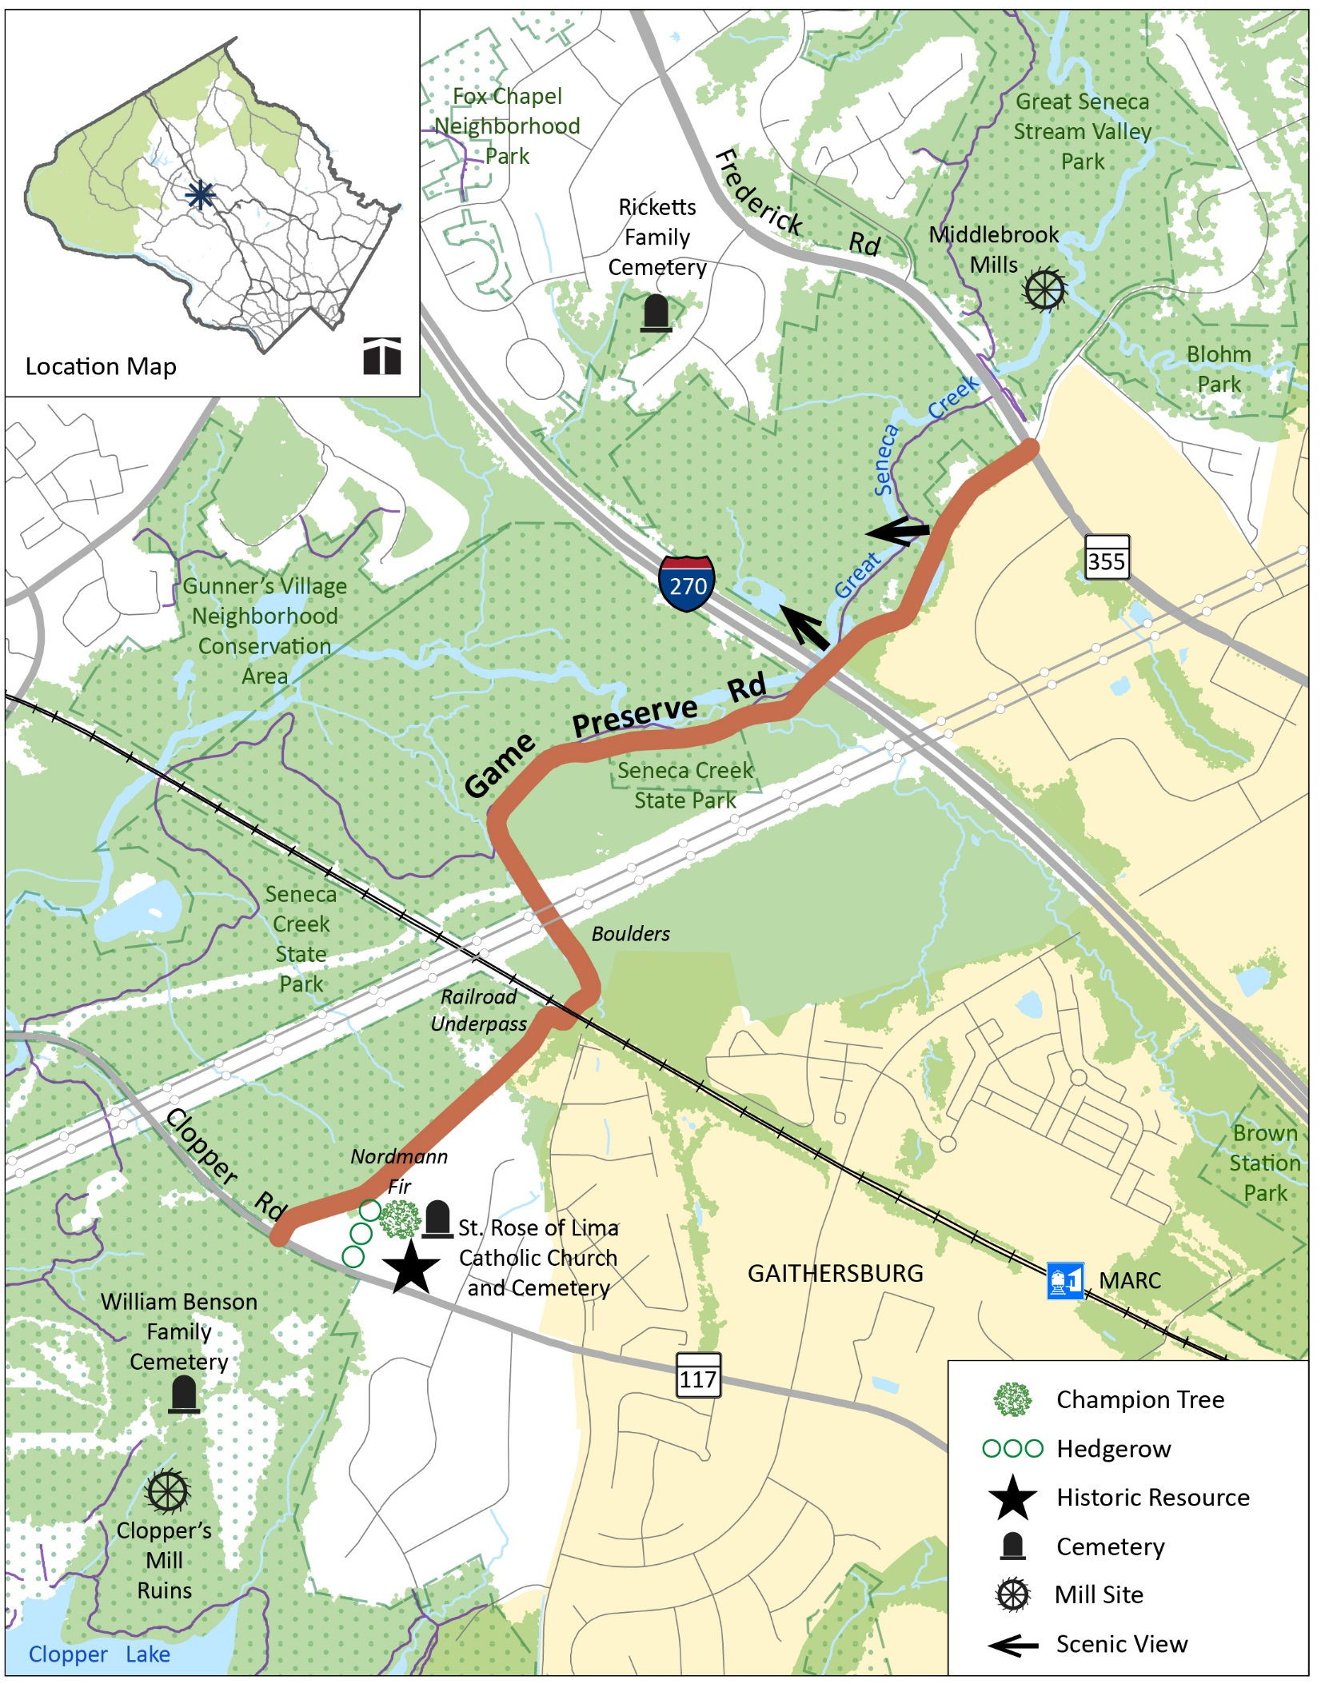
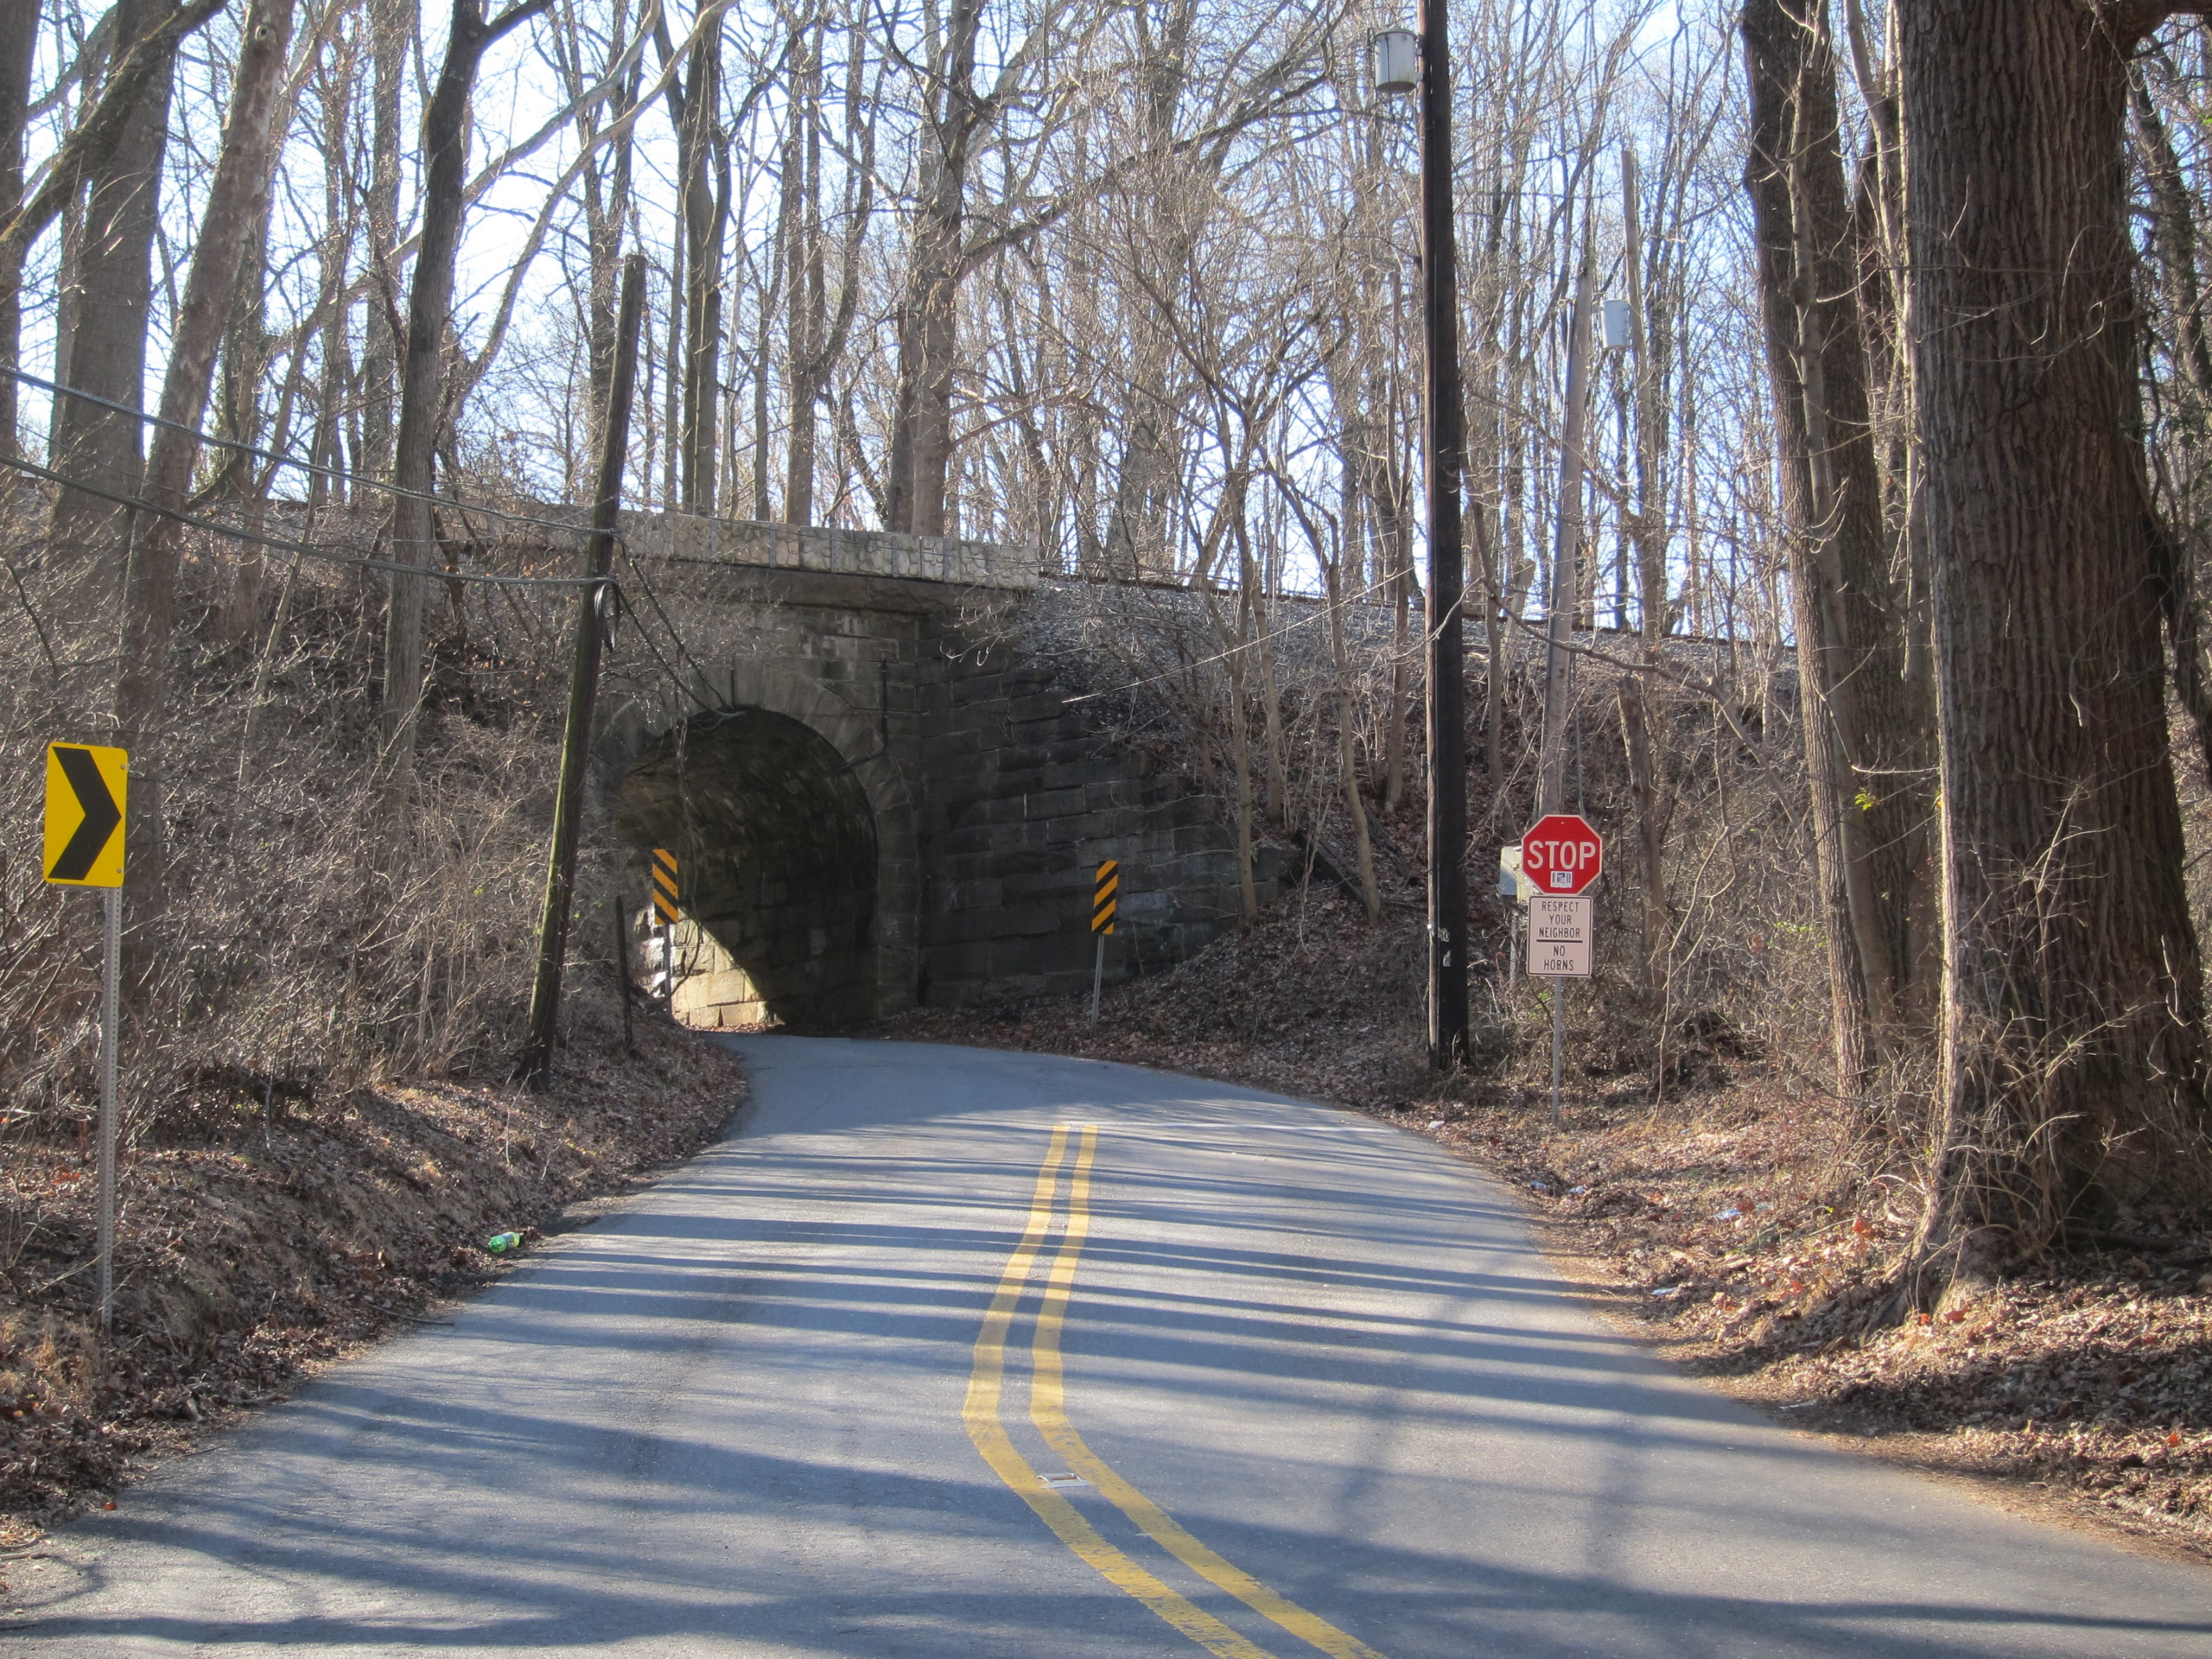
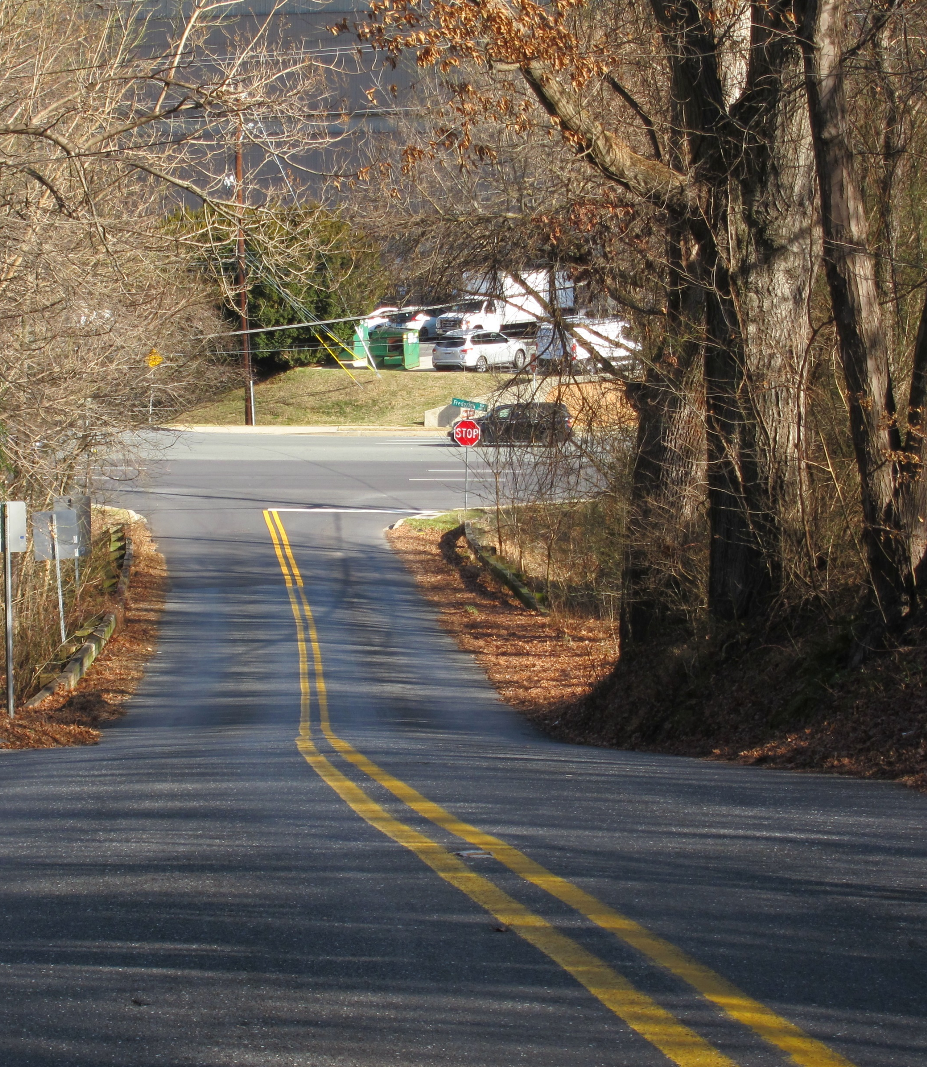
Game Preserve Road
Designated rustic in the 2010 Great Seneca Science Corridor Master Plan.
Will need to approve entire road description.
Notes:
Game Preserve Road was designated rustic in the 2010 Great Seneca Science Corridor Master Plan. However, the 2010 Plan only classified the road. It did not provide a complete description of the road with its significant features, a history of the road, a driving experience or the road characteristics.

Slide 20
24 Roads
Avoca Lane
Batchellors Forest Road
Batson Road
Belle Cote Drive
Berryville Road
Brighton Dam Road
Bryants Nursery Road
Dustin Road
Frederick Road (MD 355)
Game Preserve Road
Glen Mill Road
Glen Road
Haviland Mill Road
Johnson Road
Oak Hill Road
Old Orchard Road
Poplar Hill Road
Query Mill Road
Santini Road
South Glen Road
Stoney Creek Road
Triadelphia Lake Road
Tucker Lane
Turkey Foot Road
Notes:
There are 24 roads already in the rustic roads program with incomplete descriptions, including significant features.

Slide 21
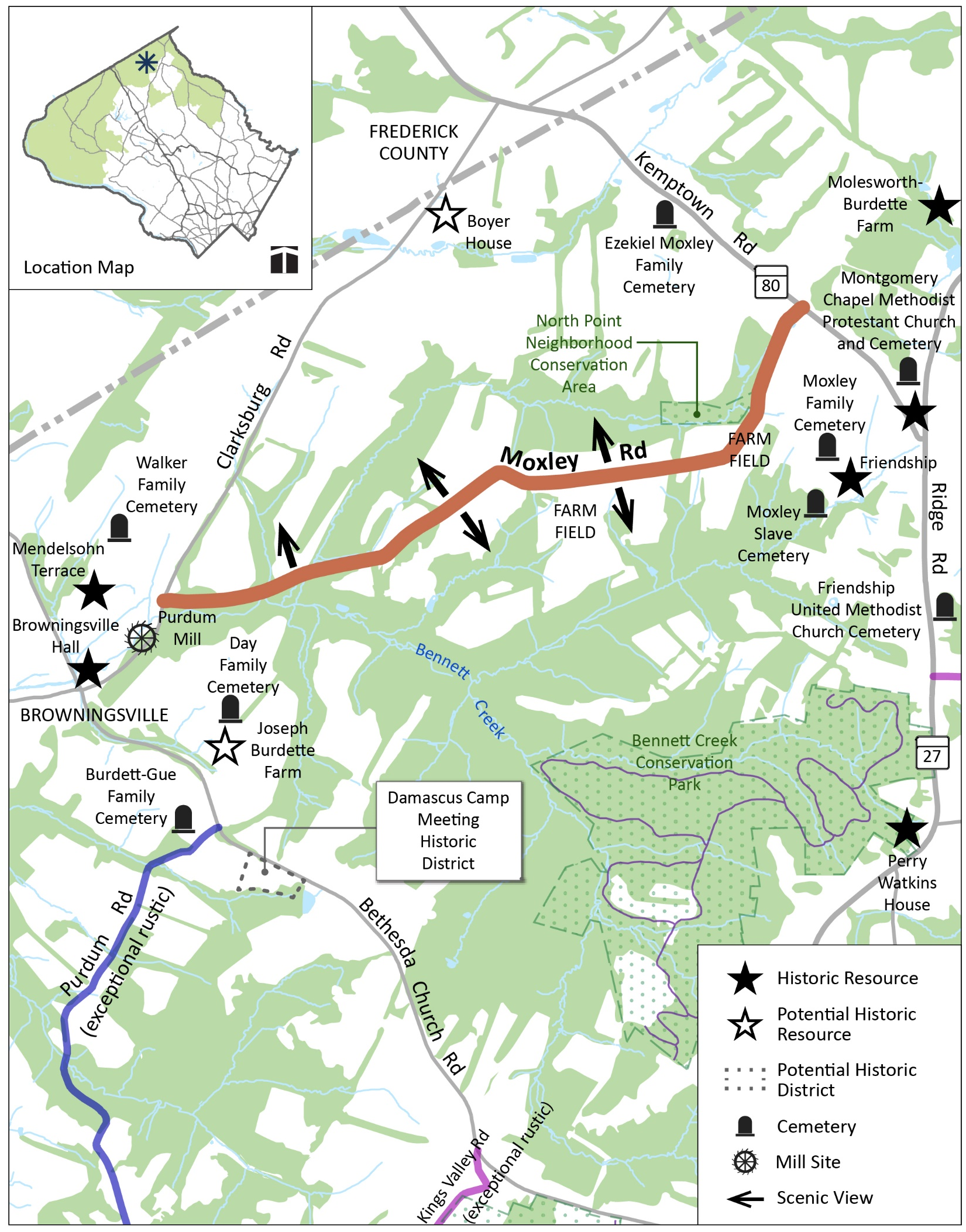
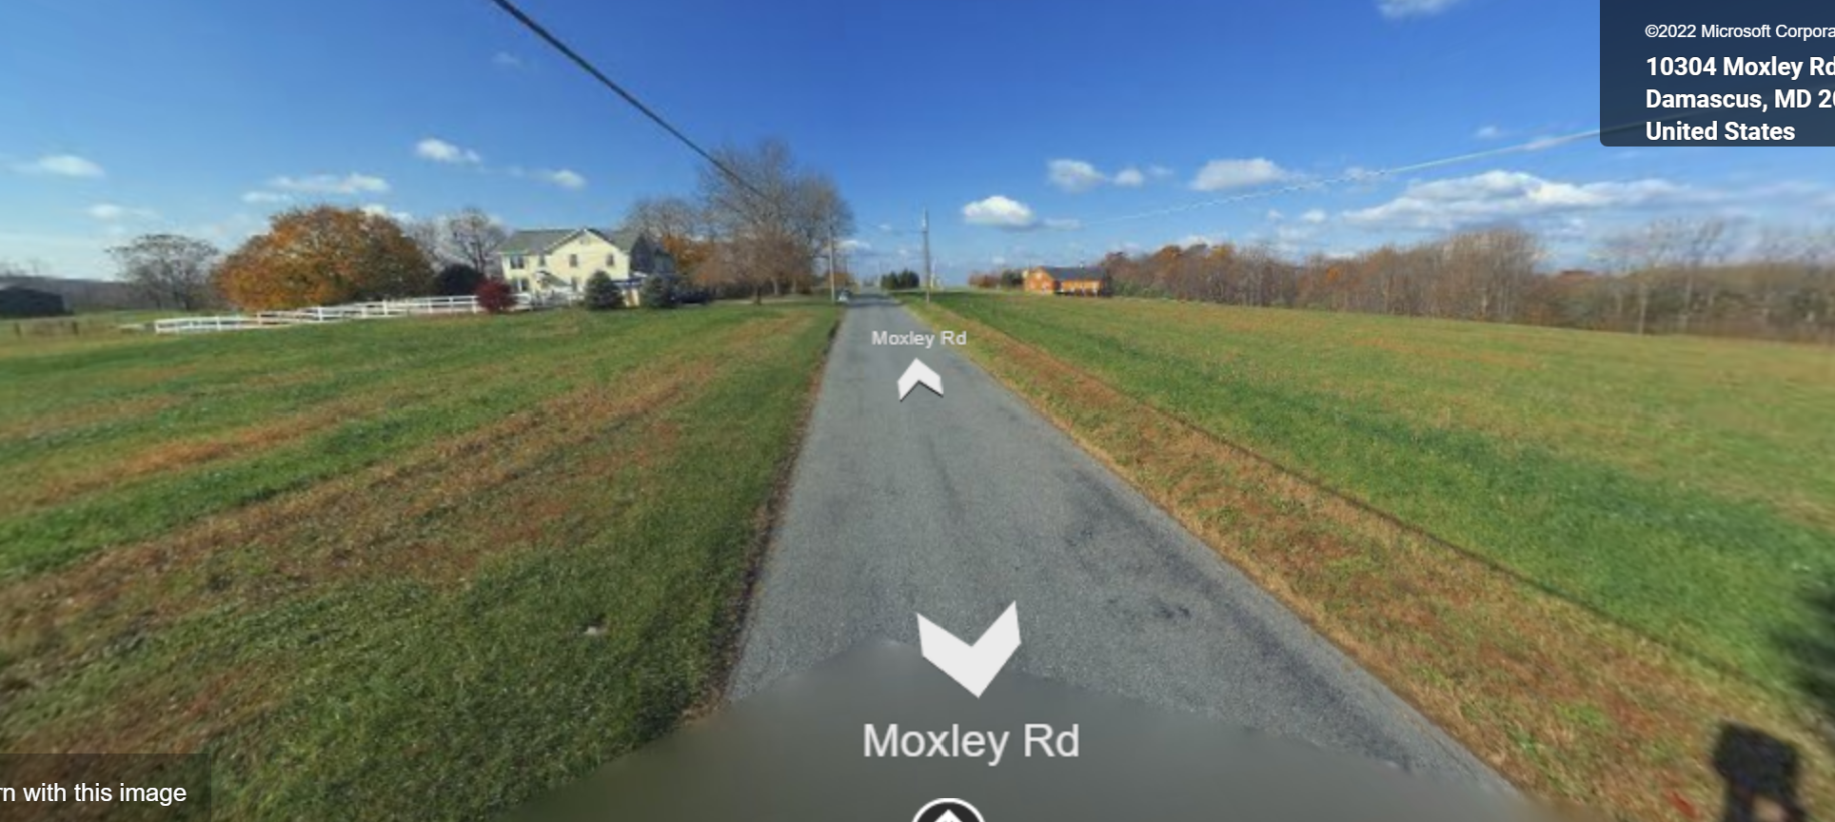
Moxley Road
Designated rustic in the 1996 Rustic Roads Functional Master Plan.
Revise significant features.
Image from Bing Maps
Notes:
Moxley Road was designated as rustic in the 1996 Plan. This Plan update slightly revise the list of significant features to include views in all directions, not just towards Frederick County.

Slide 22
27 Roads
Barnesville Road
Beallsville Road
Brookeville Road
Burnt Hill Road
Gregg Road
Howard Chapel Road
Hunting Quarter Road
Hyattstown Mill Road
Martinsburg Road
Mouth of Monocacy Road
Moxley Road
Old Hundred Road (MD 109)
Old River Road
Pennyfield Lock Road
Prescott Road
River Road (exceptional segment)
River Road (rustic segment)
Rocky Road
Sugarland Road
Sugarloaf Mountain Road
Swains Lock Road
Sycamore Landing Road
Wasche Road
West Hunter Road
West Old Baltimore Road
Westerly Road
White Ground Road
Wildcat Road
Notes:
There are 27 roads that have recommended changes to significant features.

Slide 23
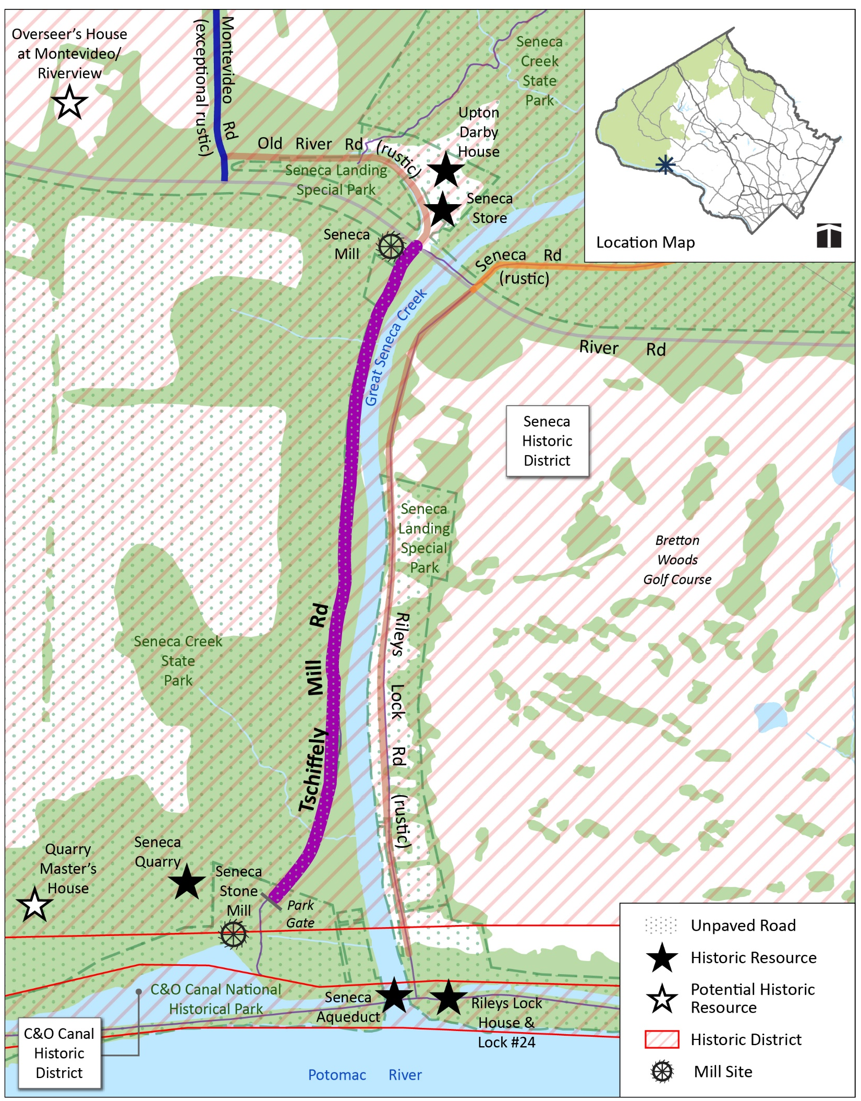
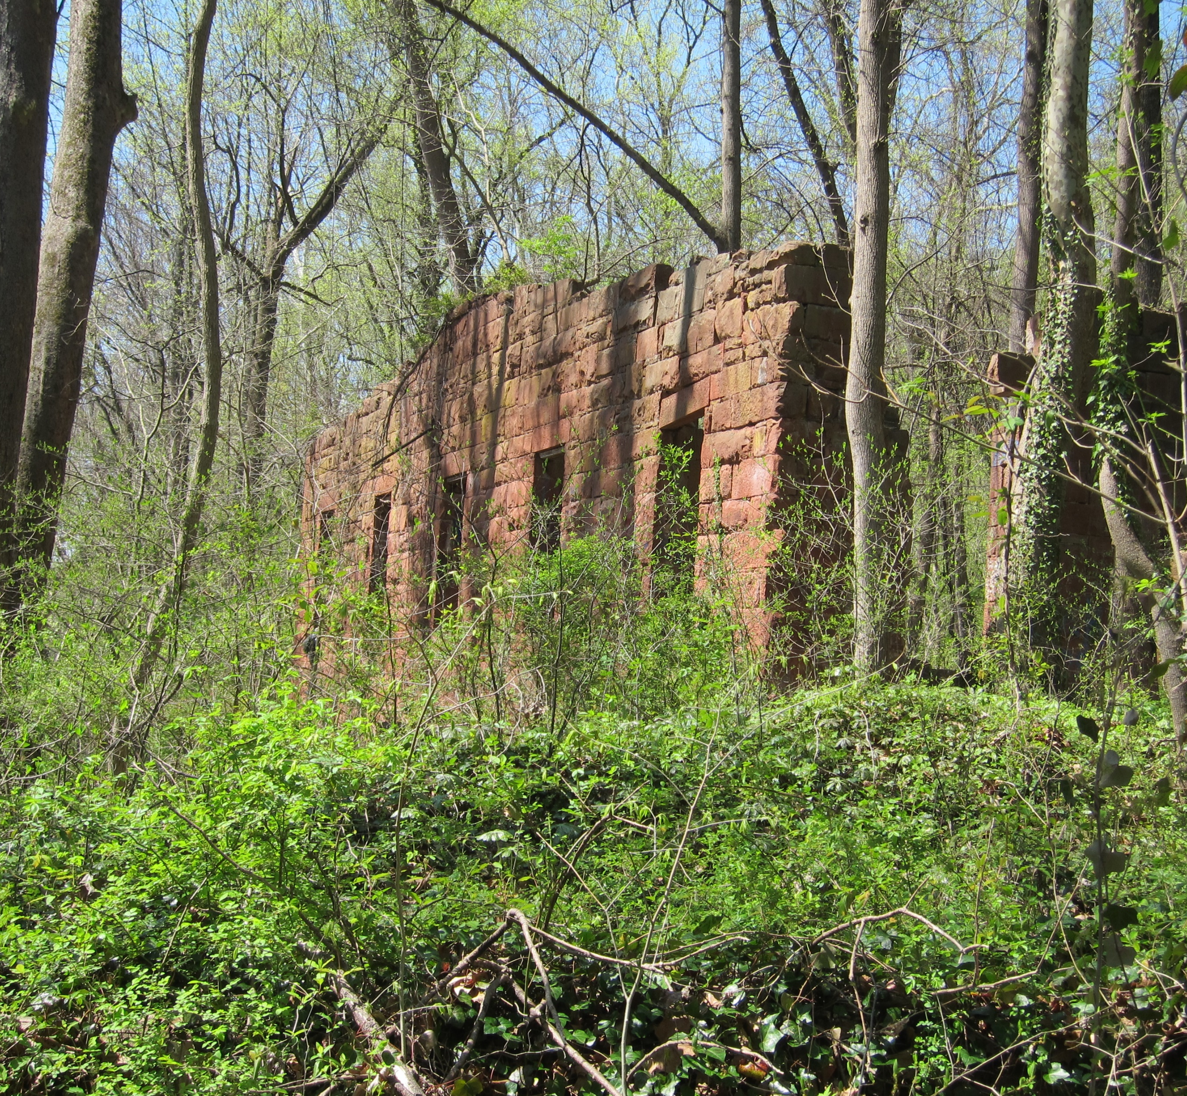
Tschiffely Mill Road
Designated rustic in the 1996 Rustic Roads Functional Master Plan.
Change designation to exceptional rustic.
Notes:
Tschiffely Mill Road was designated rustic in the 1996 Plan. This Plan recommends changing the designation to exceptional rustic. The road is a gravel road that runs parallel to Seneca Creek, and the ruins of Seneca Mill and Seneca Stone Mill are located on each ends of the road.

Slide 24
17 Roads
Avoca Lane
Belle Cote Drive
Brighton Dam Road
Davis Mill Road
Elton Farm Road
Gregg Road
Hunting Quarter Road (clarification)
Hyattstown Mill Road
Old Bucklodge Lane
Peach Tree Road
Prescott Road
Query Mill Road
Riggs Road
Triadelphia Lake Road
Tschiffely Mill Road
Tucker Lane
Wildcat Road
Notes:
17 roads are proposed to be reclassified.

Slide 25
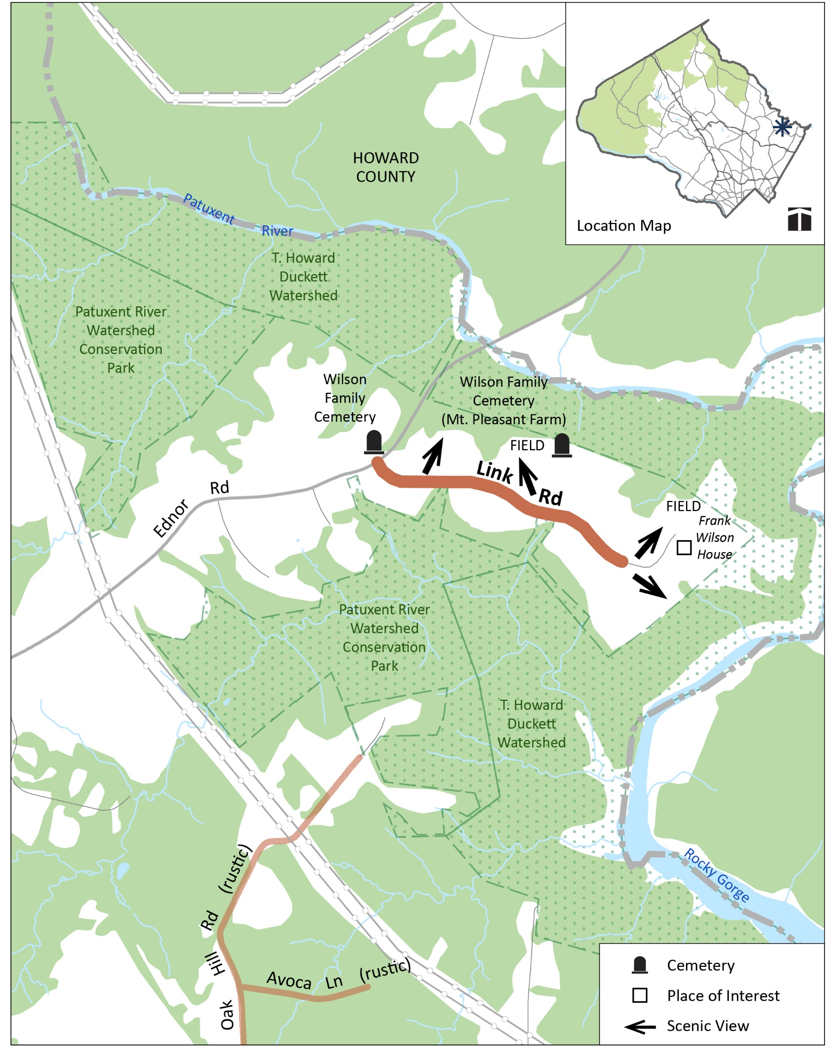
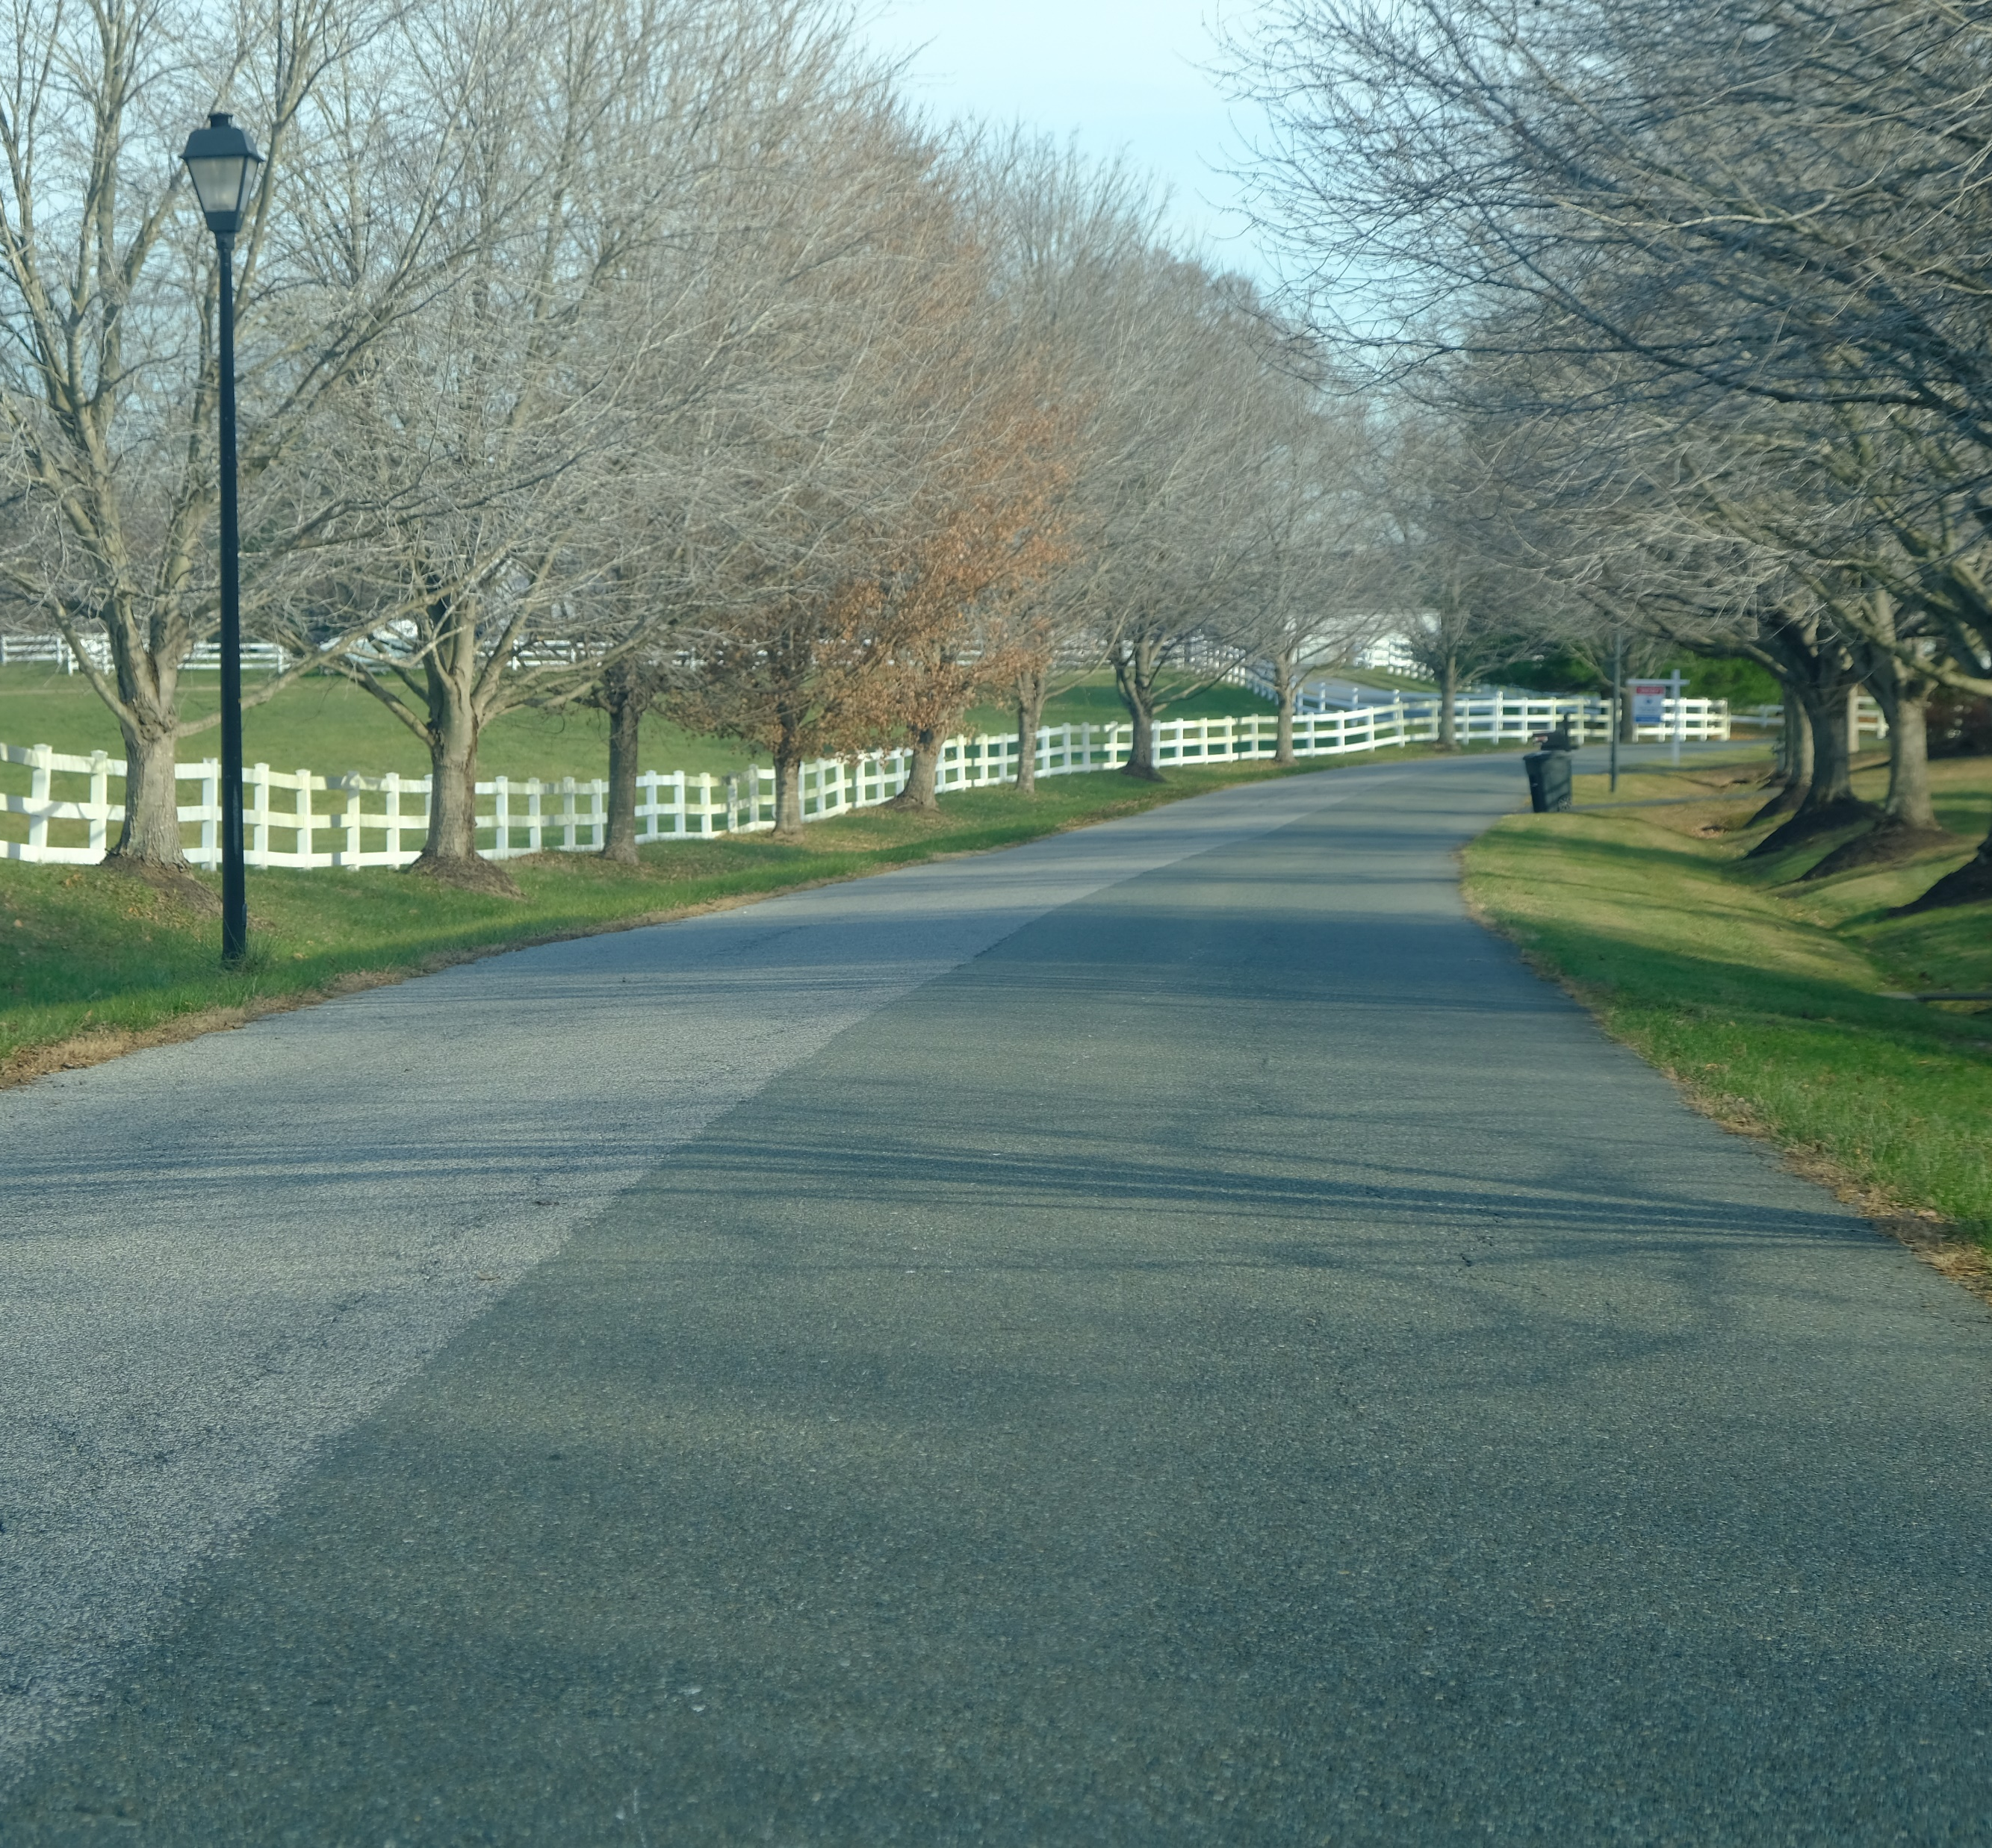
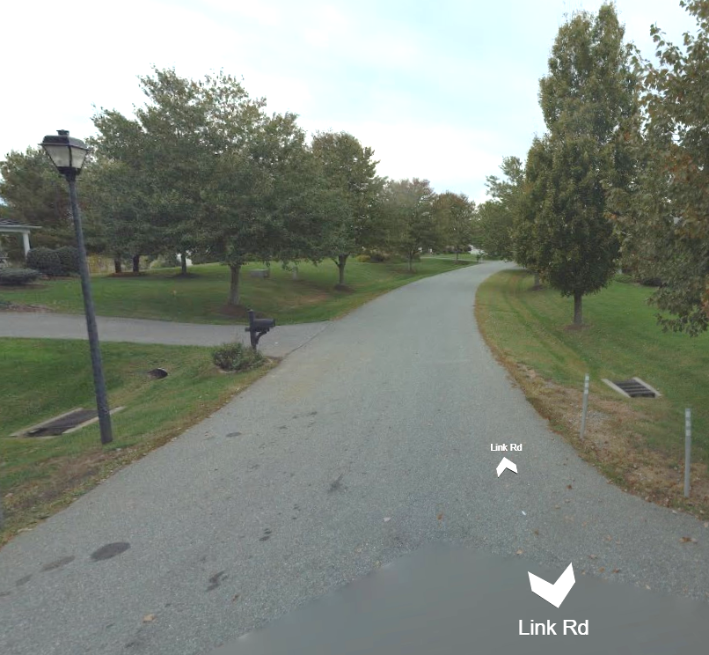
Link Road
Designated rustic in the 1997 Cloverly Master Plan.
Remove Link Road from the program.
Image from Bing Maps
Notes:
Link road is a road Link Road was designated in the 1997 Cloverly Master Plan. As you can see from the two images, i

Slide 26
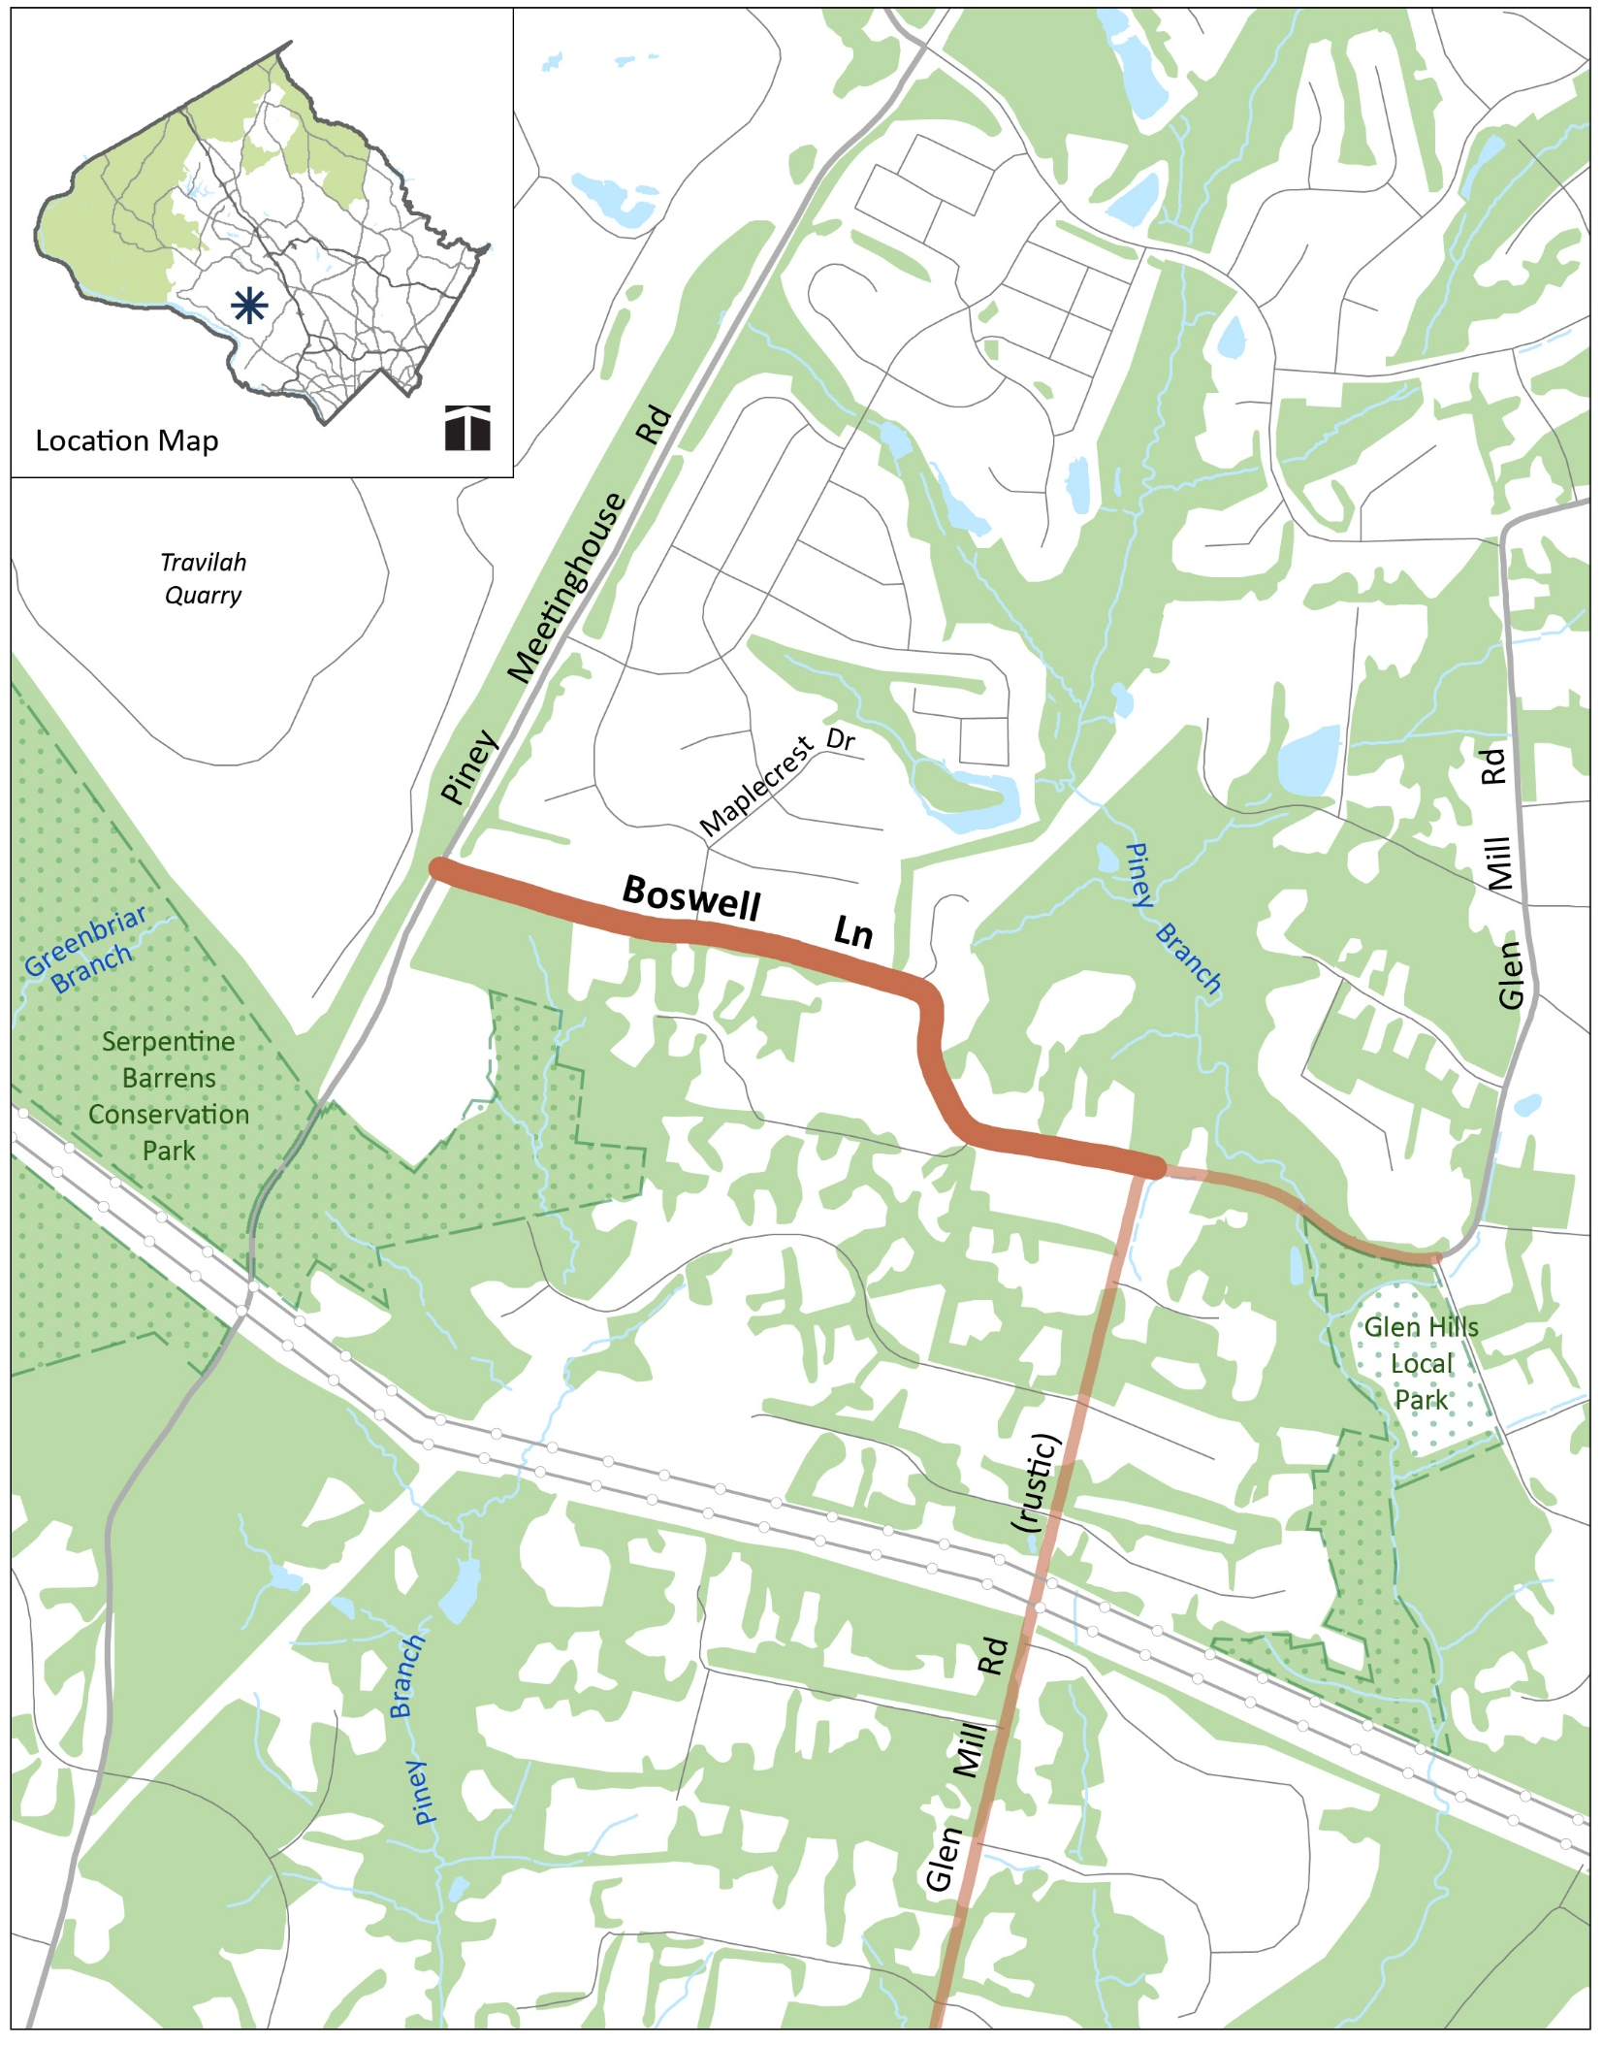
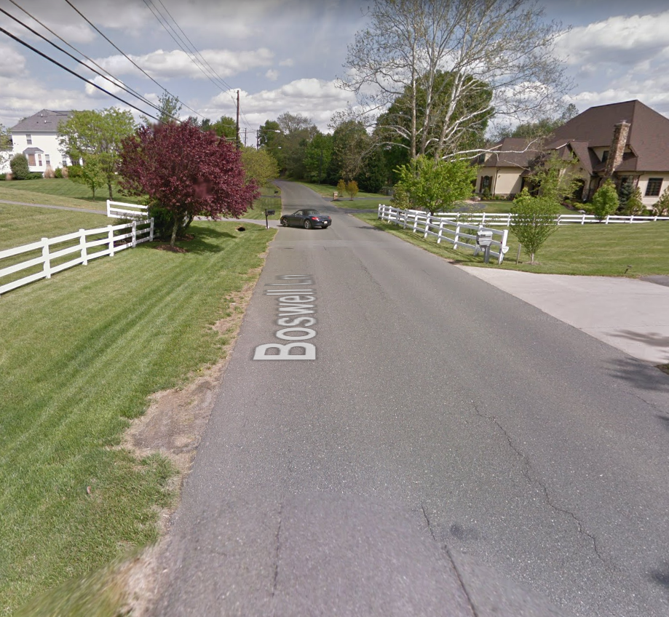
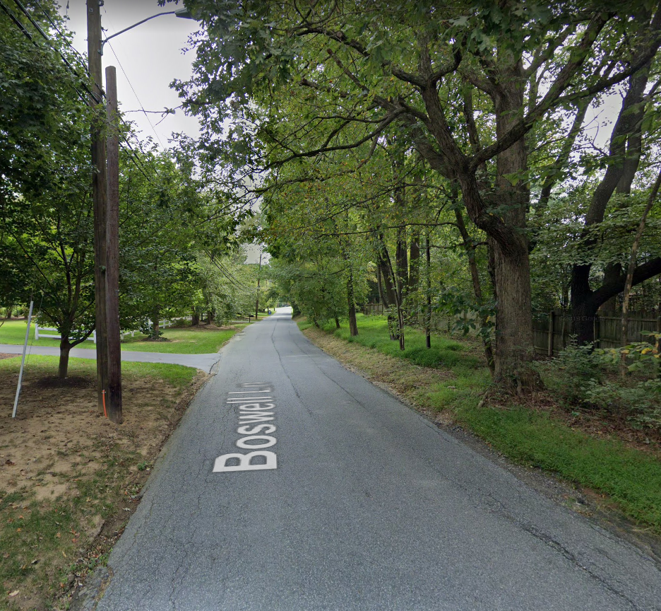
Boswell Lane
Designated rustic in the 2002 Potomac Subregion Master Plan.
Remove Boswell Lane from the program.
Image from Google Maps
Image from Google Maps

Slide 27
2 Roads
Boswell Lane
Link Road
(If roads remain in program, approve significant features.)

Slide 28
Equity
Staff reviewed each of the existing individual road profiles. Used National Park Service Guidance to updated language in the Plan.
Where opportunity provided, highlighted the histories of underrepresented groups and communities in the histories of those road profiles that are being written as a part of this update.
Considered adding roads to the program from communities established by formerly enslaved people and their descendants.
Notes:
Looked at equity for existing road profiles to see if the language needs to be updated to be more equitable, especially concerning slavery and people’s who’s wealth was built on an enslaved workforce. In the previous Plan, sometimes mention of the Confederacy that was overly glorified, so we have combed through the text and tried to tone down the language.

Slide 29
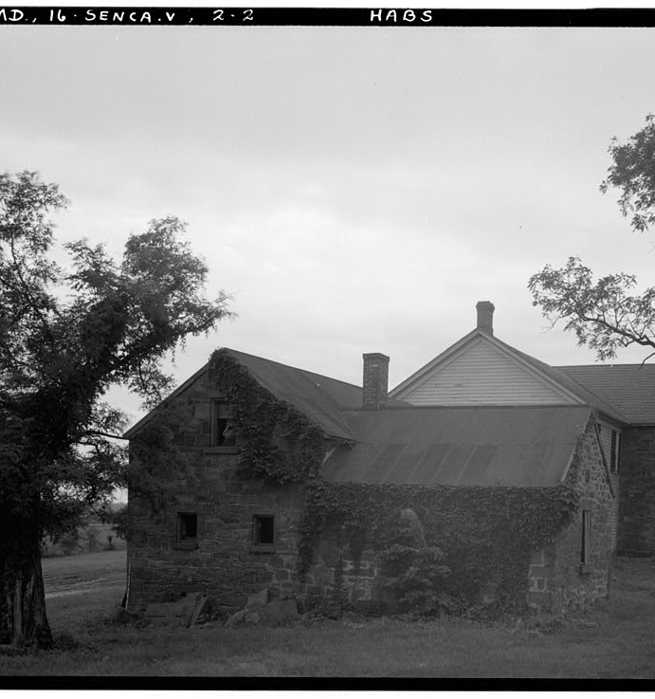
Text Changes: Montevideo Road
1996 Plan:
“Montevideo is one of the finest examples of Federal style architecture in the County. Built c. 1830 by John Parke Custis Peter, offspring of the prominent Georgetown family … The Overseer’s House was built for Montevideo. It displays fine workmanship of rough-cut Seneca sandstone laid in regular courses.”
Updated text:
“Montevideo exemplifies Federal style architecture in the county. It was built c. 1830 by John Parke Custis Peter, a member of the Maryland House of Delegates, and first president of the county agricultural society. … The Overseer’s House at Montevideo is a remnant of the slavery which underpinned these sites and the Peter family’s wealth. It is built of rough, cut Seneca sandstone laid in regular courses and incorporates a structure once home to people enslaved on the property.”

Slide 30
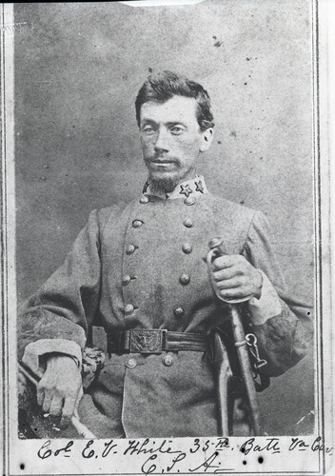
Text Changes: Westerly Road
1996 Plan:
“Continuing westward there is a view of Stoney Castle, birthplace of Elijah Viers White, a Civil War military commander and local hero.”
Updated text:
“Continuing westward past the wooded section, views open on both sides of road, with a pond just off the road to the right on the Stoney Castle property. … Stoney Castle is the birthplace of Elijah Viers White, who fought for the Confederacy during the U.S. Civil War. The residence was owned by the White family from 1831 to 1949. In the 19th century, the property was also home to people enslaved by the White family.”
Notes:
The 1996 Plan talked about Stoney Castle, the birthplace of Elijah Viers White and described him as a Civil War commander and local hero. However, in the update we have provided a more accurate description. So here is original language. And here is the updated language.

Slide 31
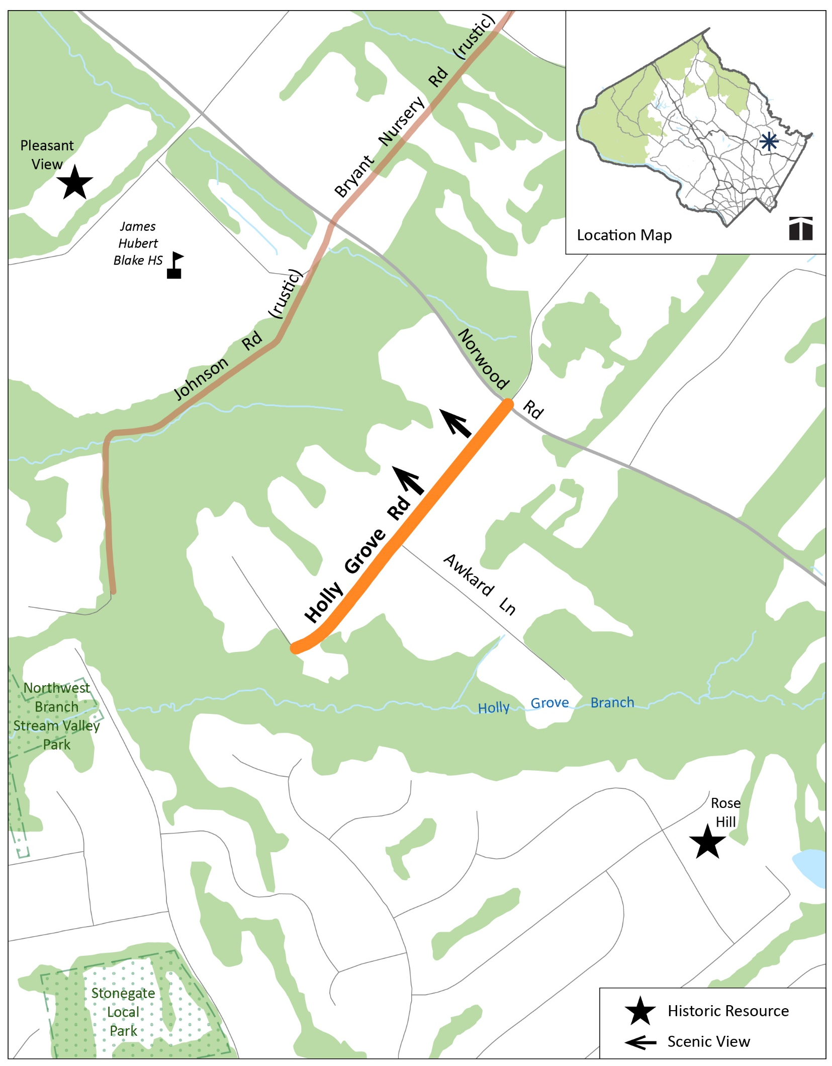
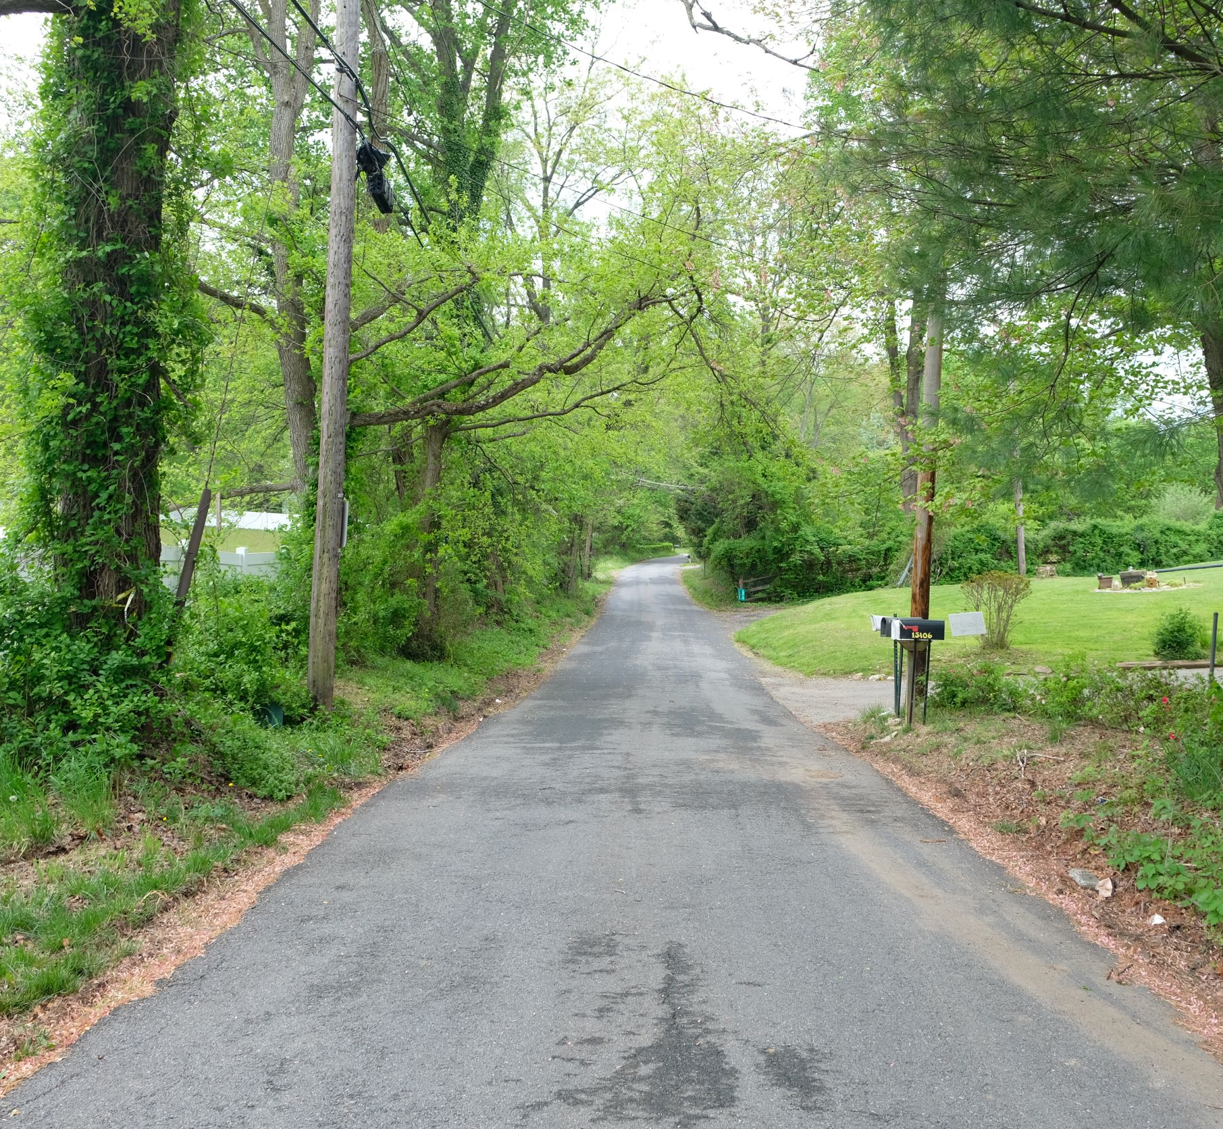
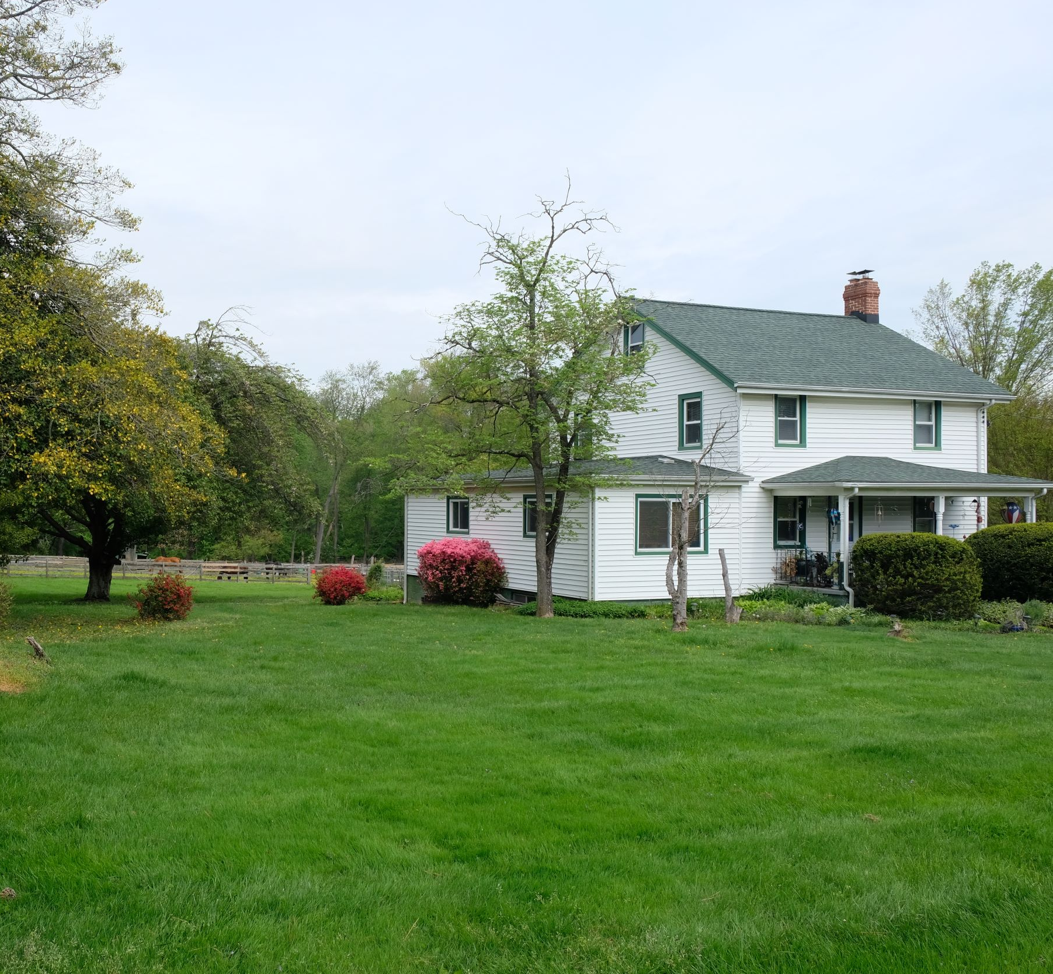
Holly Grove Road
A historic African American community grew along the road in the post-Civil War era.
Notes:
Holly Grove Road is located just west of New Hampshire Avenue. A historic African American community grew along the road after the Civil War. Some of the descendants of the original families still live along the road.

Slide 32
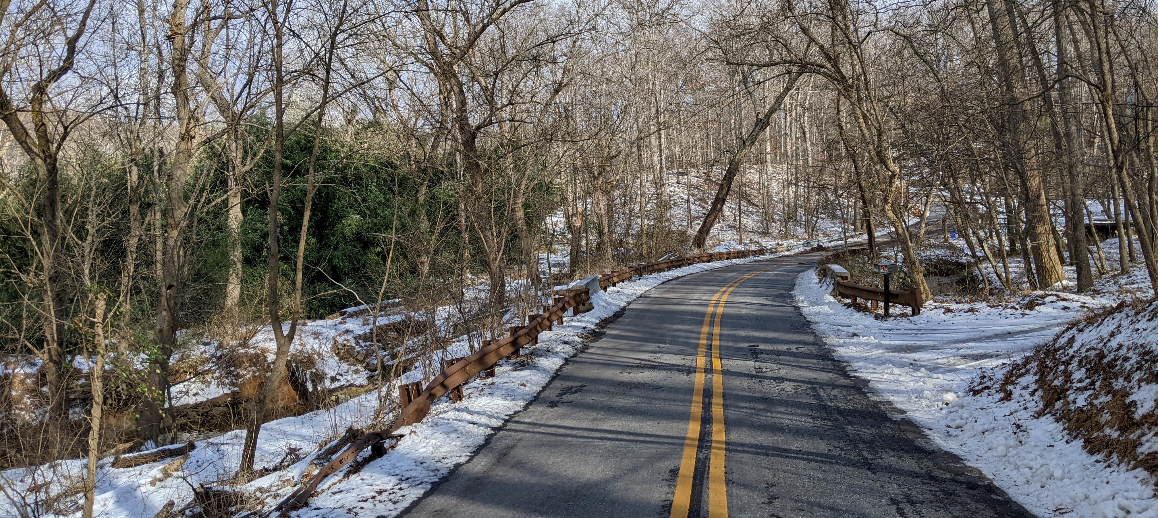
Game Preserve Road
New road profile provided an opportunity to highlight the contribution of people like Emma Jane King, an early female game warden
Notes:
Although this is not a nominated road, we are making sure that the road profile tells a more complete picture. Emma Jane King, the first female game warden, resided on Game Preserve Road.

Slide 33
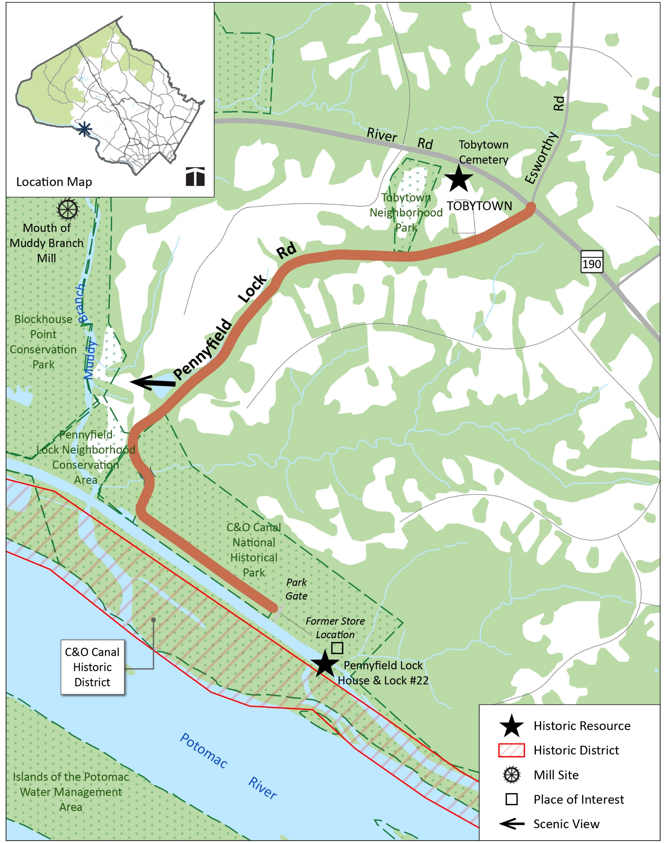
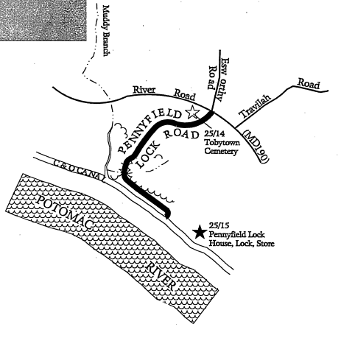
Pennyfield Lock Road
Updated profile including more information about historic community and founding members
This cemetery is the burial site of the founders of the small African American kinship community known as Tobytown. William Davis, Ailsie Martin, and Emory Genus established Tobytown in 1875.
Notes:
We are updating road profiles to try include more information about underrepresented communities where possible. In the driving experience for Pennyfield Lock Road, Tobytown cemetery is mentioned along with the community of Tobytown. However, the original map never points out the location of Tobytown, so we have included that on the updated map. Also, we have included the names of the residents that established the community.

Slide 34
Outreach
Previous Outreach
MidCounty Citizens Advisory Board
Upcounty Citizens Advisory Board
Darnestown Civic Association
Town of Brookeville
Montgomery Parks
Religious Land Use Working Group
Montgomery County History Conference Presentation
Postcard Mailing
Ongoing Outreach
Online Feedback Map
Mailing List
Rustic Roads Advisory Committee
Montgomery County Department of Transportation
Montgomery County Office of Agriculture
Ag Community Meetings

Slide 35
To Do
Finish environmental sections for each road, including tree canopy analysis
Complete crash history analysis
Evaluate traffic counts
Complete road profiles and individual road recommendations

Slide 36
Contact Information
Project Leads
Roberto Duke, Planner III
roberto.duke@montgomeryplanning.org
301-495-2186
Jamey Pratt, Planner III
jamey.pratt@montgomeryplanning.org
301-495-4588
https://montgomeryplanning.org/planning/transportation/highway-planning/rustic-roads/

Slide 37
Questions

