Slide 1
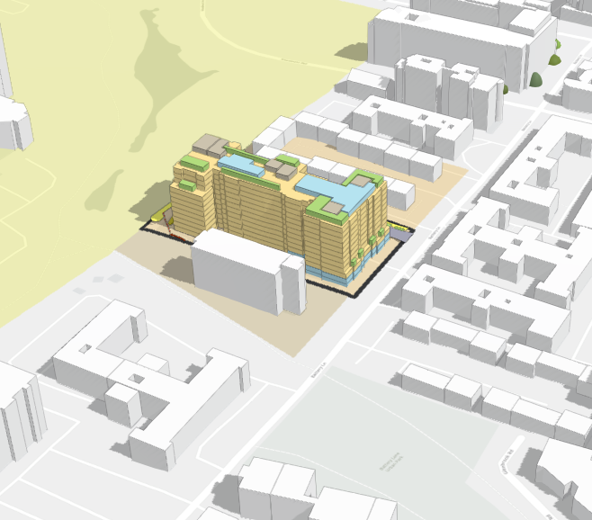
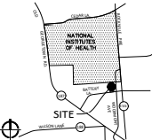
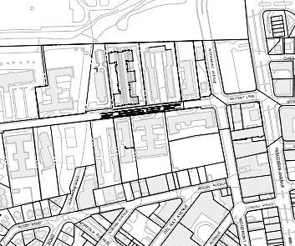
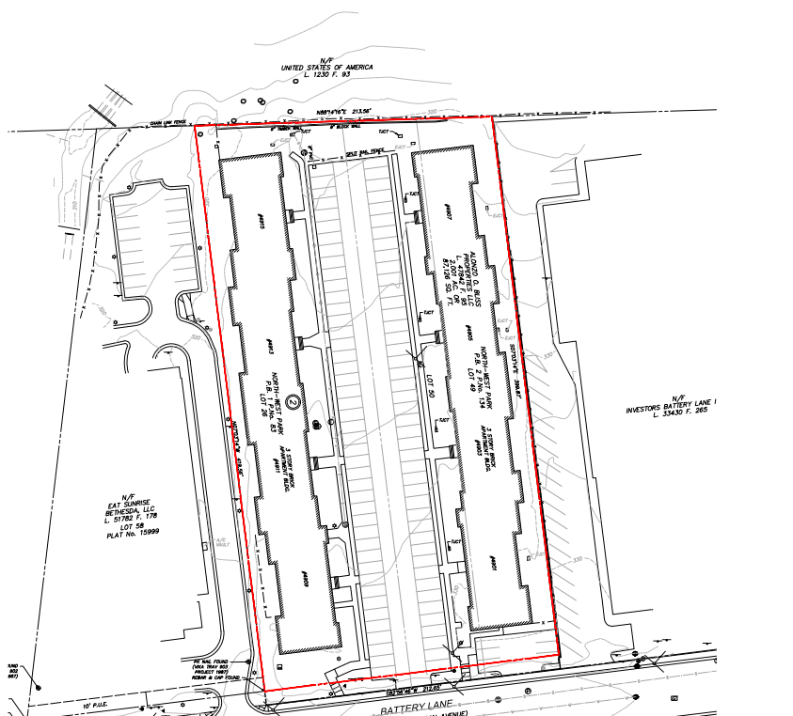
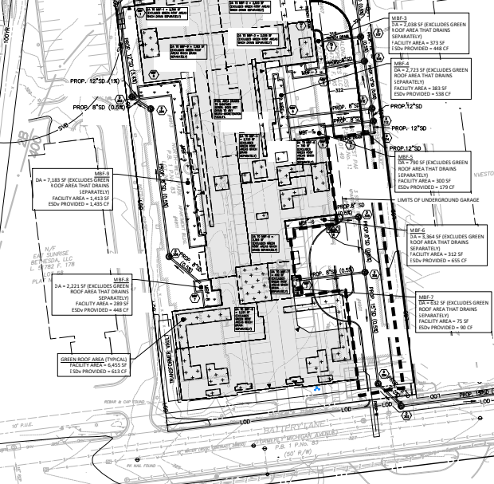
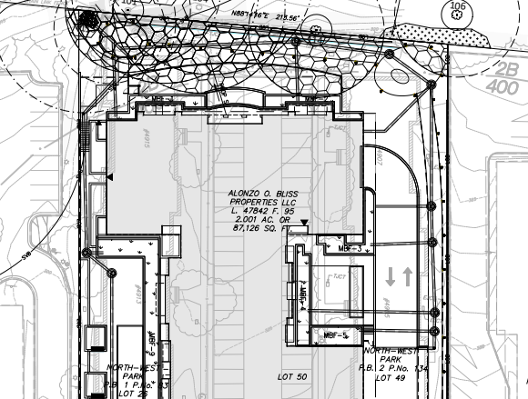
Information Technology & Innovation (ITI) Division IS-GIS Section - ArcGIS Urban Group
M-NCPPC Montgomery Planning
Esri/Montgomery County | ArcGIS Urban Connect | Webinar | April 6, 2023
Jay Mukherjee, Principal GIS Specialist, IS-GIS
Mary Beth O’Quinn, Urban Planner-Architect, IS-GIS

Slide 2
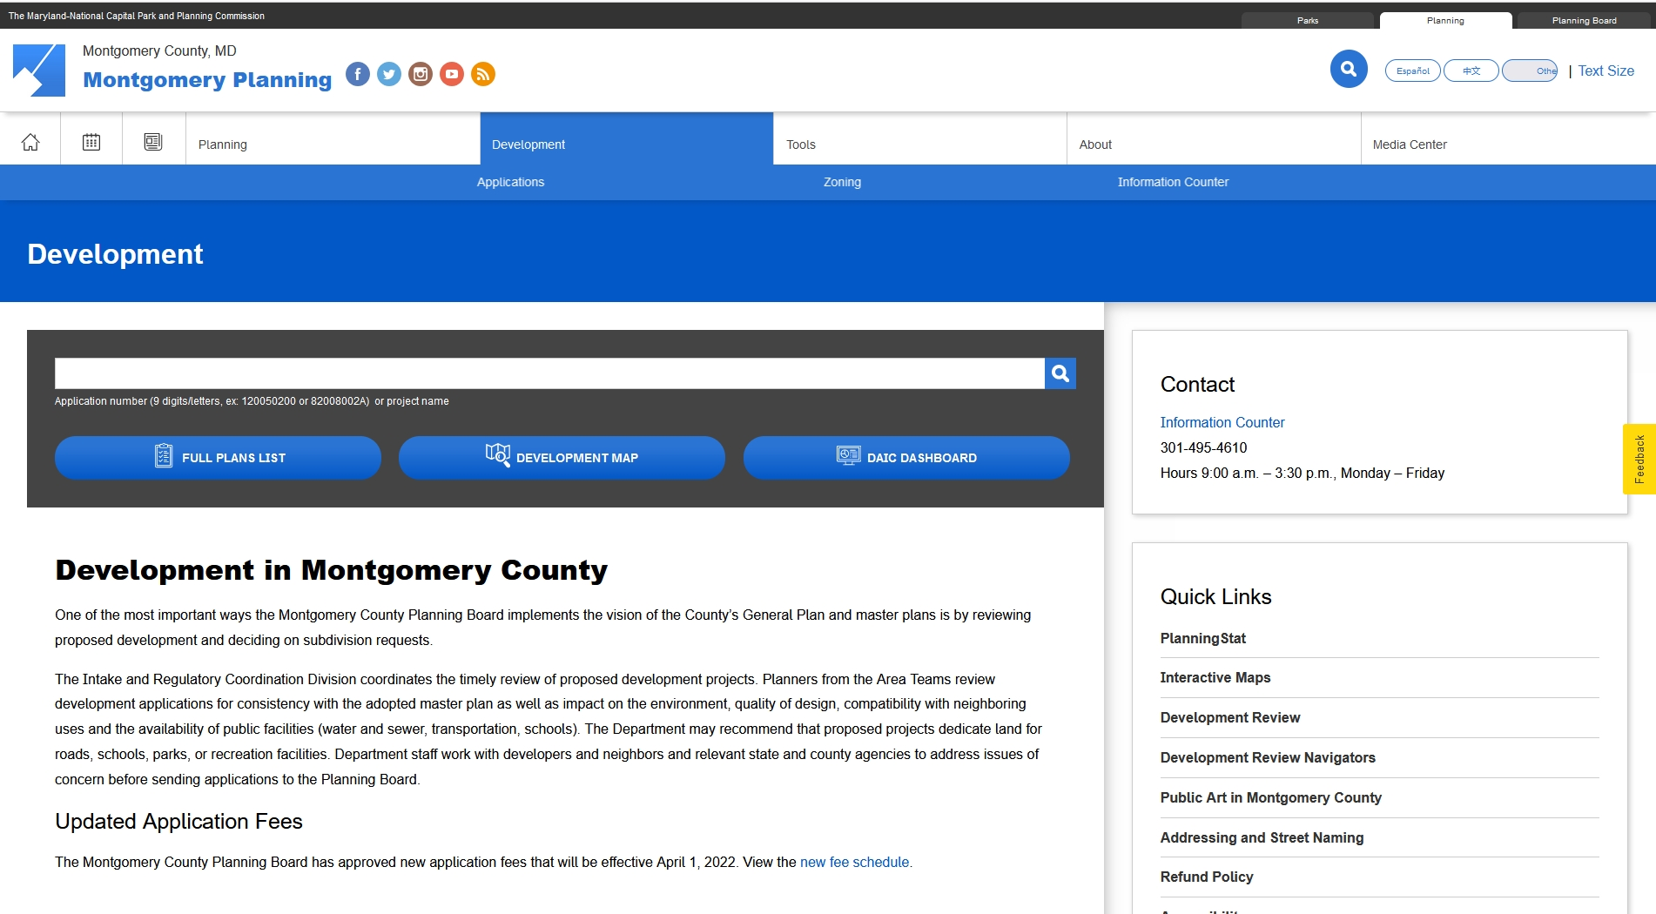
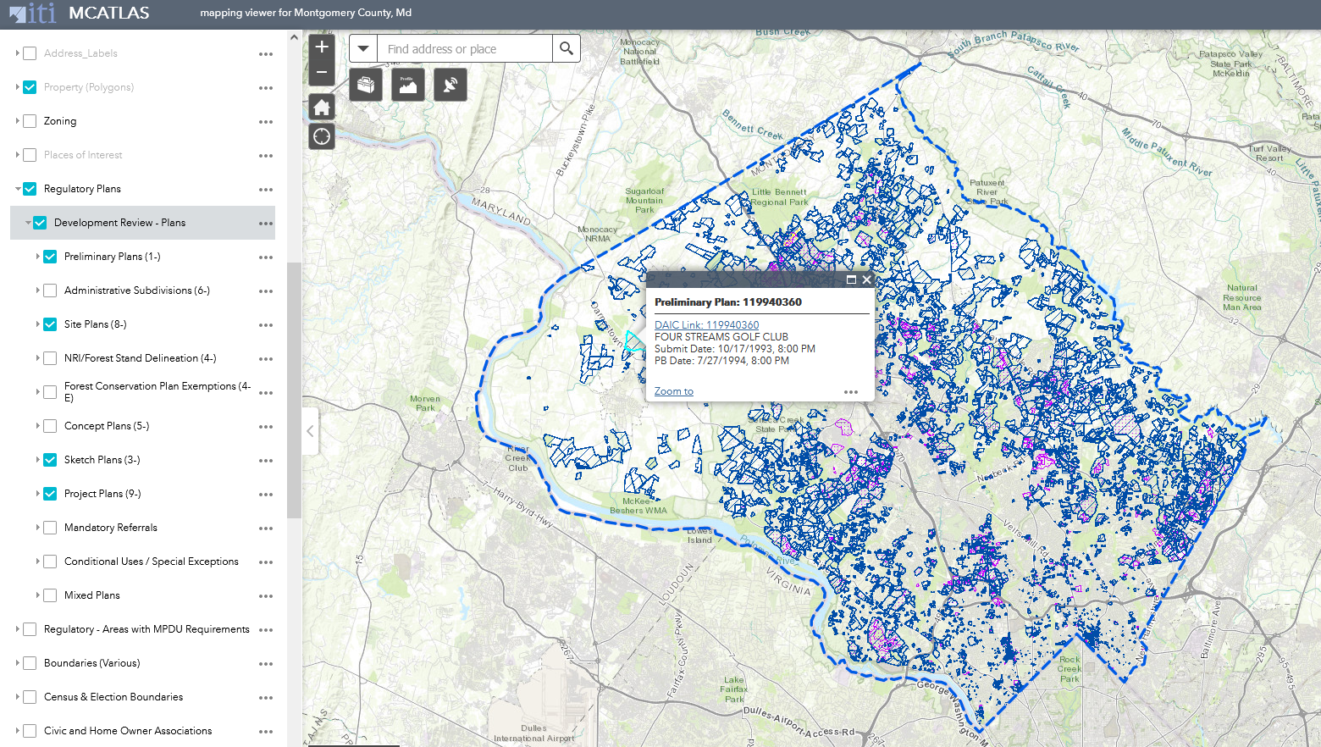
FINDING PROJECTS & SHARING PROJECT INFO BY TYPE, GEOGRAPHY, PROGRAM
Sharing Projects by Development Type, Planning Area, Special Interests
DAIC and MCAtlas often display a handful of different project applications
Many forms of information: plan type (prelim, sketch plan, site plan), plan #, planning area, school district
Plan “cards” show sketch, preliminary, site plan, zoning, public projects etc.
Summary on each project card shows zone, density, land use
Need: Unified web page to coalesce summaries of multiple approvals in one view
DAIC Development Activity Info Center Page
MCAtlas

Slide 3
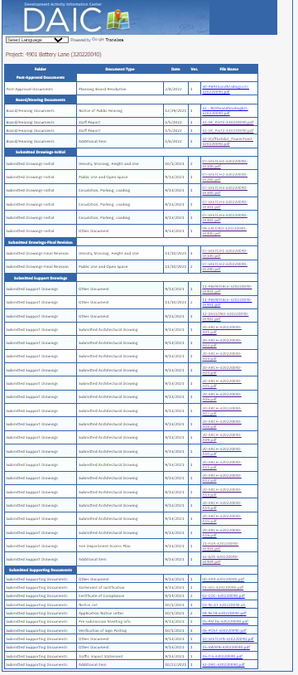
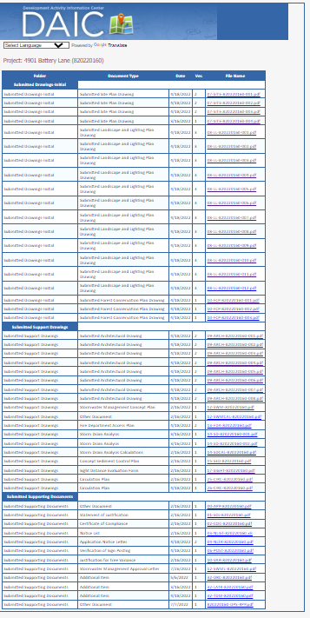
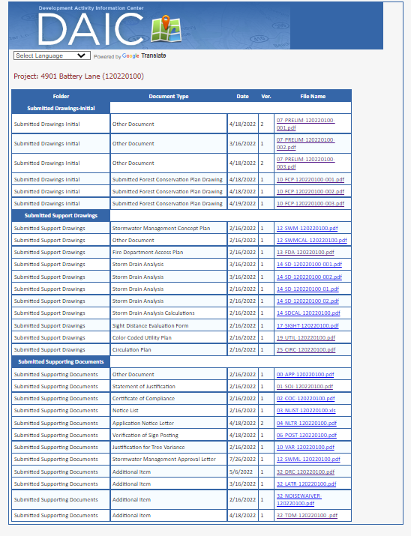
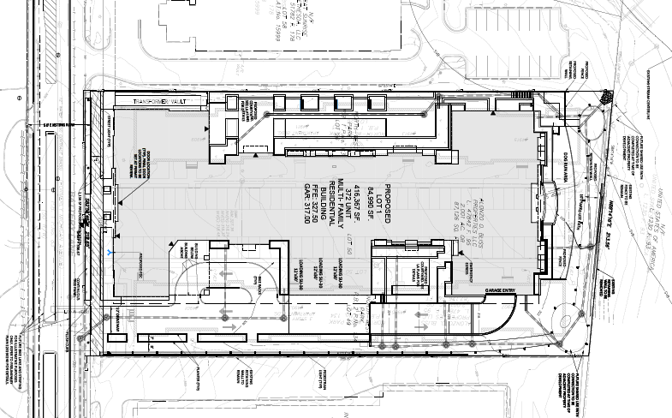
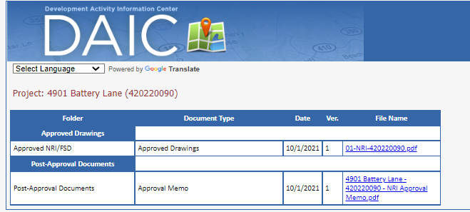
EXISTING REGULATORY WORKFLOW: CONCURRENT PLAN APPLICATIONS
Sketch Plan
Site Plan
1. Understanding a Project [Battery Lane Site Plan]
The challenge is for the public and constituents to parse many drawings
and quickly visualize what building will look like.
Our implementation of Urban provides a solution for this challenge.
Multiple 2D documents, typically 20-50 plan drawings
Battery Lane = 125 plans/documents
Difficult to “pick” the drawing with most readable information
Requires switching thru multiple plans to understand
site features and building form
Need: An interactive, 3D visioning tool with Bird’s Eye view
to quickly gain understanding of the project
Preliminary Plan
Forest Cons Plan

Slide 4
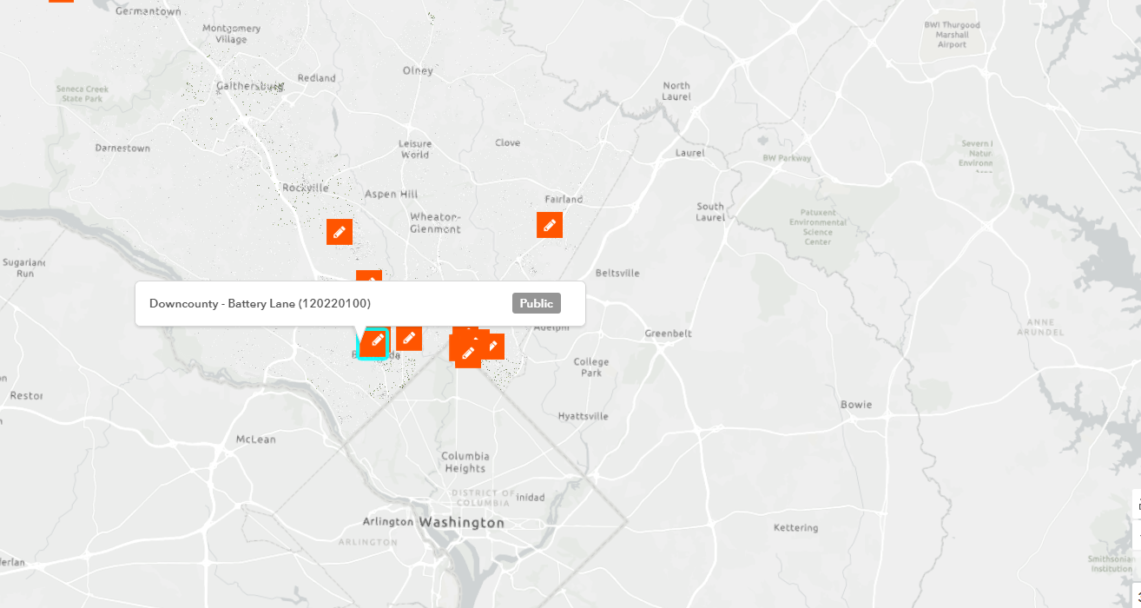
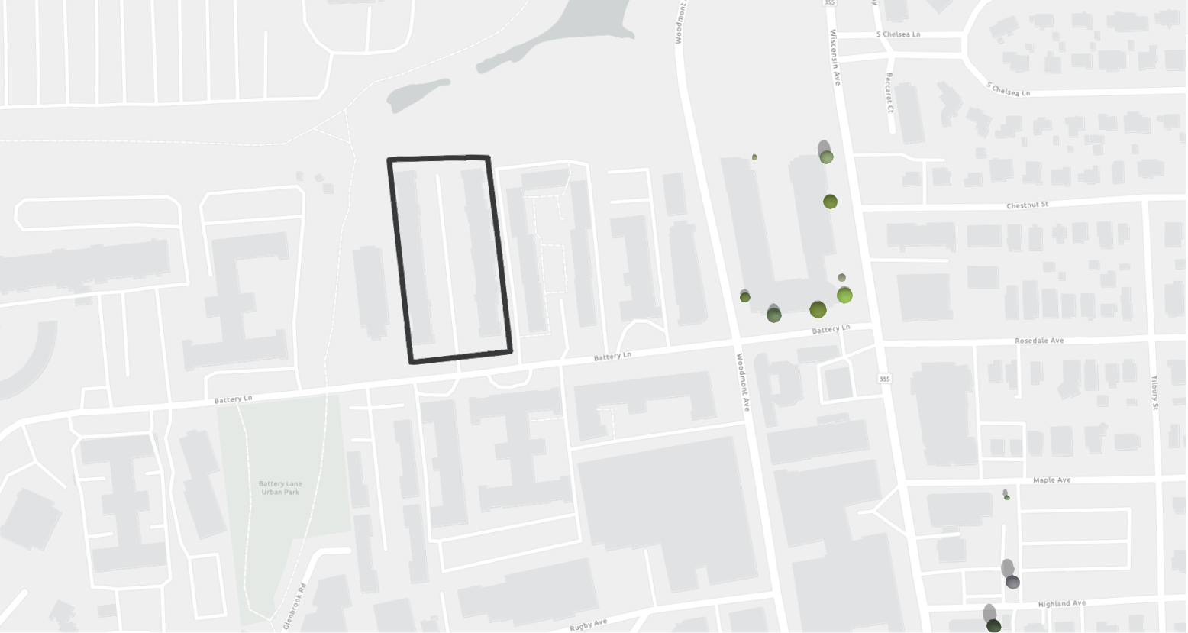
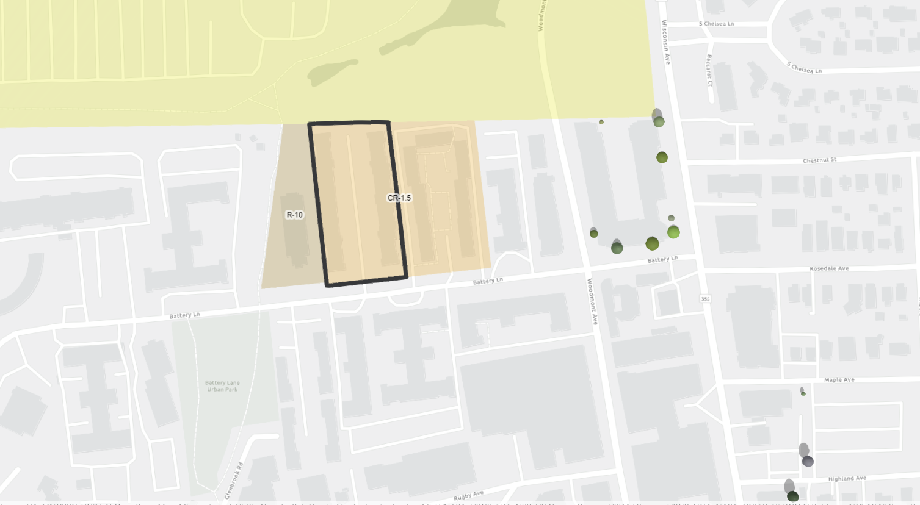
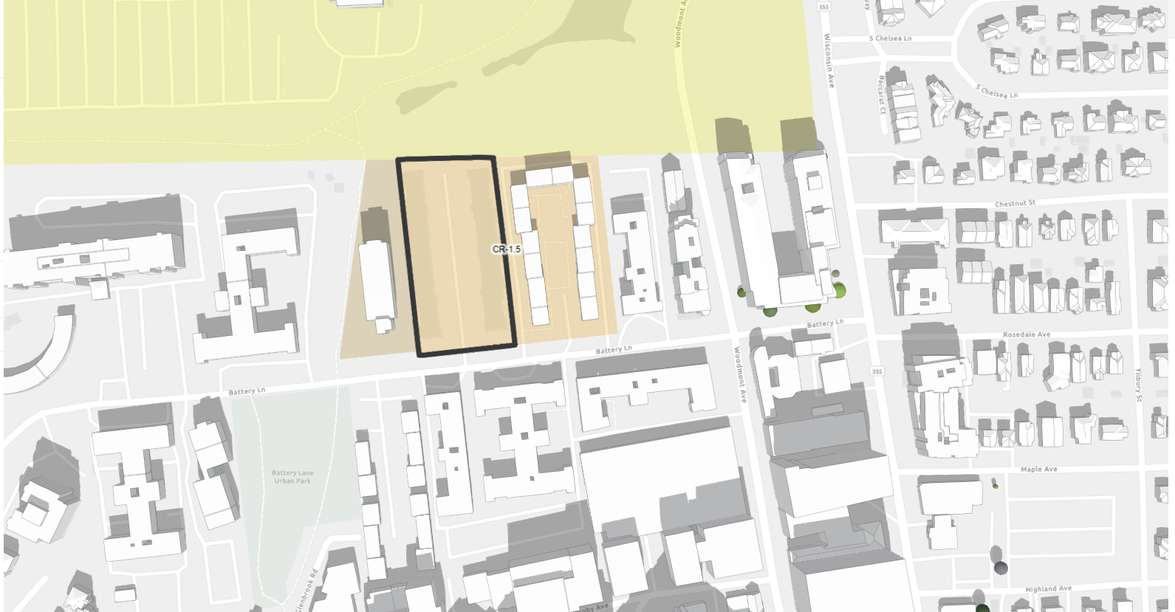
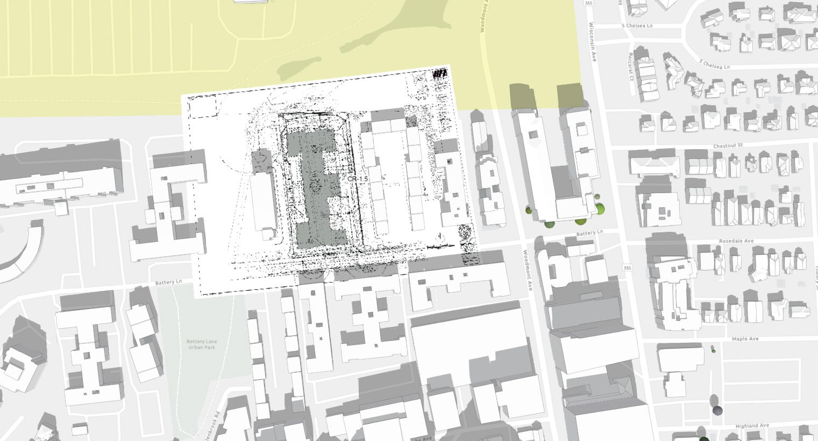
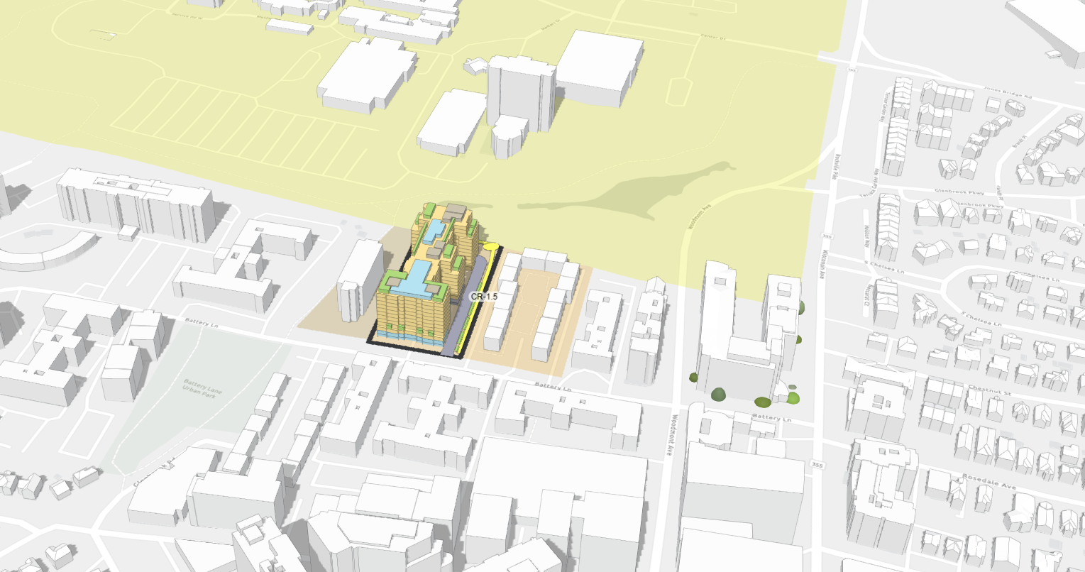

BRINGING A PROJECT TO LIFE: SHARING THE PROCESS FROM 2D to 3D
Bringing a Project to Life: from 2D to 3D
HUB: sharing our projects in a simplified and visual manner
Select by Location
Show Property
Identify Zoning
Show Existing 3D
Proposal Overlay
Future Development in 3D

Slide 5
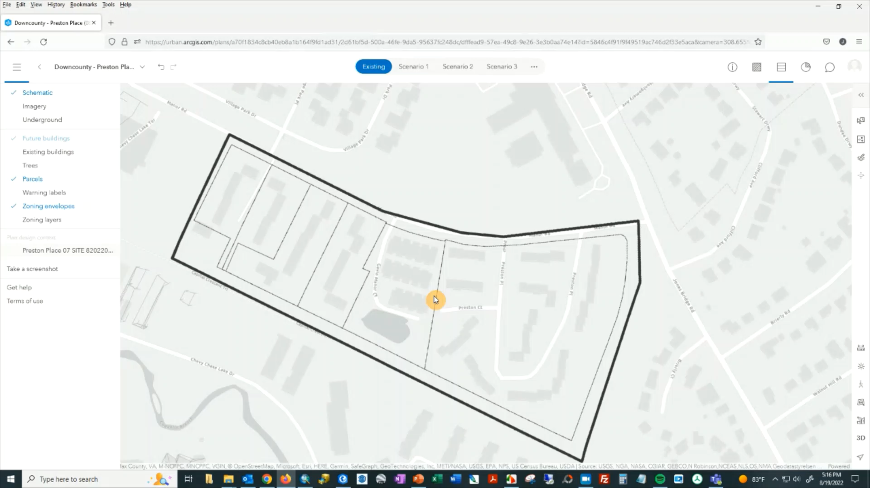
DEVELOPING THE MODEL – CREATION OF THE 3D

Slide 6
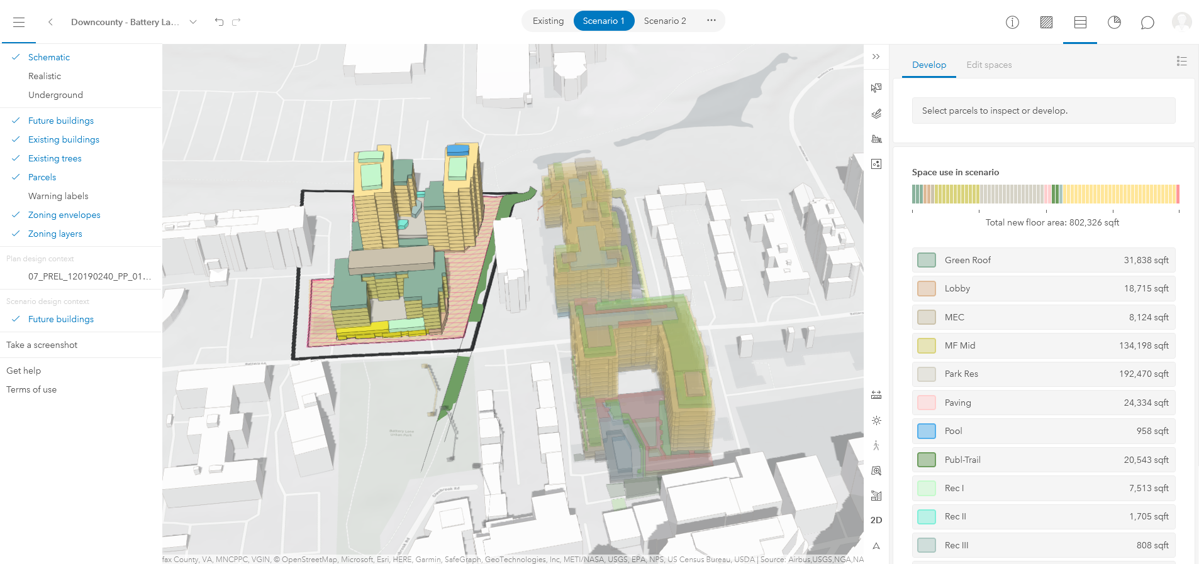
CREATING CONTEXT: MASSING, OPEN SPACE, STREET SCAPE

Slide 7
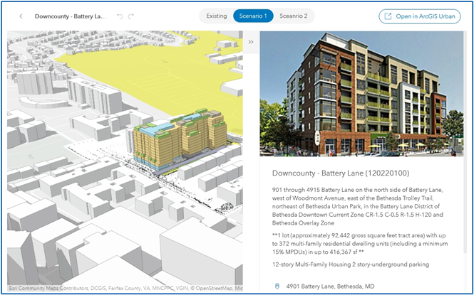
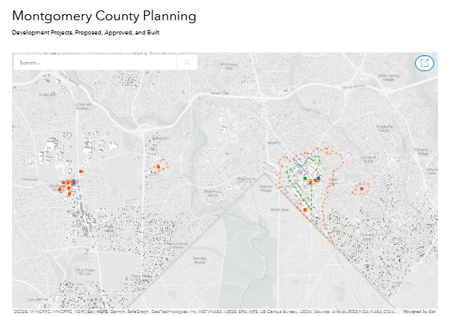
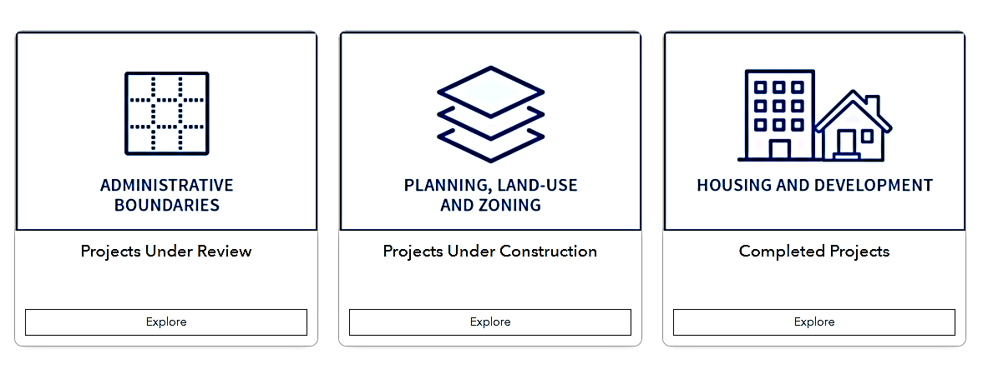
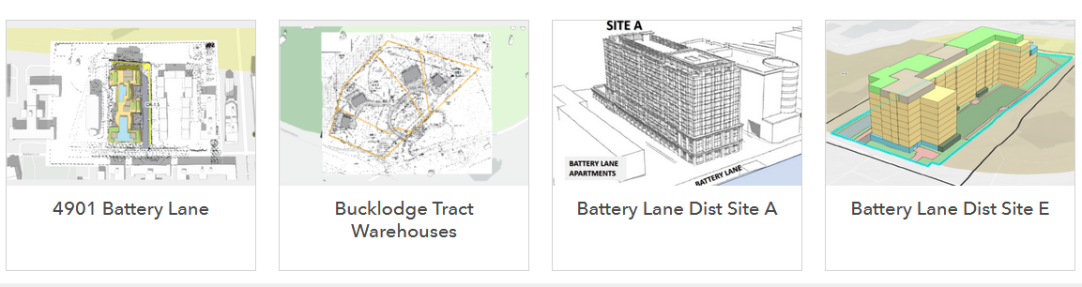
THE HUB: REGULATORY PROJECTS
Projects under Review
Projects under Review

Slide 8
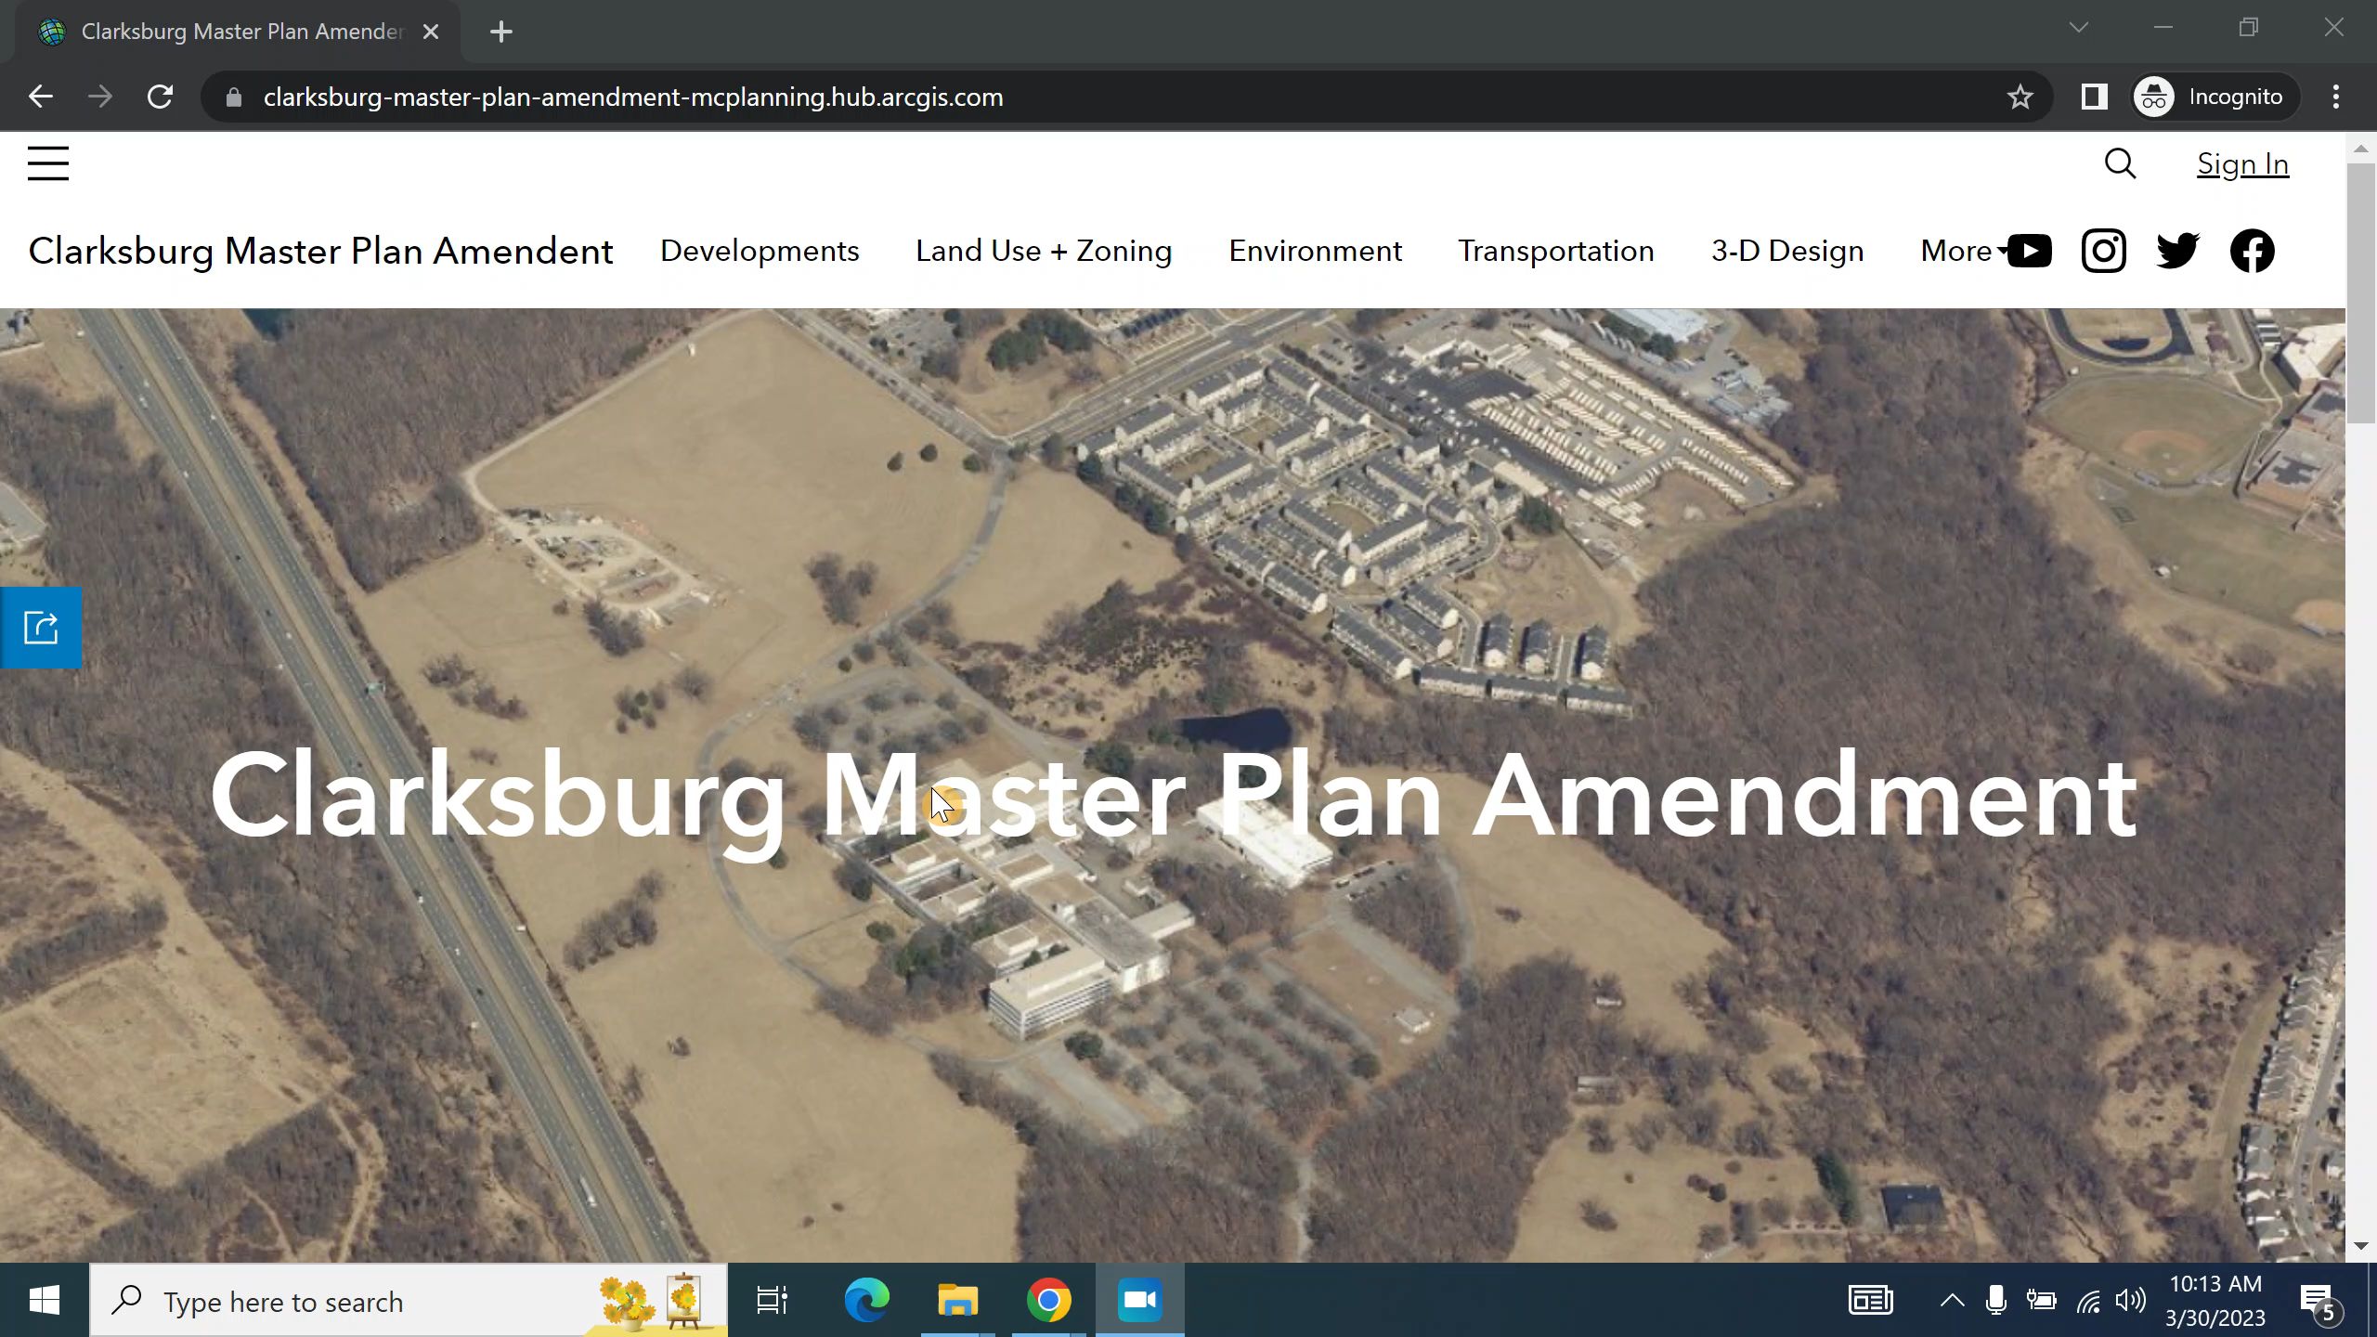

Slide 9
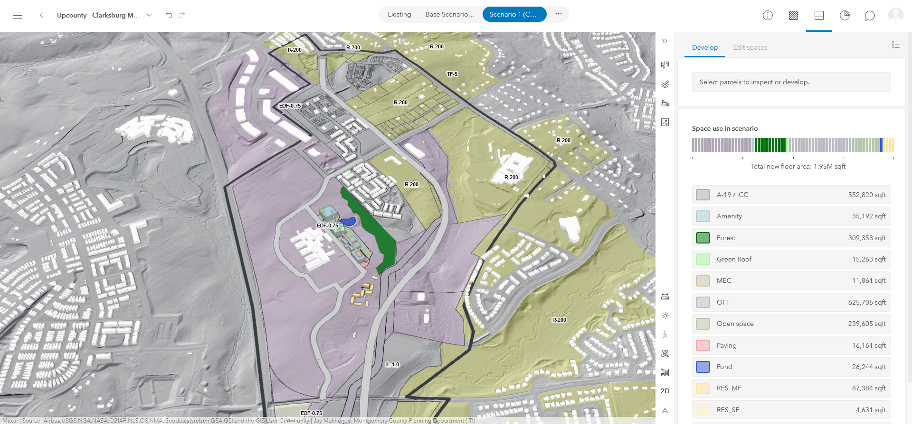
URBAN FOR MASTER PLANNING
9

