Slide 1

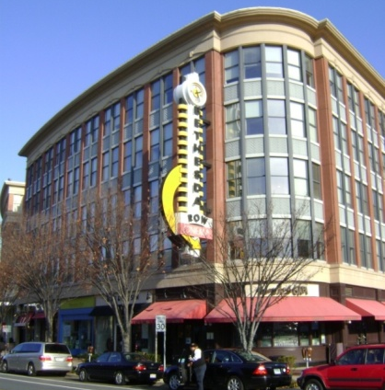
Commercial/Residential Zones (CRN, CRT, CR)
About
The Commercial/Residential (C/R) family of zones is a set of mixed-use zones. The 3 zones in this family have a range of commercial and residential uses and densities and heights. The provision of public open space may be required.
CRN allows development only under standard method. CRT and CR allow standard and optional method development. Optional method development requires the provision of public benefits.
Density and Height Limits
Density in the C/R zones is calculated as an allowed floor area ratio (FAR). FAR is the ratio of the total floor area of buildings on a property to the size of that property. For example, a tract of 10,000 square feet with an FAR limit of 2.0 could have a building of up to 20,000 square feet.
Each C/R zone has a unique sequence of maximum density and height as indicated on the zoning map. This sequence shows the maximum total FAR, maximum non-residential FAR (C), maximum residential FAR (R), and maximum height (H). The mapped densities and height must fall within the statutory limits (see table to the right). In most cases, developers must mix residential and non-residential uses to achieve the maximum allowed density. For example, a CR zone allowing a maximum total FAR of 5.0, a maximum non-residential FAR of 4.0, a maximum residential FAR of 3.5, and a maximum height of 80 feet would be mapped as follows:
Zone | Statutory Limits (range that can be mapped)
 | Overall FAR | Commercial FAR | Residential FAR | Height
CRN | 0.25 – 1.5 | 0.0 – 1.5 | 0.0 – 1.5 | 25’ – 65’
CRT | 0.5* – 4.0 | 0.25 – 3.5 | 0.25 – 3.5 | 35’ – 150’
CR | 0.5 – 8.0 | 0.25 – 7.5 | 0.25 – 7.5 | 35’ – 300’
Zone | Standard Method Limits (optional method required when development exceeds these limits)
CRT | The greater of 1.0 FAR or 10,000 SF of GFA
CR | The greater of 0.5 FAR or 10,000 SF of GFA
Benefits of the Commercial/Residential Zones
Because density and height can be mapped for each property, the zone can be tailored to fit the surrounding area.
Encourages pedestrian-friendly development, particularly in the CRT and CR zone where parking is not allowed between the building and the street.
CRT and CR encourage public benefits that help achieve master plan priorities.
*Pending the adoption of ZTA 14-09, the CRT zone can be mapped with an overall FAR of 0.25.
Example | CR-5.0 C-4.0 R-3.5 H-80
Protections
Approval Process
Development must meet the Compatibility Requirements regarding side and rear setbacks and height of the building at the setback line
Development must provide screening when abutting an Agricultural, Rural Residential, or Residential zone that is vacant or improved with an agricultural or residential use
Sketch and site plan approval is always required under the optional method. Under the standard method, site plan approval may be required when abutting or confronting property in an Agricultural, Rural Residential, Residential, or Residential Floating zone.
www.zoningmontgomery.org
8/5/2014

