Slide 1

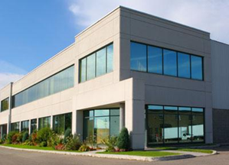
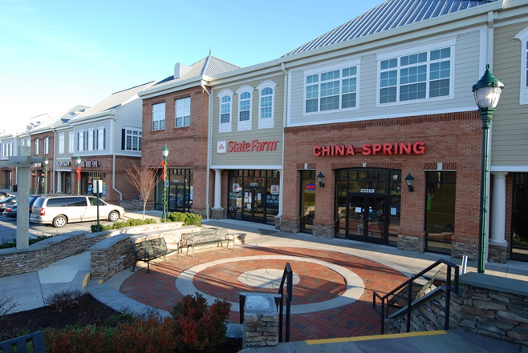
Employment Zones (GR, NR,LSC, EOF)
About
The Employment family of zones is a set of commercial and employment zones. The 4 zones in this family have a range of densities and heights. In general, residential densities are limited to 30% of the GFA on the site (in the LSC zone it’s 30% of the mapped FAR). The provision of public open space may be required.
GR and NR allow development only under standard method. LSC and EOF allow standard and optional method development. Optional method development requires the provision of public benefits.
Density and Height Limits
Density in the Employment zones is calculated as an allowed floor area ratio (FAR). FAR is the ratio of the total floor area of buildings on a property to the size of that property. For example, a tract of 10,000 square feet with an FAR limit of 2.0 could have a building of up to 20,000 square feet.
Each Employment zone has a unique sequence of maximum density and height as indicated on the zoning map. This sequence shows the maximum total FAR and maximum height (H). The mapped density and height must fall within the statutory limits (see table to the right). Although developers can choose to provide some residential uses, it is not necessary to achieve the maximum allowed density.
Zone | Statutory Limits (range that can be mapped)
 | Overall FAR | Height
GR | 0.5 – 2.5 | 25’ – 120’
NR | 0.25 – 1.5 | 25’ – 50’
LSC | 0.5 – 2.5 | 35’ – 200’
EOF | 0.5 – 4.0 | 35’ – 200’
Zone | Standard Method Limits (optional method required when development exceeds these limits)
EOF | The greater of 1.0 FAR or 10,000 SF of GFA
LSC | The greater of 0.5 FAR or 10,000 SF of GFA
Example | GR-1.5 H-45
Approval Process
Protections
The GR and NR zones only allow standard method development. Site plan approval may be required.
The LSC and EOF zones allow both standard and optional method development. Sketch and site plan approval is always required under the optional method. Under the standard method, site plan approval may be required.
Development must meet the Compatibility Requirements regarding side and rear setbacks and height of the building at the setback line
Development must provide screening when abutting an Agricultural, Rural Residential, or Residential zone that is vacant or improved with an agricultural or residential use
www.zoningmontgomery.org
9/16/2014

