Slide 1
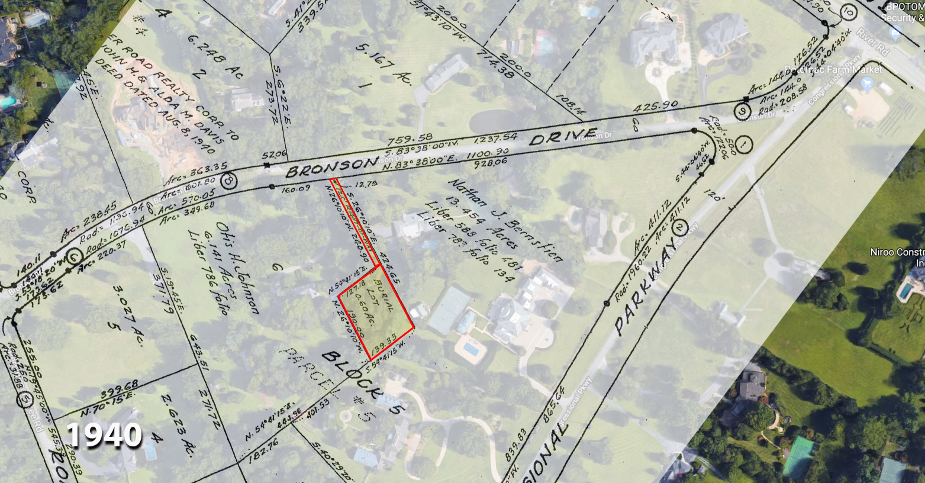
Bronson Drive Cemetery, Potomac, MD (#217)

Slide 2
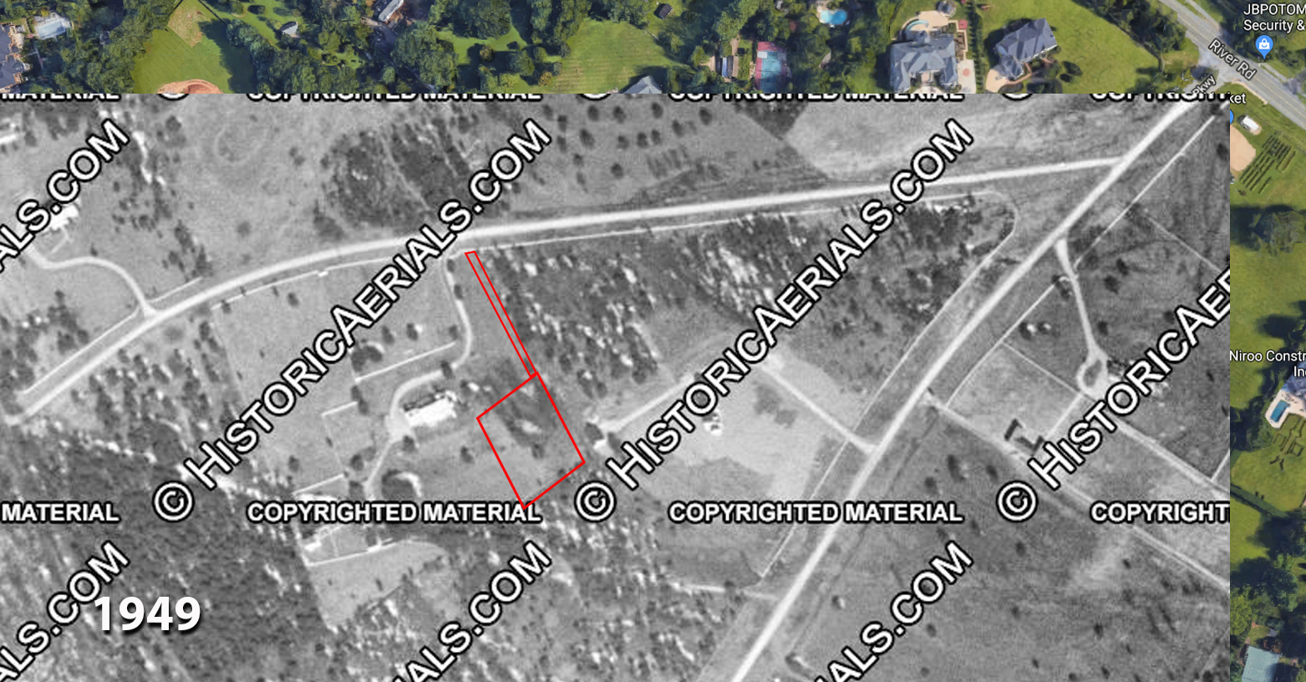
Bronson Drive Cemetery, Potomac, MD (#217)

Slide 3
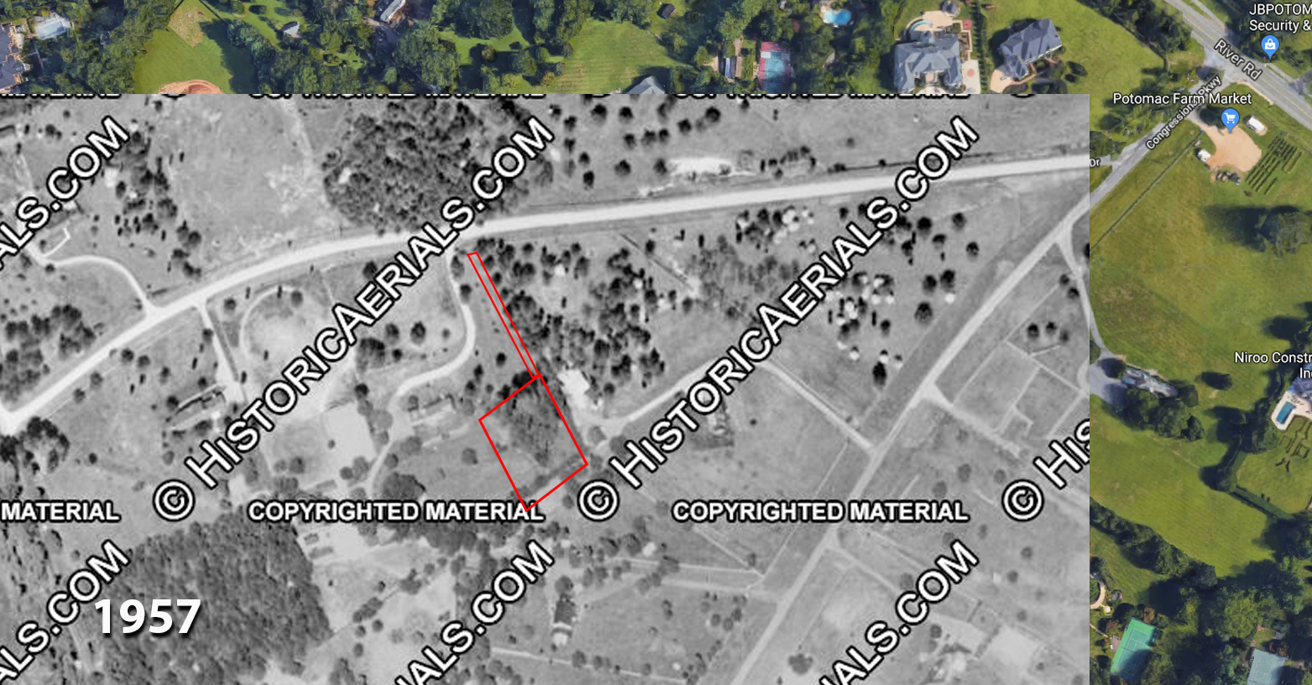
Bronson Drive Cemetery, Potomac, MD (#217)

Slide 4
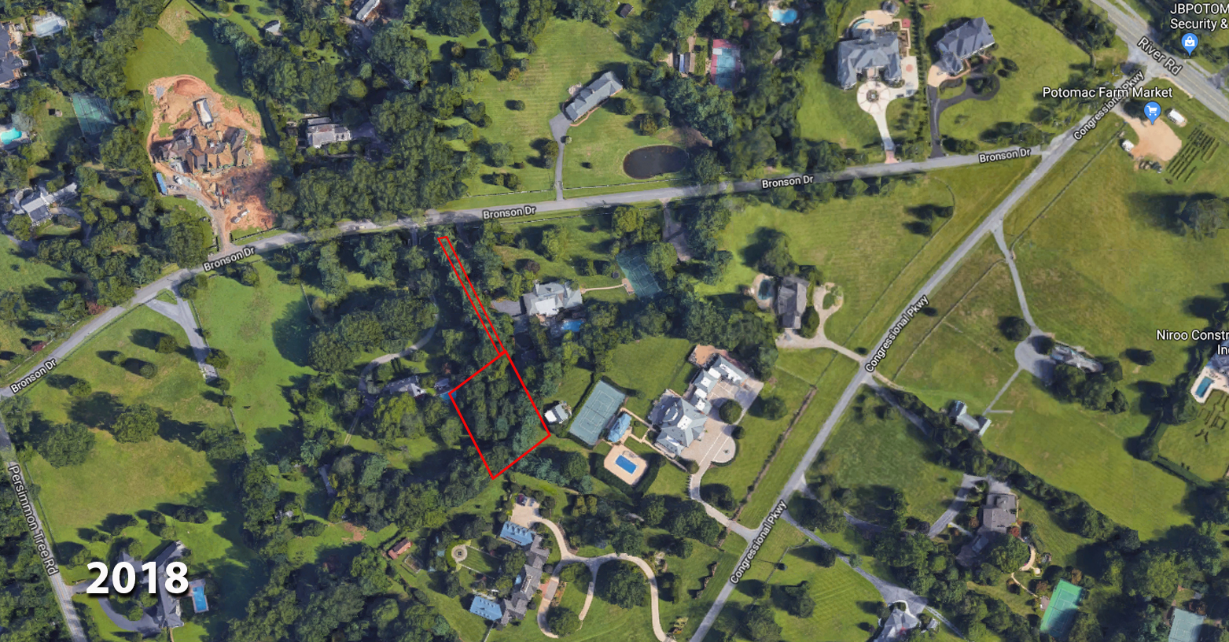
Bronson Drive Cemetery, Potomac, MD (#217)

